Slide 1
Project: IEEE P802.15 Working Group for Wireless Personal Area Networks (WPANs)
Submission Title: [BCH Code Construction for Information Reconciliation]
Date Submitted: [January 2016]
Source: [Byung-Jae Kwak, Seong-Soon Joo]¹,
[Sangseok Yun, Sanghun Im, Jeongseok Ha]²,
[Youn-Kwan Kim]³
Company: [ETRI, Daejeon, Korea]¹, [KAIST, Daejeon, Korea]², [The Catholic University of Korea]³
Address: [218 Gajeong-ro, Yuseong-gu, Daejeon, Korea]¹, [291 Daehak-ro, Yuseong-gu, Daejeon, Korea]²,
[43 Jobong-ro Wonmi-gu, Buchun, Korea]³
Voice: [+82-42-860-6618]¹, [+82-42-350-7524]²
E-Mail: [bjkwak@etri.re.kr]¹, [ssyun@kaist.ac.kr]², [ykkim123@catholic.ac.kr]³
Re:
Abstract: Informative text providing an example of the construction of BCH code.
Purpose: Discussion
Notice: This document has been prepared to assist the IEEE P802.15. It is offered as a basis for discussion and is not binding on the contributing individual(s) or organization(s). The material in this document is subject to change in form and content after further study. The contributor(s) reserve(s) the right to add, amend or withdraw material contained herein.
Release: The contributor acknowledges and accepts that this contribution becomes the property of IEEE and may be made publicly available by P802.15.

Slide 2
BCH Code Construction for Information Reconciliation
Jan. 2016

Slide 3
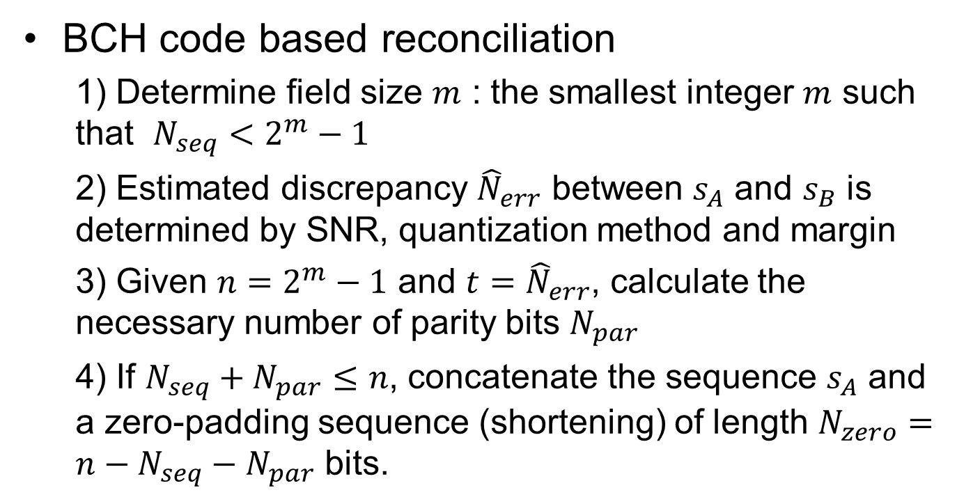





Information Reconciliation (1/3)
BCH code based reconciliation
  1) Determine field size $m$ : the smallest integer $m$ such that $N_{seq}<2^{m}−1$
  2) Estimated discrepancy ${\hat{N}}_{err}$ between $s_{A}$ and $s_{B}$ is determined by SNR, quantization method and margin
  3) Given $n=2^{m}−1$ and $t={\hat{N}}_{err}$, calculate the necessary number of parity bits $N_{par}$
  4) If $N_{seq}+N_{par}≤n$, concatenate the sequence $s_{A}$ and a zero-padding sequence (shortening) of length $N_{zero}=n−N_{seq}−N_{par}$ bits.
$$2^{m}−1$$
$$N_{seq}$$
$$N_{zero}$$
$$N_{par}$$
$$2^{m−1}−1$$

Slide 4



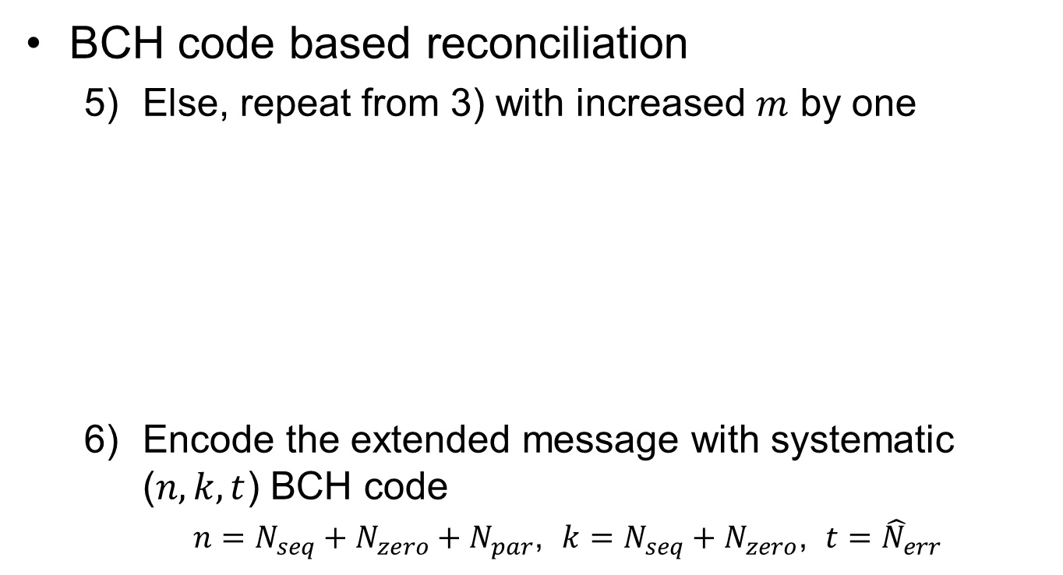





Information Reconciliation (2/3)
BCH code based reconciliation
  Else, repeat from 3) with increased $m$ by one
  Encode the extended message with systematic ($n,k,t$) BCH code
  $n=N_{seq}+N_{zero}+N_{par}$, $k=N_{seq}+N_{zero}$, $t={\hat{N}}_{err}$
$$2^{m}−1$$
$$N_{seq}$$
$$N_{par}$$
$$2^{m−1}−1$$
$$m^{′}=m+1$$
$$2^{m^{′}}−1$$
$$N_{seq}$$
$$N_{zero}$$
$$N_{par}$$
$$2^{m^{′}−1}−1$$

Slide 5
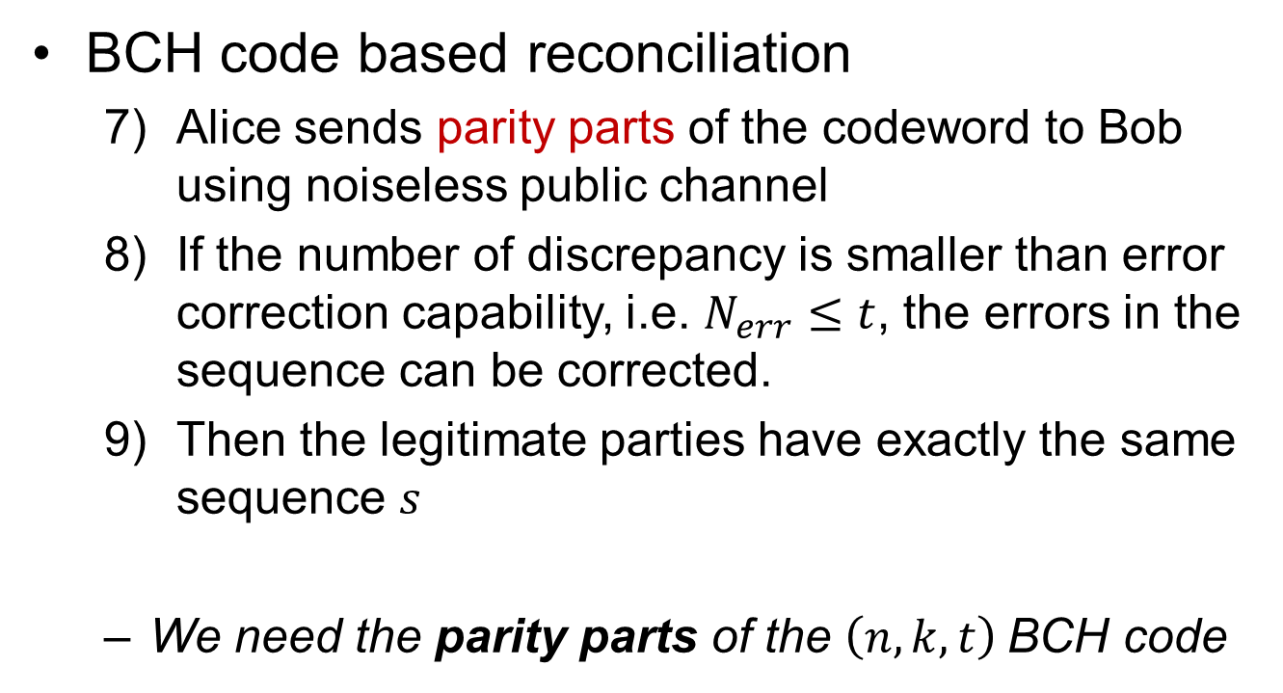
Information Reconciliation (3/3)
BCH code based reconciliation
  Alice sends parity parts of the codeword to Bob using noiseless public channel
  If the number of discrepancy is smaller than error correction capability, i.e. $N_{err}≤t$, the errors in the sequence can be corrected.
  Then the legitimate parties have exactly the same sequence $s$
  We need the parity parts of the $\left(n,k,t\right)$BCH code

Slide 6
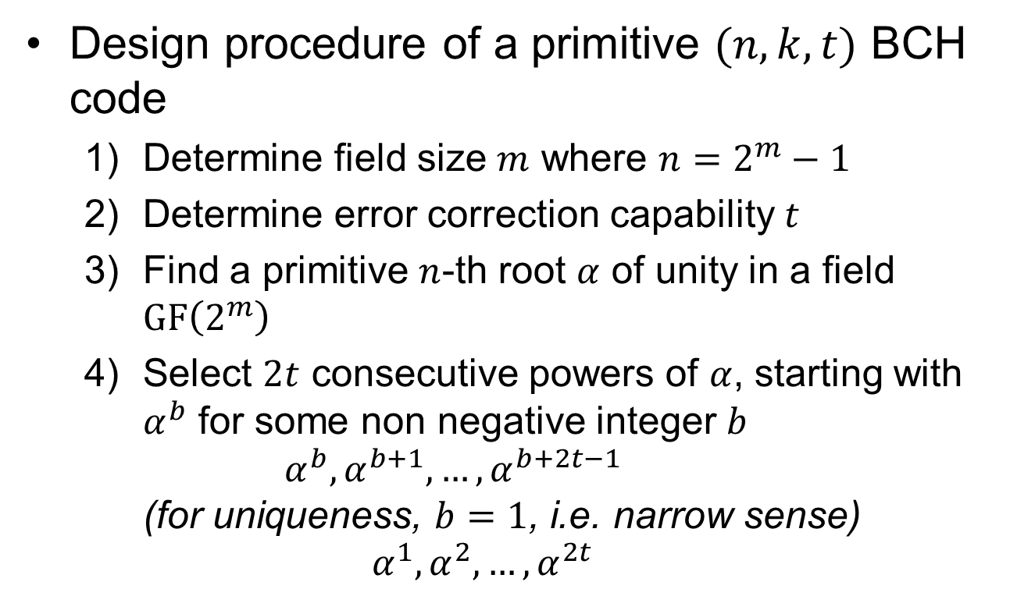
BCH Code Construction (1/2)
Design procedure of a primitive $(n,k,t)$ BCH code
  Determine field size $m$ where $n=2^{m}−1$
  Determine error correction capability $t$
  Find a primitive $n$-th root $α$ of unity in a field $GF\left(2^{m}\right)$
  Select $2t$ consecutive powers of $α$, starting with $α^{b}$ for some non negative integer $b$
  $α^{b}, α^{b+1}, …,α^{b+2t−1}$
  (for uniqueness, $b=1$, i.e. narrow sense)
  $$α^{1},α^{2},…,α^{2t}$$

Slide 7
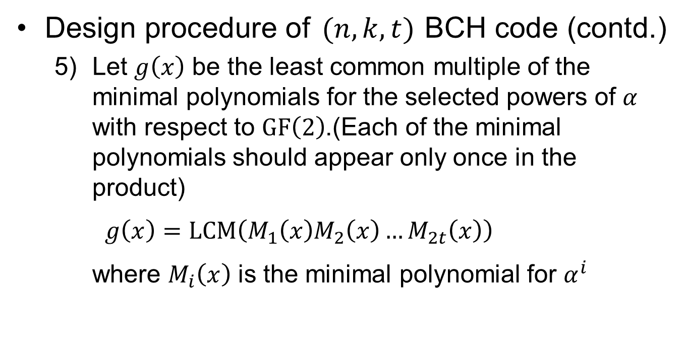
BCH Code Construction (2/2)
Design procedure of $(n,k,t)$BCH code (contd.)
  Let $g\left(x\right)$ be the least common multiple of the minimal polynomials for the selected powers of $α$ with respect to $GF\left(2\right)$.(Each of the minimal polynomials should appear only once in the product)
  $g\left(x\right)=LCM\left(M_{1}\left(x\right)M_{2}\left(x\right)…M_{2t}\left(x\right)\right)$
  where $M_{i}\left(x\right)$ is the minimal polynomial for $α^{i}$

Slide 8
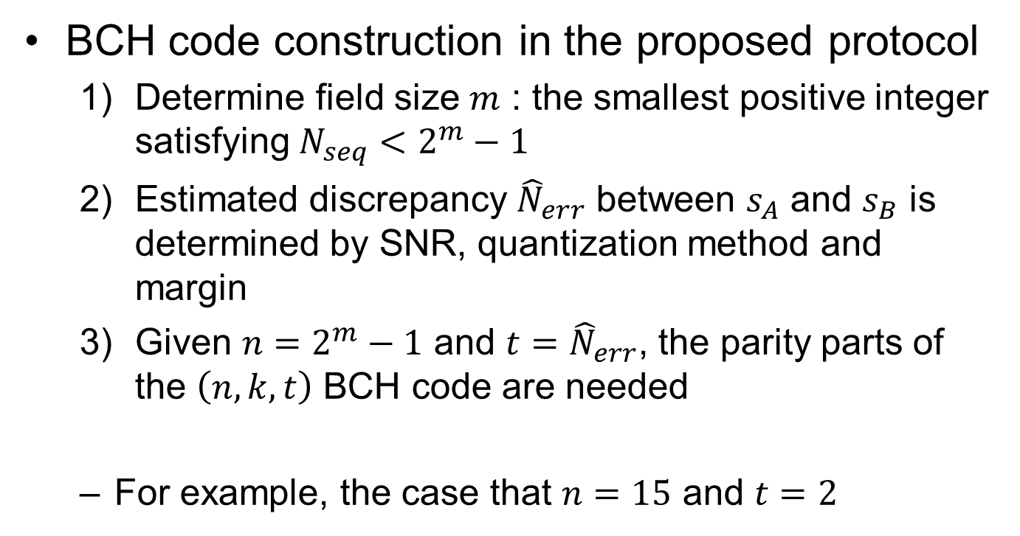
BCH Code Construction Example (1/4)
BCH code construction in the proposed protocol
  Determine field size $m$ : the smallest positive integer satisfying $N_{seq}<2^{m}−1$
  Estimated discrepancy ${\hat{N}}_{err}$ between $s_{A}$ and $s_{B}$ is determined by SNR, quantization method and margin
  Given $n=2^{m}−1$ and $t={\hat{N}}_{err}$, the parity parts of the $\left(n,k,t\right)$ BCH code are needed
  For example, the case that $n=15$ and $t=2$

Slide 9
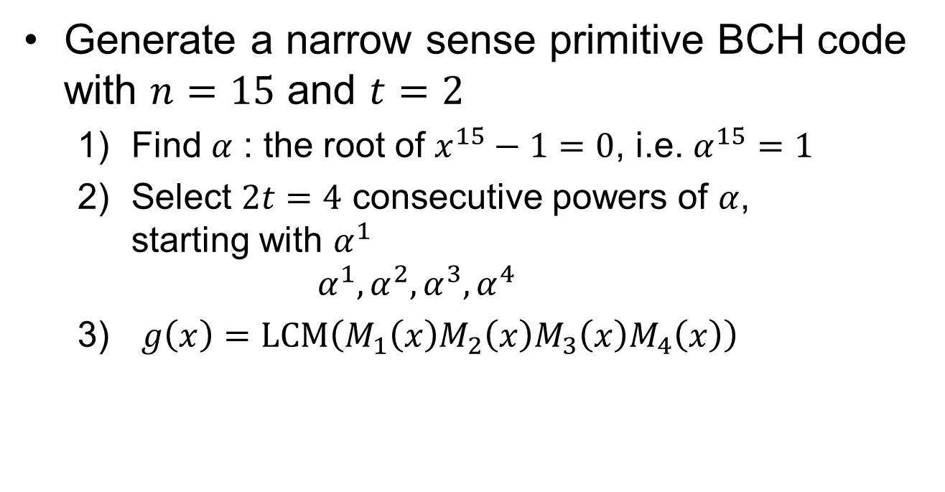
BCH Code Construction Example (2/4)
Generate a narrow sense primitive BCH code with $n=15$ and $t=2$
  Find $α$ : the root of $x^{15}−1=0$, i.e. $α^{15}=1$
  Select $2t=4$ consecutive powers of $α$,
  starting with $α^{1}$
  $α^{1},α^{2},α^{3},α^{4}$
  $g\left(x\right)=LCM\left(M_{1}\left(x\right)M_{2}\left(x\right)M_{3}\left(x\right)M_{4}\left(x\right)\right)$

Slide 10
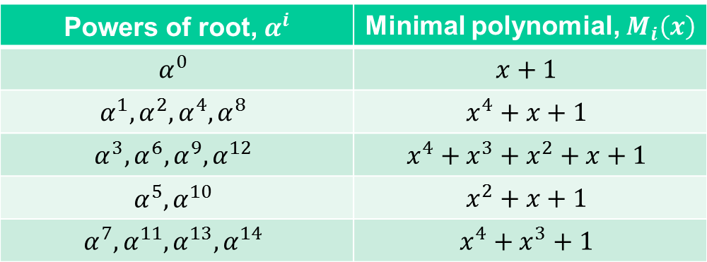

BCH Code Construction Example (3/4)
Generate a narrow sense primitive BCH code with $n=15$ and $t=2$
  The table of minimal polynomial for $α^{i}$ (See Appenxix)
Powers of root, $α^{i}$ | Minimal polynomial, $M_{i}\left(x\right)$
$$α^{0}$$ | $$x+1$$
$$α^{1},α^{2},α^{4},α^{8}$$ | $$x^{4}+x+1$$
$$α^{3},α^{6},α^{9},α^{12}$$ | $$x^{4}+x^{3}+x^{2}+x+1$$
$$α^{5},α^{10}$$ | $$x^{2}+x+1$$
$$α^{7},α^{11},α^{13},α^{14}$$ | $$x^{4}+x^{3}+1$$

Slide 11




BCH Code Construction Example (4/4)
Generate a primitive narrow sense BCH code with $n=15$ and $t=2$
  $g\left(x\right)=LCM\left(M_{1}\left(x\right)M_{2}\left(x\right)M_{3}\left(x\right)M_{4}\left(x\right)\right)$
$$=M_{1}\left(x\right)M_{3}\left(x\right)$$
Since $M_{1}\left(x\right)=M_{2}\left(x\right)=M_{4}\left(x\right)$
$$=\left(x^{4}+x+1\right)\left(x^{4}+x^{3}+x^{2}+x+1\right)$$
$$=x^{8}+x^{7}+x^{6}+2x^{5}+3x^{4}+2x^{3}+2x^{2}+2x+1$$
Since 2 equals to 0
in binary calculation
$$=x^{8}+x^{7}+x^{6}+x^{4}+1$$

Slide 12
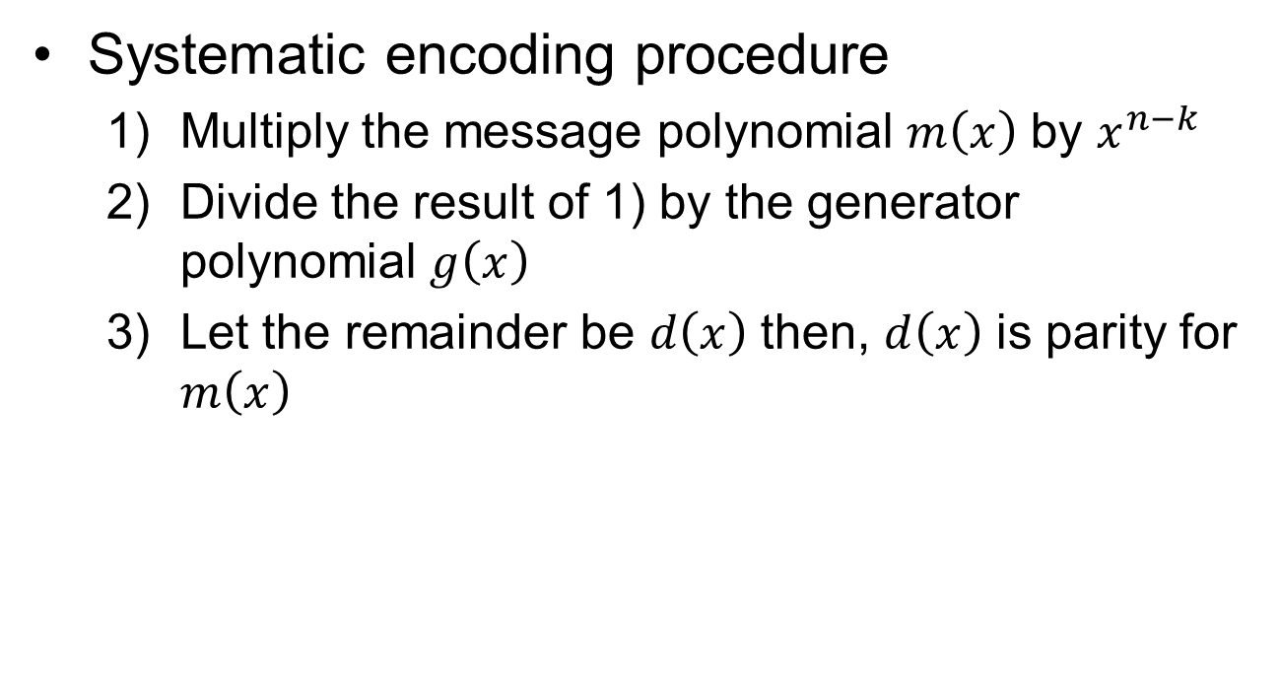
BCH Encoding (1/2)
Systematic encoding procedure
  Multiply the message polynomial $m\left(x\right)$ by $x^{n−k}$
  Divide the result of 1) by the generator polynomial $g\left(x\right)$
  Let the remainder be $d\left(x\right)$ then, $d\left(x\right)$ is parity for $m\left(x\right)$

Slide 13
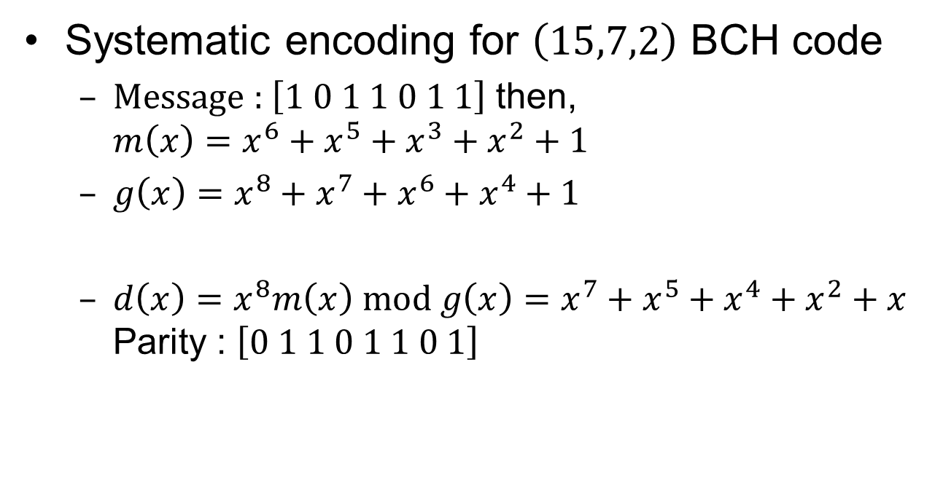
BCH Encoding (2/2)
Systematic encoding for $\left(15,7,2\right)$ BCH code
  Message : $\left[1 0 1 1 0 1 1\right]$ then,
  $m\left(x\right)=x^{6}+x^{5}+x^{3}+x^{2}+1$
  $g\left(x\right)=x^{8}+x^{7}+x^{6}+x^{4}+1$
  $d\left(x\right)=x^{8}m\left(x\right) mod g\left(x\right)=x^{7}+x^{5}+x^{4}+x^{2}+x$
  Parity : $\left[0 1 1 0 1 1 0 1\right]$

Slide 14
Appendixes

Slide 15
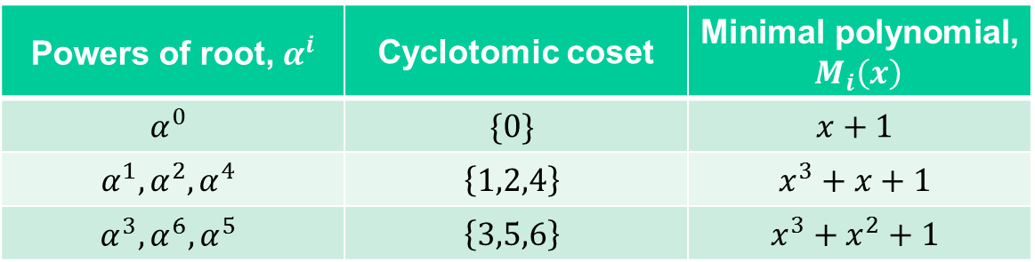

Appendix
Powers of primitive element in same cyclotomic coset have same minimal polynomial
  Ex) $GF\left(2^{3}\right)=GF(8)$
Powers of root, $α^{i}$ | Cyclotomic coset | Minimal polynomial, $M_{i}\left(x\right)$
$$α^{0}$$ | $$\{0\}$$ | $$x+1$$
$$α^{1},α^{2},α^{4}$$ | $$\left\{1,2,4\right\}$$ | $$x^{3}+x+1$$
$$α^{3},α^{6},α^{5}$$ | $$\left\{3,5,6\right\}$$ | $$x^{3}+x^{2}+1$$

Slide 16
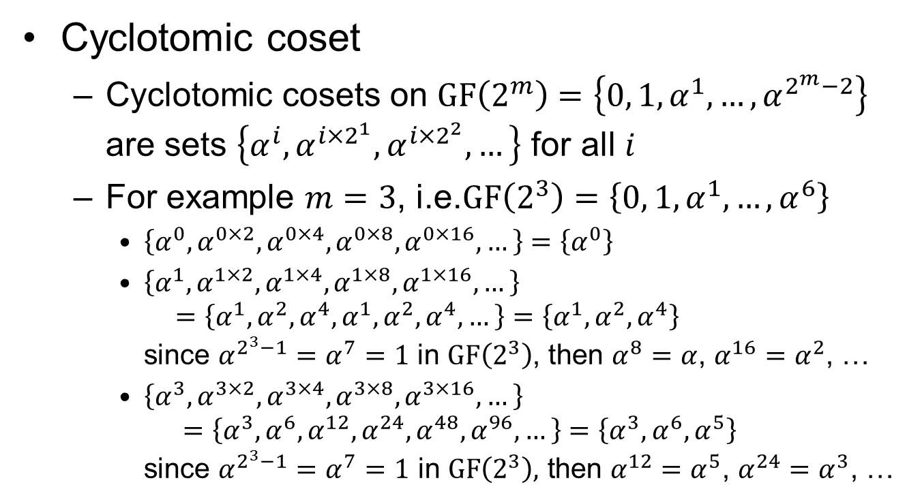
Appendix
Cyclotomic coset
  Cyclotomic cosets on $GF\left(2^{m}\right)=\left\{0, 1, α^{1}, …,α^{2^{m}−2}\right\}$ are sets $\left\{α^{i},α^{i×2^{1}},α^{i×2^{2}},…\right\}$ for all $i$
  For example $m=3$, i.e.$GF\left(2^{3}\right)=\left\{0, 1, α^{1}, …,α^{6}\right\}$
    $\left\{α^{0}, α^{0×2},α^{0×4},α^{0×8},α^{0×16},…\right\}=\left\{α^{0}\right\}$
    $\left\{α^{1}, α^{1×2},α^{1×4},α^{1×8},α^{1×16},…\right\}$
    $=\left\{α^{1}, α^{2},α^{4},α^{1},α^{2},α^{4},…\right\}=\left\{α^{1}, α^{2},α^{4}\right\}$
    since $α^{2^{3}−1}=α^{7}=1$ in $GF\left(2^{3}\right)$, then $α^{8}=α$, $α^{16}=α^{2}$, …
    $\left\{α^{3}, α^{3×2},α^{3×4},α^{3×8},α^{3×16},…\right\}$
    $=\left\{α^{3}, α^{6},α^{12},α^{24},α^{48},α^{96},…\right\}=\left\{α^{3}, α^{6},α^{5}\right\}$
    since $α^{2^{3}−1}=α^{7}=1 \text{in} GF\left(2^{3}\right)\text{,} \text{then} α^{12}=α^{5}\text{, }α^{24}=α^{3}\text{, …}$

Slide 17
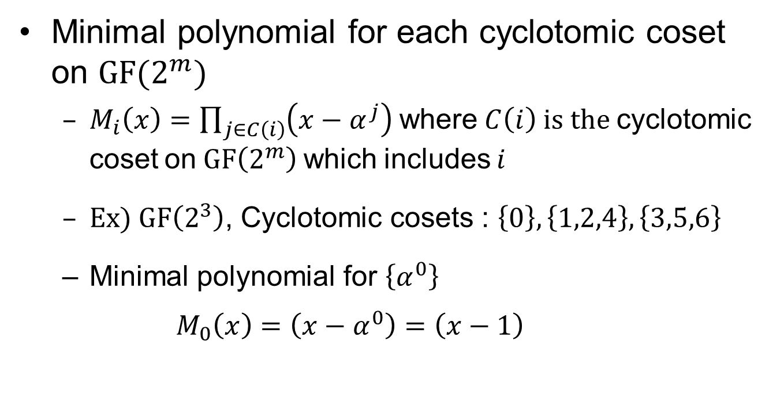
Appendix
Minimal polynomial for each cyclotomic coset on $GF(2^{m})$
  $M_{i}\left(x\right)=\prod_{j∈C\left(i\right)}{\left(x−α^{j}\right)}$ where $C\left(i\right)$ is the cyclotomic coset on $GF\left(2^{m}\right)$ which includes $i$
  Ex) $GF\left(2^{3}\right)$, Cyclotomic cosets : $\left\{0\right\},\left\{1,2,4\right\},\left\{3,5,6\right\}$
  Minimal polynomial for $\left\{α^{0}\right\}$
  $M_{0}\left(x\right)=\left(x−α^{0}\right)=\left(x−1\right)$

Slide 18
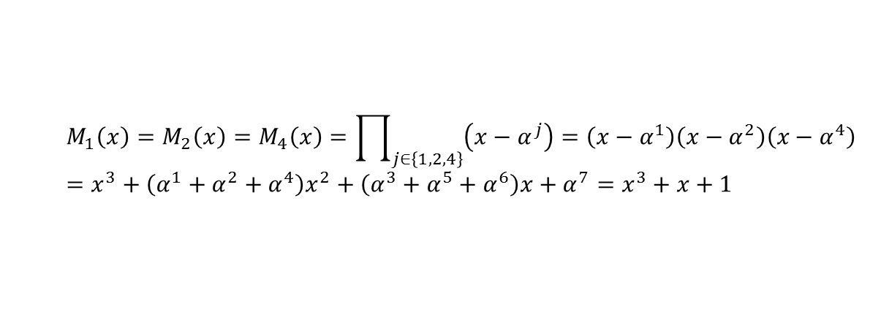

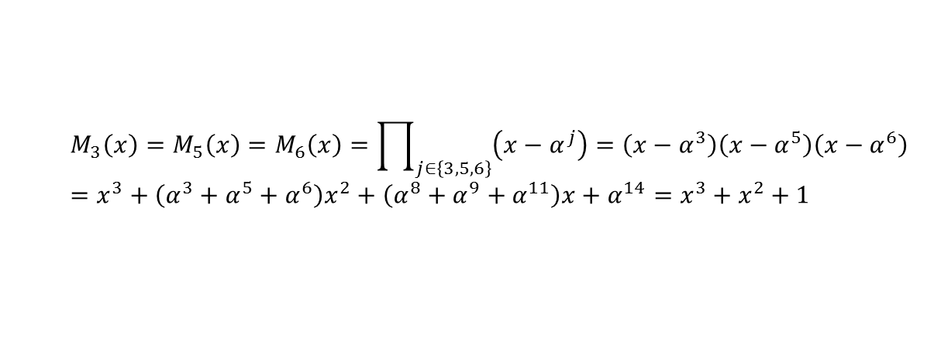
Appendix
Minimal polynomial for each cyclotomic coset on $GF(2^{m})$
  Minimal polynomial for $\left\{α^{1}, α^{2},α^{4}\right\}$
  Minimal polynomial for $\left\{α^{3}, α^{5},α^{6}\right\}$
  $$M_{1}\left(x\right)=M_{2}\left(x\right)=M_{4}\left(x\right)=\prod_{j∈\left\{1,2,4\right\}}{\left(x−α^{j}\right)}=\left(x−α^{1}\right)\left(x−α^{2}\right)\left(x−α^{4}\right)=x^{3}+\left(α^{1}+α^{2}+α^{4}\right)x^{2}+\left(α^{3}+α^{5}+α^{6}\right)x+α^{7}=x^{3}+x+1$$
  $$M_{3}\left(x\right)=M_{5}\left(x\right)=M_{6}\left(x\right)=\prod_{j∈\left\{3,5,6\right\}}{\left(x−α^{j}\right)}=\left(x−α^{3}\right)\left(x−α^{5}\right)\left(x−α^{6}\right)=x^{3}+\left(α^{3}+α^{5}+α^{6}\right)x^{2}+\left(α^{8}+α^{9}+α^{11}\right)x+α^{14}=x^{3}+x^{2}+1$$

Slide 19
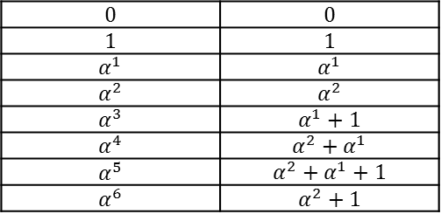
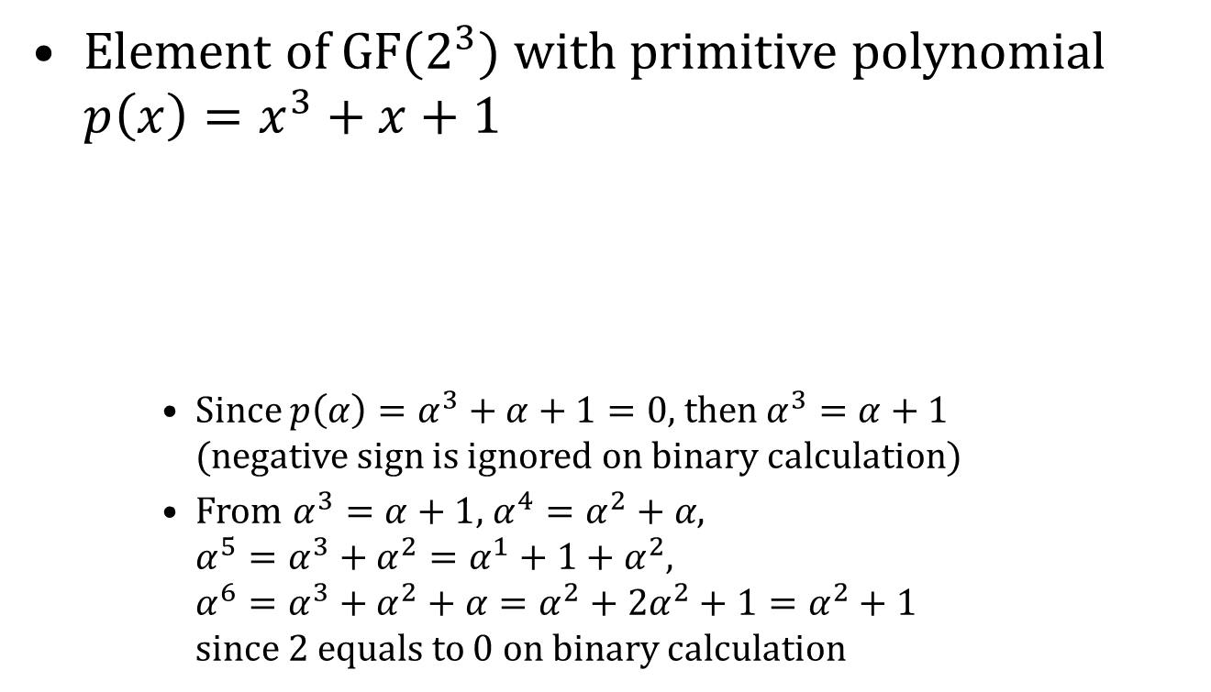
Appendix
Element of $GF(2^{3})$ with primitive polynomial $p\left(x\right)=x^{3}+x+1$
    Since $p\left(α\right)=α^{3}+α+1=0$, then $α^{3}=α+1$
    (negative sign is ignored on binary calculation)
    From $α^{3}=α+1$, $α^{4}=α^{2}+α$,
    $α^{5}=α^{3}+α^{2}=α^{1}+1+α^{2}$,
    $α^{6}=α^{3}+α^{2}+α=α^{2}+2α^{2}+1=α^{2}+1$
    since 2 equals to 0 on binary calculation
$$0$$ | $$0$$
$$1$$ | $$1$$
$$α^{1}$$ | $$α^{1}$$
$$α^{2}$$ | $$α^{2}$$
$$α^{3}$$ | $$α^{1}+1$$
$$α^{4}$$ | $$α^{2}+α^{1}$$
$$α^{5}$$ | $$α^{2}+α^{1}+1$$
$$α^{6}$$ | $$α^{2}+1$$

