Slide 1
Project: IEEE P802.15 Working Group for Wireless Personal Area Networks (WPANs)
Submission Title: Proposal for TG7r1 High-rate PD Communications
Date Submitted: 10, January 2016 (text version) and 22, Jan. 2016 (slides)
Source: V. Jungnickel ⁽¹⁾, P. Wilke Berenguer⁽¹⁾, D. Schulz⁽¹⁾, F. Ghassemloy⁽²⁾, S. Zvánovec⁽³⁾, G. Kleinpeter⁽⁴⁾ , B. Siessegger⁽⁵⁾ , M. Martinez⁽⁶⁾, S. Iranzo⁽⁶⁾
Companies: ⁽¹⁾ Fraunhofer, ⁽²⁾ UoN Newcastle, ⁽³⁾ CTU Prague, ⁽⁴⁾ BMW AG, ⁽⁵⁾ OSRAM GmbH, ⁽⁶⁾ Marvell Semiconductor Inc.
Voice: :+49 30 31002 768, +49 162 255 2756, E-Mail: volker.jungnickel@hhi.fraunhofer.de
Re: TG7r1 CfP
Abstract: This document describes a network architecture and proposed technologies how to address mandatory and optional features of the High-rate PD Communications in the TG7r1 TCD.
Purpose: Proposal submission
Notice: This document has been prepared to assist the IEEE P802.15. It is offered as a basis for discussion and is not binding on the contributing individual(s) or organization(s). The material in this document is subject to change in form and content after further study. The contributor(s) reserve(s) the right to add, amend or withdraw material contained herein.
Release: The contributor acknowledges and accepts that this contribution becomes the property of IEEE and may be made publicly available by P802.15.

Slide 2
Outline
Introduction
Network Architecture
Standalone link
Multiuser link
Coordinated link
Performance evaluation
Summary

Slide 3
Introduction
TG7r1 released CfP during the Meeting in Bangkok.
Fraunhofer presented a text proposal with initial simulation results before the deadline, see document number 15-16-0016-00-007a.
Fraunhofer is pleased to presents the full proposal, being supported by other parties.
This proposal covers PHY and MAC in High-speed PD Communications for different network topologies.
Performance is evaluated against the channel model used in TG7r1.
Future submissions will add more details.

Slide 4
This proposal…
supports fixed wireless links and multiple mobile user links via an optical wireless communications (OWC) infrastructure, which consists of one or more wireless access points.
extends the optical wavelength range beyond the scope of 802.15.7 standard for visible light communication (VLC) also below and above the wavelengths of 380 nm and 780 nm, respectively hereby including the invisible light.
supports a wide range of data rates (i.e., 1 Mb/s to 10 Gb/s), targeting the efficient use of the available optical bandwidth under variable channel conditions.
modern wireless transmission technologies, such as OFDM, adaptive transmission, MIMO and coordinated links in order to provide mobility for mobile users in an OWC based network.

Slide 5
This proposal…
describes unified interfaces for the user plane as well as open interfaces to the control plane information, which can be used to optimize the links and to support seamless mobility.
addresses specific requirements for robustness and low latency for industrial wireless, vehicular and backhauling scenarios (B2, B3, B4).
enables the coexistence of OWC with radio based wireless links.

Slide 6
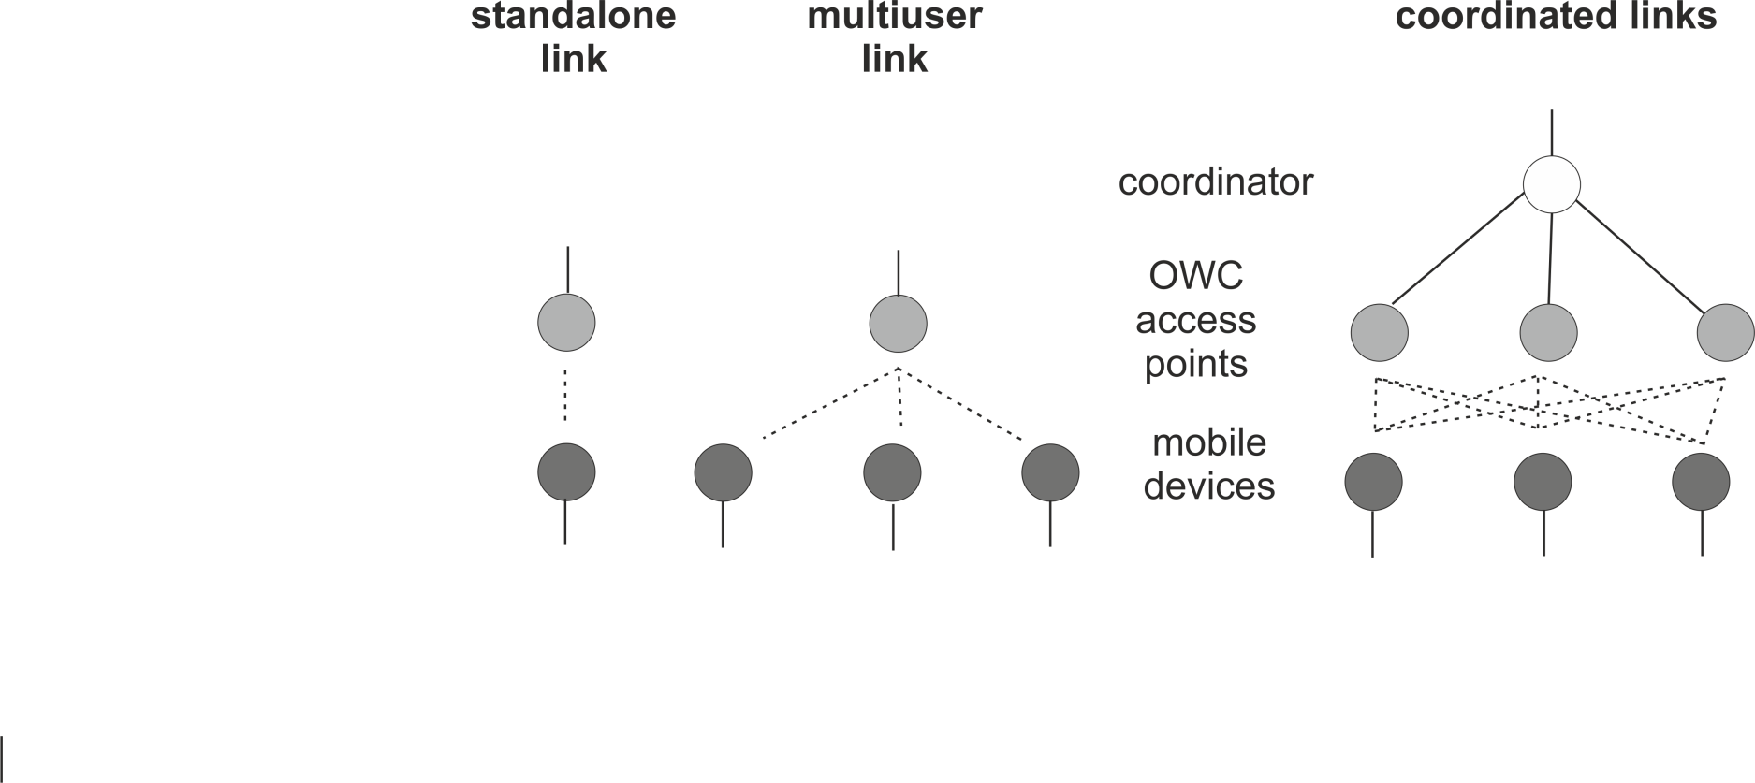
Network architecture
In order to address the diverse set of use cases in the TCD, a bottom-up approach is followed that develops the required network topologies with increasing degree of sophistication.

Slide 7
Network topologies
PHY and MAC enable an efficient use of the optical bandwidth.
Standalone (SA) link: PHY and MAC support bidirectional wireless transmission between two user devices (UD), automatic link setup and the feedback path for closed-loop adaptive transmission.
Multiuser (MU) link: One UD acts as AP serving multiple other UDs in parallel. The AP aggregates traffic from multiple UDs and coordinates their wireless transmission. PHY and MAC support spectrally efficient MU transmission.
    The feedback paths of UDs to the AP are made orthogonal.
    Terminals are time-synchronized by means of ranging (FDMA).
    A control channel is broadcast to all UDs in order to inform them about the granted transmission resources in both link directions.

Slide 8
Network topologies (2)
Coordinated (CO) links: Multiple UDs are served by multiple APs. Interference is coordinated by a network coordinator (NC). The NC aggregates the traffic from multiple UDs via multiple APs.
PHY and MAC support handover and interference management.
    All APs are operated in a time-synchronized manner.
    UDs estimate the downlink interference channel. The corresponding metrics reports are conveyed via the APs over the fronthaul to the NC.
    APs estimate the uplink interference channel. The corresponding metrics reports are conveyed via the fronthaul to the NC.
Depending on the link situation, handover events can be initiated by the NC, by rerouting the fronthaul traffic and controlling the interference.
Coordination by the NC is not part of the proposal.

Slide 9
Features
Use cases: B1-B4, All light sources described in TCD.
Transfer mode: bidirectional, continuous and packet-based.
1 Mbit/s to 10 Gbit/s: depending on the use case.
Waveform
    Based on adaptive OFDM with optional precoding
    Scalable bandwidth using variable number of subcarriers
Adaptive bit- and power loading
    Feedback and control channels for closed-loop operation.
    Variable modulation formats on each subcarrier or on groups of subcarriers, depending on the channel conditions.
Efficient use of the optical bandwidth
    robustness against multipaths, noise and interference

Slide 10
Features (2)
Dimming support (relevant for B1- B3)
Coexistence with ambient lighting and other light sources
Metrics reporting
    Signal strength of strongest cells
    Error vector magnitude (EVM) vs. frequency
    Channel state information (CSI) for strongest cells
    Control plane information is made easily available to higher layers
Advanced wireless networking
    Support for multiple users, handover and interference coordination
High availability
    in line-of-sight (LOS) and non-LOS (NLOS) scenarios
    at low signal-to-noise ratio (SNR) and in case of interference

Slide 11
Standalone link
Adaptive OFDM
  IFFT+CP@Tx
  orthogonal subcarriers (SC)
  variable modulation on each subcarrier, variable code rate
  Hermitian symmetry, DC bias
  digital clipping
  real-valued, non-negative waveform
  FFT and frequency-domain equalizer (FDE) @Rx
Adaptive bit- and power loading
    based on feedback of EVM measured per SC (or SC group) after the FDE
    Loading algorithm determines the power and modulation formats for the data transport on each SC or SC group
    Loading algorithm maximizes the throughput so that a constant target bit error rate (BER) is reached

Slide 12
Frame structure
Preamble for coarse synchronization and channel estimation
    the preamble of the coax mode in G.hn is used.
    optimization is done for operation at low SNR.
    the final OFDM symbol in the preamble is used for channel estimation
    enables the Rx to decode both, the header and data in SISO mode
Header for control information
    setup the link and to decode the data.
    pre-coding is optional for optimization at low SNR.
    same numerology is used like in the last preamble symbol.
    header information is transparent and defined by the MAC.
Data with additional reference signals
    used for MIMO and correction of the sampling frequency offset (SFO)

Slide 13
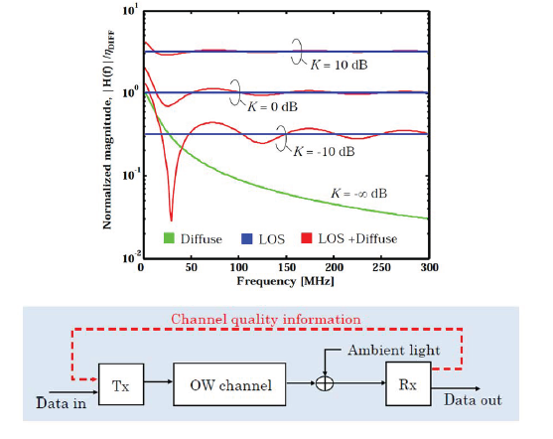
Used-bandwidth adaptation
In NLOS and if the LOS signal is weak
Path loss is high
Transmission is possible only over a small bandwidth (10 MHz and less).
Preamble, header and data use the full power and operate at reduced bandwidth.
It is proposed to adapt the used bandwidth and power by adopting a generic approach.
Possible approaches to be discussed
    Reduce the # of used subcarriers and redistribute power when creating all signals (preamble, header and data).
    Switch to another fixed-bandwidth mode (e.g. 200 MHz → 10 MHz)
    Stretch the whole frame in the time domain to reduce bandwidth, e.g. by using frequency-domain zero padding (FDZP) → more complex

Slide 14
Waveform
SA PHY uses the adaptive OFDM (DMT) waveform in both directions
    The waveform is always non-negative and real-valued
    A bias is added to the LED current (if needed)
OFDM signal generation contains the following blocks
    A block of 2N data symbols is always transmitted.
    Pre-coding can be used to improve power efficiency (optional).
    Carrier mapping maps the data symbols onto subcarriers, used e.g. for Hermitian symmetry and precoding
    Mapped data signals are passed through IFFT
    The CP is added
    Controlled clipping is implemented in the digital domain
  Th

Slide 15
Precoding
Precoding can be used to reduce PAPR and increase modulation index.
    In general, single-carrier (SC) modulation is emulated by using OFDM
Top: DFT precoding yields a SC signal with a Nyquist pulse-shape and α=0.
Center: A root raised-cosine filter is used in the frequency domain (α>0).
Bottom: A Gaussian filter is used in the frequency-domain, and a minimum-shift keying modulator (MSK) in the time domain, to obtain GMSK

Slide 16
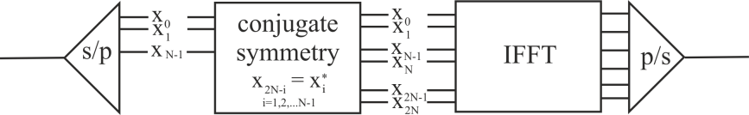
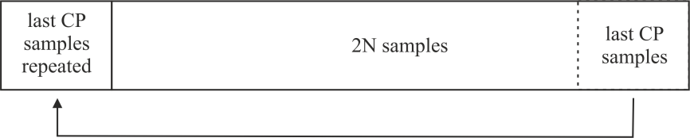
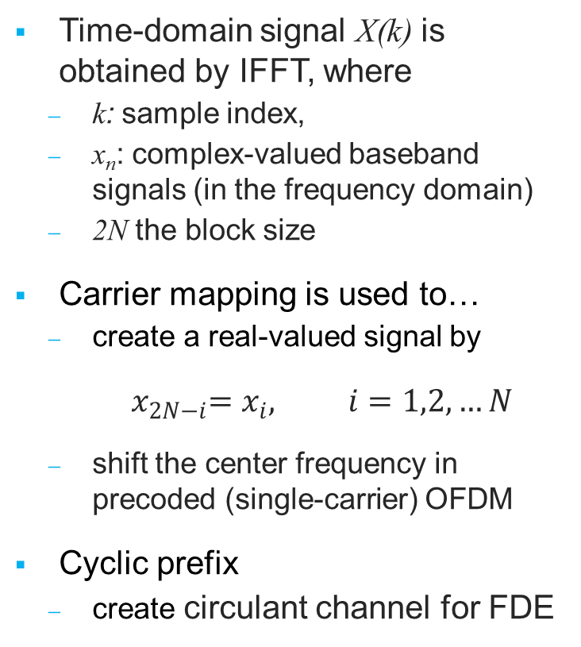

IFFT, Carrier Mapping, Cyclic Prefix
Time-domain signal X(k) is obtained by IFFT, where
    k: sample index,
    x_{n}: complex-valued baseband signals (in the frequency domain)
    2N the block size
Carrier mapping is used to…
    create a real-valued signal by
$${ x}_{2N−i}=x_{i}, i=1,2,…N−1$$
    shift the center frequency in precoded (single-carrier) OFDM
Cyclic prefix
    create circulant channel for FDE
$$X\left(k\right)=\frac{1}{2N}\sum_{n=0}^{2N−1}{x_{n}e^{j2π\frac{nk}{2N}}}$$

Slide 17
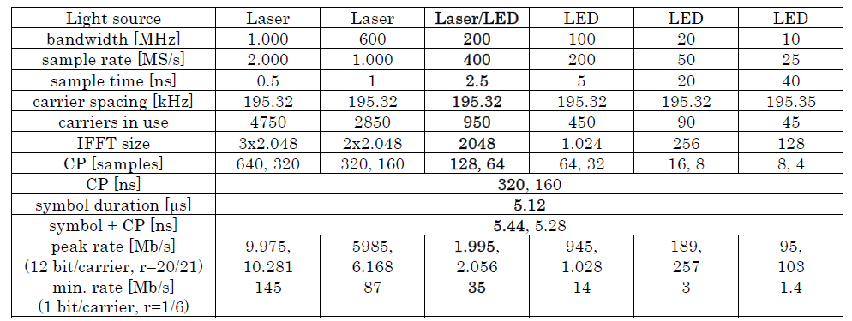
Numerology
Approach is based on the ITU G.hn standard, having an adaptive OFDM PHY that is functionally the same as what is needed for OWC.
Variable bandwidth with same CP duration and same subcarrier spacing
Same PHY with different modulation and coding for 1 Mb/s up to 10 GB/s

Slide 18
MIMO Reference Symbols
Initial link setup and header detection are performed in SISO mode. Link is improved by transmitting the signal from all LEDs and max.-ratio combin.
MIMO reference symbols (RS) are sent at the beginning of the data block.
RS have the same numerology as used for data.
RSs are defined in frequency domain and over multiple OFDM symbols.
The same reference symbol {s_{n}} is used by one LED, and multiplied as a whole with another sign, taken out of an orthogonal sequence, e.g.
1 LED: [{s_{n}}]
2 LEDs: 1st LED [{s_{n}} {s_{n}}], 2nd LED [{s_{n}} {-s_{n}}].
4 LEDs: 1st LED [{s_{n}} {-s_{n}} {s_{n}} {s_{n}}], 2nd LED [{s_{n}} {s_{n}} {-s_{n}} {s_{n}}],
3rd LED [{s_{n}} {s_{n}} {s_{n}} {-s_{n}}] , 4th LED [{-s_{n}} {s_{n}} {s_{n}} {s_{n}}].
Channel estimation is performed, at the same subcarrier index n, by correlation over multiple RS (like in 802.11n).

Slide 19
Reference Symbols for WDM and CSK
LEDs occupy a wide optical spectrum.
Estimation of the mutual interference between different color paths is supported with the same concept also used for MIMO, when using wavelength-division multiplex (WDM) and color shift keying (CSK).
For each LED color, a different MIMO reference signal is used.
If the spectral overlap of LEDs with different colors is negligible, the same sequence can be reused for multiple wavelengths.
The assignment of colors to sequences is included in the header.

Slide 20
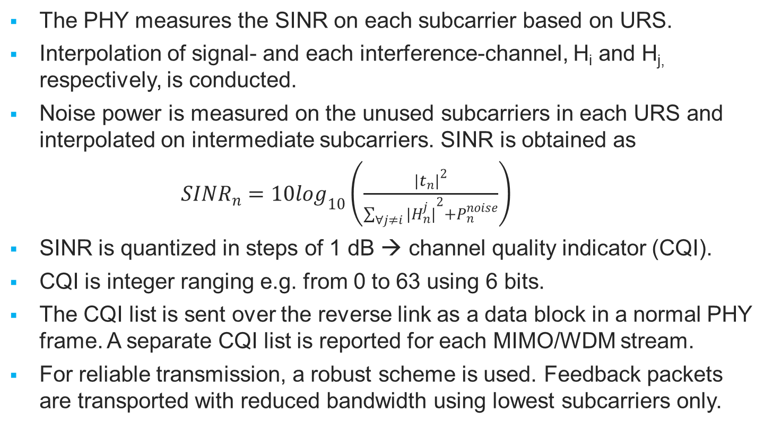
Metrics Reporting for Adaptive Transmission
The PHY measures the SINR on each subcarrier based on URS.
Interpolation of signal- and each interference-channel, H_{i} and H_{j,} respectively, is conducted.
Noise power is measured on the unused subcarriers in each URS and interpolated on intermediate subcarriers. SINR is obtained as
${SINR}_{n}=10\log_{10}\left(\frac{{|t_{n}^{}|}_{}^{2}}{\sum_{∀j≠i}{{|H_{n}^{j}|}_{}^{2}+P_{n}^{noise}}}\right)$
SINR is quantized in steps of 1 dB → channel quality indicator (CQI).
CQI is integer ranging e.g. from 0 to 63 using 6 bits.
The CQI list is sent over the reverse link as a data block in a normal PHY frame. A separate CQI list is reported for each MIMO/WDM stream.
For reliable transmission, a robust scheme is used. Feedback packets are transported with reduced bandwidth using lowest subcarriers only.

Slide 21
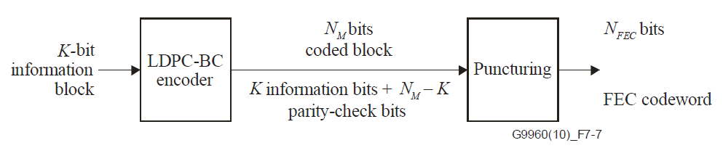
Channel coding
  Channel coding for header: LDPC with 168 data bits and code rate ½
  Channel coding for data: Low density parity check code (LDPC)
      For performance evaluation, an LDPC with information block size of 4320 bits and a code rate of 5/6 is used, according to G.hn standard.
      Other block sizes and code rates are possible.
      Channel coding for MIMO
Stream-interleaved encoding is used.
      Selective repeat
      Optimize the link performance and reduce latency.

Slide 22
Bidirectional transmission
Both, half and full duplex are supported.
Half duplex can be combined with the same wavelength or different wavelengths in both directions. Time sharing can be unequal for both directions, so that statistical multiplexing between both directions and higher peak rates in each direction are supported.
Full duplex is typically combined with different wavelengths in uplink and downlink (e.g. visible light in the downstream, infrared in the upstream). Same wavelength can be used in the directive backhaul scenario B4. But even in B4, full duplex is costly, from an implementation point of view.

Slide 23
Multiuser link: TDMA
  Using a superframe, UDs can be assigned individual time slots.
  First time slot is reserved for contention-based random access (RA)
  AP sends a beacon
  UDs access the RA channel randomly and listen before they talk
  Default time offset is 0. In case of contention, random time offsets on a fixed grid are used for next access to the RA channel
Last time slot is reserved for control information and metrics reports
AP informs UDs about the order of transmission for uplink and downlink transmissions during the next superframe.
UDs send their metrics reports in the assigned order.
TDMA transmission of AP and UDs
  Starts in the second time slot of the next superframe.
  This was all half duplex. Full duplex may vary a little.

Slide 24
Multiuser link: FDMA
UDs can have different path losses and distances from the AP.
Power control and ranging are needed (vehicular use case, B3).
    The random time offset, which is always on a fixed grid, enables the AP to measure the roundtrip time for each UD.
    In the last time slot, the AP informs all UDs about their transmit power and the number of samples by which transmission delayed.
    Signals arrive now almost simultaneously.
  Metrics reports and control messages
  Regarding metrics reports, there is no difference between TDMA and FDMA.
  But the slot assignment in TDMA is extended by the assignment of subcarrier groups to individual UDs.
  Allows concurrent transmission of UDs for low latency and multiuser diversity
feedback & control channels
user 1 user 2
user 3
frequency

Slide 25
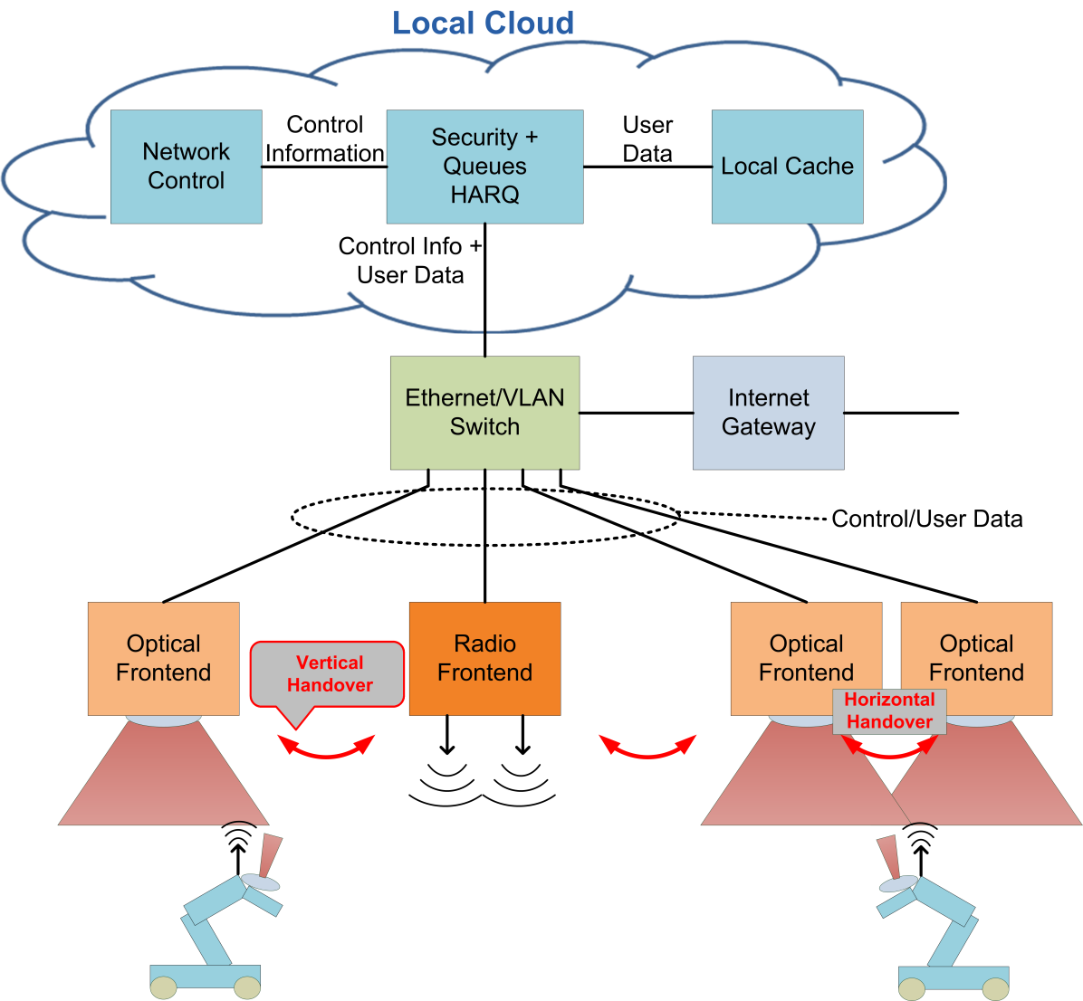
Coordinated Link
    Network Control (NC) in local cloud
    Security, User Queues, HARQ
    Handover and interference coordination
    All transport is Ethernet with PoE
    This is the coordinated link
    Access Points (APs)
    LED, PD, analog frontend
    Include coordinated PHY and MAC
    User Devices (UD)
        PHY and MAC for coordinated link
        Interfaces to NC for coordinated transmission

Slide 26
Reference Symbols in CO Link
To identify different APs or UDs, reference symbols are made orthogonal in the frequency domain. During the entire MIMO RS block, each AP is assigned another comb of subcarriers (marked with the same specific color), from a set of orthogonal combs. The comb can be reused by another AP after a distance, where the signal is attenuated enough.

Slide 27
Cell- and User-specific RS
In the CO link, each AP and UD transmits a first block of MIMO reference symbols that can be used for multi-cell channel estimation. This block is denoted as cell-specific reference symbols (CRS).
Based on feedback provided over the downlink, the transmitter can pre-distort the coordinated transmission, what can depend on other UDs. I.e., the effective channel seen by the UD becomes unpredictable.
Therefore, CRS are sent first, followed by an identical sequence denoted as user-specific reference signals (URS).
URS are passed through the pre-distortion like the data. In this way, the effective channel can be estimated.
URS can be used for correct demodulation, SINR metrics reporting and adaptive transmission.

Slide 28
Handover and Interference Coordination Support
PHY provides CRS and URS
UDs subscribe to the strongest cell
  establish a link at PHY and MAC levels
NC decides what cell is serving and how it transmits
  NC coordinates the interference in adjacent cells
  AP PHY and MAC perform the interference coordination
  UDs and AP measure the resulting EVM in downlink and uplink
  UD and AP provide URS feedback to the NC
  NC adapts the transmission mode, data are sent/received via the serving cell

Slide 29
Metrics Reporting
Signal strengths of strongest cells
  for initial link setup, best-cell selection and handover
  very primitive+reliable signaling, results are passed via Ethernet/IP to NC
EVM vs. frequency (for each terminal)
  based on URS: for adaptive transmission
  URS feedback is directly used inside the MAC (in stand-alone links)
  or transferred via Ethernet/IP to the NC for coordinated transmission
Channels state information (CSI) for the strongest cells
  based on CRS: only used for coordinated transmission
  wireless transmission of feedback channel is orthogonal to other cells
  feedback is passed via fixed Ethernet/IP link to NC

Slide 30
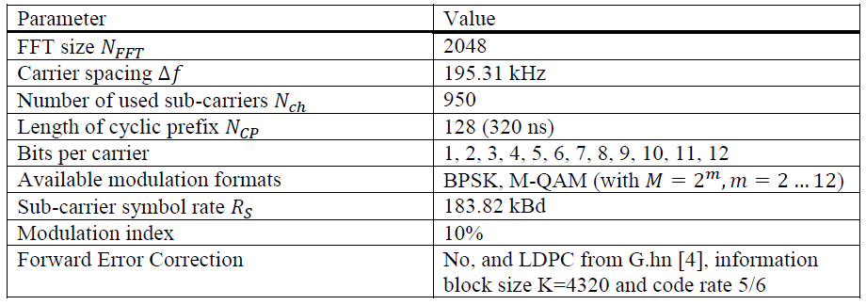
Performance Evaluation
Simulation framework
  New modular simulator has been set up.
    All channel impulse responses (CIRs) in the TG7r1 CIRs Channel Model Document for High-rate PD Communications [6] can be used.
    Scenario 4 Manufacturing Cell is used as worst-case w.r.t. multi-paths
    CIRs in which all LEDs transmit simultaneously, and D1-D8 at the Rx

Slide 31
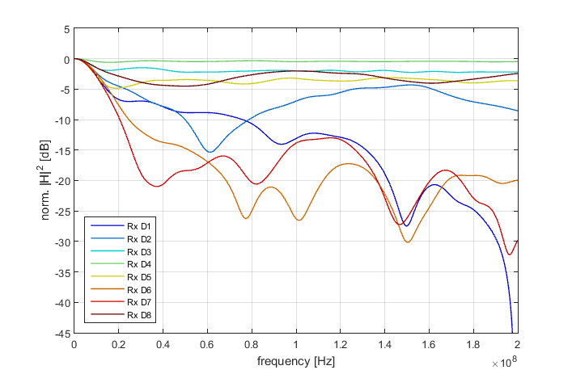
CIR in the frequency domain
  Superposition of line-of-sight (LOS) and non-LOS (NLOS).
  Big variety of the path loss and the channel bandwidth is observed.
  Rx D7 is dominated by NLOS with 3-dB bandwidth of only 10 MHz.
  LiFi needs need adaptation of both, modulation and used bandwidth

Slide 32
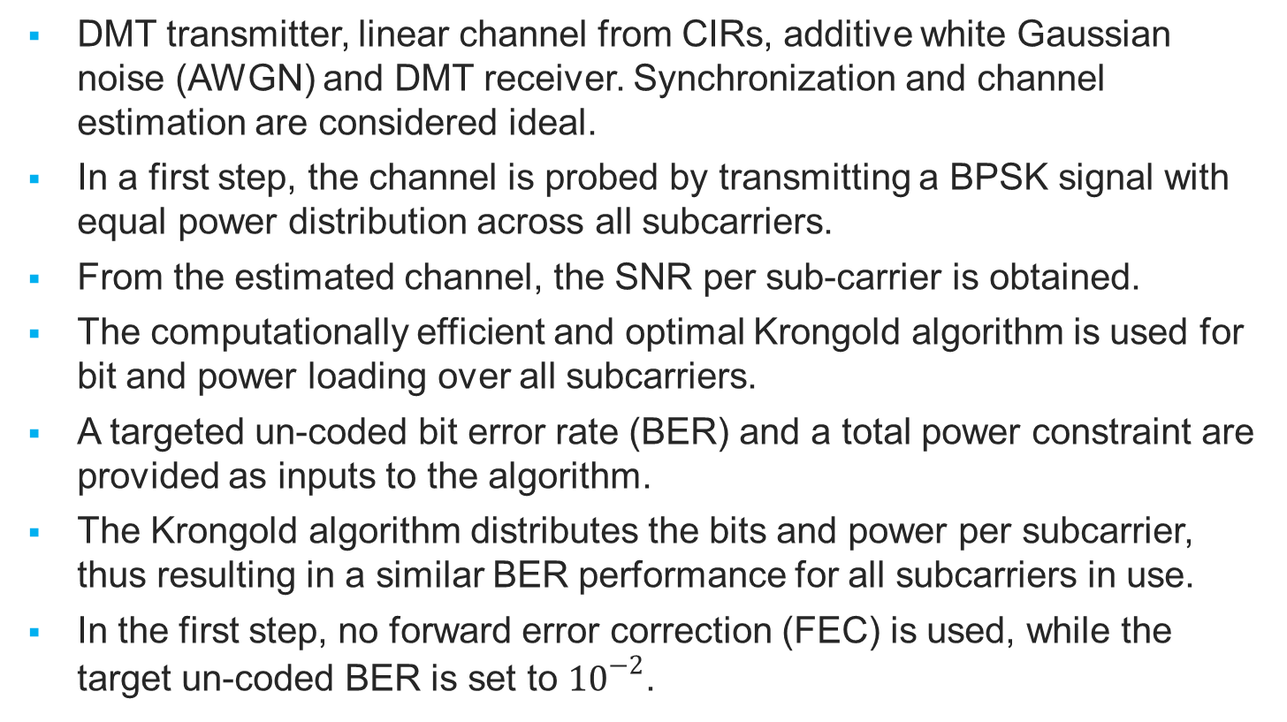
Implemented Algorithms
  DMT transmitter, linear channel from CIRs, additive white Gaussian noise (AWGN) and DMT receiver. Synchronization and channel estimation are considered ideal.
  In a first step, the channel is probed by transmitting a BPSK signal with equal power distribution across all subcarriers.
  From the estimated channel, the SNR per sub-carrier is obtained.
  The computationally efficient and optimal Krongold algorithm is used for bit and power loading over all subcarriers.
  A targeted un-coded bit error rate (BER) and a total power constraint are provided as inputs to the algorithm.
  The Krongold algorithm distributes the bits and power per subcarrier, thus resulting in a similar BER performance for all subcarriers in use.
  In the first step, no forward error correction (FEC) is used, while the target un-coded BER is set to ${10}^{−2}$.

Slide 33
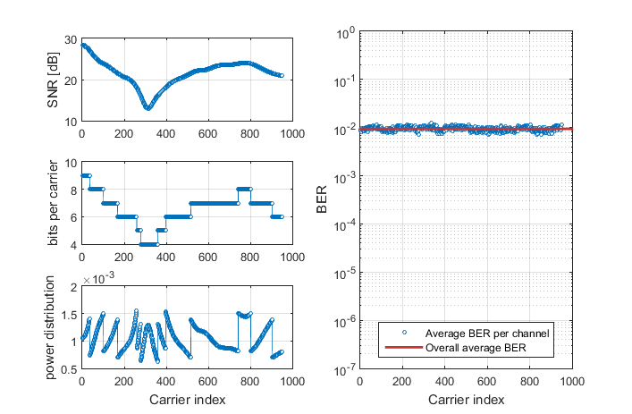

One exemplary channel
  As an example, SNR versus the subcarrier index with the resulting bit- and power loading for a fixed SNR of 28 dB is shown (left) at Rx D2.
  Gross throughput is $6.232 \text{bits}⋅R_{S}=1.15 \text{Gb}\text{/}\text{s}$ in this example.
  BER vs. subcarrier index profile is flat and has reached the 10⁻² target.

Slide 34
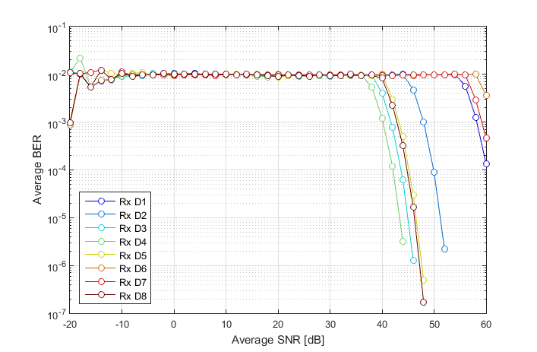
BER vs. SNR
  CIRs corresponding to the 8 Rx D1-D8 were now all used and the SNR varied over a wide range.
  The resulting average BER is flat, except at low and high SNR.
  Not enough bits and limited set of modulation formats, respectively.

Slide 35
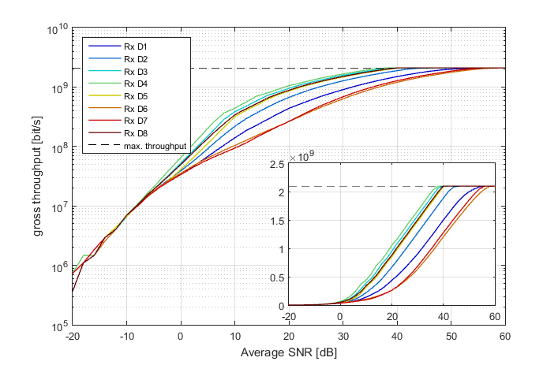
Gross Throughput vs. SNR
  At low SNR, bits are loaded on few subcarriers, with all available power.
  DMT can transmit also in very low SNR scenarios → enhanced mobility
  Significant throughputs variations due to path loss and bandwidth.

Slide 36
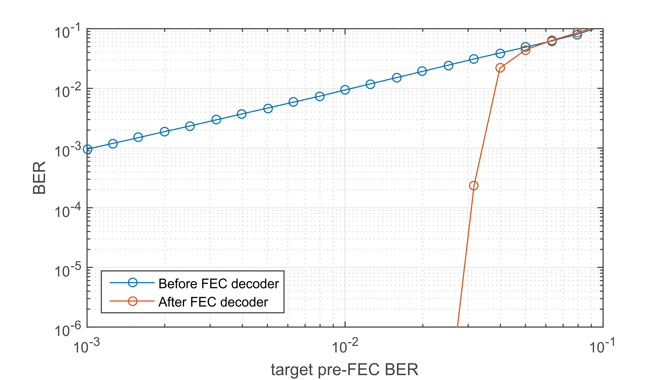
    Targeted pre-FEC BER vs. reached post-FEC BER
  For bit- and power loading, the targeted pre-FEC BER is reached.
  But it must be ensured that the FEC can correct the residual errors.
  This has been tested, with LDPC from the G.hn with information block size of 4320 and code rate 5/6. A pre-FEC BER target of 10⁻² is enough.

Slide 37
Impact of Precoding
  π/2 BPSK with rectangular filter
    Better performance than BPSK
  Impact of RRC filter using BPSK
    Envelope is filtered data sequence
    Zero-crossings still problematic
  Filtered π/2 BPSK
    No more zero crossings
    But envelope is not fully smooth
  GMSK
    Totally constant envelope
    0 dB PAPR
    But more spectrum is needed

Slide 38
Significantly Reduced PAPR
  BPSK
    1.6 dB better than OFDMA
  π/2 BPSK with rectangular filter
    2.6 dB better than BPSK
  RRC filtered BPSK
    4.4 dB better than BPSK
    needs 20% more bandwidth
  Filtered π/2 BPSK
    6 dB better than BPSK
  GMSK
    7.9 dB better than BPSK
  Values measured at 99%-ile of the cdf

Slide 39
Summary
A partial proposal was presented to TG7r1 in response to the CfP.
It explaines how the requirements in the TCD for High-speed PD Communications can be met. Moreover, initial performance results for the standalone link and the effect of precoding were shown.
The proposal is open to be joined for other parties and to be merged with other proposals. In this case, please, contact Fraunhofer HHI.
Parts of this proposal were already tested [1]
  use of DMT for optical wireless links up to 1 Gbps
  adaptive transmission in mobile scenarios with interference
  coordination of multiple parallel links
  efficient MAC and network routines for multiuser and coordinated links
  clustering of cells, user selection and rank adaptation
[1] This proposal is based on recent research projects funded by the German Ministry of Education and Research (BMBF) in the projects ScaleNet, EASY-C, CONDOR and OWICELLS, the German Research Council (DFG) in the projects CoMPImpairments and CoMPmobil and the European Union in the projects OMEGA, SODALES, OPTICWISE, iCirrus and CHARISMA. The authors thank all partners in these projects for their cooperation.

