Slide 1
Project: IEEE P802.15 Working Group for Wireless Personal Area Networks (WPANs)
Submission Title: [Liaison Report on 802.11 for Jan 2016]
Date Submitted: [21 Jan, 2016
Source: [Al Petrick 802.11] Company [Jones-Petrick and Associates]
Address [Orlando, Florida, 32832]
Voice:[321-235-3269], FAX: [], E-Mail:[al@jpasoc.com ]
Re: [Liaison Report on 802.11 for January, 2016]
[If this is a response to a Call for Contributions, cite the name and date of the Call for Contributions to which this document responds, as well as the relevant item number in the Call for Contributions.]
[Note: Contributions that are not responsive to this section of the template, and contributions which do
not address the topic under which they are submitted, may be refused or consigned to the “General Contributions” area.]
Abstract: [Liaison Report on 802.11 for January, 2016.]
Purpose: [Informative]
Notice: This document has been prepared to assist the IEEE P802.15. It is offered as a basis for discussion and is not binding on the contributing individual(s) or organization(s). The material in this document is subject to change in form and content after further study. The contributor(s) reserve(s) the right to add, amend or withdraw material contained herein.
Release: The contributor acknowledges and accepts that this contribution becomes the property of IEEE and may be made publicly available by P802.15.
NOTE: Update all red fields replacing with your information; they are required. This is a manual update in appropriate
fields. All Blue fields are informational and are to be deleted. Black stays. After updating delete this box/paragraph.

Slide 2
802.11 Liaison Report
Atlanta - GA
January 2016

Slide 3
802.11 Task Groups in Comment Resolution
Task Group | Ballot | Draft | Comments | Resolved | Plans | Closing Report
TGai | SB #1 | D6.3 | 760 | ALL | Recirculation | 11-16-0179r0
TGaq | LB 216 | D3 | 400 | 85 | Continue Comment Resolution March 2016 | 11-16-0178r0
TGmc | SB Rec #1 Closes 1/26 | D5.0 |  |  | 2nd SB Recirculation D6.0 March 2016 | 11-16-0185r0
TGah | SP#1 | D5.0 | 552 | ALL | 1st Recirculation Jan 2016 | 11-16-0184r0
TGak | LB212 | D1.0 |  | ALL | 1st Recirculation D2.0 Jan 2016 | 11-16-0188r0

Slide 4
802.11ax (High Efficiency WLAN)
45 technical submissions.
22 PHY submissions
12 MAC Submissions
09 MU Submissions
01 SR submissions
04 submissions addressing TG issues
Approved initial draft D0.1
Comment period March 2016
WG Letter Ballot draft D1.0 – July 2016
List of submissions: https://mentor.ieee.org/802.11/dcn/15/11-15-1516-03-00ax-tgax-november-2015-meeting-agenda.ppt
Closing report: 16/0187r0

Slide 5
802.11ay
Enhanced throughput (20Gb/s) above 45 GHz (Millimeter Wave)
18 technical submissions
Channel models, Use-Cases
Specification Framework Document
Closing report: 16-0181r0

Slide 6
802.11az (Next Generation Positioning)
High Rate PHY 2.4 GHz, 5 GHz, 60 GHz
Fine timing measurement – reduce power and media usage
Positioning with better accuracy
Scalable dense deployments
Technical documents
Specification Framework Document
Millimeter Wave positioning requirements
Use-Case
Closing report: 15-1457r0

Slide 7
IEEE 802.11 JTC1 SC
Reviewed status of PSDO pipeline
IEEE 802 has pushed 18 standards completely through the PSDO ratification process
IEEE 802 has 9 standards pending
SC6 meeting in March 2016
Topics
WG1: Human Body Area Networking proposal
WG7: WLAN Access Controller (AC) Coordination Technology proposal
WG7: Convergence Service for Interworking of Heterogeneous Wireless Networks proposal
Closing report: 16/0177r0

Slide 8
802.11WNG (Wireless Next Generation
Technical presentations
“ITU-R IMT-2020 Status” by Joseph Levy (Interdigital)
https://mentor.ieee.org/802.11/dcn/16/11-16-0127-00-0wng-itu-r-imt-2020-status.pptx
“Next steps for IMT-2020” by Andrew Myles (Cisco Systems)
https://mentor.ieee.org/802.11/dcn/16/11-16-0004-00-0000-next-steps-for-imt-2020.ppx
“IMT-2020 Way Forward and Straw Polls” by Joseph Levy (Interdigital)
https://mentor.ieee.org/802.11/dcn/16/11-16-0128-01-0wng-imt-2020-way-forward-and-straw-polls.pptx
Straw polls indicated some interest in moving forward with ITU-R engagement, but questions about whether members would receive support from their sponsors
Closing report 16/0180r0

Slide 9
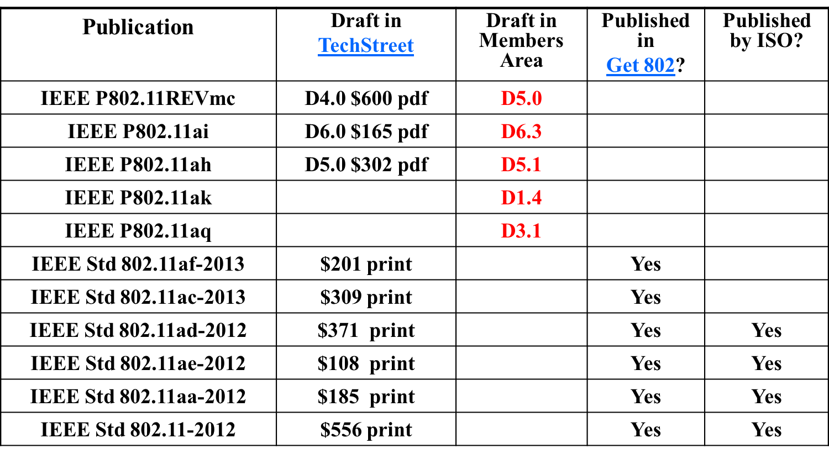
Available 802.11 - Drafts

Slide 10
Questions???

