Slide 1
Project: IEEE P802.15 Working Group for Wireless Personal Area Networks (WPANs)
Submission Title: [Liaison Report on 802.11 for Jan 2016]
Date Submitted: [21 Jan, 2016
Source: [Al Petrick 802.11] Company [Jones-Petrick and Associates]
Address [Orlando, Florida, 32832]
Voice:[321-235-3269], FAX: [], E-Mail:[al@jpasoc.com ]
Re: [Liaison Report on 802.11 for January, 2016]
[If this is a response to a Call for Contributions, cite the name and date of the Call for Contributions to which this document responds, as well as the relevant item number in the Call for Contributions.]
[Note: Contributions that are not responsive to this section of the template, and contributions which do
not address the topic under which they are submitted, may be refused or consigned to the “General Contributions” area.]
Abstract: [Liaison Report on 802.11 for January, 2016.]
Purpose: [Informative]
Notice: This document has been prepared to assist the IEEE P802.15. It is offered as a basis for discussion and is not binding on the contributing individual(s) or organization(s). The material in this document is subject to change in form and content after further study. The contributor(s) reserve(s) the right to add, amend or withdraw material contained herein.
Release: The contributor acknowledges and accepts that this contribution becomes the property of IEEE and may be made publicly available by P802.15.
NOTE: Update all red fields replacing with your information; they are required. This is a manual update in appropriate
fields. All Blue fields are informational and are to be deleted. Black stays. After updating delete this box/paragraph.

Slide 2
802.11 Liaison Report
Atlanta - GA
January 2016

Slide 3
802.11 Task Groups in Comment Resolution
Task Group | Ballot | Draft | Comments | Resolved | Plans | Closing Report
TGai | SB #1 | D6.3 | 760 | ALL | Recirculation | 11-16-0179r0
TGaq | LB 216 | D3 | 400 | 85 | Continue Comment Resolution March 2016 | 11-16-0178r0
TGmc | SB Rec #1 Closes 1/26 | D5.0 |  |  | 2nd SB Recirculation D6.0 March 2016 | 11-16-0185r0
TGah | SP#1 | D5.0 | 552 | ALL | 1st Recirculation Jan 2016 | 11-16-0184r0
TGak | LB212 | D1.0 |  | ALL | 1st Recirculation D2.0 Jan 2016 | 11-16-0188r0

Slide 4
802.11ax
(High Efficiency WLAN)
45 technical submissions.
  22 PHY submissions
  12 MAC Submissions
  09 MU Submissions
  01 SR submissions
  04 submissions addressing TG issues
Approved initial draft D0.1
Comment period March 2016
WG Letter Ballot draft D0.0 – July 2016
  List of submissions: https://mentor.ieee.org/802.11/dcn/15/11-15-1516-03-00ax-tgax-november-2015-meeting-agenda.ppt
Closing report: 16/0187r0

Slide 5
802.11ay
Enhanced throughput (20Gb/s)
above 45 GHz (Millimeter Wave)
18 technical submissions
  Channel models, Use-Cases
  Specification Framework Document
Closing report: 16-0181r0

Slide 6
802.11az
(Next Generation Positioning)
High Rate PHY 2.4 GHz, 5 GHz, 60 GHz
  Fine timing measurement – reduce power and media usage
  Positioning with better accuracy
  Scalable dense deployments
Technical documents
  Specification Framework Document
  Millimeter Wave positioning requirements
  Use-Case
Closing report: 15-1457r0

Slide 7
IEEE 802.11 JTC1 SC
Reviewed status of PSDO pipeline
  IEEE 802 has pushed 18 standards completely through the PSDO ratification process
  IEEE 802 has 9 standards pending
SC6 meeting in March 2016
  Topics
    WG1: Human Body Area Networking proposal
    WG7: WLAN Access Controller (AC) Coordination Technology proposal
    WG7: Convergence Service for Interworking of Heterogeneous Wireless Networks proposal
Closing report: 16/0177r0

Slide 8
802.11WNG
(Wireless Next Generation
Technical presentations
  Presentation #1: 802.11 and 5G/IMT-2020 – Joseph Levy (Interdigital)
  Presentation #2: 802.11 and 5G/IMT-2020 – Andrew Myles (Cisco)
    11-16/0004r0 “Next steps for IEEE 802.11
    as an IMT-2020 technology?”, Andrew Myles

Slide 9
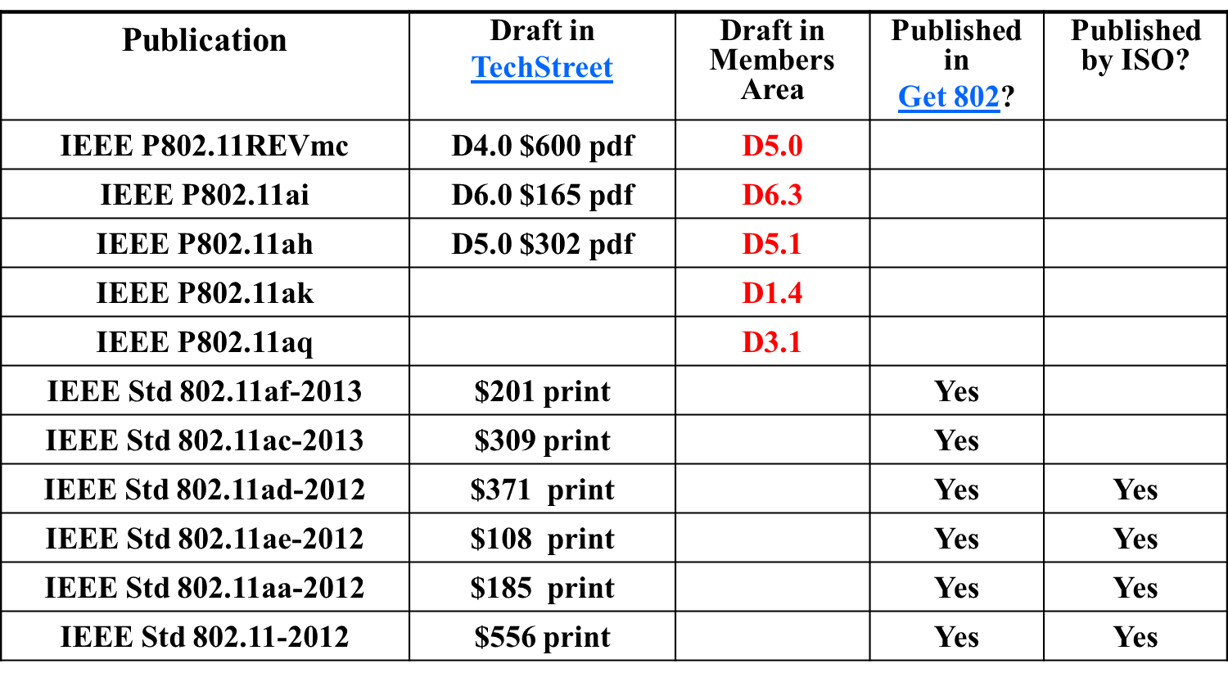
Available 802.11 - Drafts

Slide 10
Questions???

