Slide 1
Project: IEEE P802.15 Working Group for Wireless Personal Area Networks (WPANs)
Submission Title: [IG 6tisch Closing Report for Jan 2016 Session]
Date Submitted: [20 Jan 2016]
Source: [Patrick Kinney] Company [Kinney Consulting LLC]
Address [Chicago area, IL, USA]
Voice:[+1.847.960.3715], E-Mail:[pat.kinney@ieee.org]
Re: [IG 6tisch Opening& Closing Report for Jan 2016 Session.]
Abstract: [Closing Report for the Jan Session]
Purpose: []
Notice: This document has been prepared to assist the IEEE P802.15. It is offered as a basis for discussion and is not binding on the contributing individual(s) or organization(s). The material in this document is subject to change in form and content after further study. The contributor(s) reserve(s) the right to add, amend or withdraw material contained herein.
Release: The contributor acknowledges and accepts that this contribution becomes the property of IEEE and may be made publicly available by P802.15.

Slide 2
IG 6T Meeting Goals (Agenda 15-15-0980-00)
Tuesday 19 Jan, PM1:
  6tisch issues discussion
    6top correspondence (IEs and PAN ID compression)
    6Lo Routing Headers
    Minimal
Slide 2
Notes:
January 16
Page 2

Slide 3
Administrative Items
Required notices
  IEEE Code of Ethics
    http://www.ieee.org/about/corporate/governance/p7-8.html
  IEEE Standards Association (IEEE-SA) Affiliation FAQ
    http://standards.ieee.org/faqs/affiliation.html
  Antitrust and Competition Policy
    http://standards.ieee.org/resources/antitrust-guidelines.pdf
  IEEE-SA Patent Committee FAQ & Patent slides
    http://standards.ieee.org/board/pat/faq.pdf
    http://standards.ieee.org/board/pat/pat-slideset.ppt
  Letter of Assurance Form
    http://standards.ieee.org/board/pat/loa.pdf
Chair and Secretary request
  Chair is Pat Kinney (Kinney Consulting)

Slide 4
Other Guidelines for IEEE WG Meetings
All IEEE-SA standards meetings shall be conducted in compliance with all applicable laws, including antitrust and competition laws.
  Don’t discuss the interpretation, validity, or essentiality of patents/patent claims.
  Don’t discuss specific license rates, terms, or conditions.
    Relative costs, including licensing costs of essential patent claims, of different technical approaches may be discussed in standards development meetings.
      Technical considerations remain primary focus
  Don’t discuss or engage in the fixing of product prices, allocation of customers, or division of sales markets.
  Don’t discuss the status or substance of ongoing or threatened litigation.
  Don’t be silent if inappropriate topics are discussed … do formally object.
---------------------------------------------------------------
See IEEE-SA Standards Board Operations Manual, clause 5.3.10 and “Promoting Competition and Innovation: What You Need to Know about the IEEE Standards Association's Antitrust and Competition Policy” for more details.
Notes:
4

Slide 5
    6TISCH Issues Discussion
    6top IEs
    6LoRH
    Minimal draft revision
Slide 5
Notes:
January 16
Page 5

Slide 6
    6TISCH Issues Discussion - 6top IEs
The 6P messages are carried in a payload IE, i.e. IETF Information Element:
Group ID: IANA_IETF_IE_GROUP_ID -Length: variable
Content: defined as follows
IEEE Liaison Considerations
If the specification described in this document is supported by the 6TiSCH WG, the authors of this document ask the 6TiSCH WG chairs to liaise with the IEEE to request a Payload Information Element Group ID to be assigned to the IETF (Group ID IANA_IETF_IE_GROUP_ID described in Appendix A).
Members of 6tisch also asked if IG 6tisch could assist in the use of the requested ID by proposing a detailed format consisting of elements such as sub-ids and other fields
Current 6tisch proposal
draft-wang-6tisch-6top-coapie-01
Slide 6
Notes:
January 16
Page 6

Slide 7
    6TISCH Issues Discussion - 6top IEs
30 November 2015
This email is in response to Thomas Watteyne’s email dated 23 October requesting the IEEE 802.15 6T interest group to make a recommendation on IE format. It also addresses correct settings for the PAN ID compression bit in response to the 6tisch minimal document.
These documents ( 15-15-0939-02, and 15-15-0911-01 respectively) have been reviewed for accuracy and the IE format recommendation was approved by the 6T interest group.
Slide 7
Notes:
January 16
Page 7

Slide 8
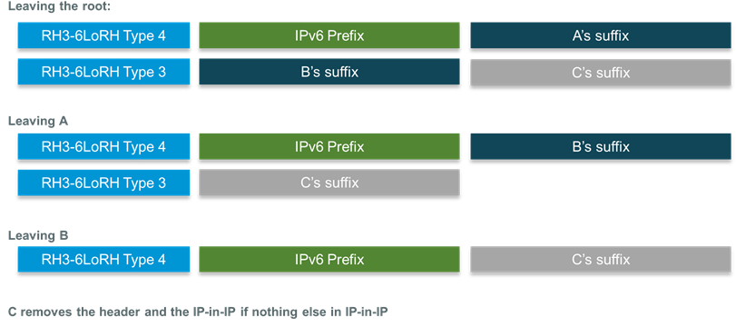
    6TISCH Issues Discussion – 6LoRH
The picture below illustrates how the RH3 6LoRH works with draft 03 in a case like Root -> A -> B -> C -> leaf
The first 6LoRH is expected to be a full address (128 bits) to set up a reference and the next 6LoRH are expected to be smaller and just override the rightmost bits which form the delta from the reference.
Proposal: we could consider that the 128bits source of the IP header before the RH3 is the reference to start with.
With that even the first hop could be compressed the same way as the other hops. With RPL, the root is the encapsulator if IP in IP in used. Good thing, in that case the root is totally elided with the IP-in-IP 6LoRH.
So this simple proposal saves up to 16 octets (that’s in the case with a single subnet and all addresses differ only by the last 2 bytes). I’m willing to add it in the next revision.
Slide 8
Notes:
January 16
Page 8

Slide 9
    6TISCH Issues Discussion - Minimal
draft-ietf-6tisch-minimal/
Current Revision is 14
Draft still needlessly contains significant portions of 802.15.4e and also has many errors
Slide 9
Notes:
January 16
Page 9

Slide 10
Meeting Accomplishments
  Reviewed documents sent to 6tisch
    15-15-0939-02-0000-IETF_6tisch_IE_Information
    15-15-0911-01-0mag-Proper_PAN_ID_Field_Settings_for_802.15.4-2015
  Reviewed Minimal draft
    Action Item: Chair to redline current draft eliminating copies of IEEE 802.15.4e and errors and send redline out to 6T reflector for review
Slide 10
Notes:
January 16
Page 10

Slide 11
IETF 6TISCH Mailing List Information
6tisch@ietf.org
https://www.ietf.org/mailman/listinfo/6tisch
Slide 11
Notes:
January 16
Page 11

Slide 12
IETF 6TISCH call information
Next 3 dates: 10-Oct 08:00 PDT, 24-Oct 08:00 PDT, 07-Nov 08:00 PDT
Meeting Number: 206 802 913
Meeting Password: sixtus
To start the online meeting:
1. Go to: https://ciscosales.webex.com/ciscosales/j.php?ED=219615007&UID=481905242&PW=NZTRkNDAwOTE1&RT=MiMyMw%3D%3D
2. Log in to your account.
3. Click "Start Now”
4. Follow the instructions that appear on your screen
5. Note: Local access numbers for the following areas are:
San Jose/Milpitas (408) area: 525-6800
RTP (919) area: 392-3330
Slide 12
Notes:
January 16
Page 12

Slide 13
IG 6TISCH reflector information
stds-802-15-ig6t@listserv.ieee.org
http://grouper.ieee.org/groups/802/15/pub/Subscribe.html
Slide 13
Notes:
January 16
Page 13

Slide 14
IETF 6tisch Working Group Scope
6tisch Goal: The 6tisch Working Group is focused upon enabling IPv6 over the TSCH mode of the IEEE802.15.4e standard. The extent of the problem space for the WG is one or more Low Power and Lossy Networks (LLNs), eventually federated through a common backbone link via one or more LLN Border Routers (LBRs).
Work Item 1: Produce "6TiSCH architecture" to describe the design of 6TiSCH networks. This document will highlight the different architectural blocks and signaling flows, including the operation of the network in the presence of multiple LBRs. Initially, the document will focus on distributed routing operation over a static TSCH schedule.
Work Item 2: Produce an Information Model containing the management requirements of a 6TiSCH node. This includes describing how an entity can manage the TSCH schedule on a 6TiSCH node, and query timeslot information from that node. A data model mapping for an existing protocol (such as Concise Binary Object Representation (CBOR) over the Constrained Application Protocol (CoAP)) will be provided.
Work Item 3: Produce "Minimal 6TiSCH Configuration" defining how to build a 6TiSCH network using the Routing Protocol for LLNs (RPL) and a static TSCH schedule. It is expected that RPL and the Objective Function 0 (OF0) will be reused as-is.
Slide 14
Notes:
January 16
Page 14

