Slide 1
Project: IEEE P802.15 Working Group for Wireless Personal Area Networks (WPANs)
Submission Title: [Modification of capability for notifying supported kinds* of SIFS]
Date Submitted: [18 January 2016]
Source: [Keitarou Kondou]
Company: [Sony Corporation]
Address¹: [1-7-1 Konan, Minato-ku, Tokyo 108-0075]
E-Mail¹: [keitarou.Kondou at jp.sony.com]
Abstract: This document presents the method for selecting SIFS duration.
Purpose: To modify the current TG3e draft document.
Notice: This document has been prepared to assist the IEEE P802.15. It is offered as a basis for discussion and is not binding on the contributing individual(s) or organization(s). The material in this document is subject to change in form and content after further study. The contributor(s) reserve(s) the right to add, amend or withdraw material contained herein.
Release: The contributors acknowledge and accept that this contribution becomes the property of IEEE and may be made publicly available by P802.15.

Slide 2
MAC CID #1055
CID | Submitter Name | Affiliation | Page | Sub-clause | Line # | Comment | Proposed Change | E/T | Must Be Satisfied? (Yes or No)
1055 | K.Kondou | Sony | 39 | 6.4.1.1 | 1 | Both SC and OOK PHY defines three kinds of duration for SIFS. But no procedure to choose duration among them is provided in MAC part. | Define shortest SIFS field in capablity IE and add a new SIFS IE, so that DEVs can exchange capabilities in the assosiation process and notify a determined duration in the Association Response with a SIFS IE. | T | Yes

Slide 3
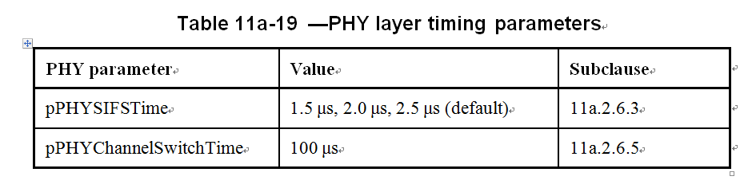
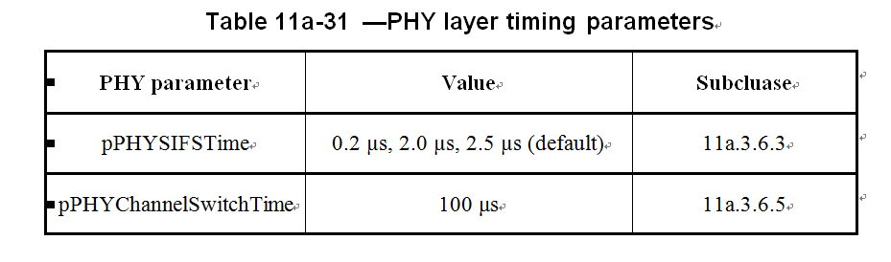
SIFS duration defined in current draft
Both HRCP-SC (Table 11a-19) and HRCP-OOK(11a-31) PHY define several kinds of duration for SIFS, but no selection method is provided.
Variety kinds of SIFS allows both cost effective or descent performance devices exist.

Slide 4
Suggested modification
Add supported SIFS encoding field to current capability field to indicate shortest SIFS duration supported at each device.
In case supported SIFS encoding field value is 10000, from 1.6 to 2.5 µs of SIFS duration is supported.
Table X-XX – Supported SIFS encoding
Field value | SIFS duration
00000 | 0.0 µs
00001 | 0.1 µs
00010 | 0.2 µs
11000 | 2.4 µs
11001 | 2.5 µs
11010-11111 | reserved

Slide 5
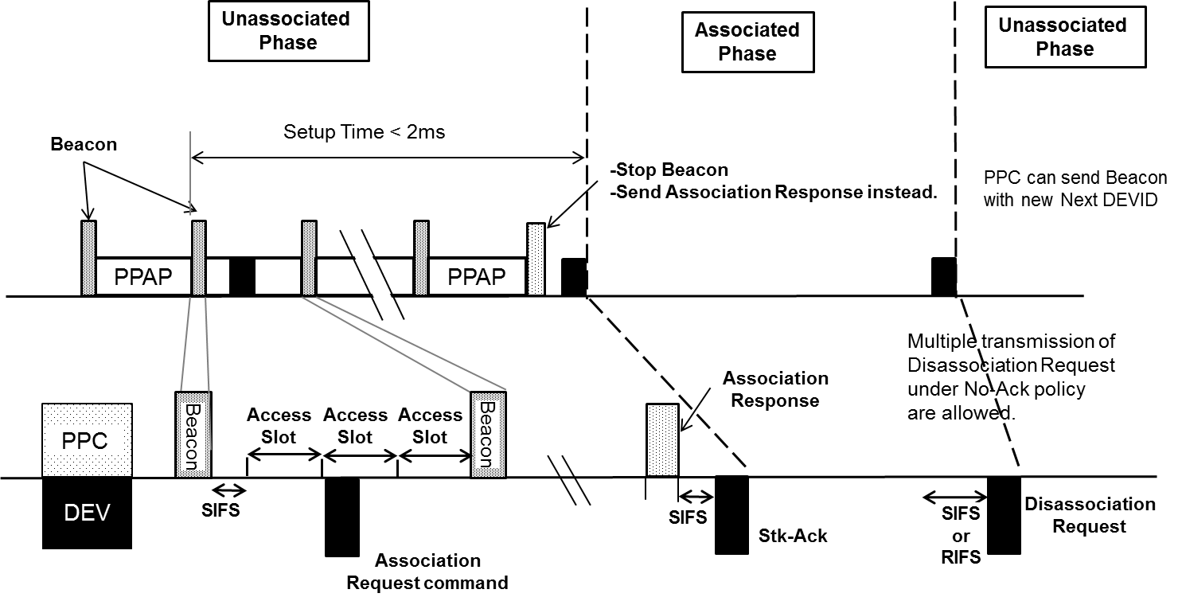
How it works
Exchange values of SIFS in Unassociated Phase and determined value shall be used in Associated Phase.
SIFS duration of 2.5 µs (default)
Use SIFS duration of SIFS_ASSOC
includes SIFS_PPC
SIFS_PPC: shortest SIFS supported in the PPC
SIFS_DEV: shortest SIFS supported in the DEV
SIFS_ASSOC: shortest SIFS supported in both DEVs
includes SIFS_DEV
Figure 4-2a – One cycle of PPAP

Slide 6
Further discussions
Is one SIFS duration is enough for a session?
  Need to provide the mechanism to change the SIFS duration within Associated Phase?
No objection for using fixed SIFS duration for an Associated Phase at the meeting

