Slide 1
Project: IEEE P802.15 Working Group for Wireless Personal Area Networks (WPANs)
Submission Title: A proposal for 802.15.4u (India band)
Date Submitted: 11 January 2016
Source: Benjamin A. Rolfe
Company: Blind Creek Associates
Address: PO Box 798 Los Gatos CA 95031
Voice: +1 408 332 0725, E-Mail: ben @ blindcreek.com
Re: A proposal to meet the project scope and criteria stated in the Call for Proposals
Abstract: Presentation summarizing the technical requirements and proposed amendment to meet those requirements with minimal risk and complexity.
Purpose: Satisfy the need for a standard PHY that can operate in the 865-867 MHz band.
Notice: This document has been prepared to assist the IEEE P802.15. It is offered as a basis for discussion and is not binding on the contributing individual(s) or organization(s). The material in this document is subject to change in form and content after further study. The contributor(s) reserve(s) the right to add, amend or withdraw material contained herein.
Release: The contributor acknowledges and accepts that this contribution becomes the property of IEEE and may be made publicly available by P802.15.

Slide 2
Purpose and objective
Meet the requirements of the approved project by adding the channel plan to support operation of the currently defined SUN FSK PHY in the band indicated below using all other PHY characteristics (e.g. modulation parameters, PPDU format) that are identical to the SUN FSK PHY modes already defined.
India | 865-867 | Data Rate (kb/s) | 50 | 100 | 150*
 |  | Modulation Index | 1.0 | 0.5 | 0.5
 |  | Channel Spacing (MHz) | 200 | 200 | 200
* See Discussion slides

Slide 3
Summary of Project Scope
PAR scope:
This amendment defines a PHY layer enabling the use of the 865-867 MHz band in India. The supported data rate should be at least 40 kb/s per second and the typical Line of Sight (LOS) range should be on the order of 5 km using omni directional antenna. Included are any channel access and/or timing changes in the MAC necessary to support this PHY layer.

Slide 4
Proposal Conforms to Project Scope
Objective from PAR scope | Met by this proposal | Notes
Define a PHY Layer enabling the use of the 865-867 MHz band in India | YES
Data Rate at least 40kb/s | YES | Minimum proposed rate is 50 kb/s
Typical LOS range on the order of 5km | YES | Based on field performance of 802.15.4g deployments in other sub-GHz bands
Channel access and/or timing changes in the MAC necessary to support this PHY layer | YES | No channel access or timing changes are required to support the PHY in this proposal, as all PHY characteristics are identical to existing PHY defined in the standard.

Slide 5
Technical Details
Based on P802.15.4REVc-D02:
Add row to table 10-170 defining band
Add row to table 10-179 defining channel numbering
Add row to table 20-245 specifying base symbol timing
Add row to table 20-250 to define modulation and coding
See document 15-16-0032 for proposed amendment text.

Slide 6
Technical Details
Table 10-170:
Table 20-245:
Table 20-250:
Band designation | Frequency band (MHz)
866 MHz | 865-867
Frequency band (MHz) | Symbol duration used for MAC and PHY timing parameters (μs)
902–928 | 20
Frequency band (MHz) | Parameter | Operating mode #1 | Operating mode #2 | Operating mode #3
865-867 | Data rate (kb/s) | 50 | 100 | 150
 | Modulation | 2-FSK | 2-FSK | 2-FSK
 | Modulation index | 1.0 | 0.5 | 0.5
 | Channel spacing (kHz) | 200 | 200 | 200

Slide 7
Advantages of this Proposal
Satisfies all the requirements stated in the project authorization
Satisfies the needs identified in the CFP
Does not change anything that does need to be changed
Can be implemented by existing equipment
Millions of 802.15.4 SUN FSK devices already deployed
Many can add channel plan with firmware update in the field
Uses the stuff that’s widely used, proven to work
Entire amendment will be 1 page of normative content
Low risk of introducing technical errors
Low risk of messing up stuff already in the standard
Minimizes distractions
High probability of getting the project finished on schedule

Slide 8
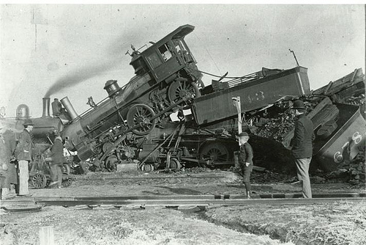
Why?
Because we want this:
Not this:

Slide 9
Discussion Topics
150 kb/s 2-FSK in 200 kHz channel spacing
Channelization- 9 channel vs 10 channel plans

Slide 10
Discussion on Op Mode #3
Concern:
Operating at 150ksps in a 200kHz channel with 802.15.4 SUN FSK transmit tolerances results in overlapping channels

Slide 11
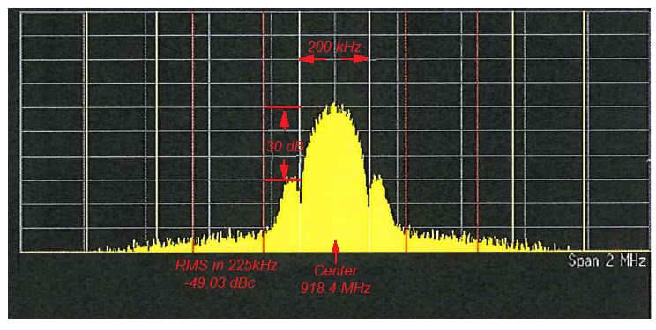
Discussion on Op Mode #3: Is it possible?
This shows a typical implementation that meets the output spectral mask defined in the standard by large margins.
Simultaneous use of 200kHz channels looks possible, with some impact on the adjoining channels…when the signal is clean and frequency stability tight.
-25dB
-30dB

Slide 12
Discussion on Op Mode #3: 802.15.4 SUN FSK Transmit Spectral Mask
Transmit spectral mask: .
M1 = 1.5 × R × (1 + h)
M2 = 3 × R × (1 + h)
h = 0.5 R = 150 kHz
M1 = 337.5 kHz
With 200 kHz channel spacing this means the -25dB step down is past the middle of the adjacent channels!

Slide 13
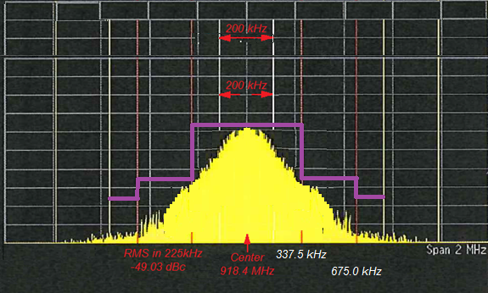
Discussion on Op Mode #3
With the transmit mask specified in the standard:
M1 = 1.5 × R × (1 + h)
M2 = 3 × R × (1 + h)
h = 0.5 R = 150 kHz
A conforming transmitted signal could look like this…full power at the channel boundary!
Channel

Slide 14
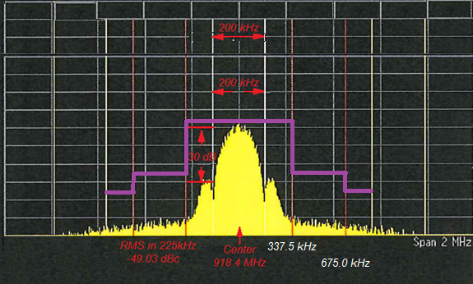
Discussion on Op Mode #3: Mask compared to real-world example.

Slide 15
Discussion on Op Mode #3: Frequency Offset
The frequency 41.175 kHz¹.
If we assume the worst case frequency offset we could have one device transmitting at 918.4412 MHz or 918.3588 MHz.
This would move the 10dB point in the “tight” signal example into the adjacent channel, which is significant. This would most certainly cause interference, cause CCA to report “busy”, etc. .
Now consider devices occupying adjoining channels each with the worst cast offset in opposite directions: The separation of center frequencies is 117.65 kHz
1. [802.15.4-2015 RevC Draft 02 20.5.3]

Slide 16
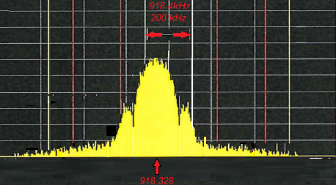
Discussion on Op Mode #3: Frequency Offset

Slide 17
Discussion on Op Mode #3: Possible on Paper, Practical in air?
Options:
Drop mode
Simple and effective
Use wider channel spacing
Allowed by regulations?
Specify tighter tolerances when using the band
Requires further analysis to map “possible” to “practical”
Define it and expect implementers will figure it out in order to meet regulatory requirements and/or make useful stuff.
Potential for a ‘compliant’ device to take out 3 channels
Regulations may be enough to force reasonable solution – but then why specify something we know isn’t allowed?

Slide 18
Alternate Channel Plans
To guard or not to guard?

Slide 19
Discussion on Op Mode #3: Channel Centers
Frequency band (MHz) | Modulation | ChanSpacing (MHz) | TotalNumChan | ChanCenterFreq0 (MHz)
865-867 | SUN FSK operating mode #1, #2 | 0.2 | 10 | 865.1
Chan# | 0 | 1 | 2 | 3 | 4 | 5 | 6 | 7 | 8 | 9
MHz | 865.1 | 865.3 | 865.5 | 865.7 | 865.9 | 866.1 | 866.3 | 866.5 | 866.7 | 866.9
Pro: 10 is more than 9
Con: Channels 0 and 9 may not be usable
Frequency band (MHz) | Modulation | ChanSpacing (MHz) | TotalNumChan | ChanCenterFreq0 (MHz)
865-867 | SUN FSK operating mode #1, #2 | 0.2 | 9 | 865.125
Chan# | 0 | 1 | 2 | 3 | 4 | 5 | 6 | 7 | 8
MHz | 865.125 | 865.325 | 865.525 | 865.725 | 865.925 | 866.125 | 866.325 | 866.525 | 866.725
Pro: Protection at the band edges
Con: 9 is less than 10

Slide 20
Thanks for your time

