Slide 1
Project: IEEE P802.15 Working Group for Wireless Personal Area Networks (WPANs)
Submission Title: A proposal for 802.15.4u (India band)
Date Submitted: 11 January 2016
Source: Benjamin A. Rolfe
Company: Blind Creek Associates
Address: PO Box 798 Los Gatos CA 95031
Voice: +1 408 332 0725, E-Mail: ben @ blindcreek.com
Re: A proposal to meet the project scope and criteria stated in the Call for Proposals
Abstract: Presentation summarizing the technical requirements and proposed amendment to meet those requirements with minimal risk and complexity.
Purpose: Satisfy the need for a standard PHY that can operate in the 865-867 MHz band.
Notice: This document has been prepared to assist the IEEE P802.15. It is offered as a basis for discussion and is not binding on the contributing individual(s) or organization(s). The material in this document is subject to change in form and content after further study. The contributor(s) reserve(s) the right to add, amend or withdraw material contained herein.
Release: The contributor acknowledges and accepts that this contribution becomes the property of IEEE and may be made publicly available by P802.15.

Slide 2
Purpose and objective
  Meet the requirements of the approved project by adding the channel plan to support operation of the SUN FSK PHY in the band indicated below using all other PHY characteristics (e.g. modulation parameters, PPDU format) that are identical to the SUN FSK PHY modes already defined.
India | 865-867 | Data Rate (kb/s) | 50 | 100 | 150
 |  | Modulation Index | 1.0 | 0.5 | 0.5
 |  | Channel Spacing (MHz) | 200 | 200 | 200

Slide 3
Summary of Project Scope
PAR scope:
This amendment defines a PHY layer enabling the use of the 865-867 MHz band in India. The supported data rate should be at least 40 kb/s per second and the typical Line of Sight (LOS) range should be on the order of 5 km using omni directional antenna. Included are any channel access and/or timing changes in the MAC necessary to support this PHY layer.

Slide 4
Summary of Project Scope
Objective from PAR scope | Met by this proposal | Notes
Define a PHY Layer enabling the use of the 865-867 MHz band in India | YES
Data Rate at least 40kb/s | YES | Supported 50, 100 and 150 kb/s
Typical LOS range on the order of 5km | YES | Based on field performance of 802.15.4g deployments in other sub-GHz bands
Channel access and/or timing changes in the MAC necessary to support this PHY layer | YES | No channel access or timing changes are required to support the PHY in this proposal, as all PHY characteristics are identical to existing PHY defined in the standard.

Slide 5
Technical Details
Based on P802.15.4REVc-D02:
Add row to table 10-170 defining band
Add row to table 10-179 defining channel numbering
Add row to table 20-245 specifying base symbol timing
Add row to table 20-250 to define modulation and coding
See document 15-16-0032 for proposed amendment text.

Slide 6
Technical Details
Insert in order into Table 10-170:
Table 10-170:
Table 20-245:
Table 20-250:
Band designation | Frequency band (MHz)
866 MHz | 865-867
Frequency band (MHz) | Symbol duration used for MAC and PHY timing parameters (μs)
902–928 | 20
Frequency band (MHz) | Parameter | Operating mode #1 | Operating mode #2 | Operating mode #3
865-867 | Data rate (kb/s) | 50 | 100 | 150
 | Modulation | 2-FSK | 2-FSK | 2-FSK
 | Modulation index | 1.0 | 0.5 | 0.5
 | Channel spacing (kHz) | 200 | 200 | 200

Slide 7

Advantages of this Proposal
Satisfies all the requirements stated in the project authorization
Satisfies the needs identified in the CFP
Does not change anything that does need to be changed
Can be implemented by existing equipment
  Millions of 802.15.4 SUN FSK devices already deployed
  Many can add channel plan with firmware update in the field
  Uses the stuff that’s widely used, proven to work
Entire amendment will be 1 page of normative content
  Low risk of introducing technical errors
  Low risk of messing up stuff already in the standard
  Minimizes distractions
  High probability of getting the project finished on schedule

Slide 8

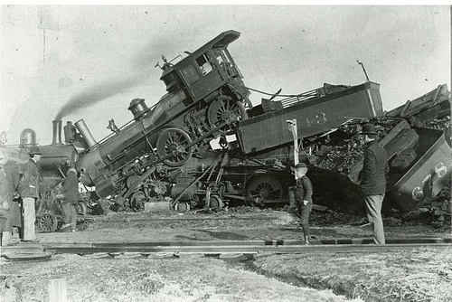
Why?
Cause we want this:
Not this:

Slide 9
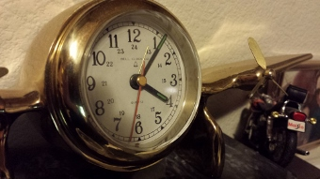
Thanks for your time

