Slide 1
Project: IEEE P802.15 Working Group for Wireless Personal Area Networks (WPANs)
Submission Title: [General considerations and proposals for low rate PD communications]
Date Submitted: [10 January, 2016]
Source: [Li Qiang, Jiang Tong, Dong Chen] Company [Huawei]
Address [Huawei Building, No.3 Xinxi Road, Haidian, Beijing, China]
Voice:[86-15801539749], FAX: [+86-10-82882144], E-Mail:[john.liqiang@huawei.com]
Re: []
Abstract: [In this contribution we provides general considerations and analysis for low rate PD communications]
Purpose: [Contribution to IEEE 802.15.7r1 Optical Wireless Communication]
Notice: This document has been prepared to assist the IEEE P802.15. It is offered as a basis for discussion and is not binding on the contributing individual(s) or organization(s). The material in this document is subject to change in form and content after further study. The contributor(s) reserve(s) the right to add, amend or withdraw material contained herein.
Release: The contributor acknowledges and accepts that this contribution becomes the property of IEEE and may be made publicly available by P802.15.

Slide 2
General considerations and proposals for low rate PD communications
Li Qiang, Jiang Tong, Dong Chen
Huawei

Slide 3
System architecture
The following transfer modes are defined for low rate PD communications
  D2D/IoT data transmission and Relay mode with ID information with PHY/ MAC frame for applications C2, C3, C4, C5 and C6.
  Uni-directional data transfer mode for applications C1 – C6.
  Bi-directional data transfer mode for applications C1-C6
D2D architecture
Star architecture
Star, Bi-directional
Star, Uni-directional

Slide 4
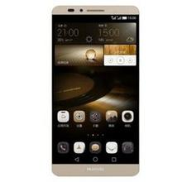







Low rate PD applications
D2D/IoT data transmission mode
File sharing
Vehicle to vehicle
Uni-directional transmission mode
Information forwarding
Indoor navigation
Tell me about all the restaurants in this mall
Bi-directional transmission mode
Interactive navigation
Smart home

Slide 5
D2D data transmission mode
Functions | Considerations
Beacon or Non-beacon | Non-beacon enabled is preferred.
Association | Needed
Data transfer | Contention based
VPAN maintenance | Link status monitoring Fast link recovery
Interference management | Supported
Mobility management | Handover is not supported
Dimming and flickering control | Needed. Specific scheme is dependent on the modulation scheme.

Slide 6
Unidirectional data transmission mode
Functions | Considerations
Beacon or Non-beacon | It is preferred beacon is used for the instructions of broadcasted data streams
Association | No association
Data transfer | TDM of different data streams is preferred
VPAN maintenance | Link status monitoring: no need Fast link recovery: no need
Interference management | Supported
Mobility management | Handover is not supported
Dimming and flickering control | Needed. Specific scheme is dependent on the modulation scheme.

Slide 7
Bidirectional data transmission mode
Functions | Considerations
Beacon or Non-beacon | Beacon enabled is preferred.
Association | Needed
Data transfer | Contention based / Contention free
VPAN maintenance | Link status monitoring Fast link recovery
Interference management | Supported
Mobility management | Handover is supported
Dimming and flickering control | Needed. Specific scheme is dependent on the modulation scheme.

Slide 8
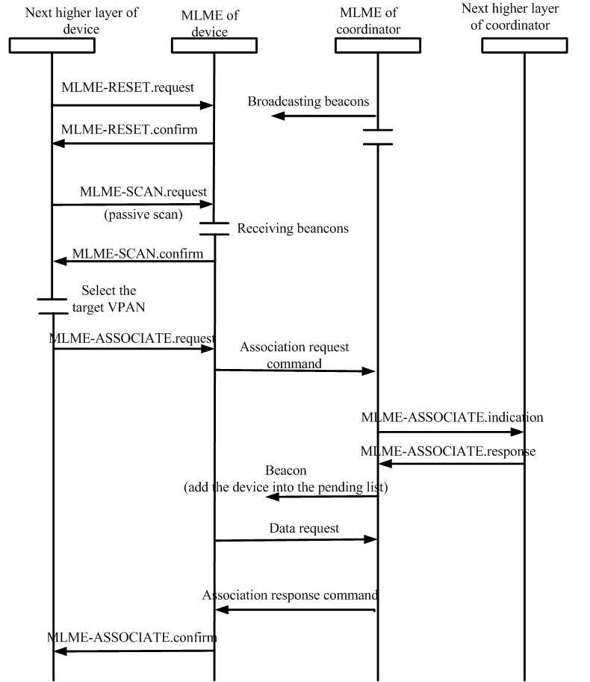
Joining a VPAN
Current 15.7 association procedures may be reused with potential optimizations
Current 15.7 association procedures
The association response command is send to the device using indirect transmission in 15.7 (2011). To reduce the latency, direct transmission may be used.

Slide 9
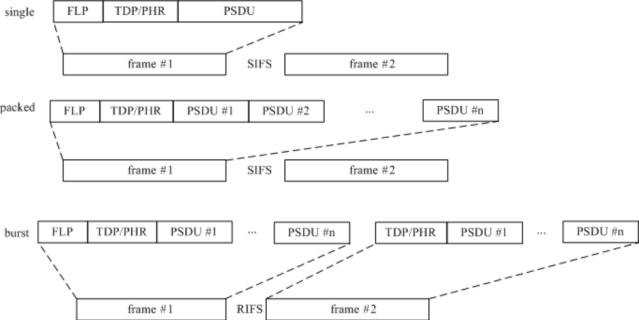
Data transfer in beacon enabled VPANs
Command frames (association request command, GTS request command, etc)
  It is preferred that command frames are sent via contention based channel access
Data frame
  Burst mode / Packed mode /Single mode transmissions are adopted in 15.7
  It is preferred that Burst mode / Packed mode /Single mode are adopted for data transfer in 15.7r1

Slide 10
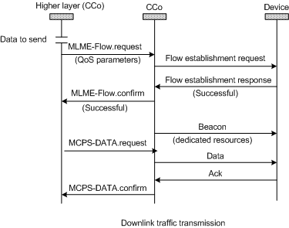
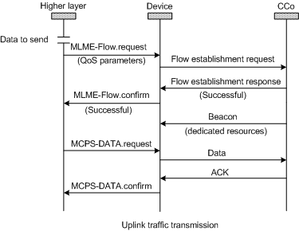
Data transfer in beacon enabled VPANs
Unicast (e.g. Video/audio service with QoS support )
  Flow establishment before data transmission is preferred
  Link adaptation: modulation and coding scheme (MCS) is selected based on metric reports for each transmission
Flow establishment: originator provide traffic specification parameters(for example, traffic priority, maximum latency, etc.) to the recipient. Recipient can assess whether to accept the request or not.

Slide 11
Data transfer in beacon enabled VPANs
Broadcast
  Link adaptation: MCS selection is up to the CCo. It should be able to serve most devices in the VPAN with high reliability

Slide 12
Data transfer in beacon enabled VPANs
Acknowledgement and retransmission
  Stop-and-Wait ARQ
  Selective Repeat ARQ
  Selective repeat ARQ is preferred for 15.7r1 due to higher efficiency

Slide 13
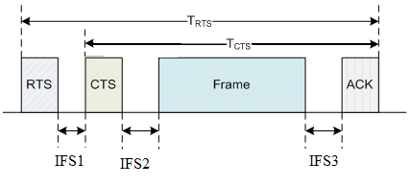
Contention based channel access
Hidden node problem on uplink
Potential solution: RTS/CTS mechanism
    RTS/CTS mechanism
    Each device shall send a RTS frame before it communicate to the CCo.
    The device cannot try to contend the channel unless it receives the CTS frame from the CCo.
    In the RTS frame, the device shall indicate the total duration of its transmission, i.e., T_{RTS}.
    In the CTS frame, the CCo shall also indicate T_{CTS}, and the information of the device that is allowed to transmit in this contention period.
Hidden node problem
Because of the limitation of FOV, Device 1 cannot hear the signal from Device2. Therefore Device1 may not be able to sense the signal transmitted by Device2 when Device2 is making a random access. It results in collision. Current CSMA/CA procedure in 802.15.7 does not provide any hidden node avoidance mechanisms.

Slide 14
Contention free channel access
In 802.15.7, CFP is used for contention free channel access. CFP is divided into several GTS and each GTS is assigned to one device.
As specified by 802.15.7,
  the coordinator shall be able to store all the information necessary to manage seven GTSs.
  A single GTS may extend over one or more superframe slots.
For 15.7r1, it is preferred that dedicated resource allocation can be more flexible. So that users with different QoS requirements can be simultaneously served.
GTS allocations in 802.15.7

Slide 15
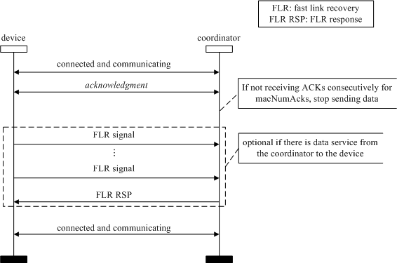
VPAN maintenance
Link status monitoring
  The device send metric reports to the associated CCo periodically.
  Event-triggered metric reports is also supported.
Fast link recovery
  The fast link recovery procedure defined by 15.7 can be reused with potential optimizations
Link failure
  If can not be recovered by fast link recovery, the device may assume link failure and may disassociate.
Fast link recovery specified by 802.15.7

Slide 16
Mobility management
Horizontal handover between neighbor VPANs is crucial to ensure continuous user experience.
Possible handover schemes
  Device initiated handover
  CCo assisted handover
    Device initiated handover: the device may associate with a neighbouring VPAN before it leaves its VPAN and request for the time/frequency/time-frequency resources for its data transmission.
    CCo assisted handover: associated CCo predicts the potential handover of a device. Associated CCo may send HO related information to the target CCo. The target CCo may reserve resources for the device in advance.

Slide 17
Interference management
Type of interference
  Ambient light and artificial lighting
  Inter-VPAN interference
Interference avoidance approaches for inter-VPAN interference
  WDM (neighboring VPANs use different wave length bands)
  FDM (neighboring VPANs use different modulation frequencies)
  CDM (neighboring VPANs use different cover codes, needs tight time sync)
  CDM (neighboring VPANs use different time slots, needs tight time sync)
Interference detection and report
  A CCo can detect the interference by itself.
  A device may measure the interference experienced and report to associated CCo

Slide 18
Interference management
Interference coordination
  Centralized interference coordination
  Distributed interference coordination
Centralized interference mitigation
A global controller is needed. It shall be able to collect the interference information from different CCos which it manages. The global controller is responsible for the coordination among different VPANs.
Distributed interference mitigation
This approach applies to the case that the device can detect the interference from other CCos. The CCos of the two interfering VPANs shall negotiate with each other for interference avoidance. The interfered device may be able to communicate with the two CCos and act as a relay device for the negotiation between the two CCos.

Slide 19
Conclusions
In this contribution, we provide general considerations for low rate PD communications. We provide analysis and our preferences on the following aspects
System architecture
Association
Data transfer
Channel access
VPAN maintenance
Mobility management
Interference management

