Slide 1
Project: IEEE P802.15 Working Group for Wireless Personal Area Networks (WPANs)
Submission Title: High-speed VLC for out-door free-space communication
Date Submitted: January 2016
Source: Prof. Nan Chi, Dr. Junwen Zhang Company: Fudan Univerisity
Address: Fu Dan University, 220 Handan Rd., Yangpu District, Shanghai
Voice: Tel: 0086-21-65642983, E-Mail: nanchi@fudan.edu.cn hustzjw@gmail.com
Abstract: In response to «Call for Proposals for OWC Channel Models» issued by 802.15.7r1, this contribution presents the PHY technologies proposal of outdoor free space VLC long distance transmission for high rate PD communication in wireless backhaul (mobile back haul).
Purpose: Call for Proposal Response
Notice: This document has been prepared to assist the IEEE P802.15. It is offered as a basis for discussion and is not binding on the contributing individual(s) or organization(s). The material in this document is subject to change in form and content after further study. The contributor(s) reserve(s) the right to add, amend or withdraw material contained herein.
Release: The contributor acknowledges and accepts that this contribution becomes the property of IEEE and may be made publicly available by P802.15.

Slide 2
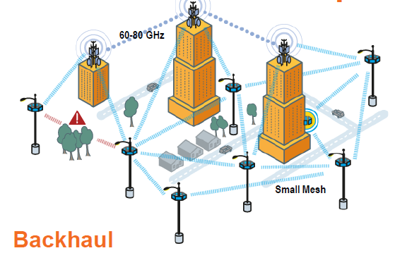
Application Scenarios: Mobile backhauling
VLC outdoor free-space high speed PD communication for mobile backhaul
It shares the same CAPEX/OPEX advantages with mmW
More competitive with lower device cost
Characters:
Large indoor/outdoor public spaces
Distance: ~50 m~1 km
Speed: ~Gbps
Link: mainly Point-to-point
*A typical mmW backhaul link
Backhaul is a top priority for small cell deployments
•80% of small cells will have wireless backhaul
•Cost of fiber is ~4x greater than wireless (cumulative CAPEX/OPEX)
•Small Cell mesh inter-connectivity over ~250m
•Large indoor and outdoor public spaces
* According to InterDigital Whitepaper 2013

Slide 3
Targets
High-speed VLC Out-door long-distance communication for mobile backhaul
Data Rates Speed: ~Gbps
Distance: 50m~1km, typical ~250-500 m
Environment: Large outdoor public spaces
Link: mainly Point-to-point
To provide a Out-door VLC free-space link for high-speed user applications.

Slide 4
Proposal Research Route
VLC Free Space Transmission Channel Model
LED/PD Modulation Property
Optics System design
Free-space channel
Key Technique for High Speed Outdoor VLC Transmission System
Modulation formats
Multiplexing Technology
Pre Equalization and post-equalization
Diversity reception technology
Simulation for Outdoor Long Distance VLC Transmission System
System Structure and Simulation Parameters
Simulation Results and Analysis
Outdoor Transmission Experiments
System Structure
Results and Analysis

Slide 5
High-speed VLC our-door modeling
High-speed VLC Out-door long-distance communication for mobile backhaul:Theoretical study of system Model
Tx/Rx LED and PD modulation model
LED Tx model:
modulation bandwidth (linear); Nonlinearity
PD/APD receiver sensitivity, noise
Link analysis
SISO
MIMO
Point-to-Point
Point-to-multi-Point
Optical System Model
LED beam, LED power, active area, beam width, multi-LED
Tx Focal length and diameter of lens, Tx/Rx Angle of Half
Received power, PD area, Rx Focal length/diameter of lens
Free-space channel model
Path loss, Distance
Air Turbulence
Background Noise, optical filter
Fog/Rain, impact of visibility

Slide 6
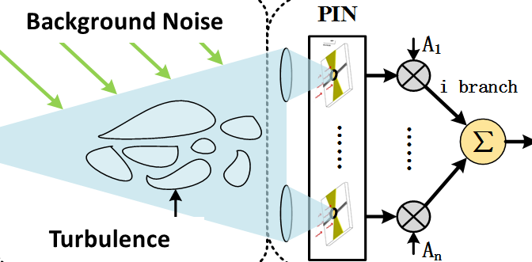
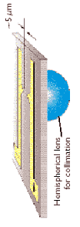
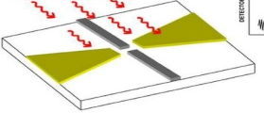
Physical Layer of VLC system
Visible light transmission
LED Modulation
Rx Module
Demodulator
Tx Module
I
Decoder
AD
Phase
coding
modulation
Pre-equalization
AD
Q
Baseband
LED
O to E
Signal processing
Data
TX：
  electronics：LED driving circuit，signal processing (coding,modulation, equalization)
  optics：transmitter antenna
RX：
  optics：receiver antenna，PD
  electronics： signal processing (decoding,demodulation, equalization),

Slide 7
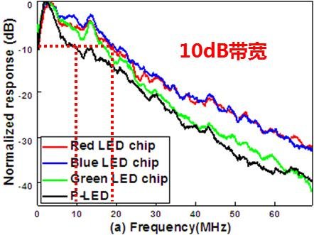
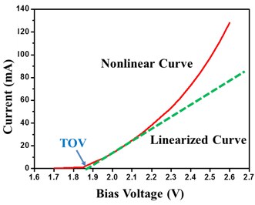
1. LED bandwidth limitations
2. VLC system Nonlinear
10dB Bandwidth
LED Nonlinearity
Phosphor LED 10dB bandwidth<15MHz
RGB LED 10dB bandwidth<25MHz
Inter-symbol interference
LED nonlinearity
Solutions
Higher order modulation and pre-equaliztion
PAM、OFDM
Advanced post-equalization techniques
ZF、DFE、RLS、DD-LMS
Single Carrier、CAP and so on
CMMA、M-CMMA
Volterra
Software/ hardware pre-equalization

Slide 8
VLC Channel Pre-equalization
Visible light transmission
LED Modulation
Rx Module
Tx Module
I
Demodulator
AD
Decoder
Phase
coding
modulation
AD
Q
Baseband
LED
O to E
Signal processing
Data
Pre-equalization
Pre-equalization schemes:
  Hardware Equalization：hardware circuit design
  Software Equalization：digital signal processing

Slide 9
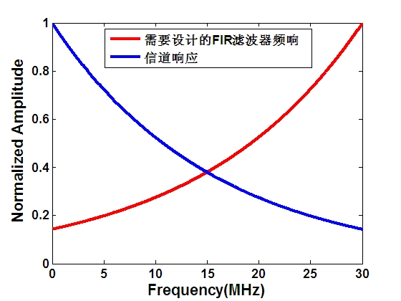
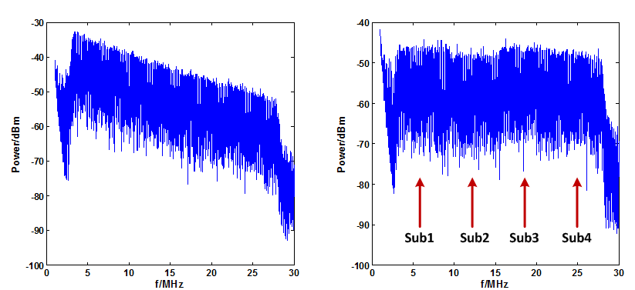
Software Pre-equalization
Pre-equalization
  Obtain the channel knowledge(H) at the RF domain
  Make pre-equalization Tx*1/H at the baseband
—FIR response
—Channel response
w/o pre-equlization
with pre-equlization
Y. Wang, et al, IEEE Communication Letters, Vol. 18, No. 10

Slide 10
Hardware bridged-T amplitude equalizer
  Z₁₁ : RLC network1 (R₁, C₁ and L₁)
  Z₂₂ : RLC network2 (R₄, C₂ and L₂)
  R₂ =R₃ =R₀
X. Huang, et al, OFC 2015, Tu2G.1
Notes:
Resistor, Inductor and capacitor

Slide 11
Hardware Pre-EQ for Gbps VLC system
X. Huang, et al, Optics express, 2015

Slide 12
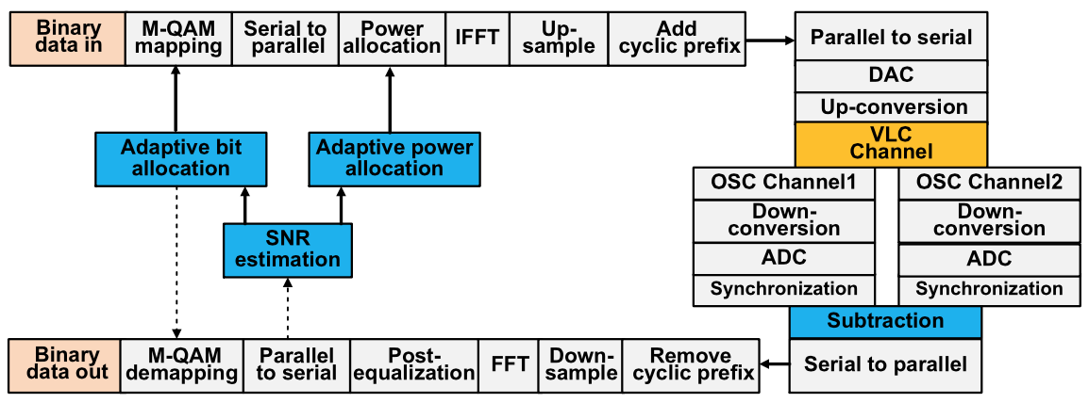
Bit-loading based OFDM-DMT modulation for Gbps VLC
X. Huang, et al, IEEE Photonics Journal, 2015

Slide 13
Bit-loading based OFDM-DMT modulation for Gbps VLC
X. Huang, et al, IEEE Photonics Journal, 2015

Slide 14
VLC Channel Post-equalization
Visible light transmission
LED Modulation
Rx Module
Tx Module
I
Demodulator
AD
Decoder
Phase
coding
modulation
AD
Q
Baseband
LED
O to E
Signal processing
Data
Post-equalization
Post-equalization solutions:
  ISI Equalization：Classical DFE→ Modified Eqs
  Nonlinear Compensations：Volterra series

Slide 15
Volterra nonlinear equalizer
LED nonlinearity
LED nonlinearity seriously degrades the system performance;
The LED forward current exhibits strong nonlinearity with the bias voltage;
Two factors dominate the nonlinear effects: DC bias voltage and the input signal peak-to-peak value (Vpp);

Slide 16
Volterra nonlinear equalizer
Principle
The Volterra series based equalizer is considered as a promising solution to mitigate the LED nonlinearity;
The Volterra series expansion contains a linear term and nonlinear series.
M-CMMA is utilized to update the weights of the nonlinear equalizer without using training symbols

Slide 17
RGB LED (LED Engine) Multiplexing for high-speed VLC (WDM

Slide 18
Receiver diversity technology
January, 2015
In receiver diversity, the outputs of multiple receivers are combined which is a weighted sum of the different branches
the output SNR:
The goal of MRC is to find the weight to maximize the output SNR
According to the Schwarz inequality, it is found that:
the maximum SNR of the combiner output is the sum of SNRs in each branch:

Slide 19
Out-door Long distance testing results
At the distance of 50m, the total data rate of 1.8Gb/s can be achieved with the BER less than the 7 % FEC limit of 3.8x10-3.

Slide 20
Conclusion
In this contribution, we propose several general technique considerations for high rate PD VLC out-door communications.
The out-door high-speed VLC modeling including three parts
LED/PD Modulation Property
Optical system design
Free-space channel
The results show the benefit and feasibility of the advanced pre-equalization and post-equalization technology for the high-speed VLC systems.
To achieve high speed VLC out-door communication, we provide analysis and our proposals on the following aspects
Adaptive Modulation formats: DMT with bit loading
Multiplexing Technology using different color LED and MIMO setup
Advanced Pre-/post- equalization methods
Receiver-diversity reception technology

