Slide 1
doc.: IEEE 802.15-16- 0015 -02-007a
Project: IEEE P802.15 Working Group for Wireless Personal Area Networks (WPANs)
Submission Title: Kookmin University PHY sub-proposal for ISC using Dimmable Spatial M-PSK (DSM-PSK)
Date Submitted: January 2016
Source: Yeong Min Jang, Trang Nguyen [Kookmin University]
Contact: +82-2-910-5068 E-Mail: yjang@kookmin.ac.kr
Re:
Abstract: This is a PHY sub-proposal for ISC using Spatial M-PSK. The dimming and compatibility are supported in the scheme.
Purpose: Call for Proposal Response
Notice: This document has been prepared to assist the IEEE P802.15. It is offered as a basis for discussion and is not binding on the contributing individual(s) or organization(s). The material in this document is subject to change in form and content after further study. The contributor(s) reserve(s) the right to add, amend or withdraw material contained herein.
Release: The contributor acknowledges and accepts that this contribution becomes the property of IEEE and may be made publicly available by P802.15.
Submission

Slide 2
doc.: IEEE 802.15-16- 0015 -02-007a
Content
PHY design considerations
Technologies Detail
  Spatial 2-PSK (S2-PSK)
  Spatial M-PSK (S8-PSK)
  Dimmable Spatial M-PSK (DS8-PSK)
PHY modes and PHY frame format
Appendix: System designs
Submission

Slide 3
doc.: IEEE 802.15-16- 0015 -02-007a
Definitions
spatial phase (denoted by S_Phase): the phase of a discrete waveform which is built from the states of LEDs on a group those captured and decoded from a global shutter image.
global phase shift: the phase value that all LEDs in a data group together are shifted to transmit data.
data group: A group of data LEDs those operate together to transmit a data symbol
reference group: A group of reference LEDs those operate together to transmit a reference signal
S_Phase shift: the abstraction value between the spatial phase values of data group and of the reference group.
long exposure bad-sampling: an image sampling that captures an unclear sate of LED (neither ON nor OFF) due to long exposure time.
SM-PSK (e.g. S2-PSK; S8-PSK; etc.): Spatial Multiple-Phase Shift Keying
DSM-PSK (e.g. DS8-PSK): Dimmable SM-PSK
Submission

Slide 4
doc.: IEEE 802.15-16- 0015 -02-007a
PHY design considerations
Submission

Slide 5
doc.: IEEE 802.15-16- 0015 -02-007a
Considerations for PHY design
Flicker mitigation
  The flicker-free band is used.
Frame rate variation Mitigation
  The variation is irregular, but the range > 20 fps
Spatial MIMO to target high link rate for a global shutter receiver
  Link rate goal is kbps - Mbps
Dimming support
  Dimming is supported in steps of <20%
Error correction
  Cancel error due to long exposure time
Submission

Slide 6
doc.: IEEE 802.15-16- 0015 -02-007a
Detail of technologies
Submission

Slide 7
doc.: IEEE 802.15-16- 0015 -02-007a
Spatial 2-PSK
Submission

Slide 8
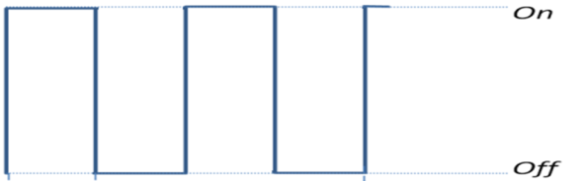
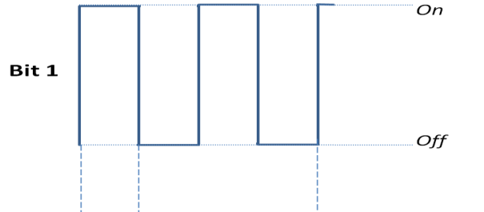
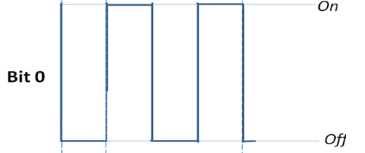

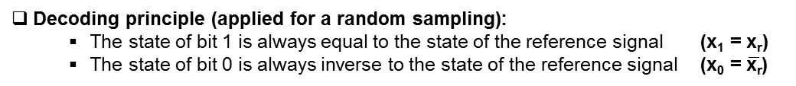
doc.: IEEE 802.15-16- 0015 -02-007a
Spatial 2-PSK (S2-PSK)
2 LEDs transmitter
Decoding
Data LED:
Phase = 0 ⬄ bit 1
Phase = 180⬄ bit 0
x_{r}
Reference signal
Captured reference state
x_{r} = ON
Reference LED:
Phase = 0
Bit definition (Encoding):
  Same frequency and amplitude
  Inverse phase
  (bit 1 phase = 0; bit 0 phase = 180
x₁
Captured bit 1 state
x₁ = x_{r}
Captured bit 0 state
x₀ = $\overline{\text{x}\text{r}}$
x₀
A random sampling of global receiver
Decoding principle (applied for a random sampling):
  The state of bit 1 is always equal to the state of the reference signal (x₁ = x_{r})
  The state of bit 0 is always inverse to the state of the reference signal (x₀ = $\overline{\text{x}\text{r}}$)
Compatibility support
  The decoding result is non-affected by the state of the LEDs but by the comparison.
  The principle is compatible to different frame rate variation.
Submission

Slide 9
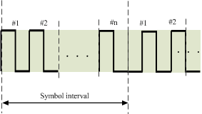
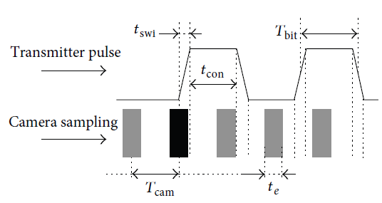
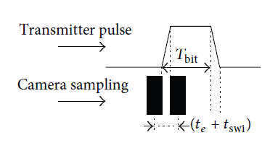


doc.: IEEE 802.15-16- 0015 -02-007a
Long exposure bad-sampling in S2-PSK
$$Modulation Rate=n ×(Symbol Rate)$$
Modulation considered
  Modulation frequency is less than the global shutter speed of the camera (e.g. 1 kHz)
  The long exposure causes error (BER)
Bad sampling due to long exposure time
The appearance of bad-sampling
Note
  BER is proportional to the value of exposure time
  (TBD) FEC can be used to correct error caused by the long exposure
Submission

Slide 10
doc.: IEEE 802.15-16- 0015 -02-007a
Compatible Spatial M-PSK
(SM-PSK)
Submission

Slide 11
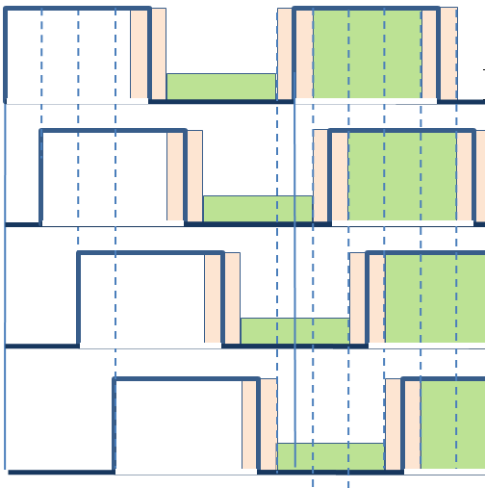
doc.: IEEE 802.15-16- 0015 -02-007a
Advantage of spatial M-PSK
Principles
  A group of LEDs together define a spatial phase (e.g. 4 LEDs per group as illustrated in the figure)
  LEDs in a group are phases-shifted in encoding procedure to define a spatial phase
1
2
3
. . .
(1) Group of 4-LEDs for reference Phase transmission
(2): Group of 4-LEDs for Data transmission
(3): A LED.
  - Green color represents data LED.
  - Red color represents reference LED.
.
.
.
Spatial 8-PSK
Transmitter
.
.
.
. . .
Advantages of spatial M-PSK compared to spatial 2-PSK
  At the moment of capturing, among LEDs in a group there is only one or non bad-sampling happens because those LEDs are phase-shifted. => Easy to detect and mitigate error.
Green slots : good-sampling (clear state of LED)
Pink slots : may cause bad-sampling (unclear state of LED)
A random sampling
Submission

Slide 12
doc.: IEEE 802.15-16- 0015 -02-007a
Operation of Compatible Spatial 8-PSK (S8-PSK)
A group of reference LEDs
Spatial-Phase Definition Table
Duty Circle T
A discrete waveform (4-States) Input | Spatial Phase (S_Phase) Output
1000 | 1
1100 | 2
1110 | 3
1111 | 4
0111 | 5
0011 | 6
0001 | 7
0000 | 8
Delay 0
LED # 1
Delay T/8
LED #2
Delay 2T/8
LED #3
Delay 3T/8
LED# 4
Phase Shift
1 2 3 4 5 6 7 8 1 2
Camera sampling
Submission

Slide 13
doc.: IEEE 802.15-16- 0015 -02-007a
A group of data LEDs: Global Phase Shift = 0
Duty Circle
LED # 1
LED #2
LED #3
LED# 4
S_Phase Shift Value (compared to the spatial phase of the reference group): S_Phase_Shift = 0
Submission

Slide 14
doc.: IEEE 802.15-16- 0015 -02-007a
A group of data LEDs: Global Phase Shift = 2π/8
Duty Circle
LED # 1
LED #2
LED #3
LED# 4
Global Phase Shift
2π/8
S_Phase Shift Value (compared to the spatial phase of the reference group): S_Phase_Shift = 1
Submission

Slide 15
doc.: IEEE 802.15-16- 0015 -02-007a
A group of data LEDs: Global Phase Shift = 2 × 2π/8
Duty Circle
LED # 1
LED #2
LED #3
LED# 4
Global Phase Shift
2 × 2π/8
S_Phase Shift Value (compared to the spatial phase of the reference group): S_Phase_Shift = 2
Submission

Slide 16
doc.: IEEE 802.15-16- 0015 -02-007a
A group of data LEDs: Global Phase Shift = 3 × 2π/8
Duty Circle
LED # 1
LED #2
LED #3
LED# 4
Global Phase Shift
3 × 2π/8
S_Phase Shift Value (compared to the spatial phase of the reference group): S_Phase_Shift = 3
Submission

Slide 17
doc.: IEEE 802.15-16- 0015 -02-007a
A group of data LEDs: Global Phase Shift = 4 × 2π/8
Duty Circle
LED # 1
LED #2
LED #3
LED# 4
Global Phase Shift
4 × 2π/8
S_Phase Shift Value (compared to the spatial phase of the reference group): S_Phase_Shift = 4
Submission

Slide 18
doc.: IEEE 802.15-16- 0015 -02-007a
A group of data LEDs: Global Phase Shift = 7 × 2π/8
Duty Circle
LED # 1
LED #2
LED #3
LED# 4
Global Phase Shift
7 × 2π/8
S_Phase Shift Value (compared to the spatial phase of the reference group): S_Phase_Shift = 7
Submission

Slide 19
doc.: IEEE 802.15-16- 0015 -02-007a
Encoding/Decoding
Encoding Table
Decoding Tables
3-bits Input | Global Phase Shift Output
000 | 0
001 | 1
010 | 2
011 | 3
100 | 4
101 | 5
110 | 6
111 | 7
States-to-Phase Table
Phase-to-Bits Table
A discrete waveform (4-States) Input | Spatial Phase (S_Phase) Output
1000 | 1
1100 | 2
1110 | 3
1111 | 4
0111 | 5
0011 | 6
0001 | 7
0000 | 8
(S_Phase_Shift) Input | 3-bits Output
0 | 000
1 | 001
2 | 010
3 | 011
4 | 100
5 | 101
6 | 110
7 | 111
S_Phase Shift = S_Phase(data) – S_Phase(reference)
Submission

Slide 20
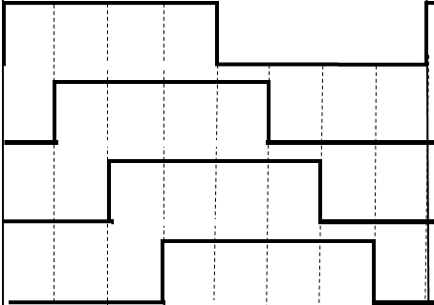
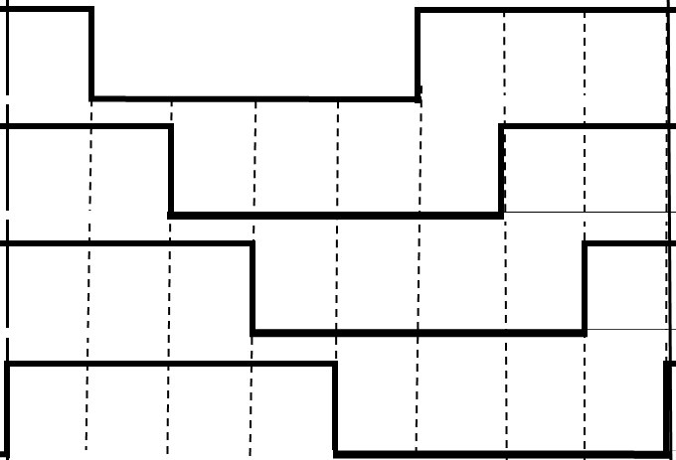
doc.: IEEE 802.15-16- 0015 -02-007a
Decoding Example
Camera sampling
Build discrete waveform
Spatial Phase detecting
Reference group
1 1 1 0
S_Phase = 3
Data (3 bits)
S_Phase_Shift = 3
0 1 0
Data group
0 0 1 1
S_Phase = 6
Submission

Slide 21
doc.: IEEE 802.15-16- 0015 -02-007a
Long exposure Bad-sampling Mitigation
Submission

Slide 22
doc.: IEEE 802.15-16- 0015 -02-007a
Spatial Phase Re-Definition in Bad-sampling Image
States-to-Phase Table (2)
1
1
0
A discrete waveform (4-States) Input | Spatial Phase (S_Phase) Output
1x00 | 1
11x0 | 2
111x | 3
x111 | 4
0x11 | 5
00x1 | 6
000x | 7
x000 | 8
LED # 1
LED #2
LED #3
LED# 4
1 2 3 4 5 6 7 8 1 2
Capturing moment
Time axis
Where x state is the unclear state of LED.
Submission

Slide 23
doc.: IEEE 802.15-16- 0015 -02-007a
Decoding Example with bad-sampling image
bad sampling
Build discrete waveform
Spatial Phase detecting
(Re-defined table)
Reference group
1 1 x 0
S_Phase = 2
Data (3 bits)
S_Phase_Shift = 3
0 1 0
Data group
0 x 1 1
S_Phase = 5
Submission

Slide 24
doc.: IEEE 802.15-16- 0015 -02-007a
Dimmable Spatial M-PSK (DSM-PSK)
Submission

Slide 25
doc.: IEEE 802.15-16- 0015 -02-007a
Dimmable Spatial 8-PSK (DS8-PSK)
Principles
  8 LEDs per group together define a spatial-phase (with dimming supported)
1
2
3
(1) Group of 8-LEDs for reference Phase transmission
(2): Group of 8-LEDs for Data transmission
(3): Single LED.
  - Green color represents data LED.
  - Red color represents reference LED.
Example of 8x8 Transmitter
for DS8-PSK
 | S8-PSK | DS8-PSK
Data rate | 4 LEDs per group together define a S_Phase Data rate = 3×K/4 (bits/symbol) | 8 LEDs per group together define a S_Phase Data rate = 3×K/8 (bits/symbol)
Dimming | No dimming supported. AB% = 50% constant | Dimming is supported in steps of 1/8 (12.5%)
where K is the number of LEDs in a transmitter
Submission

Slide 26
doc.: IEEE 802.15-16- 0015 -02-007a
Operation of DS8-PSK
Duty Circle T
Delay 0
Dimmed Signal of LED 1
Similar to S8-PSK
  A reference group
  Global Phase Shift = 0
  A data group
  Global Phase Shift = 0/1/…/7
Delay T/8
Dimmed Signal of LED 2
Delay 2T/8
Dimmed Signal of LED 3
Delay 7T/8
Dimmed Signal of LED 8
Camera sampling
Time axis
To due dimming, there are 7 tables for every single dimming level (1/8; 2/8; 3/8; 4/8; 5/8; 6/8 ; 7/8).
Submission

Slide 27
doc.: IEEE 802.15-16- 0015 -02-007a
Encoding/Decoding Tables
Encoding Table
Decoding Tables
(Phase-to-Bits Table)
3-bits Input | Global Phase Shift Output
000 | 0
001 | 1
010 | 2
011 | 3
100 | 4
101 | 5
110 | 6
111 | 7
S_Phase_Shift Input | 3-bits Output
0 | 000
1 | 001
2 | 010
3 | 011
4 | 100
5 | 101
6 | 110
7 | 111
S_Phase_Shift = S_Phase(data) - S_Phase(reference)
Submission

Slide 28
doc.: IEEE 802.15-16- 0015 -02-007a
S_Phase Decoding Tables in DS8-PSK
1/8 Dimming
2/8 Dimming
3/8 Dimming
4/8 Dimming
8-States Input |  | S_Phase Output
1000 | 0000 | 1
0100 | 0000 | 2
0010 | 0000 | 3
0001 | 0000 | 4
0000 | 1000 | 5
0000 | 0100 | 6
0000 | 0010 | 7
0000 | 0001 | 8
8-States Input |  | S_Phase Output
1000 | 0001 | 1
1100 | 0000 | 2
0110 | 0000 | 3
0011 | 0000 | 4
0001 | 1000 | 5
0000 | 1100 | 6
0000 | 0110 | 7
0000 | 0011 | 8
8-States Input |  | S_Phase Output
1000 | 0011 | 1
1100 | 0001 | 2
1110 | 0000 | 3
0111 | 0000 | 4
0011 | 1000 | 5
0001 | 1100 | 6
0000 | 1110 | 7
0000 | 0111 | 8
8-States Input |  | S_Phase Output
1000 | 0111 | 1
1100 | 0011 | 2
1110 | 0001 | 3
1111 | 0000 | 4
0111 | 1000 | 5
0011 | 1100 | 6
0001 | 1110 | 7
0000 | 1111 | 8
5/8 Dimming
6/8 Dimming
7/8 Dimming
8-States Input |  | S_Phase Output
1000 | 1111 | 1
1100 | 0111 | 2
1110 | 0011 | 3
1111 | 0001 | 4
1111 | 1000 | 5
0111 | 1100 | 6
0011 | 1110 | 7
0001 | 1111 | 8
8-States Input |  | S_Phase Output
1001 | 1111 | 1
1100 | 1111 | 2
1110 | 0111 | 3
1111 | 0011 | 4
1111 | 1001 | 5
1111 | 1100 | 6
0111 | 1110 | 7
0011 | 1111 | 8
8-States Input |  | S_Phase Output
1011 | 1111 | 1
1101 | 1111 | 2
1110 | 1111 | 3
1111 | 0111 | 4
1111 | 1011 | 5
1111 | 1101 | 6
1111 | 1110 | 7
0111 | 1111 | 8
Submission

Slide 29
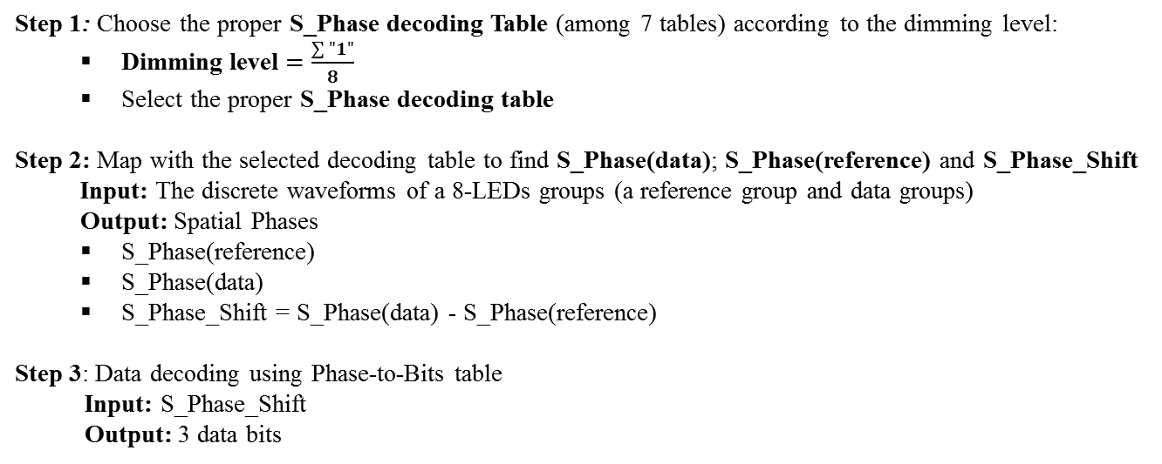
doc.: IEEE 802.15-16- 0015 -02-007a
Decoding Procedure in DS8-PSK
Step 1: Choose the proper S_Phase decoding Table (among 7 tables) according to the dimming level:
  Dimming level $=\frac{\sum{"1"}}{8}$
  Select the proper S_Phase decoding table
Step 2: Map with the selected decoding table to find S_Phase(data); S_Phase(reference) and S_Phase_Shift
  Input: The discrete waveforms of a 8-LEDs groups (a reference group and data groups)
  Output: Spatial Phases
  S_Phase(reference)
  S_Phase(data)
  S_Phase_Shift = S_Phase(data) - S_Phase(reference)
Step 3: Data decoding using Phase-to-Bits table
Input: S_Phase_Shift
Output: 3 data bits
Submission

Slide 30
doc.: IEEE 802.15-16- 0015 -02-007a
PHY modes
Submission

Slide 31
doc.: IEEE 802.15-16- 0015 -02-007a
PHY modes for SM-PSK and DSM-PSK
 |  |  |  | Data rate | Compatibility Support
PHY modes ID | Modulation | Symbol Rate (/sec) |  | (e.g. 10 symbol/s) | Varying frame rates | Long-exposure mitigation | shutter type
16 | S2-PSK | 5/ 10/ 15 |  | 2.5 kbps | Y | Y | Global
17 | S8-PSK | 5/ 10/ 15 |  | 1.92 kbps | Y | Y | Global
18 | DS8-PSK | 5/ 10/ 15 |  | 0.96 kbps | Y | Y | Global
19 | S2-PSK | 5/ 10/ 15 |  | 40 kbps | Y | Y | Global
20 | S8-PSK | 5/ 10/ 15 |  | 30.7 kbps | Y | Y | Global
21 | DS8-PSK | 5/ 10/ 15 |  | 15.3 kbps | Y | Y | Global
where K is the number of data LEDs
 | S2-PSK | S8-PSK | DS8-PSK
Data rate [bps] | Data rate = (bit/symbol) x (symbol rate) = (K) x 10 | Data rate = (bit/symbol) x (symbol rate) = (3×K/4) x 10 | Data rate = (bit/symbol) x (symbol rate) = (3×K/8) x 10
Advantages | - Highest data rate | - Support for decoding even under presence of bad-sampling due to long-exposure time | - Dimming supported in steps of 12.5%
Submission

Slide 32
doc.: IEEE 802.15-16- 0015 -02-007a
PHY frame structure
Submission

Slide 33

doc.: IEEE 802.15-16- 0015 -02-007a
PHY SHR and PHR design
SHR and PHR design
Preamble symbols are inverse forms in order to
  Help a receiver in identifying how many LEDs available on the transmitter.
  Help a receiver in identifying how many LEDs-groups available
Preamble symbols are at lowest spatial-resolution among available spatial PHY modes.
Although the resolution can be increased at PSDU, the symbol rate does not change throughout the frame between preamble, header, and payload. Any symbol rate should be pre-noticed
symbol s
$$symbol \overline{s}$$
MCS ID
PSDU length
Reserved
HCS
PSDU
Preamble symbols
resolution mode 1
resolution mode 2
constant symbol rate
Submission

Slide 34

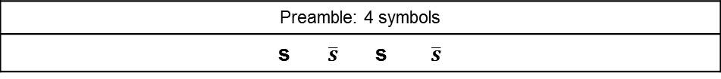

doc.: IEEE 802.15-16- 0015 -02-007a
PHY SHR and PHR design: S2-PSK
Symbol s and $\overline{s}:$
In case of S2-PSK, the white dot represents a single LED is ON while the grey dot represents a single LED is OFF.
Preamble symbols are to extract single LEDs
symbol s
$$symbol \overline{s}$$
symbol s
$$symbol \overline{s}$$
LED on
LED off
Preamble
Preamble: 4 symbols
s $\overline{s}$ s $\overline{s}$
Submission

Slide 35
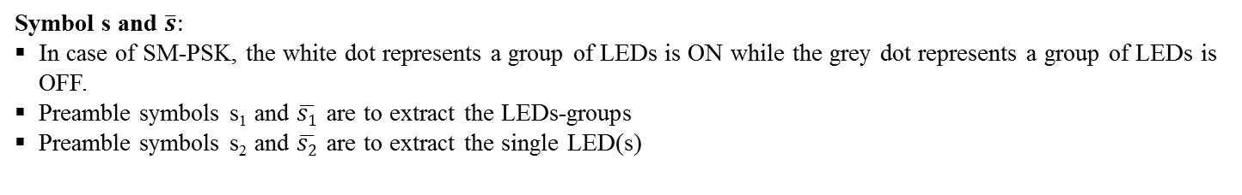

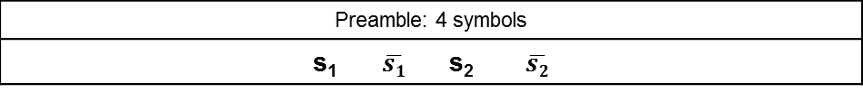

doc.: IEEE 802.15-16- 0015 -02-007a
PHY SHR and PHR design: SM-PSK/DSM-PSK
Symbol s and $\overline{s}:$
In case of SM-PSK, the white dot represents a group of LEDs is ON while the grey dot represents a group of LEDs is OFF.
Preamble symbols s₁ and $\overline{s1}$ are to extract the LEDs-groups
Preamble symbols s₂ and $\overline{s2}$ are to extract the single LED(s)
symbol s₁
$$symbol \overline{s1}$$
symbol s₂
$$symbol \overline{s2}$$
LED on
LED off
Preamble 1: LEDs-group identifier
Preamble 2: LED unit identifier
Preamble: 4 symbols
s₁ $\overline{s1}$ s₂ $\overline{s2}$
Submission

Slide 36
doc.: IEEE 802.15-16- 0015 -02-007a
PHY Summary
The proposed PHY modes using SM-PSK schemes are
  In flicker-free
  Compatible to varying frame rate
  Able to cancel the bad-sampling problem due to long exposure time of global shutter camera receiver
Performance:
  The data rate is from kbps to tens of kbps based upon the number of LEDs
  The S2-PSK provides highest data rate
  The DM8-PSK provides dimming feature in steps of 12.5%
In case of single LED, the S2-PSK scheme is compatible to both global shutter and rolling shutter receiver type.
The PHY frame structure is considered.
Submission

Slide 37
doc.: IEEE 802.15-16- 0015 -02-007a
Appendix 1:
Submission

Slide 38
doc.: IEEE 802.15-16- 0015 -02-007a
Scenarios for SM-PSK and DSM-PSK
SM-PSK signal
SM-PSK signal
SM-PSK signal
Submission

Slide 39
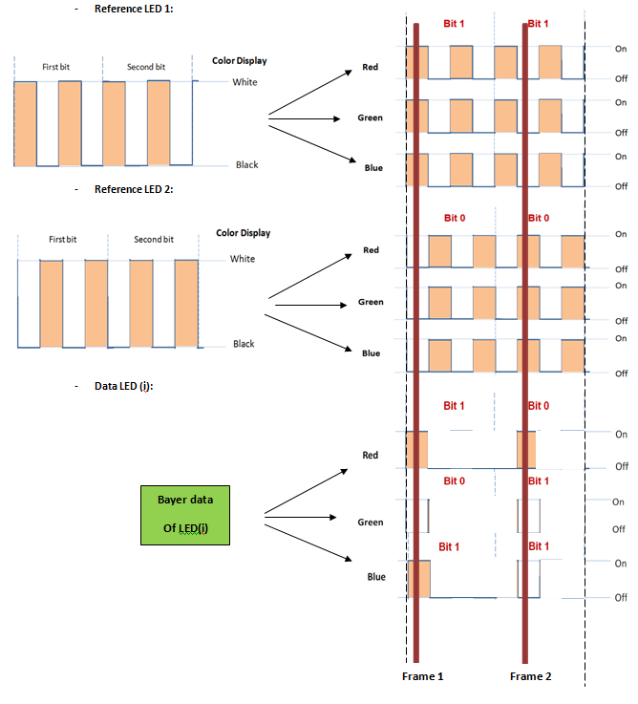
doc.: IEEE 802.15-16- 0015 -02-007a
DSM-PSK and Color transmission (TBD)
Transmitter side
Receiver side
Submission

Slide 40
doc.: IEEE 802.15-16- 0015 -02-007a
Appendix 2:
Hybrid S2-PSK and DSM-PSK for a dual camera mode:
- A low speed camera detects 2-PSK signal
- A high speed camera decode data at DSM-PSK signal
Reference: Intel’s proposal r.01 – slide 63
https://mentor.ieee.org/802.15/dcn/16/15-16-0006-01-007a-intel-occ-proposal.pdf
Submission

Slide 41

doc.: IEEE 802.15-16- 0015 -02-007a
Hybrid S2-PSK/DSM-PSK
Same phase
Inverse phase
MIMO-LED 1
MIMO-LED 2
MIMO-LED 1
MIMO-LED 2
Hybrid Scheme for dual cameras:
(Quick exposer + Slow exposer)
S2-PSK for slow exposer camera
DSM-PSK for quick exposer camera
DSM-PSK
Low Dimming
DSM-PSK
High Dimming
Submission

Slide 42
doc.: IEEE 802.15-16- 0015 -02-007a
Hybrid S2-PSK/DSM-PSK: Single Camera is possible
2-PSK signal:
Slow speed camera
DSM-PSK signal:
High speed camera
DSM-PSK: Low Dimming
DSM-PSK: High Dimming
Slow exposer camera: See all LEDs at dimmed level (that is the amplitude of 2-PSK signal).
(Slow speed but fast exposer camera: See each LED at clear state. The dimmed level is defined by the average intensity of all LEDs)
Quick exposer camera: See each LED at clear state (to decode high speed link).
To see the 2-PSK signal, the slow frame rate camera, e.g. 30fps, is used. The slow exposer camera can see the dimmed level of all LEDs on the same image; however, the exposure does not required to be set up at slow. If the 30fps camera operates at quick exposer mode, the 2-PSK amplitude is calculated by the average dimmed level of the transmitter.
By seeing the 2-PSK signal at quick exposer and low frame rate, the detection of LEDs can get better performance (expected).
Submission

