Slide 1
doc.: IEEE 802.15-16- 0014 -01-007a
Project: IEEE P802.15 Working Group for Wireless Personal Area Networks (WPANs)
Submission Title: Kookmin University PHY sub-proposal for ISC using a Compatible M-FSK Scheme (CM-FSK)
Date Submitted: January 2016
Source: Yeong Min Jang, Trang Nguyen, Hong Chang Hyun [Kookmin University]
Contact: +82-2-910-5068 E-Mail: yjang@kookmin.ac.kr
Re:
Abstract: This is a PHY sub-proposal using M-FSK based Modulation Scheme. Being compatible to rolling shutter image sensors, it is called Compatible M-FSK (CM-FSK).
Purpose: Call for Proposal Response
Notice: This document has been prepared to assist the IEEE P802.15. It is offered as a basis for discussion and is not binding on the contributing individual(s) or organization(s). The material in this document is subject to change in form and content after further study. The contributor(s) reserve(s) the right to add, amend or withdraw material contained herein.
Release: The contributor acknowledges and accepts that this contribution becomes the property of IEEE and may be made publicly available by P802.15.
Submission

Slide 2
doc.: IEEE 802.15-16- 0014 -01-007a
Content
PHY design considerations
Frame rate variation
Different sampling rates and shutter speeds
System designs
System architecture
Frequency band and frequency separation
Data packet structure
Asynchronous Decoding
PHY format and PHY modes
Appendix 1: Indoor hybrid Compatible M-FSK/N-PSK system
Appendix 2: Seaside communications using CM-FSK
Submission

Slide 3
doc.: IEEE 802.15-16- 0014 -01-007a
PHY design considerations
for Compatible M-FSK (CM-FSK)
Submission

Slide 4
doc.: IEEE 802.15-16- 0014 -01-007a
Compatibility to varying-frame-rates
Symbol clock out
… | symbol i | symbol (i+1) | …
Rolling camera sampling
Transform
frequency
symbol i
frequency
symbol i
frequency
symbol i/(i+1)
frequency
symbol (i+1)
frequency
symbol (i+1)
Majority voting
symbol i voting
symbol (i+1) voting
How to transmit the clock information along with the symbol?
Submission

Slide 5
doc.: IEEE 802.15-16- 0014 -01-007a
Different sampling rates/shutter speeds
In-band
Eye cut-off
Camera cut-off
Camera
shutter speed
~200 Hz
~8 kHz
Bandwidth =?
(shutter speed)
Frequency separation =?
(sampling rate)
In-band
Eye cut-off
Camera cut-off
lower
shutter speed
~200 Hz
The frequency band in use is upper limited by shutter speed of camera. Lower shutter speed narrows the available band for communications
Sampling rate (rolling sampling rate) is also a matter to utilize the usage of frequency band efficiently. E.g. the sampling rate defines the minimum value of frequency separation.
Submission

Slide 6
doc.: IEEE 802.15-16- 0014 -01-007a
CM-FSK for ISC
Submission

Slide 7
doc.: IEEE 802.15-16- 0014 -01-007a
System Architecture
Transmitter side
Receiver side
clock information (of a data packet): This scheme is similar to the C-OOK scheme in which asynchronous bits (Ab) represent the form of clock information. However, the data packet with clock information (called a symbol) is encoded using M-FSK technique.
a data packet with the clock information
Clock information
Ab = 1
Ab=1
data packet i
Symbol clock
Merger
Clock information
Ab= 0
M-FSK Encoder
… | data packet i | …
a frequency symbol i
Submission

Slide 8
doc.: IEEE 802.15-16- 0014 -01-007a
CM-FSK Modulation frequency band
In-band
Eye cut-off
Camera cut-off
Camera
shutter speed
~200 Hz
~8 kHz
Frequency band | Compatibility
[200Hz ; ~2 kHz] | Webcams, Smartphone cameras (Auto-exposure is OFF)
[200Hz ; ~4 kHz] | Smartphone cameras (Auto-exposure is OFF)
The frequency band:
B = 2kHz to be compatible to low shutter speed cameras
B = 4kHz (or higher, up to < 8kHz) to be compatible to most of smartphone cameras.
Submission

Slide 9
doc.: IEEE 802.15-16- 0014 -01-007a
CM-FSK frequency separation
Selected image resolution: 640x480
Spectrum peak and the corresponding frequency measurement
The peak value of the FFT spectrum is linear proportional to the modulation frequency of light
In our specific experiment
Center frequency values:
Frequency separation: ∆(FFT peak) ≥ 1 <=> ∆(frequency) ≥ 32.192 Hz
$$f=32.192 × \frac{rolling sampling rate}{15.323 kHz}$$
Submission

Slide 10
doc.: IEEE 802.15-16- 0014 -01-007a
Frequency separation
∆(FFT peak) =3
Max (number of channel)$=\frac{4kHz}{96.576Hz}$= 41 [channels]
FDM spectrum with frequency separation = 96.576 Hz
∆(FFT peak) =1
Max (number of channel$)=\frac{4kHz}{32.192 Hz}$= 124 [channels]
FDM spectrum with frequency separation = 32.192 Hz
Submission

Slide 11
doc.: IEEE 802.15-16- 0014 -01-007a
Data packet Structure and Encoding
Submission

Slide 12
doc.: IEEE 802.15-16- 0014 -01-007a
Data packet structure
Time Domain
frequency symbol (i-1)
frequency symbol i
frequency symbol (i+1)
DS i ⁽¹⁾
DS i ⁽²⁾
DS i ^{(N)}
Information of a symbol before encoding
Ab
Data packet i
DS: Data Sub-Packet; SF: Start Packet-Frame Symbol; Ab: Asynchronous bit(s)
A symbol is N times repeated in transmission
An asynchronous bit (represents the clock information of the data packet) is along with the packet in transmission.
Submission

Slide 13
doc.: IEEE 802.15-16- 0014 -01-007a
Encoding PHY modes (SHR and PHR)
best compatible band
f'_{SF}
extended band
f_{SF}
Camera
limit
. . .
. . .
32 frequency
~8 kHz
SHR and PHR design:
On the lowest-band among the CM-FSK PHY modes to ensure compatibility with low sampling-rate cameras.
Relationship between f_{SF} and f’_{SF} is for training
f_{SF} is chosen as lowest frequency on the available bandwidth, e.g. 200Hz, to be easily detected.
f’_{SF} = f_{SF} + 33x ∆f to train different cameras which have different sampling rates.
Submission

Slide 14
doc.: IEEE 802.15-16- 0014 -01-007a
Encoding PHY modes
symbols:
2
2
SHR
MCS ID
PSDU length
Reserved
HCS
C32-FSK
Data frequency: f_{i} = f_{SF} + i.∆f (i=1; 2;…; 32)
Preamble frequency: f’_{SF} = f_{SF} + 33.∆f
PHY modes | Number of frequency | Data rate | Unit
I.2/ I.3 | 32 | 50 | bps
I.4/ I..5 | 64 | 60
Reserved | 128 | 70
Submission

Slide 15
doc.: IEEE 802.15-16- 0014 -01-007a
Encoding table (C32-FSK)
C32-FSK encoding table
Symbol structure
Baud symbol | Frequency
f_{SF} | fo
00000 | f1
00001 | f2
. . .
11110 | f₃₁
11111 | f₃₂
f'_{SF} | f₃₃
bits: 1 | 4
Ab | Data packet
∆f = $96.576$ Hz (~ 100Hz)
B = [200Hz; 3400Hz]
Data frequency: f_{i} = f_{SF} + i.∆f (i=1; 2;…; 32)
Preamble frequency: f’_{SF} = f_{SF} + 33.∆f
Symbol rate: 5/10/15 (symbol/sec)
Submission

Slide 16
doc.: IEEE 802.15-16- 0014 -01-007a
Encoding table (C64-FSK)
C64-FSK encoding table
Symbol structure
Baud symbol | Frequency
f_{SF} | fo
000000 | f₁
000001 | f₂
. . .
101110 | f₃₁
101111 | f₃₂
f'_{SF} | f₃₃
010000 | f₃₄
010001 | f₃₅
. . .
111110 | f₆₄
111111 | f₆₅
bits: 1 | 5
Ab | Data packet
∆f = $48.3$ Hz (~ 50Hz)
B = [200Hz; 3500Hz]
Data frequency: f_{i} = f_{SF} + i.∆f (i=1; 2;…; 32; 34;35; …; 65)
Preamble frequency: f’_{SF} = f_{SF} + 33.∆f
Symbol rate: 5/10/15 (symbol/sec)
Submission

Slide 17
doc.: IEEE 802.15-16- 0014 -01-007a
Asynchronous Decoding
Submission

Slide 18
doc.: IEEE 802.15-16- 0014 -01-007a
Asynchronous Decoding example
Ab=1
Ab=1
Symbol out
Ab=0
Image frame sequence
Decoded symbol
along with Ab(s)
1-0100
1-1110
1-1110
1-0100
0-0011
0-0001
0-0011
Group to vote
Ab =1
Ab=0
Ab=1
Majority voting result
0100
0011
1110
CM-FSK solves the communications performance, and the asynchronous bits solve the frame rate variation.
Submission

Slide 19
doc.: IEEE 802.15-16- 0014 -01-007a
PHY frame format
Submission

Slide 20
doc.: IEEE 802.15-16- 0014 -01-007a
Best Compatible Band
Camera
Physical
limit
Extended band
Camera
Physical
limit
CM-FSK scheme (on the compatible-band)
CM-FSK (extended band)
SHR symbol 1
SHR symbol 2
MCS ID
PSDU length
Reserved
HCS
PSDU
f_{SF}
f’_{SF}
SHR
PHR
SHR and PHR design:
This part should have compatibility to almost of rolling shutter cameras
CM-FSK is chosen because of its advantages of lower error rate compared to OOK:
Hence CM-FSK is more reliable in detection and synchronization
The frequency band for encoding SHR and PHR is the lowest band among proposed frequency bands to ensure the compatibility to any rolling shutter camera.
The PSDU (can keep CM-FSK scheme or switch to C-OOK scheme) is performed on extended band to achieve higher link rate in specific situations.
Submission

Slide 21
doc.: IEEE 802.15-16- 0014 -01-007a
CM-FSK PHY modes
PHY header design:
All frequencies used for PHY header are on low- band of the available bandwidth (e.g. 200Hz – 3.5kHz). This is to be compatible to low sampling rate cameras.
SHR and PHR are allocated in a common band (low-band)
The length for each frequency symbol is constant throughout the frame between preamble, header, and payload
PSDU can be allocated to the extended band.
MCS indication | PHY modes | Data rate | Unit
0000 0001 | I.2 (C32-FSK) | 50 | bps
0000 0010 | I.3 (C32-FSK/2-PSK) | 60
0000 0011 | I.4 (C64-FSK/2-PSK) | 70
0000 0100 | I.5(C32-FSK/4-PSK) | 80
Submission

Slide 22
doc.: IEEE 802.15-16- 0014 -01-007a
Appendix 1:
Indoor hybrid Compatible M-FSK/M-PSK system
Submission

Slide 23
doc.: IEEE 802.15-16- 0014 -01-007a
CM-FSK LEDs lighting
4
4
In general way, multiple LEDs are grouped together in communications. This is to provide the brightness for indoor when LEDs seems to be dimmed at 50%.
3
3
Top-floor LEDs
5
2
5
2
Camera’s RoI
1
1
Walking direction
Camera FOV
Walking road
Walking road
Camera sequentially exposes light row by row. To get the maximum length of a LED on the image, LEDs are hang up along the walking way.
Submission

Slide 24
doc.: IEEE 802.15-16- 0014 -01-007a
L
d
LED 2
LED 3
LED 1
H
FOV
Walking Speed = w (m/s)
- Condition of LEDs separation in user moving environment: L ≤ 2H.tg(FOV/2)
- Longer d is better for communications, but not power consumption.
Example: H = 2m; FOV = 68⁰ (Samsung S5); d = 1.2m (equal size of fluorescent lamp); L = 2.7m.
Walking speed is limited by connection switching algorithm between LEDs.
Submission

Slide 25
doc.: IEEE 802.15-16- 0014 -01-007a
Hybrid Compatible M-FSK/N-PSK: Benefits
Advantages of M-FSK:
Support for multiple transmitters (LEDs). Frequency allocation is based on M-FSK to share the bandwidth to all LEDs. The M-FSK technique is to avoid interference efficiently.
Great support for rolling shutter receivers. The detection of frequency is much easier with rolling effect.
Additional advantage of N-PSK:
The N-PSK is additionally used to achieve higher data rate than just M-FSK. The higher link rate is helpful when a part of link rate must be shared for mitigating frame rate variation (by transmitting the asynchronous bits instead of data).
Additionally support for global shutter receivers (only 2-PSK, optional).
Submission

Slide 26
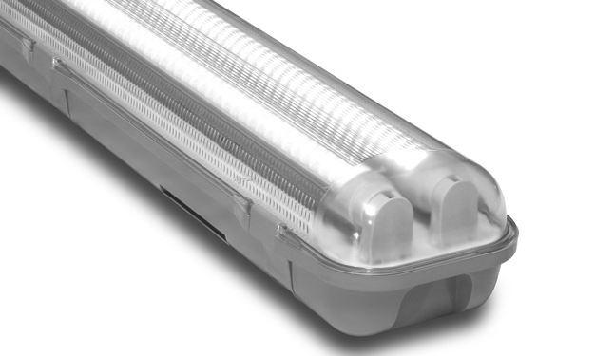
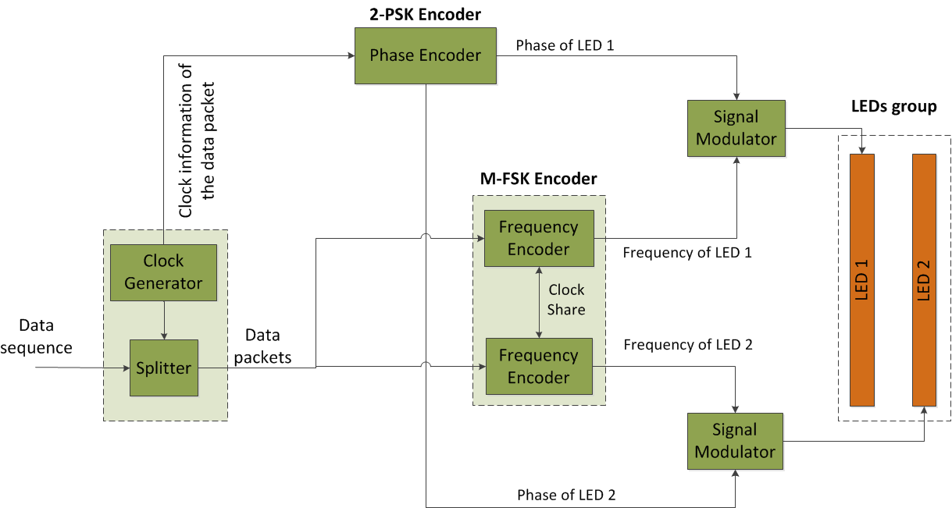
doc.: IEEE 802.15-16- 0014 -01-007a
Hybrid Compatible M-FSK/2-PSK
Data_Phase LED
Reference_Phase LED
Architecture #1 of LEDs-group transmitter employing the hybrid 2-PSK /CM-FSK modulation scheme.
LED 1 and LED 2 together transmit the clock information of data packets through phase (2-PSK technique). The phase difference between LEDs decide the asynchronous bit (bit 1 if two LEDs are same phase; and bit 0 if phases are inverse). This is to solve the frame rate variation.
The data packets are transmitted through M-FSK, allowing log₂M bits data link rate per symbol.
Submission

Slide 27
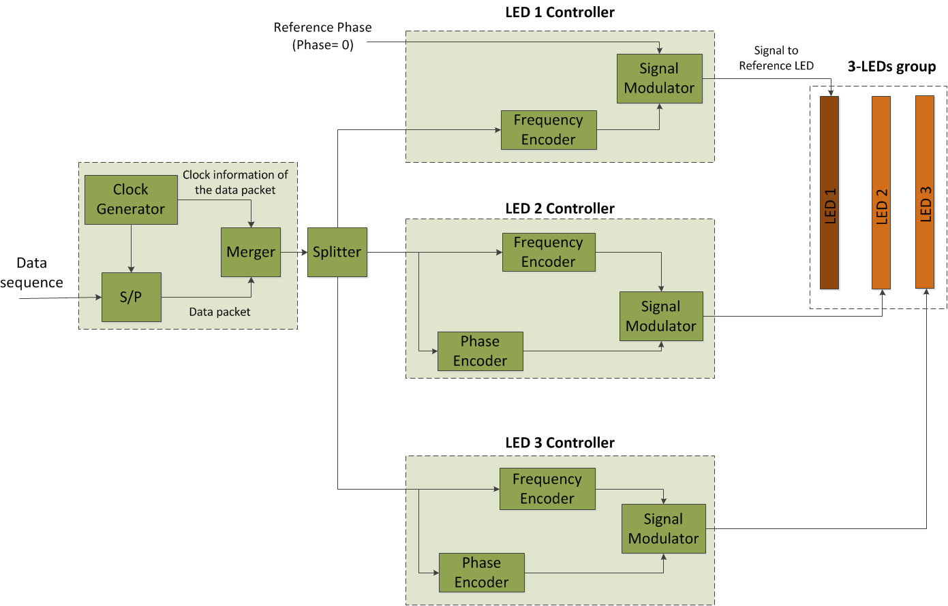
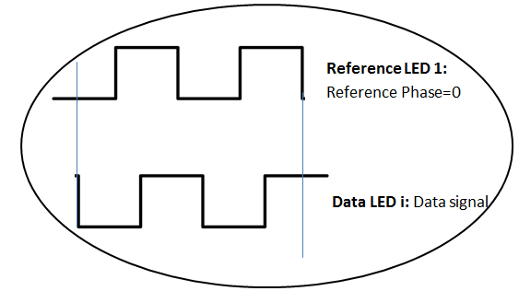
doc.: IEEE 802.15-16- 0014 -01-007a
Hybrid Compatible M-FSK/2-PSK
2-PSK Modulation
Architecture #2 of LEDs-group transmitter employing the hybrid 2-PSK /M-FSK modulation scheme.
In N-PSK scheme, among three LEDs one is for transmitting a phase reference and the other two are for data phases. It means 2 bits are transmitted through 2-PSK.
The M-FSK still takes whole advantage of bandwidth without any interference to N-PSK transmission.
Submission

Slide 28
doc.: IEEE 802.15-16- 0014 -01-007a
Data rate of hybrid system
 | Modulation Scheme and Proposed System | Data rate
1 | 2-PSK and M-FSK combination: (groups of 2-LED tubes) | R_{bit} = (K/2) x log_{M}(#_frequency) x (symbol rate)
2 | 2-PSK and M-FSK combination: (groups of k-LED tubes) | R_{bit} = (K/k) x log_{M}(#_frequency) x (symbol rate)
3 | 4-PSK and M-FSK combination: (groups of 4-LED tubes) | R_{bit} = 6 x (K/4) x log_{M}(#_frequency) x (symbol rate)
4 | N-PSK and M-FSK combination: (groups of k-LED tubes) | R_{bit} = (k-1)log₂N x (K/k) x log_{M}(#_frequency) x (symbol rate)
where K: is the number of LED tubes
#_frequency: denotes the number of frequencies used for communications in M-FSK
Submission

Slide 29
doc.: IEEE 802.15-16- 0014 -01-007a
Appendix 2:
Seaside communications using CM-FSK
Submission

Slide 30
doc.: IEEE 802.15-16- 0014 -01-007a
Prototype
Prototype 1: Continuous symbols transmission along with the clock information (asynchronous bits)
Symbol structure
symbol 1
symbol 2
symbol 3
bits: 1 | 4/5
Ab | Data packet
The communications for this prototype is exactly same as mentioned.
Prototype 2: Burst mode (with inter-symbol guard time for low-rate PD communications)
Symbol structure
symbol 1
Inter-symbol
guard time
symbol 2
Inter-symbol
guard time
symbol 3
x
Data packet
The purpose of inter-symbol guard time:
A guard time to mitigate frame rate variation, and
Also is a period for low-rate PD communications. PD communications is allocated in high band that is invisible to camera (>10 kHz).
Purpose of PD communications here:
Additional information broadcasting (more data)
Localization beacon. ISC provides direction of the lighthouse, while PD communication determines the distance from the lighthouse.
Submission

Slide 31
doc.: IEEE 802.15-16- 0014 -01-007a
Non-Imaging based ISC: An additional optical module
In order to collect light energy and distribute uniformly into 2D image sensor, an additional optical lens module is used in front of the camera lens.
Incoming beam
Rolling shutter camera
A type of Fresnel Lens
(to collect light energy)
Lighthouse LED
Fresnel Lens
Image Sensor
The beam output from Fresnel lens into camera will cover the entire of image sensor instead of focusing into an focal point.
Submission

