Slide 1
doc.: IEEE 802.15-16- 0013 -02-007a
Project: IEEE P802.15 Working Group for Wireless Personal Area Networks (WPANs)
Submission Title: Kookmin PHY sub-proposal for ISC using Temporal Scheme (C-OOK)
Date Submitted: January 2016
Source: Yeong Min Jang, Trang Nguyen [Kookmin University]
Contact: +82-2-910-5068 E-Mail: yjang@kookmin.ac.kr
Re:
Abstract: This is a PHY sub-proposal of ISC using OOK based modulation scheme for rolling shutter camera receiver. Being compatible to image sensors, it is called Compatible-OOK scheme (C-OOK).
Purpose: Call for Proposal Response
Notice: This document has been prepared to assist the IEEE P802.15. It is offered as a basis for discussion and is not binding on the contributing individual(s) or organization(s). The material in this document is subject to change in form and content after further study. The contributor(s) reserve(s) the right to add, amend or withdraw material contained herein.
Release: The contributor acknowledges and accepts that this contribution becomes the property of IEEE and may be made publicly available by P802.15.
Submission

Slide 2
doc.: IEEE 802.15-16- 0013 -02-007a
Content
PHY design considerations
  Frame rate variation
  Different sampling rates
  Different rolling exposure time
System designs
  System architecture
  Frequency band in use
  Data packet structure
  Asynchronous Decoding
  Packet recovery
PHY format and PHY modes
Submission

Slide 3
doc.: IEEE 802.15-16- 0013 -02-007a
Definitions
varying frame rate ISC mode: an ISC mode that supports a varying frame-rate receiver.
asynchronous decoding: a decoding procedure under presence of frame rate variation.
optical clock rate (modulation rate): The frequency at which the data is clocked out to the optical source. In flicker-free mode, let assume the frequency no less than 200Hz to be invisible to human eyes.
asynchronous bit: a form of clock information in the temporal scheme helping a varying frame rate receiver in asynchronous-decoding. Note that this is not only necessarily one single bit (bit 1 or bit 0), but also can be a symbol (a set of bits in which symbol 1 and symbol 0 are orthogonal some how) to operate at high noise affected.
clock information (of a data packet/symbol): The information represents the state of a symbol clocked out. The clock information is transmitted along with a symbol to help a receiver identifying an arrival state of new symbol under presence of frame rate variation.
rolling exposure time: the time from the first line to the last line exposes to light in a rolling shutter image sensor.
rolling sampling rate: //…
forward decoding: a decoding process in asynchronous decoding that taken from the position of the SF backward on a rolling image.
backward decoding: a decoding process in asynchronous decoding that taken from the position of the SF forward on a rolling image.
packet recovery: a process in asynchronous decoding that recovers a complete data packet from the incomplete data parts decoded, forward and backward part of one (two) data packet(s).
data fusion: a process in asynchronous decoding to group data parts (forward and backward parts) those belong to one packet. There are two types of data fusion that happens according to the value of asynchronous bits:
  inter-frame fusion: to group data parts from different images
  intra-frame fusion: to group data parts from an image.
Submission

Slide 4
doc.: IEEE 802.15-16- 0013 -02-007a
PHY design considerations
Submission

Slide 5
doc.: IEEE 802.15-16- 0013 -02-007a
Frame rate variation
Symbol clock out
… | symbol i | symbol (i+1) | …
Rolling camera sampling
(at high frame rate)
Rolling camera sampling
(at low frame rate)
Packet Fusion (Recovery)
symbol i voting
symbol (i+1) voting
Clock interval ≥ Max{sampling interval}
Submission

Slide 6
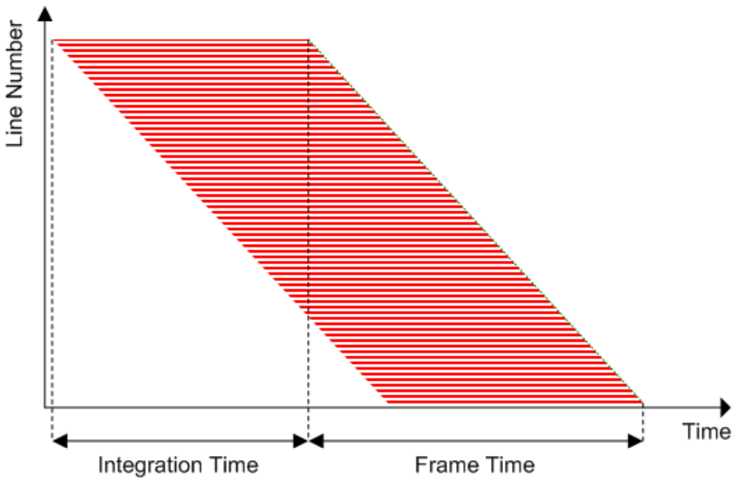
doc.: IEEE 802.15-16- 0013 -02-007a
Different sampling rates
Sampling
interval
rolling exposure
Source: http://www.onsemi.com/pub_link/Collateral/NOIV1SN1300AD.PDF
Rolling shutter Operation
The sampling rate of a Smartphone rolling image sensor is different from the other’s, and typically larger than 15 kHz.
The light modulation and demodulation of a frequency will need to be compatible to different cameras those have different sampling rates.
Submission

Slide 7
doc.: IEEE 802.15-16- 0013 -02-007a
Different rolling exposures
Symbol clock out
… | symbol i | symbol (i+1) | …
rolling exposure time
rolling exposure time
rolling exposure time
Rolling camera sampling
(at low frame rate)
losing information
losing information
Data Fusion
Packet Recovery
symbol i
symbol (i+1)
The rolling exposure time decides how much the amount of data is recorded per a rolling image.
Under presence of frame rate variation, different rolling exposure time is challenging.
Submission

Slide 8
doc.: IEEE 802.15-16- 0013 -02-007a
System Design
Submission

Slide 9
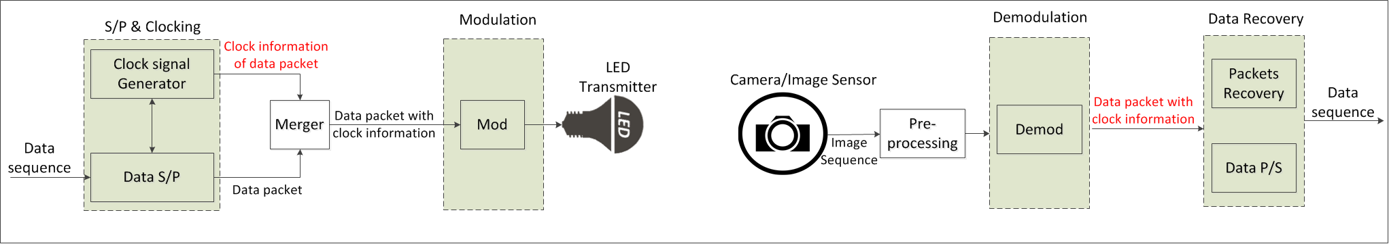
doc.: IEEE 802.15-16- 0013 -02-007a
System Architecture
Transmitter side
Receiver side
clock information (of a data packet): In this scheme, asynchronous bits (Ab) are in form of clock information.
Clock information
Ab = 1
Symbol clock out
Clock information
Ab= 0
Merger
Ab=1
data packet i
Ab=1
… | data packet i | …
Submission

Slide 10
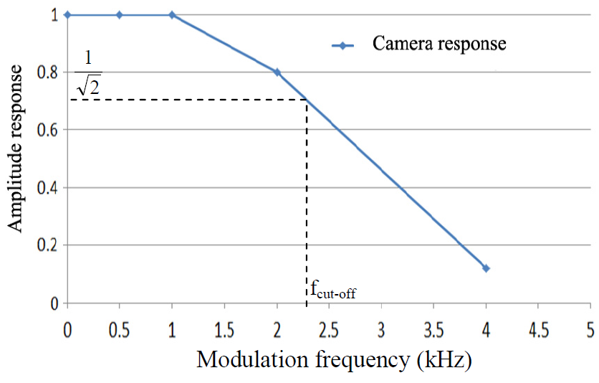
doc.: IEEE 802.15-16- 0013 -02-007a
Modulation frequency
In-band
Eye cut-off
Camera cut-off
Camera
shutter speed
~200 Hz
~8 kHz
The modulation frequency is constant on a frame.
The upper threshold of frequency band in use is less than the shutter speed of camera (Currently, Smartphone has a shutter speed of 8kHz).
Frequency | Compatibility
2 kHz | Webcams, Smartphone cameras (Auto-exposure is OFF)
4 kHz | Smartphone cameras (Auto-exposure is OFF)
The practical response of a long-exposure-camera (A webcam)
Submission

Slide 11
doc.: IEEE 802.15-16- 0013 -02-007a
Data packet Structure
Submission

Slide 12
doc.: IEEE 802.15-16- 0013 -02-007a
Data packet structure
packet (i-1)
packet i
packet (i+1)
DS i ⁽¹⁾
DS i ⁽²⁾
DS i ^{(N)}
SF
Ab
Data packet i
Ab
DS: Data Sub-Packet; SF: Start Packet-Frame Symbol; Ab: Asynchronous bit(s)
A packet is multiple times repeat of one data symbol.
A complete DS has a very-low-header symbol (SF), two similar asynchronous bits (which is a form of the clock information)
Submission

Slide 13
doc.: IEEE 802.15-16- 0013 -02-007a
Data packet structure: The purpose of repetition
packet (i-1)
packet i
packet (i+1)
DS i ⁽¹⁾
DS i ⁽²⁾
DS i ^{(N)}
recorded a complete DS
Problem of losing repeated ones
(is mitigated by using our frame structure)
Repetition is to avoid losing any data when camera makes sampling discretely.
Submission

Slide 14
doc.: IEEE 802.15-16- 0013 -02-007a
Data packet structure: The purpose of Asynchronous bits
DS i ^{(N-1)}
DS i ^{(N)}
DS i+1 ⁽¹⁾
DS i+1 ⁽²⁾
…
Ab=0
Ab=0
data packet i
Ab=0
Ab=1
data packet (i+1)
Ab=1
Ab=1
Rolling exposure time
Apart of
data packet i
Ab=0
Ab=1
Apart of
packet (i+1)
Ab=0
Ab=0
Ab=1
Ab=1
data packet i
. . .
Apart of
data packet i
Apart of
packet (i+1)
. . .
data packet i
A group of (packet i) for voting
A group of (packet i+1) for voting
Asynchronous bits decide how to group adjacent decoded data packets (complete or apart) into a voting
Submission

Slide 15

doc.: IEEE 802.15-16- 0013 -02-007a
Data packet structure: The SF symbol
SF symbol | Ab | Data | Ab
011100 | bit 1/0 | Manchester coding | bit 1/0
0011111000 |  | 4B6B coding
000011111111100000 |  | 8B10B coding
Backward decoding
SF #n
Forward decoding
A SF symbol is detectable. When the frame rate is varying irregularly, the position of the SF symbol on the rolling image is also varying. The detection of SF becomes indispensable for the decoding (forward and backward parts) and recovering data.
The length of SF is different for each RLL code (in order to be low-overhead and detectable).
Submission

Slide 16
doc.: IEEE 802.15-16- 0013 -02-007a
Asynchronous Decoding
Submission

Slide 17
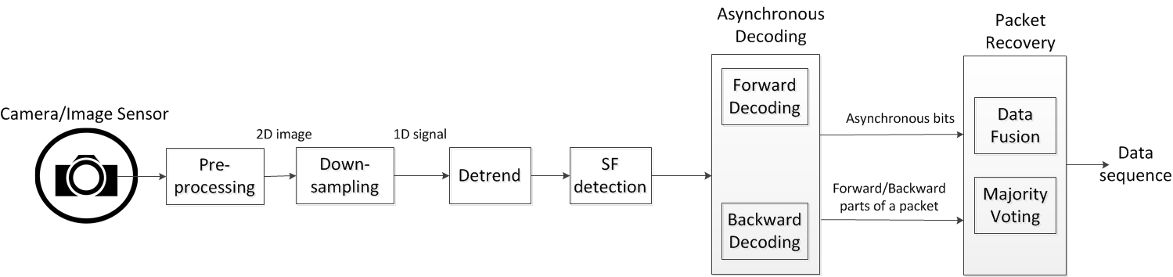
doc.: IEEE 802.15-16- 0013 -02-007a
Decoding Procedure
SF detection: to detect the position of SF on a rolling image.
Asynchronous decoding: From the position of SF, two tasks are performed
  Forward decoding: Decode the forward part of the image
  Backward decoding: Decode the backward part of the image
Packet recovery: To recover a complete data packet from the incomplete parts decoded, forward and backward part of one (two) data packet(s):
  Data fusion: to group parts (forward and backward parts) those belong to one packet. This is indispensable because a camera has a rolling exposure time different from the other camera’s and not equal to DS interval.
  Majority voting: to get a complete packet from several discrete-parts of the packet.
Submission

Slide 18
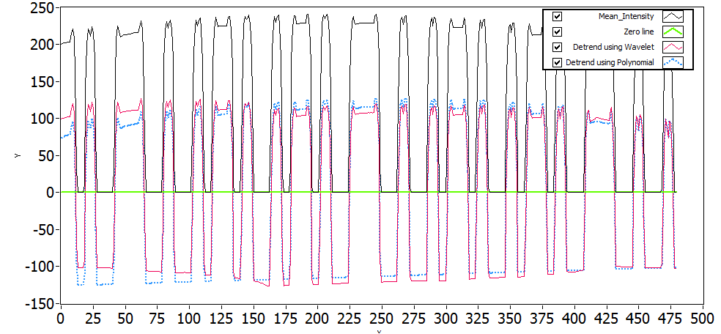
doc.: IEEE 802.15-16- 0013 -02-007a
Asynchronous Decoding: Rolling exposure time >> (DS interval)
SF
SF
SF
Oversampled Asynchronous decoding
This happens when the DS interval is short to be compatible to different rolling exposure times
The majority voting is applied between several images or within an image (using asynchronous bits) to enhance BER.
Submission

Slide 19
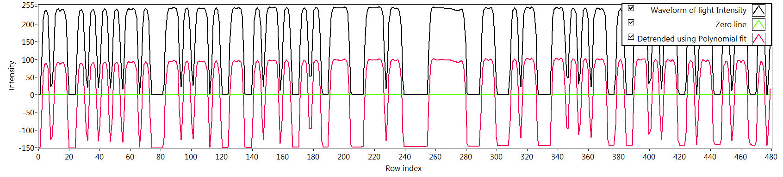
doc.: IEEE 802.15-16- 0013 -02-007a
Asynchronous Decoding: Rolling exposure time ~ (DS interval)
4B6B-Data (Backward)
1
SF
1
4B6B-Data (Forward)
Data Fusion
Packet recovery
Data (Forward)
Data (Backward)
Forward decoding and Backward decoding
When the rolling exposure time is almost equal to DS interval, forward and backward are both used to get 100% information of an image.
The fusion of forward part and backward part (of a data packet) is performed to output a complete data packet.
Submission

Slide 20
doc.: IEEE 802.15-16- 0013 -02-007a
Packet Recovery
Packet 1: Ab(s)=1
Packet 2: Ab(s)=0
Packet 3: Ab(s)=1
SF
Ab=1
Ab=1
Ab=0
Ab=0
Packet #1
Packet #2
Inter-frame fusion
intra-frame fusion
Ab=1
Packet #1
Ab=0
Packet #2
Two cases may happen at different sampling time:
Case 1- Inter-frame data fusion: Fusing two sub-parts of a packet at two different images into a complete packet.
Case 2- Intra-frame data fusion: Recovering a complete packet from an image.
Submission

Slide 21
doc.: IEEE 802.15-16- 0013 -02-007a
PHY frame format
Submission

Slide 22
doc.: IEEE 802.15-16- 0013 -02-007a
PHY Frame Format
Preamble and training | PHY header | HCS | PSDU
SHR | PHR |  | PHY payload
CM-FSK
packet (i-1)
packet i
packet (i+1)
DS i ⁽¹⁾
DS i ⁽²⁾
DS i ^{(N)}
SF
Ab⁽¹⁾
Data packet i
Ab⁽²⁾
Data rate related (TBD)
Packet rate : 5/10/15 (packet/sec)
DS rate : 60/120 (DS/sec)
Submission

Slide 23
doc.: IEEE 802.15-16- 0013 -02-007a
Medium-rate PHY I modes
 | MCS indication | PHY modes | Data rate | Unit
7 | 0000 0110 | I.7 | 0.084 | kbps
8 | 0000 0111 | I.8 | 0.17
9 | 0000 1000 | I.9 | 0.22
10 | 0000 1001 | I.10 | 0.44
11 | 0000 1010 | I.11 | 0.53
Detail parameters in medium-rate PHY I modes (using C-OOK)
 |  |  |  |  |  |  | Data rate | Compatibility Support
 |  | Modulation | Coding | Optical Clock rate | Symbol rate | DS rate | (e.g. 10 sym/s) | Varying frame rates | Shutter speeds/ Sampling rates
7 | Medium PHY I (kbps) | OOK based | Manchester | 2 kHz | 5/ 10/ 15 | 120 | 84 bps | Y | Y
8 |  | OOK based | Manchester | 2 kHz | 5/ 10/ 15 | 60 | 0.17 kbps | Y | Y
9 |  | OOK based | 4B6B | 2 kHz | 5/ 10/ 15 | 60 | 0.22 kbps | Y | Y
10 |  | OOK based | 4B6B | 4 kHz | 5/ 10/ 15 | 60 | 0.44 kbps | Y | Y
11 |  | OOK based | 8B10B | 4 kHz | 5/ 10/ 15 | 60 | 0.53 kbps | Y | Y
Submission

Slide 24
doc.: IEEE 802.15-16- 0013 -02-007a
Appendix 1:
Image processing technique
Submission

Slide 25
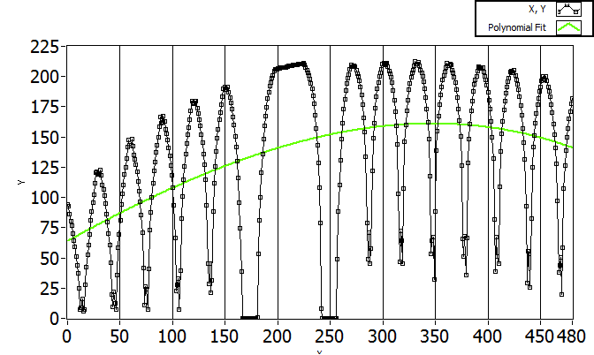
doc.: IEEE 802.15-16- 0013 -02-007a
1D Waveform De-trending
A waveform is extracted from image needs to be de-trended. In order to detrend signal, the baseline of signal is estimated.
3rd order-polynomial line or B-spline line, or Wavelet-line can be applied to estimate baseline of signal.
De-trend signal for SF detection using 3rd order polynomial fitting and Wavelet baseline
Submission

Slide 26
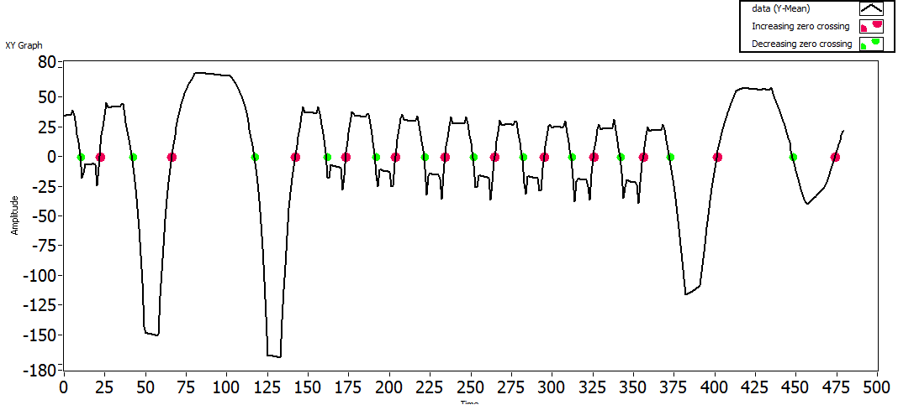
doc.: IEEE 802.15-16- 0013 -02-007a
1D Signal processing and SF Detection
In asynchronous decoding, the position of SF symbol is critical to forward decoding and backward decoding
Result of Zero-crossing detection in an sample of a rolling image
Zero-crossing detection method:
Advantage:
  High accurate SF detection even though the signal strength is low
Consideration:
  In case of dimming (AB% ≠ 50%) the baseline (offset line) of signal should be estimated carefully for zeros detection.
Submission

Slide 27
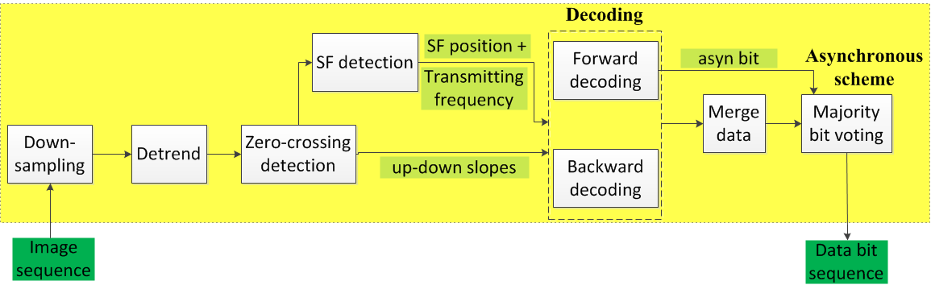
doc.: IEEE 802.15-16- 0013 -02-007a
1D Signal processing and Decoding
2- By using asynchronous bits, the variation in camera frame rate is mitigated.
1-This part detects SF and necessary information for decoding
Flow chart of asynchronous decoding using Zero-crossing detection algorithm
Submission

Slide 28
doc.: IEEE 802.15-16- 0013 -02-007a
Link rate Estimation
Submission

Slide 29
doc.: IEEE 802.15-16- 0013 -02-007a
Appendix 2:
Solution for frame rate drop to less than symbol rate
<Question from Intel>
At first, Kookmin always assume that there is no missing symbol. If frame rate drops too low, the error happens due to missing symbol and will be corrected by using line coding.
This solution related to FCS (outer correction coding) and shows how we detect the missed symbol for better error correction. Kookmin has no interest and contribution about FCS until now.; and we are willing to collaborate and merge proposals for this idea.
Submission

Slide 30
doc.: IEEE 802.15-16- 0013 -02-007a
Problem: Frame rate drop to symbol rate
Ab=1
Ab=1
Symbol clock out
Ab=0
… | symbol i | symbol (i+1) | symbol (i+2)
Rolling camera sampling
(at high frame rate) is no matter
Problem (at too low frame rate)
Miss a symbol
Packet Fusion (Recovery)
Ab= 1: (error in grouping images)
Submission

Slide 31
doc.: IEEE 802.15-16- 0013 -02-007a
Solution: More asynchronous bit to detect missing frame
Ab¹=1
Asynchronous bit 1
Ab¹=0
Ab²=1
Ab²=1
Asynchronous bit 2
Ab²=0
… | symbol i | symbol (i+1) | symbol (i+2)
(at too low frame rate)
Grouping image samples
Asynchronous bits=11
Missed a symbol
Asyn bits =10
Submission

Slide 32
doc.: IEEE 802.15-16- 0013 -02-007a
PHY Frame Format: 2 asynchronous bits to detect 1 symbol missing
packet (i-1)
packet i
packet (i+1)
DS i ⁽¹⁾
DS i ⁽²⁾
DS i ^{(N)}
SF
Ab⁽¹⁾
Ab⁽²⁾
Data packet i
Ab⁽¹⁾
Ab⁽²⁾
How many missing symbols can be detected?
1 Asynchronous bit : None
2 Asynchronous bits : 3 continuous missed symbols can be detected
3 Asynchronous bits : 2³ -1= 7 continuous missed symbols can be detected
Submission

Slide 33
doc.: IEEE 802.15-16- 0013 -02-007a
PHY Frame Format: Need FCS to recover the missed symbol/packet
packet (0)
packet 1
packet (N)
FCS
Need FCS to recover the missed symbol
FCS length is proportional to (the number of missed symbols)/ (total symbols)
Submission

