Slide 1
doc.: IEEE 802.15-16- 0013 -00-007a
Project: IEEE P802.15 Working Group for Wireless Personal Area Networks (WPANs)
Submission Title: Kookmin PHY sub-proposal for ISC using Temporal Scheme (C-OOK)
Date Submitted: January 2016
Source: Yeong Min Jang, Trang Nguyen [Kookmin University]
Contact: +82-2-910-5068 E-Mail: yjang@kookmin.ac.kr
Re:
Abstract: This is a PHY sub-proposal of ISC using OOK based modulation scheme for rolling shutter camera receiver. Being compatible to image sensors, it is called Compatible-OOK scheme (C-OOK).
Purpose: Call for Proposal Response
Notice: This document has been prepared to assist the IEEE P802.15. It is offered as a basis for discussion and is not binding on the contributing individual(s) or organization(s). The material in this document is subject to change in form and content after further study. The contributor(s) reserve(s) the right to add, amend or withdraw material contained herein.
Release: The contributor acknowledges and accepts that this contribution becomes the property of IEEE and may be made publicly available by P802.15.
Submission

Slide 2
doc.: IEEE 802.15-16- 0013 -00-007a
Content
PHY design considerations
Frame rate variation
Different sampling rates
Different rolling exposure time
System designs
System architecture
Frequency band in use
Data packet structure
Asynchronous Decoding
Packet recovery
PHY format and PHY modes
Submission

Slide 3
doc.: IEEE 802.15-16- 0013 -00-007a
PHY design considerations
Submission

Slide 4
doc.: IEEE 802.15-16- 0013 -00-007a
Frame rate variation
Symbol clock out
… | symbol i | symbol (i+1) | …
Rolling camera sampling
(at high frame rate)
Rolling camera sampling
(at low frame rate)
Packet Fusion (Recovery)
symbol i voting
symbol (i+1) voting
Clock interval ≥ Max{sampling interval}
Submission

Slide 5
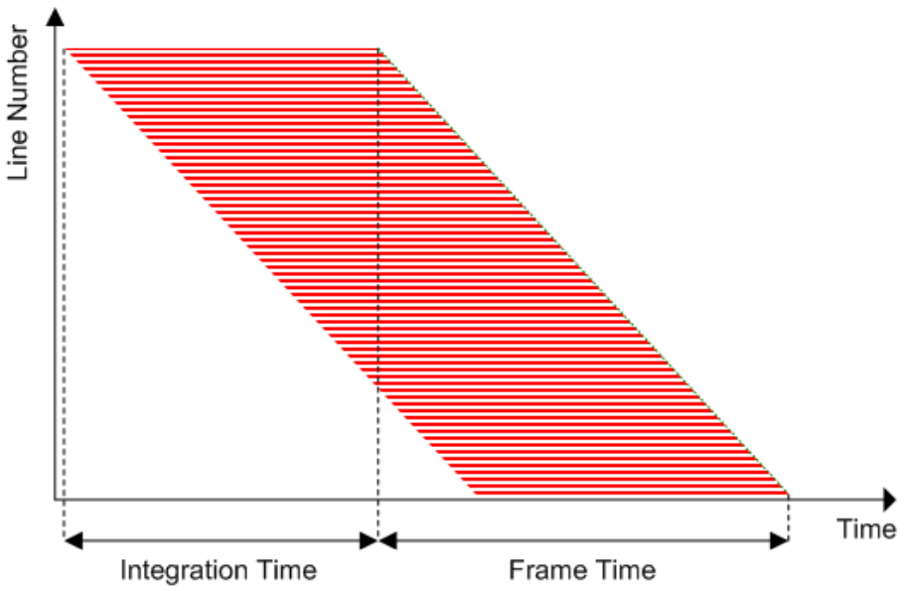
doc.: IEEE 802.15-16- 0013 -00-007a
Different sampling rates
Sampling
interval
rolling exposure
Source: http://www.onsemi.com/pub_link/Collateral/NOIV1SN1300AD.PDF
Rolling shutter Operation
The sampling rate of a Smartphone rolling image sensor is different from the other’s, and typically larger than 15 kHz.
The light modulation and demodulation of a frequency will need to be compatible to different cameras those have different sampling rates.
Submission

Slide 6
doc.: IEEE 802.15-16- 0013 -00-007a
Different rolling exposures
Symbol clock out
… | symbol i | symbol (i+1) | …
rolling exposure time
rolling exposure time
rolling exposure time
Rolling camera sampling
(at low frame rate)
losing information
losing information
Data Fusion
Packet Recovery
symbol i
symbol (i+1)
The rolling exposure time decides how much the amount of data is recorded per a rolling image.
Under presence of frame rate variation, different rolling exposure time is challenging.
Submission

Slide 7
doc.: IEEE 802.15-16- 0013 -00-007a
System Design
Submission

Slide 8
doc.: IEEE 802.15-16- 0013 -00-007a
System Architecture
Transmitter side
Receiver side
clock information (of a data packet): In this scheme, asynchronous bits (Ab) are in form of clock information.
Clock information
Ab = 1
Symbol clock out
Clock information
Ab= 0
Merger
Ab=1
data packet i
Ab=1
… | data packet i | …
Submission

Slide 9
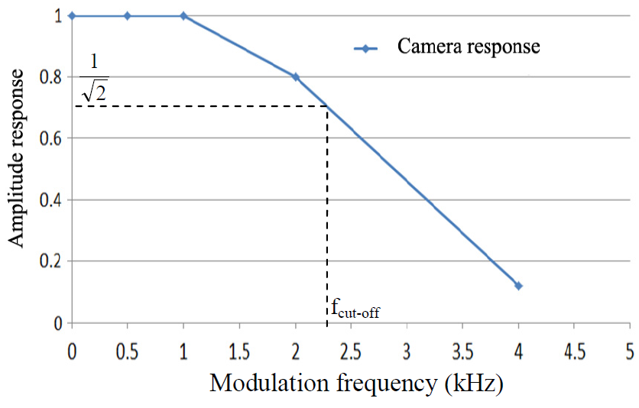
doc.: IEEE 802.15-16- 0013 -00-007a
Modulation frequency
In-band
Eye cut-off
Camera cut-off
Camera
shutter speed
~200 Hz
~8 kHz
The modulation frequency is constant on a frame.
The upper threshold of frequency band in use is less than the shutter speed of camera (Currently, Smartphone has a shutter speed of 8kHz).
Frequency | Compatibility
2 kHz | Webcams, Smartphone cameras (Auto-exposure is OFF)
4 kHz | Smartphone cameras (Auto-exposure is OFF)
The practical response of a long-exposure-camera (A webcam)
Submission

Slide 10
doc.: IEEE 802.15-16- 0013 -00-007a
Data packet Structure
Submission

Slide 11
doc.: IEEE 802.15-16- 0013 -00-007a
Data packet structure
packet (i-1)
packet i
packet (i+1)
DS i ⁽¹⁾
DS i ⁽²⁾
DS i ^{(N)}
SF
Ab
Data packet i
Ab
DS: Data Sub-Packet; SF: Start Packet-Frame Symbol; Ab: Asynchronous bit(s)
A packet is multiple times repeat of one data symbol.
A complete DS has a very-low-header symbol (SF), two similar asynchronous bits (which is a form of the clock information)
Submission

Slide 12
doc.: IEEE 802.15-16- 0013 -00-007a
Data packet structure: The purpose of repetition
packet (i-1)
packet i
packet (i+1)
DS i ⁽¹⁾
DS i ⁽²⁾
DS i ^{(N)}
recorded a complete DS
Problem of losing repeated ones
(is mitigated by using our frame structure)
Repetition is to avoid losing any data when camera makes sampling discretely.
Submission

Slide 13
doc.: IEEE 802.15-16- 0013 -00-007a
Data packet structure: The SF symbol
SF symbol | Ab | Data | Ab
011100 | bit 1/0 | Manchester coding | bit 1/0
0011111000 |  | 4B6B coding
000011111111100000 |  | 8B10B coding
Backward decoding
SF #n
Forward decoding
A SF symbol is detectable. When the frame rate is varying irregularly, the position of the SF symbol on the rolling image is also varying. The detection of SF becomes indispensable for the decoding (forward and backward parts) and recovering data.
The length of SF is different for each RLL code (in order to be low-overhead and detectable).
Submission

Slide 14
doc.: IEEE 802.15-16- 0013 -00-007a
Asynchronous Decoding
Submission

Slide 15
doc.: IEEE 802.15-16- 0013 -00-007a
Decoding Procedure
SF detection: to detect the position of SF on a rolling image.
Asynchronous decoding: From the position of SF, two tasks are performed
Forward decoding: Decode the forward part of the image
Backward decoding: Decode the backward part of the image
Packet recovery: To recover a complete data packet from the incomplete parts decoded, forward and backward part of one (two) data packet(s):
Data fusion: to group parts (forward and backward parts) those belong to one packet. This is indispensable because a camera has a rolling exposure time different from the other camera’s and not equal to DS interval.
Majority voting: to get a complete packet from several discrete-parts of the packet.
Submission

Slide 16
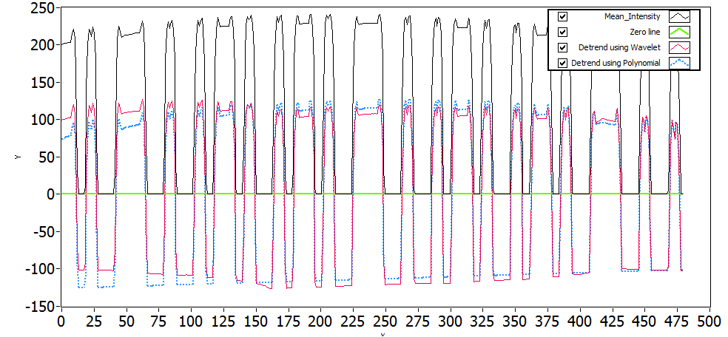
doc.: IEEE 802.15-16- 0013 -00-007a
Asynchronous Decoding: Rolling exposure time >> (DS interval)
SF
SF
SF
Oversampled Asynchronous decoding
This happens when the DS interval is short to be compatible to different rolling exposure times
The majority voting is applied between several images or within an image (using asynchronous bits) to enhance BER.
Submission

Slide 17
doc.: IEEE 802.15-16- 0013 -00-007a
Asynchronous Decoding: Rolling exposure time ~ (DS interval)
4B6B-Data (Backward)
1
SF
1
4B6B-Data (Forward)
Data Fusion
Packet recovery
Data (Forward)
Data (Backward)
Forward decoding and Backward decoding
When the rolling exposure time is almost equal to DS interval, forward and backward are both used to get 100% information of an image.
The fusion of forward part and backward part (of a data packet) is performed to output a complete data packet.
Submission

Slide 18
doc.: IEEE 802.15-16- 0013 -00-007a
Packet Recovery
Packet 1: Ab(s)=1
Packet 2: Ab(s)=0
Packet 3: Ab(s)=1
SF
Ab=1
Ab=1
Ab=0
Ab=0
Packet #1
Packet #2
Inter-frame fusion
intra-frame fusion
Ab=1
Packet #1
Ab=0
Packet #2
Two cases may happen at different sampling time:
Case 1- Inter-frame data fusion: Fusing two sub-parts of a packet at two different images into a complete packet.
Case 2- Intra-frame data fusion: Recovering a complete packet from an image.
Submission

Slide 19
doc.: IEEE 802.15-16- 0013 -00-007a
PHY frame format
Submission

Slide 20
doc.: IEEE 802.15-16- 0013 -00-007a
PHY Frame Format
Preamble and training | PHY header | HCS | PSDU
SHR | PHR |  | PHY payload
CM-FSK
packet (i-1)
packet i
packet (i+1)
DS i ⁽¹⁾
DS i ⁽²⁾
DS i ^{(N)}
SF
Ab⁽¹⁾
Data packet i
Ab⁽²⁾
Data rate related (TBD)
Packet rate : 5/10/15 (packet/sec)
DS rate : 60/120 (DS/sec)
Submission

Slide 21
doc.: IEEE 802.15-16- 0013 -00-007a
Medium-rate PHY I modes
 | MCS indication | PHY modes | Data rate | Unit
7 | 0000 0110 | I.7 | 0.084 | kbps
8 | 0000 0111 | I.8 | 0.17
9 | 0000 1000 | I.9 | 0.22
10 | 0000 1001 | I.10 | 0.44
11 | 0000 1010 | I.11 | 0.53
Detail parameters in medium-rate PHY I modes (using C-OOK)
 |  |  |  |  |  |  | Data rate | Compatibility Support
 |  | Modulation | Coding | Optical Clock rate | Symbol rate | DS rate | (e.g. 10 sym/s) | Varying frame rates | Shutter speeds/ Sampling rates
7 | Medium PHY I (kbps) | OOK based | Manchester | 2 kHz | 5/ 10/ 15 | 120 | 84 bps | Y | Y
8 |  | OOK based | Manchester | 2 kHz | 5/ 10/ 15 | 60 | 0.17 kbps | Y | Y
9 |  | OOK based | 4B6B | 2 kHz | 5/ 10/ 15 | 60 | 0.22 kbps | Y | Y
10 |  | OOK based | 4B6B | 4 kHz | 5/ 10/ 15 | 60 | 0.44 kbps | Y | Y
11 |  | OOK based | 8B10B | 4 kHz | 5/ 10/ 15 | 60 | 0.53 kbps | Y | Y
Submission

