Slide 1
doc.: IEEE 802.15-16- 0012 -01-007a
Project: IEEE P802.15 Working Group for Wireless Personal Area Networks (WPANs)
Submission Title: Kookmin University Color Transmission PHY sub-proposal for ISC
Date Submitted: January 2016
Source: Yeong Min Jang, Trang Nguyen, Mohammad Arif Hossain [Kookmin University]
Contact: +82-2-910-5068 E-Mail: yjang@kookmin.ac.kr
Re:
Abstract: This is a PHY sub-proposal for ISC using Color Transmission. The compatibility in image sensors is supported.
Purpose: Call for Proposal Response
Notice: This document has been prepared to assist the IEEE P802.15. It is offered as a basis for discussion and is not binding on the contributing individual(s) or organization(s). The material in this document is subject to change in form and content after further study. The contributor(s) reserve(s) the right to add, amend or withdraw material contained herein.
Release: The contributor acknowledges and accepts that this contribution becomes the property of IEEE and may be made publicly available by P802.15.
Submission

Slide 2
doc.: IEEE 802.15-16- 0012 -01-007a
Content
PHY design considerations
Frame rate variation
Compatible to both shutter types
Perspective distortion and Rotation mitigation
Color-channels interference
System designs
Transmitter and encoding
Image processing and Decoding
Compatibility features
PHY format and PHY modes
Error correction
Submission

Slide 3
doc.: IEEE 802.15-16- 0012 -01-007a
PHY design considerations
Submission

Slide 4
doc.: IEEE 802.15-16- 0012 -01-007a
Frame rate variation
Symbol clock out
… | symbol i | symbol (i+1) | …
Camera sampling
(varying frame rate)
Majority Voting
symbol i voting
symbol (i+1) voting
Camera frame rate range | Symbol rate
> 20 fps | 5/10/15 (symbol/sec)
Clock interval > Max{sampling interval}
Submission

Slide 5
doc.: IEEE 802.15-16- 0012 -01-007a
Compatible to shutter types
Symbol clock out
… | symbol 1 | symbol 2 | …
Global sampling type
Rolling sampling type
Rolling effect
How to mitigate rolling effect?
Submission

Slide 6
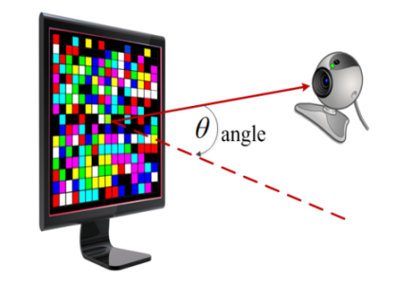
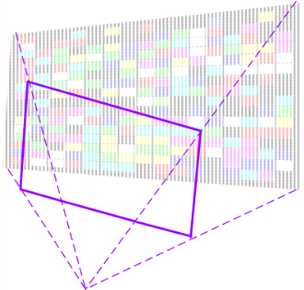
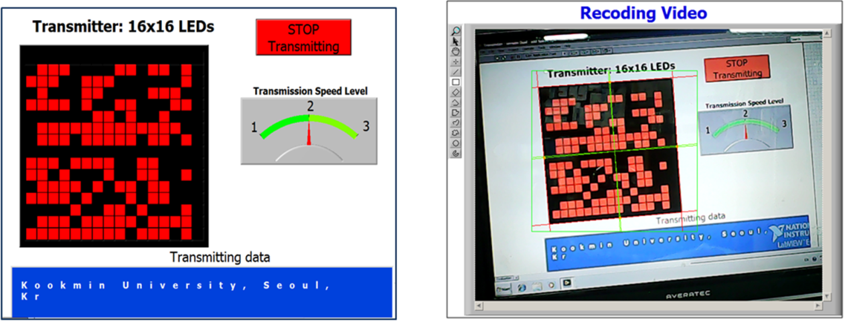
doc.: IEEE 802.15-16- 0012 -01-007a
Perspective Distortion and Rotation
Perspective Distortion
Rotation
How to mitigate perspective distortion and rotation?
Submission

Slide 7
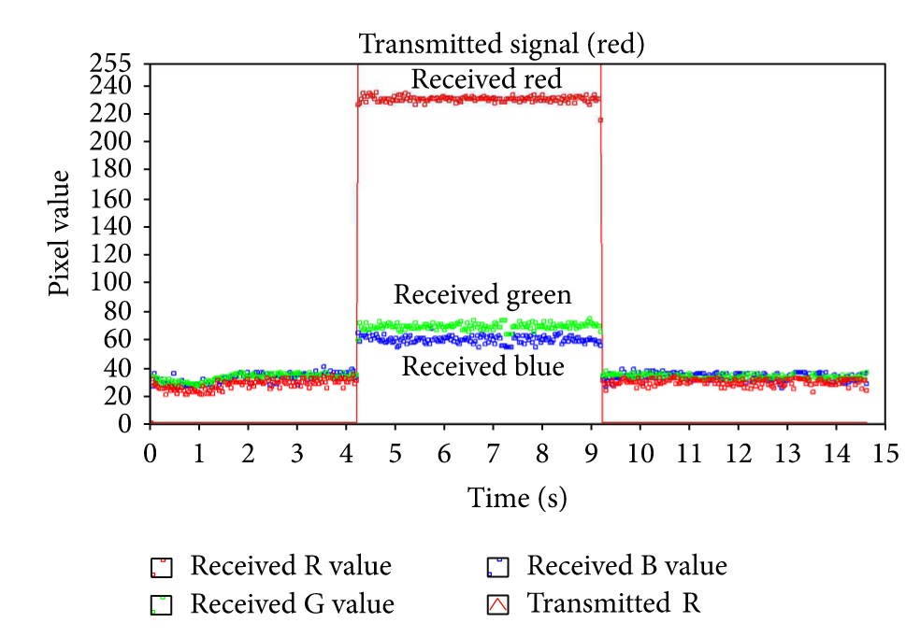
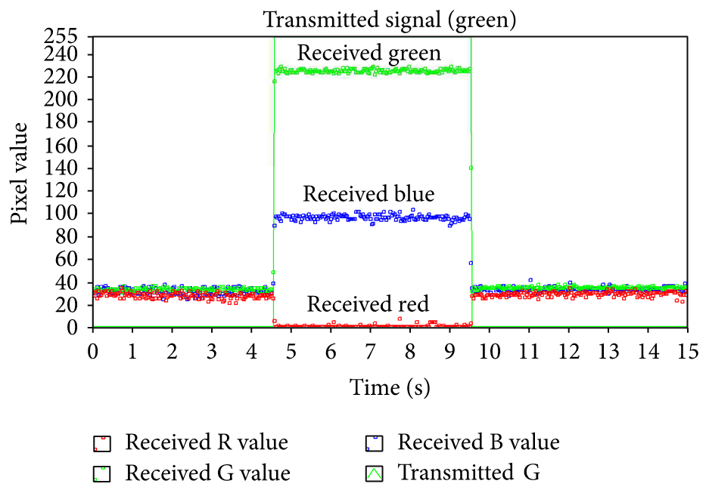
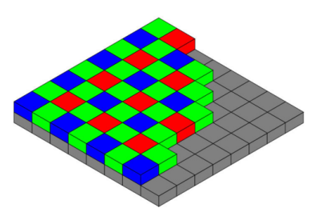
doc.: IEEE 802.15-16- 0012 -01-007a
Channels Interference
Interference between color channels due to the Bayer filter of image sensor
A fixed threshold may cause error.
Submission

Slide 8
doc.: IEEE 802.15-16- 0012 -01-007a
System Design
Submission

Slide 9
doc.: IEEE 802.15-16- 0012 -01-007a
System Architecture
Transmitter side
Receiver side
clock information (of a data packet/symbol): The information represents the state of a symbol clocked out. The clock information is transmitted along with a symbol to help a receiver in identifying an arrival state of new symbol under presence of frame rate variation.
Clock information
bit = 1
Symbol clock out
Clock information
bit = 0
… | symbol i | symbol (i+1) | …
Submission

Slide 10
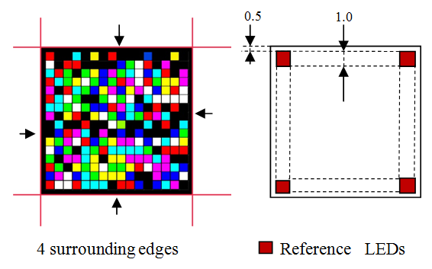
doc.: IEEE 802.15-16- 0012 -01-007a
Transmitter Design
A design of 16x16 LEDs transmitter
Reference LEDs (4 LEDs at 4 corners):
Transmit clock information to help a varying-frame rate receiver in performing asynchronous decoding
To mitigate the rolling shutter effect
4 Surrounding lines (high gradient difference):
To help a receiver in detecting and extracting LEDs in real-time
Submission

Slide 11
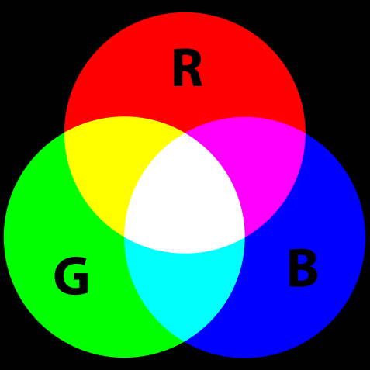
doc.: IEEE 802.15-16- 0012 -01-007a
Colors Encoding (Flicker mode)
Encoding table for reference LEDs and data LEDs
Reference LEDs | Red channel | Clock infor. bits (0 1 0 1 …)
Data LEDs |  | data bit “0” | data bit “1”
 | Red channel | 0 | 1
 | Greem channel | 0 | 1
 | Blue channel | 0 | 1
Multi-colors encoding true table
3 bits-Input | Color-Output
000 | Black
100 | Red
010 | Green
001 | Blue
110 | Yellow
101 | Magenta
011 | Cyan
111 | White
Submission

Slide 12
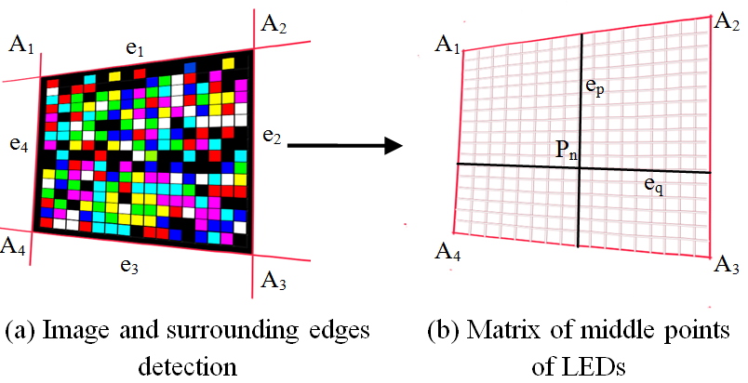
doc.: IEEE 802.15-16- 0012 -01-007a
LEDs extraction under Perspective Distortion and Rotation
LEDs extraction matrix using line detection under perspective distortion
Step 1: 4-Edges detection
Edges are detected by using Hough transform
The position of 4 corners and matrix positions of LEDs
Step 2: 16x16 LED-positions Matrix forming
Input: 4-corner positions A_{i}(w, h)
Output: 16x16 matrix of LED-positions
Submission

Slide 13
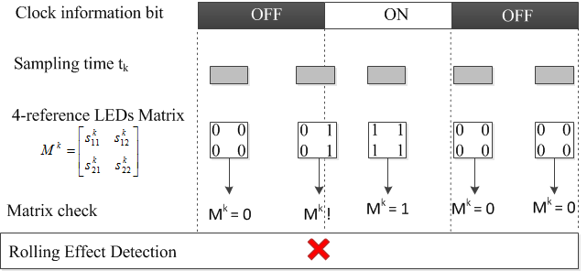
doc.: IEEE 802.15-16- 0012 -01-007a
Rolling effect Detection and Cancellation
A state-Matrix of 4 reference LEDs at the sample #k:
Notice: The detection is still true under rotation!
Detect the rolling effect in an image:
- If (M^{k} != 0 && M^{k} != 1) then (the image has rolling effect)
Submission

Slide 14
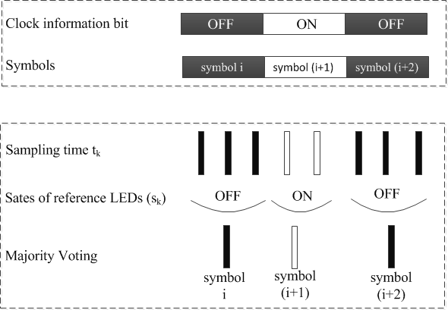
doc.: IEEE 802.15-16- 0012 -01-007a
Frame rate variation Cancellation (Asynchronous Decoding)
When at least one sample is captured on an interval of a symbol, a majority voting is applied
Clock information bit is helpful to identify the group of samples for a symbol voting.
Submission

Slide 15
doc.: IEEE 802.15-16- 0012 -01-007a
PHY frame format
Submission

Slide 16
doc.: IEEE 802.15-16- 0012 -01-007a
PHY frame format
Preamble and training | MCS ID | PSDU length | Reserved | HCS | PSDU
Symbols: 2 | 1 | 1 | 1 | x | Variable
Preamble and training: a symbol s and an inverse symbol $\overline{s}$
MCS ID: Modulation and Coding Scheme ID
PSDU: PHY Service Data Unit
HCS: Header-Check Sequence
Submission

Slide 17
doc.: IEEE 802.15-16- 0012 -01-007a
Spatial-MIMO
(resolution mode 1)
spatial-MIMO
(resolution mode 2)
symbol 1
symbol 2
MCS ID
PSDU length
Reserved
HCS
PSDU
s
$$\overline{s}$$
SHR
PHR
SHR and PHR design:
On a low resolution to ensure compatibility to different resolutions versus distance.
Submission

Slide 18
doc.: IEEE 802.15-16- 0012 -01-007a
Preamble design:
Symbol s and $symbol \overline{s}$ are inverse forms to provide DC balance.
Preamble symbols are at low spatial-resolution among spatial-MIMO PHY modes.
Although the resolution can be increased at PSDU, the symbol rate does not change throughout the frame between preamble, header, and payload. Any symbol rate should be pre-noticed
PHY header design:
SHR and PHR are at the same resolution (lowest among spatial-MIMO PHY modes).
Although the resolution can be increased at PSDU, the symbol rate does not change throughout the frame between preamble, header, and payload. Any symbol rate should be pre-noticed
symbol s
$$symbol \overline{s}$$
MCS ID
PSDU length
Reserved
HCS
PSDU
Preamble
resolution mode 1
resolution mode 2
constant symbol rate
Submission

Slide 19
doc.: IEEE 802.15-16- 0012 -01-007a
PHY modes
 | MCS indication | PHY modes | Data rate | Unit | Note
14 | 0000 1110 | I.11 | 2.5 | kbps | Flicker (16 x 16)
16 | 0001 0000 | I.12 | 5 |  | Flicker (16 x 16)
17 | 0001 0001 | I.13 | 7.5 |  | Flicker (16 x 16)
18 | 0001 0010 | I.14 | 40 |  | Flicker (64 x 64)
19 | 0001 0011 | I.15 | 80 |  | Flicker (64 x 64)
20 - 256 |  | reserved
Notice
Data rate is counted at 10 symbol/sec
Preamble symbols are at low spatial-resolution among spatial-MIMO PHY modes.
Submission

Slide 20
doc.: IEEE 802.15-16- 0012 -01-007a
PHY Error Corrections
Error due to frame rate drops unexpectedly
A transmitted symbol is missed on sampling when the camera frame rate drops to lower than the symbol rate unexpectedly. Line coding can be used to correct this type of error
If this type of error happens frequently, a reduction of image resolution can achieved a higher frame rate.
Error due to interference/noise
A electronics noise/ or noise comes from environment/ or noise comes from an incorrect threshold
If this type of error can be mitigated by using spatial coding as following slide.
Submission

Slide 21
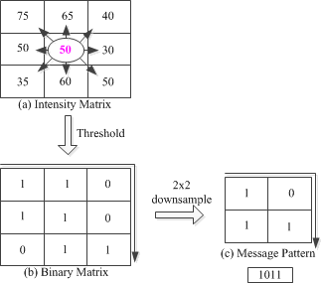
doc.: IEEE 802.15-16- 0012 -01-007a
Spatial Error Correction Coding to reduce BER
(TBD)
Example: 15x15 LEDs transmitter
A fixed threshold
=> 15x15 = 225 bits per frame
Use 3x3 spatial blocks to define 2x2 bits
10x10 = 100 bits per frame
Advantages:
A reference point (a middle point) provides a reliable intensity threshold for the whole block to reduce error
A spatial code additionally reduces error 2nd time
Reference point
3x3 LEDs block with error correction
For a high-MIMO transmitter, what kind of error correction is needed?
Submission

Slide 22
doc.: IEEE 802.15-16- 0012 -01-007a
PHY Summary
The system design supports those functionalities:
Frame rate variation
Compatible to both shutter types
Perspective distortion and Rotation mitigation
Color-channels interference
The PHY design modes
PHY modes for color transmission C-CSK (2.5kbps - 80kbps)
Compatibility support in SHR and PHR design is highly considered. The lowest data mode among available PHY modes is used for both SHR and PHR.
Low-resolution is used for SHR and PHR frames in spatial scheme.
The DPSU can use the same PHY mode or upgrade to higher PHY mode among available PHY modes. The notice of DPSU PHY mode is MCS ID frame.
Two types of error correction:
Line coding
Spatial coding
Submission

Slide 23
doc.: IEEE 802.15-16- 0012 -01-007a
Appendix: QR-ISC Code
(Integrating dynamic data into color-QR code)
Submission

Slide 24
doc.: IEEE 802.15-16- 0012 -01-007a
Integration of ISC into QR code
QR-ISC Tag is color modulation in Image Sensor Communications (ISC) integrated into QR code. The ISC uses three channels of Red, Green and Blue to transmit data, along with that is the asynchronous symbols to support varying-frame-rate camera receivers.
Block Diagram of QR-ISC Tag in Transmitter side
We borrow the format and error correction from QR code standard.
How data is transmitted was already presented in our PHY above.
Submission

Slide 25
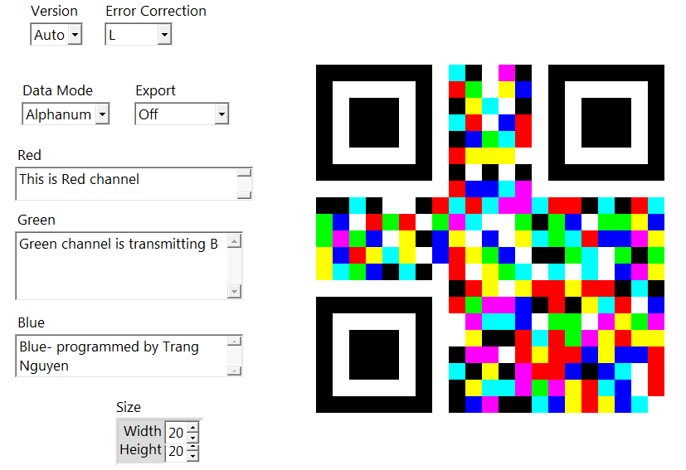
doc.: IEEE 802.15-16- 0012 -01-007a
Considerations
There are some consideration in integrating dynamic data into color QR code:
The size of QR code
The symbol rate of transmission
The decoding does not require to be real-time; however the processing of an image should finish before a new image comes to sequence.
Block Diagram of QR-ISC Tag in Transmitter side
Submission

