Slide 1
Project: IEEE P802.15 Working Group for Wireless Personal Area Networks (WPANs)
Submission Title: Proposal for OWC Using Color Space Modulation
Date Submitted: Jan. 8, 2016
Source: Soo-Young Chang
Company: SYCA
Address:
Voice: 530 574 2741 FAX: E-Mail: sychang@ecs.csus.edu
Re: CFP of 15.7r1
Abstract: Proposal for OWC for Image sensor and high rate PD communications
Purpose: to submit a proposal for 802.15.7r1
Notice: This document has been prepared to assist the IEEE P802.15. It is offered as a basis for discussion and is not binding on the contributing individual(s) or organization(s). The material in this document is subject to change in form and content after further study. The contributor(s) reserve(s) the right to add, amend or withdraw material contained herein.
Release: The contributor acknowledges and accepts that this contribution becomes the property of IEEE and may be made publicly available by P802.15.
Slide 1
        Soo-Young Chang, SYCA

Slide 2
COLOR SPACE MODULATION
PROPOSED
Slide 2
        Soo-Young Chang, SYCA
Notes:
doc.: IEEE 802.15-09-0117-00-0007
<month year>

Slide 3
CONSIDERATIONS FOR MODULATION
Need of brightness control or not
  Needs to provide superior brightness for optical wireless communications?
  It is more desirable for performance not to be affected by brightness control.
Dependency of LED characteristics
  Modulation technique applied is not dependent on technical characteristics of LED or other light sources deployed.
Not (or negligibly) affected by background noise or not
  Offsetting the impact of background lights
  Stable data transmission should be provided even if the background noise is strong.
  Offers high robustness to background light
Data speed
  Low to high data rates to be realized: adaptive to the amount of information delivered
  Adaptiveness to various data speeds is important.

Slide 4
MAJOR DISTINCTIONS BETWEEN OWC AND RADIO COMMUNICATION
OWC | Radio comm.
Data delivery by manipulating and measuring light, in terms of its perceived brightness or colors to human eyes. The radiant power at each wavelength is weighted by a luminosity function (a.k.a. visual sensitivity function) that models human brightness sensitivity. | Data delivery by manipulating electromagnetic signals and detecting parameters of the received signals or measuring radiant energy in terms of absolute power.
A light signal which will be manipulated for data delivery has a certain amount of frequency (or wavelength) band before modulation. | A carrier signal usually has a single frequency component which is modulated with data. Eventually the transmitted signal has a certain amount of band after modulation.

Slide 5
FACTORS CONSIDERED FOR OWC MOULATION (1)
Eye sensitivity
  To generate light with a color which is recognized by human eyes
  Human eyes have different sensitivity for each wavelength: chronomicity functions reflect human eyes’ sensitivity for various wavelengths.
  To determine colors recognized by human eyes after modulation
Spectral distribution of light emitting devices or light sources
  To realize colors to be recognized by human eyes
Light color spaces
  In a constellation plane of a modulation scheme, to determine a possible area of the points where most efficient modulation can be realized, light color spaces can be defined.
  To mix multiple colors to generate a target color, a set of color coordination coefficients in a light color space can be considered to define intensities of available color components.

Slide 6
FACTORS CONSIDERED FOR OWC MODULATION (2)
Responsivities of photo detection devices
  Photo detection devices have different responsivities for each wavelength.
  At the receiver, post emphasis may be needed to compensate perceptual non-uniformity.
Colors or comfortableness of light output from light emitting devices after modulation
  After modulation, any target color should be able to be generated: to human eyes.
  To mix multiple colors to generate any target color, a set of color coordination coefficients (or intensities of light sources)should be considered.
Communications should not degrade illumination efficiency.
  Compatible with dimming: no or minimum performance degradation due to dimming
Efficiency of constellation map in a light color space after considering all factors
  The above factors should be considered to design a constellation map, given a target color and the number of constellation points.

Slide 7
BASIC CONCEPT: MULTI COORDINATES TO REPRESENT COLORS (1)
In the modulation scheme suggested in this document, two coordinates (x and y) for a two dimensional light color space are considered.
  x and y are designed to be orthogonal to each other to be applied for the scheme:
    No correlation between these two.
    Any point in a space can be represented by a unique pair of these values.
    A color is represented by a unique point in a space, not by multiple points.
  Similar to QAM
    Determine points which maximize the minimum distance among distances between any two points.
    Equi-distance strategy is a possible way to assign points.

Slide 8
BASIC CONCEPT: MULTI COORDINATES TO REPRESENT COLORS (2)
A color can be generated by mixing lights from multiple light emitting devices such as LEDs: multiple light sources based, not single light source based
  It is not necessary that light of a color can be generated by mixing lights from multiple light emitting devices with a unique set of light intensities of light emitting devices.
  A multi dimensional space can be considered to represent colors.
  → A multi dimensional light color space can be used for color representation, but generally it is not true that there is only one point to represent each color: multiple points can be identified for a specific color in general.
  → Thus a light space should be well tailored not to have multiple points to represent a color, but to represent a color with a unique point.

Slide 9
MODULATION BLOCKS
Transmitter
Receiver
Data
stream
from
information
source
Serial-
to-parallel
convert
Data-to-
modulation
mapping
Light
emitting
device
driver
Light
emitting
device
Light with a color
recognized by
human eyes
Data
stream
to
information
sink
Parallel-
to-serial
convert
Modulation
-to-data
demapping
Amplifier
Photo
detector

Slide 10
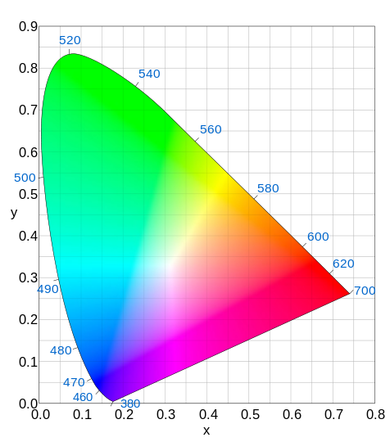





CIE 1931 COLOR SPACE (1)
The CIE xy chromaticity diagram and the CIE xyY color space
The outer curved boundary is the spectral (or monochromatic) locus, with wavelengths shown in nanometers.
The concept of color can be divided into two parts: brightness and chromaticity.
The Y parameter is a measure of the brightness or luminance of a color.

Slide 11
CIE 1931 COLOR SPACE (2)
One important fact on CIE xyY color space
The CIE 1960, CIE 1964, and CIE 1976 color spaces were developed, with the goal of achieving perceptual uniformity (to have an equal distance in the color space correspond to equal differences in color). Although they were a distinct improvement over the CIE 1931 system, they were not completely free of distortion.
→To utilize better perceptual uniformity, the CIE 1976 is more appropriate for a color space for modulation schemes using the constellation planes in a light color space including one suggested in this document. And also it has less area that can not be covered by a triangle made with any three point colors.
Another fact on primary colors
Any choice of primary colors is essentially arbitrary; for example, an early color photographic process, autochrome, typically used orange, green, and violet primaries.

Slide 12
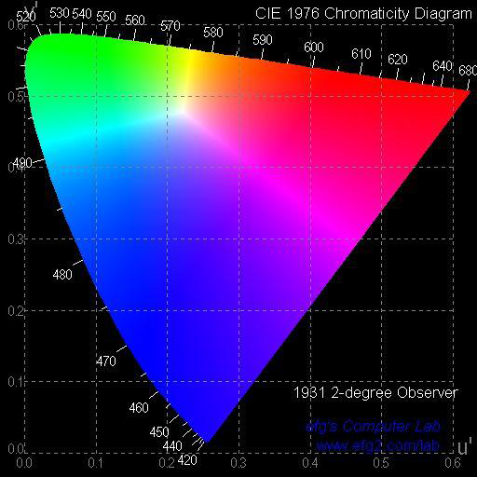
1976 CIE u’v’ COLOR SPACE
1976 CIE u’v’ (or CIE LUV) Chromaticity Diagram (1)
The advantage of the 1976 diagram is that the distance between points is now approximately proportional to the perceived color difference, something definitely not true in the 1931 diagram.
→attempted perceptual uniformity
→additive mixtures of different colored lights will fall on a line in CIE LUV's uniform chromaticity diagram with a condition that the mixtures are constant in lightness.
Historical inertia has won out over technical superiority: the 1976 diagram is not used as much as the original 1931 diagram.

Slide 13
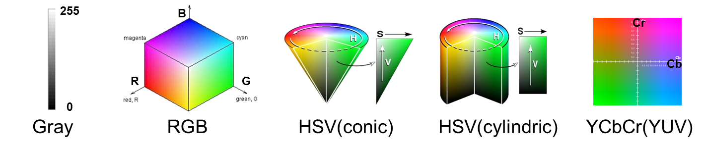
VARIOUS CONSTELLATION DIAGRAM TYPES

Slide 14
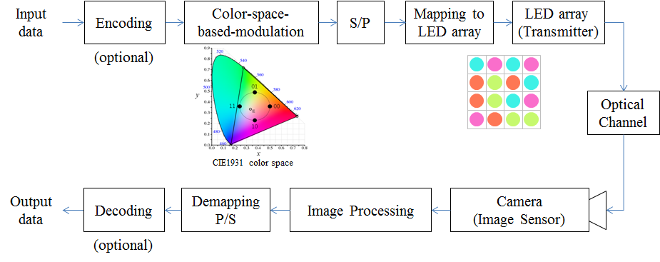
COLOR INDEPENDENT VISUAL-MIMO (1)
Color independent Visual-MIMO tranceiving procedure

Slide 15
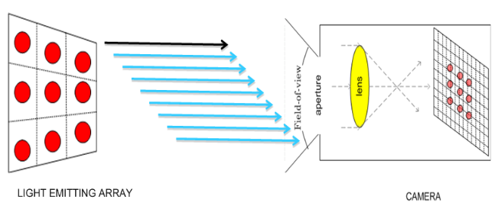
COLOR INDEPENDENT VISUAL-MIMO (2)
Visual-MIMO System
Camera
Smart phone
Vehicle
CCTV
LEA(Light Emitting Array)
LED
Display screen

Slide 16
BASIC CONCEPT (1)
Transmission and reception (or detection) of light signals
  At the transmitter, multiple light sources (or light emitting devices) such as LEDs with different spectral distributions are used for light emission.
  At the receiver, multiple photo detectors with different spectral responses are used for light detection.
Any color can be represented by a point in a multi-dimensional space uniquely.
  Any color is represented by a point in an n dimensional space –but not uniquely for most cases. It is because in general light generated by each device can also be generated by mixing light signals from other devices which have different spectral distributions.
  Thus multi-dimensional space should be defined to represent a color with a point uniquely in this space. One possibility is use of spectrally uncorrelated light sources or photo detectors, but it is not assumed in this document.
  A unique color for a point in the space can be generated by mixing lights emitted from n light emitting devices and be detected by processing light signals detected by k photo detectors.

Slide 17
BASIC CONCEPT (2)
Light Signal Delivery Model from Transmitter to Receiver
Radiation at Transmitter
  Multiple light emitting devices emit light signals at transmitter. Each device has its own spectral distribution, S(λ), which determines its emitted power by calculating total power throughout the whole wavelength range. By using the color matching functions of a light space and by calculating stimulus values –for two dimensional space, X, Y and Z values -of the light space, the color of emitted light perceivable by human eyes can be determined.
Perception by Human Eyes
  To know how human eyes react to emitted light, emitted light signal which has spectral distribution, S(λ), is multiplied by a standardized luminosity function -wavelength-weighted by the luminosity function to correlate with human brightness perception. Then total power perceived by human eyes can be determined.
Detection at Receiver
  The emitted signal has spectral distribution, S(λ), which is delivered to the detector which is characterized by its responsivity, its own spectral sensitivity, which determines the spectral characteristics and total received power to determine color detected.

Slide 18
BASIC CONCEPT (3)
Light Signal Delivery Model from Transmitter to Receiver Intensity
Intensity c’₁
Intensity c₁
light
Intensity c’₂
Intensity c₂
Intensity c’_{k}
Intensity c_{n}
n light emitting
devices
k photo detectors
transmitter
channel
receiver
c_{total} = c₁+c₂+…+c_{n}
where c_{i} = ∫s_{i}(λ)dλ
c’_{total} = c’₁+c’₂+…+c’_{k}
where c’_{i} = ∫s’_{i}(λ)dλ
Transmitted light power:
∑∫s_{i}(λ)dλ
noise
interference
Received light power:
∑ ∫s’_{i}(λ)dλ
+
=

Slide 19
MODULATION BLOCKS REVISITED
Transmitter
Receiver
Color information
Data
stream
from
information
source
Serial-
to-parallel
convert
Data-to-
modulation
mapping
Light
emitting
device
driver
Light
emitting
module
m
n
n
2^{m} points
mapping/demapping
Light colors
recognized by
human eyes
Data
stream
to
information
sink
Parallel-
to-serial
convert
Modulation
-to-data
demapping
Amplifier
Photo
detector
m
k
k
Color information (optional)

Slide 20
KEY PART FOR NEW MOD: MAPPING
Data-to-modulation mapping (transmitter)
b₁
mapper
c₁
b₂
c₂
b_{m}
c_{n}
Modulation-to-data demapping (receiver)
c’₁
demapper
b’₁
c’₂
b’₂
c’_{k}
b’_{m}

Slide 21
GENERATION OF CONSTELLATION (1)
Assumptions
  Equi-probable data elements
  For a fixed number of symbols’ duration, color is not changed.
Input
  Information data: m bits → 2^{m} symbol elements → 2^{m} points
  Color information: (x_{c},y_{c})
Output
  Constellation: (x,y)
Two parameters considered to pick points in a light space
  Colors perceptible by human eyes
  Equi-distance between two adjacent points when points are detected by photo detectors
y
Target color
position
Displacement
vector
x
(0,0)

Slide 22

GENERATION OF CONSTELLATION (2)
Point of
target color
Point of a
light emitting
device
Max area of
constellation
Maximum area of constellation is determined by two factors:
  Point of target color for human eyes: this point becomes the origin of constellation.
  Gamut formed by primary color points which represent points of light emitting devices used.
  → Maximum constellation area determined
Constellation
area with radius r_{c}
Gamut formed by seven
light emitting devices

Slide 23
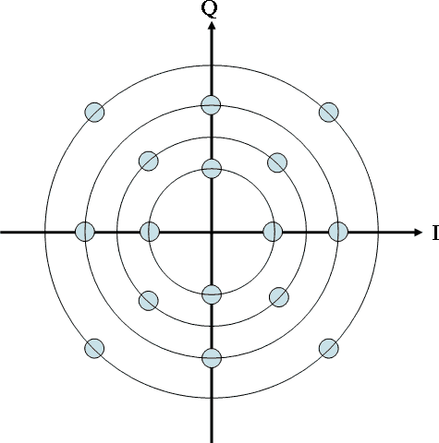
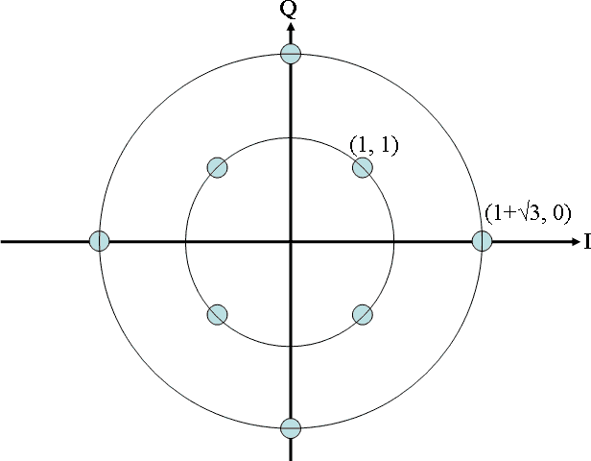
GENERATION OF CONSTELLATION (3)
Normalized constellation
Inside a unit circle centered at the original, 2^{m} points are assigned so that the minimum distance between any two points be maximized.
y
Examples of constellation
x
y
y
m=4
2^{m}=16 points
x
x
m=3
2^{m}=8 points
m=2
2^{m}=4 points

Slide 24
GENERATION OF CONSTELLATION (4)
Constellation scaled with the center of target color location
Normalized constellation generated is shifted so that the center is located at the target color point and scaled so that constellation area fits the maximum area with a radius of r_{c}.
y
(x_{c},y_{c})
x
Examples of constellation
y
y
m=4
2^{m}=16 points
(x_{c},y_{c})
(x_{c},y_{c})
x
x
m=2
2^{m}=4 points
m=3
2^{m}=8 points

Slide 25
CONSTELLATION TO (c₁, c₂, . . ., c_{n}) MAPPING
Assumption
  Perceptual uniformity or linearity of light emitting devices and photo detectors in the light space
Input/output
  Input: Constellation: (x,y)
  Output: (c₁, c₂, . . . , c_{n})
Two cases for color properties of light emitting devices
  1. Using (x_{i},y_{i}) i=1, 2, .., n for all light emitting devices if (x_{i},y_{i}) i=1, 2, .., n, is given
  2. Using spectral distributions of light emitting devices if (x_{i},y_{i}) i=1, 2, .., n, is not given

Slide 26
(c’₁, c’₂, . . ., c’_{k}) TO CONSTELLATION DEMAPPING
Assumption
  Uniformity or linearity of light emitting devices and photo detectors in the light space
  The receiver has constellation information that the transmitter applies and can get color information for each symbol received for itself or from outside.
Input/output
  Input: (c’₁, c’₂, . . . , c’_{k}): light intensities measured by photo detectors: noise added from channels to these coefficients
  Output: information point, (x’, y’), in a constellation most closely matching to a set of light intensities, (c’₁, c’₂, . . . , c’_{k})
Two cases for color detection properties of photo detectors
  1. Using (x’_{i},y’_{i}), i=1, 2, .., k, for all photo detectors if these values are given
  2. Using spectral distributions of photo detectors if (x’_{i},y’_{i}), i=1, 2, .., k, is not given

Slide 27
COLOR INFORMATION FROM CONSTELLATION
How to extract color information at receiver?
Two cases
1.Transmitter sends color information (xc,yc): TV signals, etc.
2.Using a fixed number of previous received symbols, color information can be extracted
data points identified
for a fixed number of
symbol period
constellation area
For an example for m=2
color point identified as
a center point of data points
for a fixed number of
symbol period

Slide 28
GENERATION OF TARGET COLOR OF EACH BAND USING MULTIPLE LEDS
Basic concept
  If there are multiple subbands in a whole band, each subband can not be represented by a single LED: multiple LEDs should be used.
  If 8 bands exist, eight different LEDs can be used by assigning an LED for each band. This is not a usual and most efficient case. The best way is that by using a fixed number of LEDs all bands can be covered. It can be realized using a target color generation method applied in this New Modulation.

Slide 29
INFORMATION DATA FROM CONSTELLATION (1)
With an assumption that
Gamut formed by photo detectors should include all area of gamut formed by light emitting devices at transmitter. If not, some distortion is inevitable.
How to extract constellation scaling factor for a color at receiver?
How to get constellation area at receiver?
Some cases can be considered:
  1.Periodically transmitter broadcasts information on light emitting devices used.
  2.Whenever color changes or periodically with a fixed interval, transmitter broadcasts scaling factor information with color information.
  3.Without any information above, the receiver can know color information and constellation by examining points of a fixed number of previously received symbols.

Slide 30
INFORMATION DATA FROM CONSTELLATION (2)
Case that target color information delivered from transmitter (Case 1)
Extraction of information data from received signals
Point of a
photo detector
Area of
constellation
Point of
target color
Gamut formed by
seven photo detectors

Slide 31
WHY NEW MODULATION ?
MOTIVATION TO CSM (1)
Not affected by light intensity: not intensity modulation
  Only related to positions of signals in a light space
  Dimming control is not a problem to implement.
Any colors can be generated: independent of colors
  Free from colors of lights to be sent: independent of colors of light signals
  Any target colors generated for human eyes; signals detected by PDs
Progressive modulation can be achieved without any serious burden
  Lower to higher data rates can be achieved with a common constellation (scheme) corresponding to various applications
  Varying number of points in a constellation and symbol periods
    Lowest data rate for remote controlling: 2-CSM, 1 symbol/4 symbol periods→ 1/4 bit/symbol period → 40 Mbps
    Highest data rate for file transfer: 64-CSM, 1 symbol/1 period → 6 bits/symbol period → 1 Gbps

Slide 32
WHY NEW MODULATION ?
MOTIVATION TO CSM (2)
Adaptive to various data rates and colors
Colors of light sources: adaptive to various colors
Application category | colors
Traffic light –vehicle | red, green and amber
Vehicle–vehicle | can be determined in favor of modulation scheme applied
Infra-vehicle (outdoor) | can be determined in favor of modulation scheme applied
Infra-mobile (indoor low speed) | can be determined in favor of modulation scheme applied
Infra-mobile (indoor high speed) | white/illumination
Mobile/fixed-mobile | can be determined in favor of modulation scheme applied

Slide 33
WHY NEW MODULATION ?
MOTIVATION TO CSM (3)
With peak transmit power fixed,
  Higher average transmit power
  Longer range
  Lower BER
are more desirable.
New Modulation (NM),
  should not depend on the color transmitted
    Self identification of colors of light signals detected
  should not depend on the intensity of transmitted signals
    Not intensity modulation, but constellation modulation in a color space: each point (or symbol) represented by two coordinates in a color space
    Use full power for data representation: more power can be used for transmission for the case of confined peak power.

Slide 34
WHY NEW MODULATION ?
MOTIVATION TO CSM (4)
Implementation issues for transmitters and receivers
  One light transmitter consists of more than 2 light emitting devices.
  If it is not the case, another modulation scheme should be used.
    If existing light sources with one light emitting device is used,
Simple implementation
  At the transmitter
    Given x and y coordinates or spectral distributions of n light emitting devices in a light space used for the light sources by manufacturers
    A look-up table applied for data to intensities mapping for 2^{m} CSM
  At the receiver
    Given x and y coordinates or spectral responses of k photo detection devices in a light space used for the light sources by manufacturers
    A simple formula applied for intensities to data demapping for 2^{m} CSM

Slide 35
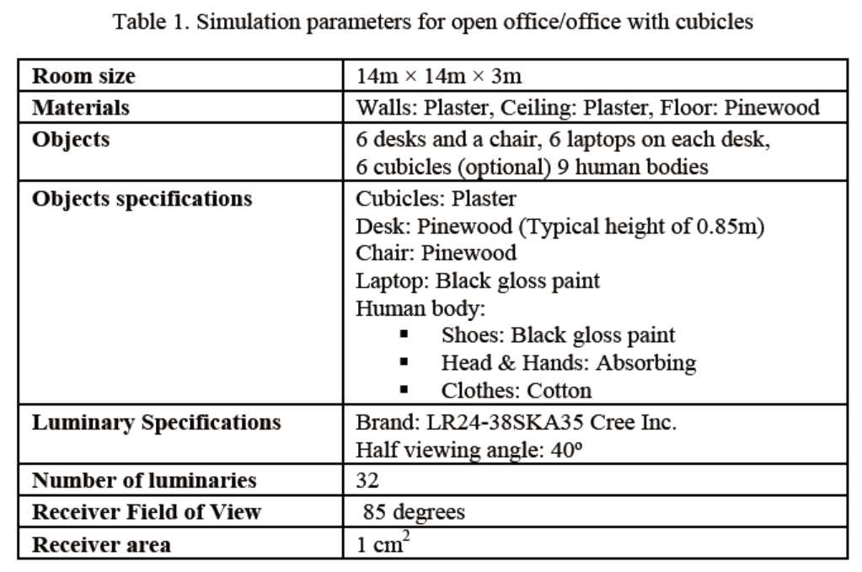
SIMULATION RESULTS (1)
Scenario 1 -> a)Open Office -> D1~24

Slide 36
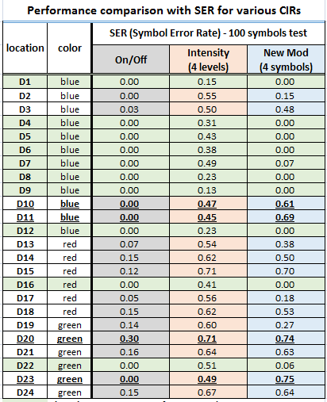
SIMULATION RESULTS (2)

Slide 37
SIMULATION RESULTS (3)

Slide 38
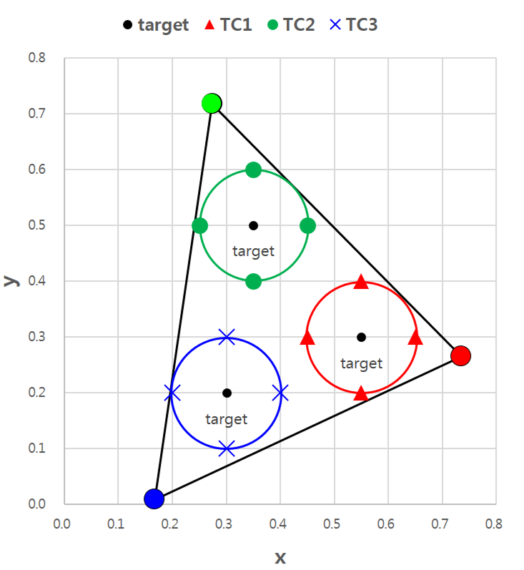
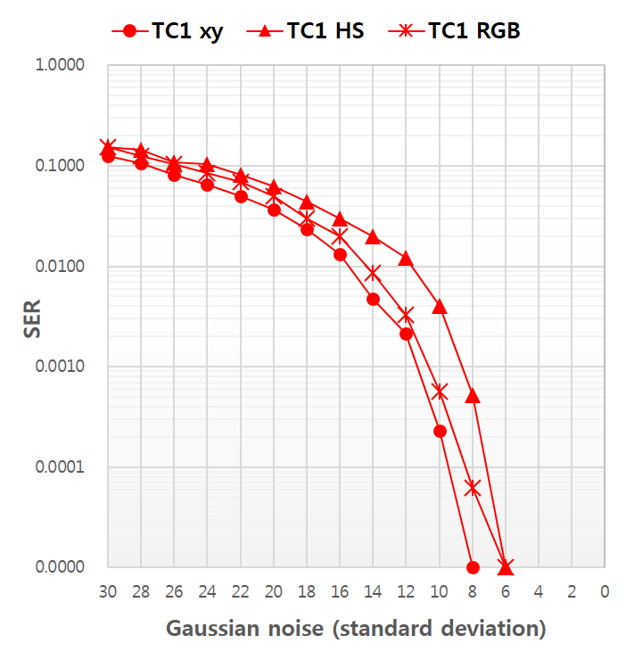
SER COMPARISON ON COLOR MODELS
constellation diagram
SER graph (TC1)
Symbol decision method in receiver.
1. x, y decision in CIE1931
2. H, S decision in HSV model
3. R, G, B decision in RGB model

Slide 39
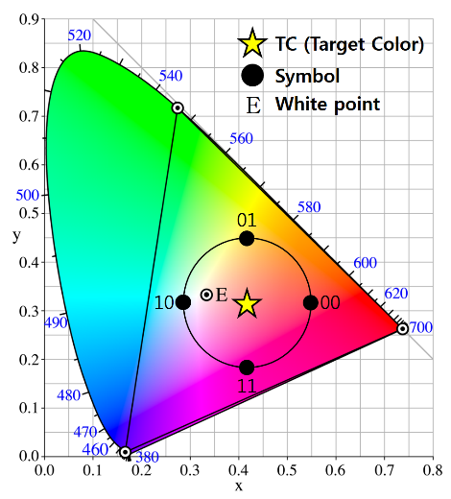
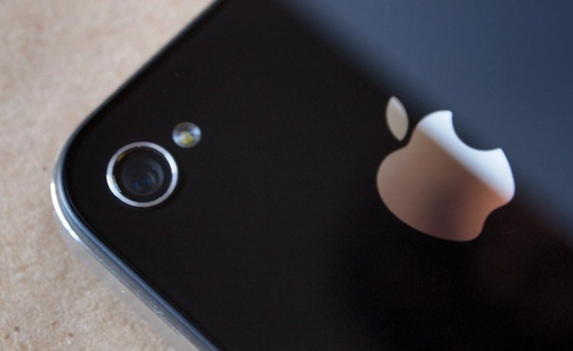
DATA RATES ACHIEVED
…
…
…
N
N
Encoding
Using m(=2^{n}) symbols
-> n [bits/symbol]
LED Array size
N x N = N² [symbol]
Camera frame rate
F [fps]
Data rate = n x N² x F [bps]

Slide 40
CONCLUSIONS
New color space modulation scheme proposed has many advantages
  Independent of brightness control
    Not to be affected by brightness control.
  Dependency of LED characteristics
    Modulation technique applied is not dependent on technical characteristics of LED or other light sources deployed.
  Not (or negligibly) affected by background noise
  Adaptiveness to various data speeds
  Simple implementation
New modulation scheme proposed has better performance than other intensity modulations.

