Slide 1
Project: IEEE P802.15 Working Group for Wireless Personal Area Networks (WPANs)
Submission Title: pureLiFi 802.15.7r1 proposal for High Speed PD OWC communications
Date Submitted: January 2016
Source: Dr. Nikola Serafimovski Company: pureLiFi Ltd.
Address: pureLiFi Ltd. ETTC, Max Born Crescent, Edinburgh, EH9 3BF, UK
Voice: +44-131-472-4704, E-Mail: nikola.serafimovski@purelifi.com
Re:
Abstract:
Purpose:
Notice: This document has been prepared to assist the IEEE P802.15. It is offered as a basis for discussion and is not binding on the contributing individual(s) or organization(s). The material in this document is subject to change in form and content after further study. The contributor(s) reserve(s) the right to add, amend or withdraw material contained herein.
Release: The contributor acknowledges and accepts that this contribution becomes the property of IEEE and may be made publicly available by P802.15.

Slide 2
pureLiFi 802.15.7r1 proposal for High Speed PD OWC communications

Slide 3
PHY Frame Structure

Slide 4
PHY Modulation-dependent Parameters

Slide 5
PHY Modulation-dependent Parameters

Slide 6
PHY OFDM preamble structure

Slide 7
PHY SIGNAL field bit arrangement

Slide 8
PHY Modulation-dependent Parameters
(PHY MOD Choice)
 | Table 5: Modulation-dependent Parameters
 | R1-R4 | Data rate (Mb/s) (20 MHz channel) | Data rate (Mb/s) (15 MHz channel) | Data rate (Mb/s) (10 MHz channel) | Data rate (Mb/s) (5 MHz channel)
OFDM | 1101 | 6 | 4.5 | 3 | 1.5
 | 1111 | 9 | 6.75 | 4.5 | 2.25
 | 0101 | 12 | 9 | 6 | 3
 | 0111 | 18 | 13.5 | 9 | 4.5
 | 1001 | 24 | 18 | 12 | 6
 | 1011 | 36 | 27 | 18 | 9
 | 0001 | 48 | 36 | 24 | 12
 | 0011 | 54 | 40.5 | 27 | 13.5
eU-OFDM | 1100 | 5.25 | 3.93 | 2.62 | 1.31
 | 1110 | 7.87 | 5.9 | 3.93 | 1.96
 | 0100 | 10.5 | 7.87 | 5.25 | 2.62
 | 0110 | 15.75 | 11.81 | 7.87 | 3.93
 | 1000 | 21 | 15.75 | 10.5 | 5.25
 | 1010 | 31.5 | 23.62 | 15.75 | 7.87
 | 0000 | 42 | 31.5 | 21 | 10.5
 | 0010 | 47.25 | 35.43 | 23.62 | 11.81

Slide 9
PHY SERVICE field bit arrangement

Slide 10
PHY Scrambler

Slide 11
PHY Convolutional Encoder

Slide 12
PHY Puncturing
Same as 802.11
  Enables 2/3 Rate encoding
  Enables ¾ Rate encoding

Slide 13
PHY Data interleaver used from the 802.11
pureLiFi implementation
  64-bit interleaver for a 64 sub-carrier OFDM modulation

Slide 14
PHY Mapping
pureLiFi implementation
  Subcarrier modulation mapping
    Gray mapping of bits with:
      1 bit – BPSK
      2 bit – QPSK
      4 bit – 16 QAM
      6 bit – 64 QAM
  Standard OFDM modulation
  Subcarrier 7 and 21 are Pilot subcarriers to help determine:
    Phase changes that may exist on a frame-per-frame basis coming from the oscillation drift from the Tx and Rx clocks

Slide 15
PHY Transmit PLCP

Slide 16
PHY Transmit
State Machine

Slide 17
PHY Receiver PLCP

Slide 18
PHY Receiver
State Machine

Slide 19
MAC Frame Format (pureLiFi and 802.11)

Slide 20
MAC Frame Format (pureLiFi and 802.11)

Slide 21
MAC Type & Subtype fields

Slide 22
MAC Ack Info field
Support up to 16 devices per light, easily extendable to more if necessary
  Fixed field size is necessary
“Duration” field is always fixed to a constant value, therefore, the Ack Info field size can be changed to support more devices

Slide 23
MAC Sequence Control field
Support up to 16 devices per light, easily extendable to more if necessary
  Fixed field size is necessary
“Queue Number” field is irrelevant for higher layer, therefore, the Sequence Control field size can be changed to support more devices

Slide 24
MAC Frame Check Sequence (FCS)

Slide 25
MAC Format of individual frame types
All frame types and structures are the same as in 802.11a
The Beacon frame is sent periodically to check which Stations are connected to the Access Point.
  No ACK can be sent in this frame.
  Every Station must respond within a given period with an ACK (either during management or data frame) to the Beacon frame
Data frame same as 802.11a with support for ACK to Beacon
Null frame only used for ACK to Beacon with no other data

Slide 26
MAC Association

Slide 27
MAC Association and Polling
The Mac works by having a “listen-then-talk” process
Stations wait for permission from the Access Point to transmit information
Use of different frequencies on the PHY for uplink and downlink means that Full Duplex functionality can be achieved
Random Back-off if Station is not polled from Access Point within a given period
Station is assumed Disconnected if it does not reply within a given period to a Poll Request

Slide 28
MAC AP failing to recognize poll response

Slide 29
MAC Example: Error Free Communications

Slide 30
MAC Example: Communications with Errors

Slide 31
Unipolar-OFDM

Slide 32
Enhanced Unipolar-OFDM

Slide 33
eU-OFDM Spectral Efficiency

Slide 34
eU-OFDM BER
BPSK
4-QAM
8-QAM
16-QAM

Slide 35
eU-OFDM BER more energy efficient & improves with constellation size

Slide 36
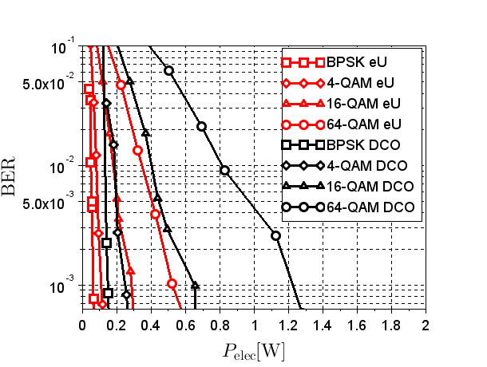
eU-OFDM BER with Scenario 1 CIRs

Slide 37

eU-OFDM BER with Scenario 1 CIRs

Slide 38
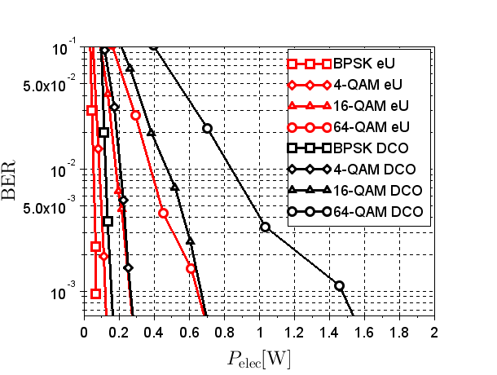
eU-OFDM BER with Scenario 1 CIRs

Slide 39
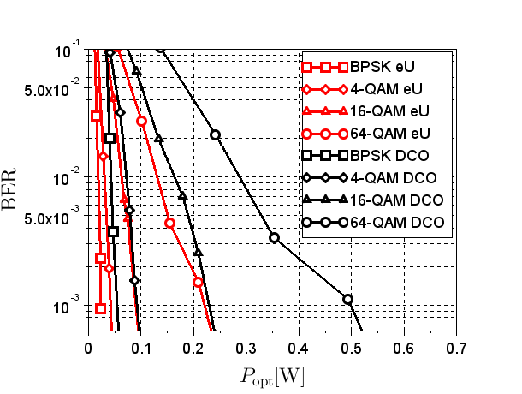
eU-OFDM BER with Scenario 1 CIRs

Slide 40
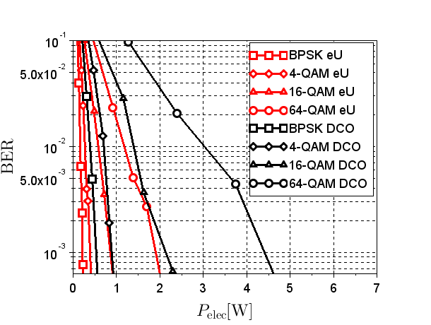
eU-OFDM BER with Scenario 1 CIRs

Slide 41
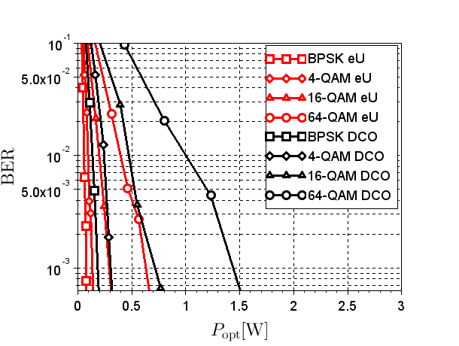
eU-OFDM BER with Scenario 1 CIRs

Slide 42
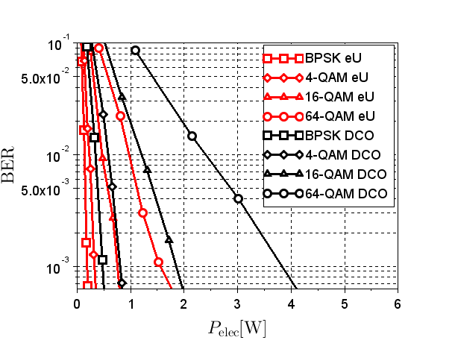
eU-OFDM BER with Scenario 1 CIRs

Slide 43
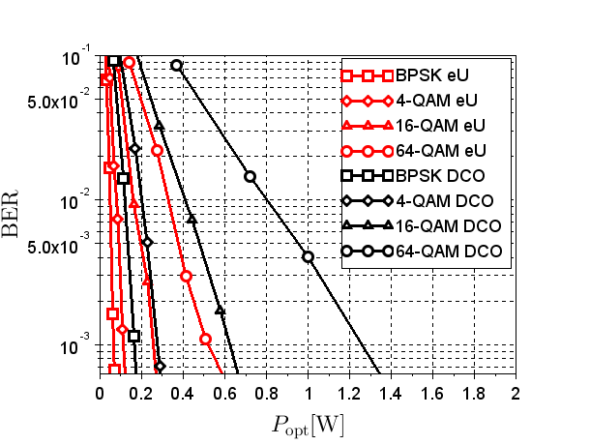
eU-OFDM BER with Scenario 1 CIRs

Slide 44
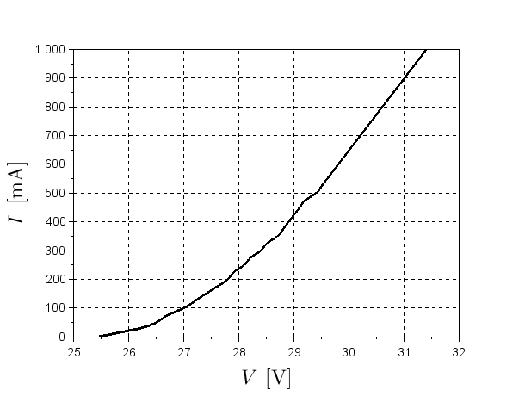
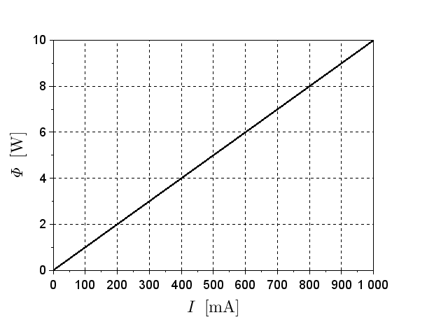
I-V curves for a typical Illumination Light
(Lucicup 22W – used in Simulations)

