Slide 1
Project: IEEE P802.15 Working Group for Wireless Personal Area Networks (WPANs)
Submission Title: [Supporting material for OOK PHY]
Date Submitted: [9 November 2015]
Source: [Jae Seung Lee, Ken Hiraga, Itaru Maekawa, Makoto Noda, Ko Togashi⁽¹⁾, (representative contributors), all contributors are listed in “Contributors” slide]
Company: [ETRI¹, JRC, NTT, Sony, Toshiba]
Address¹: [218 Gajeong-ro, Yuseong-gu, Daejeon, 305-700, Korea]
E-Mail¹: [jasonlee@etri.re.kr (all contributors are listed in “Contributors” slide)]
Abstract: This document is a supporting material for OOK PHY to improve IEEE 802.15.3e Draft.
Purpose: To propose a full set of specifications for TG3e.
Notice: This document has been prepared to assist the IEEE P802.15. It is offered as a basis for discussion and is not binding on the contributing individual(s) or organization(s). The material in this document is subject to change in form and content after further study. The contributor(s) reserve(s) the right to add, amend or withdraw material contained herein.
Release: The contributors acknowledge and accept that this contribution becomes the property of IEEE and may be made publicly available by P802.15.

Slide 2
Contributors
Name | Affiliation | Email
Jae Seung Lee | ETRI | jasonlee@etri.re.kr
Young-Hoon Kim | ETRI | yhkim23@etri.re.kr
Moon-Sik Lee | ETRI | moonsiklee@etri.re.kr
Itaru Maekawa | Japan Radio Co., Ltd | maekawa.itaru@jrc.co.jp
Lee Doohwan | NTT Corporation | lee.doohwan@lab.ntt.co.jp
Ken Hiraga | NTT Corporation | hiraga.ken@lab.ntt.co.jp
Masashi Shimizu | NTT Corporation | masashi.shimizu@upr-net.co.jp
Keitarou Kondou | Sony Corporation | Keitarou.Kondou@jp.sony.com
Hiroyuki Matsumura | Sony Corporation | Hiroyuki.Matsumura@jp.sony.com
Makoto Noda | Sony Corporation | MakotoB.Noda at jp.sony.com
Masashi Shinagawa | Sony Corporation | Masashi.Shinagawa@jp.sony.com
Ko Togashi | Toshiba Corporation | ko.togashi@toshiba.co.jp
Kiyoshi Toshimitsu | Toshiba Corporation | kiyoshi.toshimitsu@toshiba.co.jp

Slide 3
Supporting material for IEEE802.15.3e OOK PHY
November 12, 2015

Slide 4
  Improvement material – OOK
Channel bonding vs. aggregation?
  Draft material, how does the modulated signal achieve the expanded spectrum? (Lee)
Need to see the spectrum → Technical material was already presented by Noda-san
  Draft material, spectral mask (Lee)
  Note: compare with 11ad, ECMA387, bonding, tx pwr, etc.
MCS table
  Supporting material, for example, why do (2,1) and (4,0) have the same throughput but different Tx power? Same situation with (1,1) and (2,0). Need some reason for supporting larger required Eb/No to achieve the same data rate. (Lee)
  Supporting material, add data rates to the link budget table (Lee)
Consistent time direction → The draft text has been modified accordingly
  All diagrams must show increasing time from left to right (Estrada confirm time convention as well as bit ordering convention)
What about phase/frequency drift tracking at the receiver? Is 512 too long?
  Supporting material, how accurate does the Tx signal have to be? (Lee)

Slide 5
Channel Bonding (1/2)
HRCP-OOK PHY may use channel bonding using up to four channels for high throughput
The channels that are bonded together are adjacent or contiguous to one another
Bonded channels are used simultaneously to achieve high throughput
The chip rate R_{c} is increased due to the expanded bandwidth by bonding contiguous channels
Parameter | Description | Value |  |  |  | Unit | Formula
R_{c} | Chip rate | 1760 (1 channel) | 3520 (2 channel) | 5280 (3 channel) | 7040 (4 channel) | Mchip/s
T_{c} | Chip duration | 0.568 | 0.284 | 0.189 | 0.142 | ns | 1/ R_{c}

Slide 6
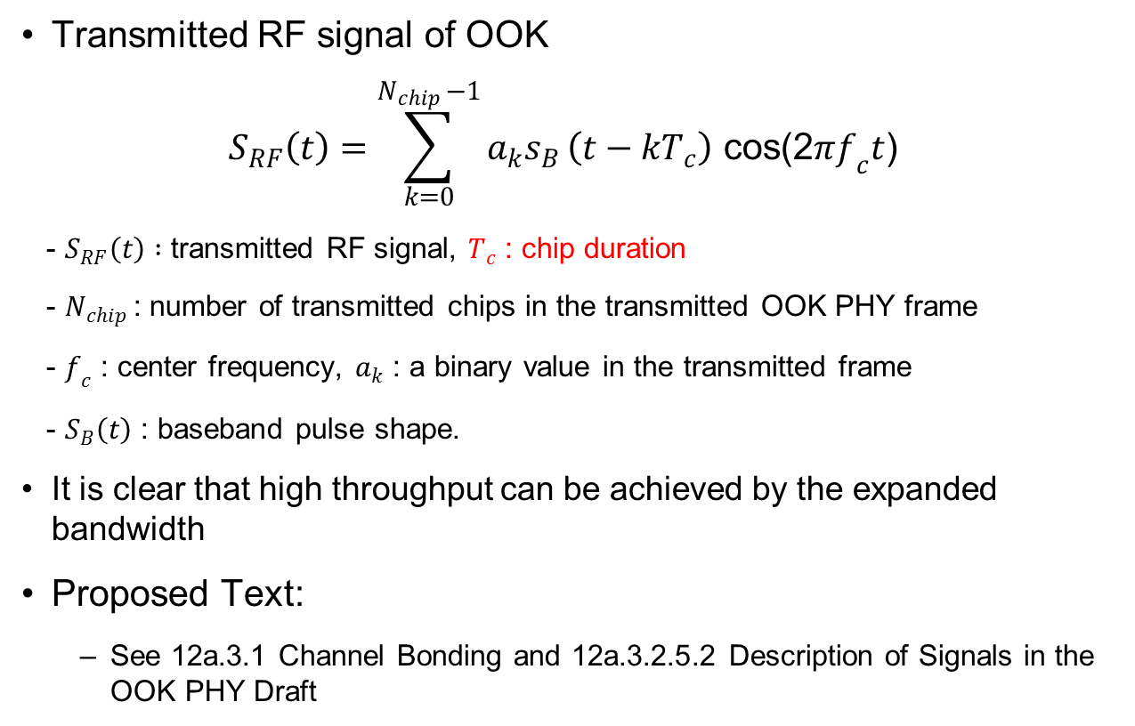
Channel Bonding (2/2)
Transmitted RF signal of OOK
$$S_{RF}\left(t\right)=\sum_{k=0}^{N_{chip }−1}{a_{k}s_{B}}\left(t−kT_{c}\right) \text{cos}\text{(2}πf_{c}t\text{)}$$
- $S_{RF}\left(t\right) :$ transmitted RF signal, $T_{c}$ : chip duration
- $N_{chip }$: number of transmitted chips in the transmitted OOK PHY frame
- $f_{c}$ : center frequency, $a_{k}$ : a binary value in the transmitted frame
- $S_{B}\left(t\right)$ : baseband pulse shape.
It is clear that high throughput can be achieved by the expanded bandwidth
Proposed Text:
  See 12a.3.1 Channel Bonding and 12a.3.2.5.2 Description of Signals in the OOK PHY Draft

Slide 7
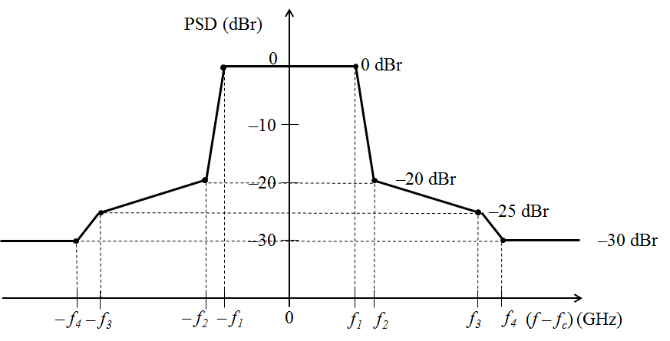
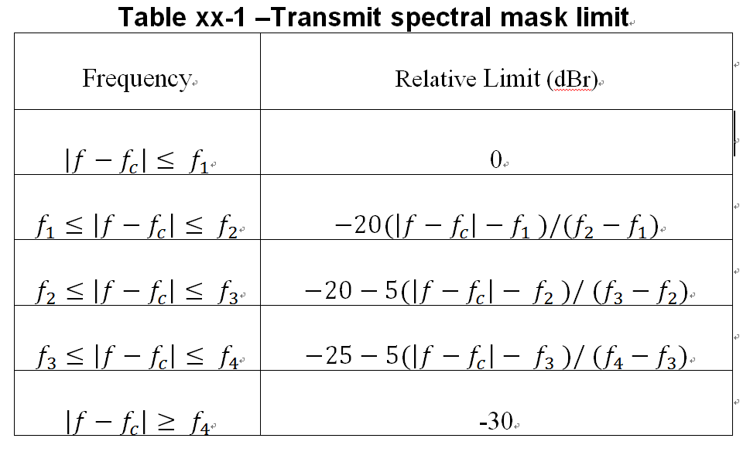
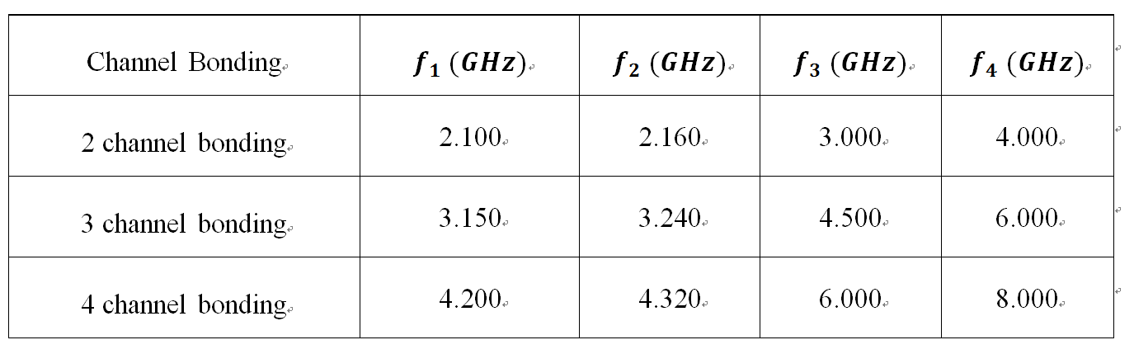
Spectral Mask for Channel Bonding
Proposed Spectral Mask for Channel Bonding (adopted ITU-R 60 GHz Spectral Mask)
  Already present by Noda-san

Slide 8
Supporting material on #3 MCS table

Slide 9
Simulation and Performance Evaluation
Modulation scheme: OOK with RS(240,224)
AWGN and SISO channels are tested.
  Channel model: Max delay 2.755ns, Same channel model used in [11]
Signal Bandwidth: 1.76 GHz~4*1.76 GHz
Assumptions and RF models [1]
  Perfect synchronization
  No FDE/FDE, Carrier frequency offset (0 ppm)
  TX & RX Phase Noise for 60GHz
    K = – 87 dBc/Hz, f_{p} = 1 MHz, f_{z} = 100 MHz used in [12]
  PA nonlinearity
    G=3.3, p=4.2, Vsat=1.413v, a=8.2x10⁵, b=0.326, q₁=10.6, q₂=8.0 used in [13]
Payload length = 16 Kbytes(=2¹⁴ bytes)
FER @ 8% are adopted as target for required Eb/No

Slide 10
Simulation Result Summary
Signal Bandwidth for OOK PHY
  2 Channel bonding with SF=1 and 4 Channel bonding with SF=2 gives the same throughput with the same Tx Power
  Single Channel with SF=1 and 2 Channel bonding with SF=2 gives the same throughput with the same Tx Power

Slide 11
Link Budget Margin (OOK)
Description |  | AWGN | SISO channel (# of Bonding, SF)
 |  |  | (1,1) (2,2) | (2,1) (4,2) | (3,2) | (3,1) | (4,1)
Data Rate (Mb/s) |  | - | 1,630 | 3,260 | 2,445 | 4,890 | 6,519
TX side & Channel | Average Tx Power level (Pt) (dBm) | -17.55 | -17.37 | -12.31 | -14.85 | -5.28 | -2.81
 | Tx_Ant gain (Gt) (dBi) | 6 | 6 | 6 | 6 | 6 | 6
 | Implementation loss (IL) (dB) | 6 | 6 | 6 | 6 | 6 | 6
 | Center frequency (fc) (GHz) | 60.48 | 60.48 | 61.56 | 60.48 | 60.48 | 61.56
 | Transmission loss at 1m (PL) (dB) | 68.1 | 68.1 | 68.2 | 68.1 | 68.1 | 68.2
RX side | Rx_Ant gain (Gr) (dBi) | 6 | 6 | 6 | 6 | 6 | 6
 | Signal Bandwidth (BW) (GHz) | 1.76 | 1.76 | 3.52 | 2.64 | 5.28 | 7.04
 | Noise power level (NP) (dBm) | -73.3 | -73.3 | -70.3 | -71.6 | -68.6 | -67.3
 | System margin (SysM) (dB) | 0 | 0 | 0 | 0 | 0 | 0
 | Required Rx level (ReqRx) (dBm) | -59.6 | -59.4 | -54.5 | -56.9 | -47.4 | -45.1
 | Allowable path loss (APL) (dB) | 48.07 | 48.07 | 48.21 | 48.07 | 48.07 | 48.26
Required Eb/No (dB) |  | 11.01 (No FDE) | 11.19 (No FDE) | 13.10 (No FDE) | 11.95 (No FDE) | 18.51 (FDE) | 19.54 (FDE)
Maximum transmission range (cm) |  | 10 | 10 | 10 | 10 | 10 | 10
OBO(Output Back Off) from full saturation: 0 dB, Noise Figure 8 dB

Slide 12
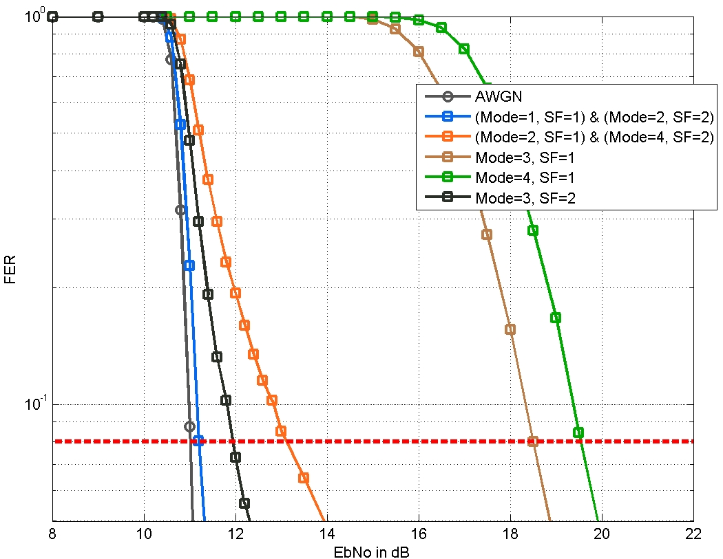
Performance (FER vs. Eb/No) in Channel
No FDE
FDE
FER = 8%

Slide 13
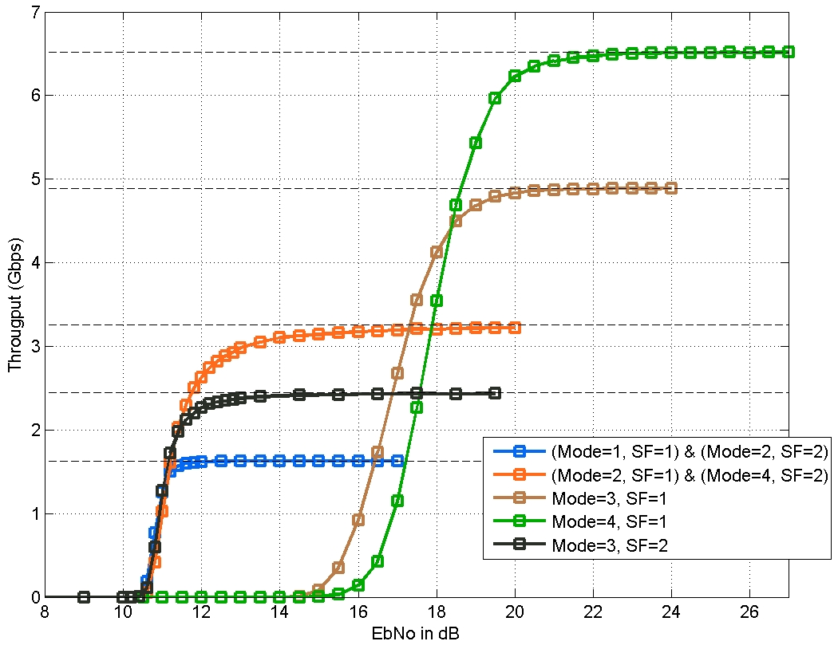
Performance (FER vs. Eb/No) in Channel
Throughput = R ( 1- FER)
where R is the peak error-free
transmission data rate [14]

Slide 14
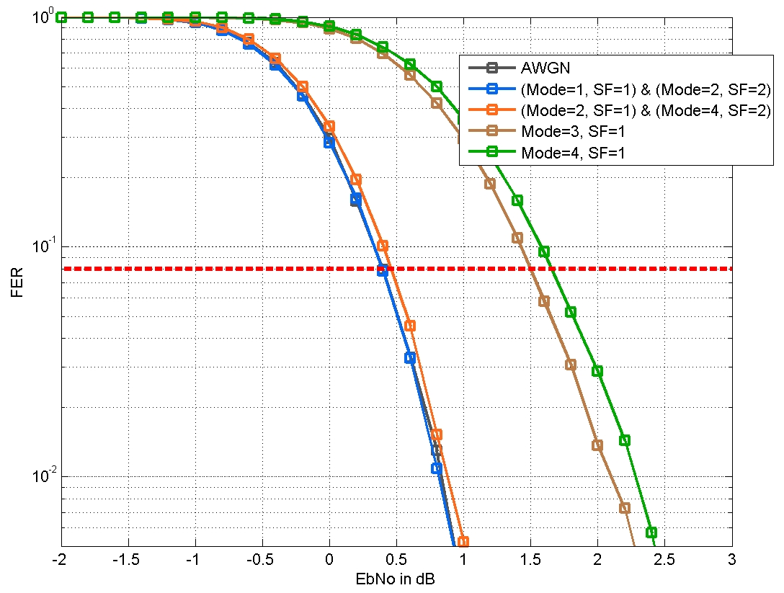
Header Performance (FER vs. Eb/No) in Channel
FER = 8%

Slide 15
Supporting material on #5
Phase/Frequency Tracking

Slide 16
Frequency offset tracking vs. block size (1/2)
Maximum frequency offset estimation range
  Maximum frequency offset is 2.42 MHz
    with 20 ppm frequency tolerance
  Maximum frequency offset estimation range is 6.87 MHz
    Estimated with preamble
    Enough estimation range
  No need for non-coherent OOK demodulation
Tracking of coherent OOK residual frequency offset for long packet
  Residual frequency offset is less than initial maximum frequency offset (2.42 MHz)
  Residual frequency offset tracking with pilot
    Maximum frequency offset estimation range is dependent for block size.
    Estimation range for tracking is same as 15.3c OOK PHY. (512 block size ➔ 1.72 MHz)
    No need for further optimization for 15.3e (64 block size ➔ 13.75 MHz)
      5.5% Data rate loss compared to data rate with 512 block size

Slide 17
Frequency offset tracking vs. block size (2/2)
Parameters | Value | Remarks
Carrier Frequency | 60.48 GHz | Center frequency
Frequency tolerance | 20 ppm
Maximum frequency offset | 2.42 MHz
Max frequency offset estimation range ( ) | 6.87 MHz (72.72 ns) | Initial estimation, preamble
 | 1.72 MHz (290.90 ns) | Residual frequency offset tracking, pilot with block size 512
 | 13.75 MHz (36.36 ns) | Residual frequency offset tracking, pilot with block size 64
a₁₂₈
a₁₂₈
a₁₂₈
Data
Pilot
Data
Pilot
block size
Initial estimation of frequency offset with preamble
Tracking of frequency offset with pilot

Slide 18
References
[1] TG3e Technical Guidance document, May, 2015
[2] TG3e Channel Modeling document, May, 2015
[3] IEEE 802.15.3 – 2003 Specification, September 2003
[4] IEEE 802.15.3b – 2005 Specification, May 2006
[5] IEEE 802.15.3c – 2009 Specification, October 2009
[6] IEEE 802.11 REVmc D4.0, January 2015
[7] 15-14-0639-03-003d, FCC NOI on Frequencies Above 24 GHz, FCC-14-154A1, GN Docket No. 14-177, November 2014
      [8] Ken Hiraga et. al, On the Transmission Method for Short-Range MIMO Communication, IEEE TRANSACTIONS ON VEHICULAR TECHNOLOGY, VOL. 60, NO. 3, MARCH 2011
      [9] Manabe, T. et. al, Polarization dependence of multipath propagation and high-speed taransmission characteristics of indoor milimeter-wave channel at 60 GHz, IEEE Transactions on Vehicular Technology, 44(2), 268-274
      [10] 15-15-0476-00-003e, ETRI Proposal for Close Proximity PHY, July 2015
      [11] 15-15-0656-00-003e, Proposal for IEEE802.15.3e-PHY MIMO, September 2015

Slide 19
References
[11] 15-15-0656-00-003e, Proposal for IEEE802.15.3e-PHY MIMO, Sep. 2015
[12] 15-06-0477-01-003c, RF impairment models for 60 GHz band system
simulation, 2006
[13] 15-15-0662-01-003e, Proposal for IEEE802.15.3e-Single Carrier PHY,
Sep. 2015
[14] X. Zhu and et. al., “On the Performance of IEEE 802.15.3c millimeterwave
WPANs: PHY and MAC,” 2010 6th Conf. on Wireless Advanced, June 2010.

Slide 20
Q & A

