Slide 1
Project: IEEE P802.15 Working Group for Wireless Personal Area Networks (WPANs)
Submission Title: [Supporting material for ATP and Expected RSSI]
Date Submitted: [9 November 2015]
Source: [Jae Seung Lee, Ken Hiraga, Itaru Maekawa, Makoto Noda, Ko Togashi⁽¹⁾, (representative contributors), all contributors are listed in “Contributors” slide]
Company: [ETRI¹, JRC, NTT, Sony, Toshiba]
Address¹: [218 Gajeong-ro, Yuseong-gu, Daejeon, 305-700, Korea]
E-Mail¹: [jasonlee@etri.re.kr (all contributors are listed in “Contributors” slide)]
Abstract: This document is a supporting material for ATP and Expected RSSI to improve IEEE 802.15.3e Draft.
Purpose: To propose a full set of specifications for TG3e.
Notice: This document has been prepared to assist the IEEE P802.15. It is offered as a basis for discussion and is not binding on the contributing individual(s) or organization(s). The material in this document is subject to change in form and content after further study. The contributor(s) reserve(s) the right to add, amend or withdraw material contained herein.
Release: The contributors acknowledge and accept that this contribution becomes the property of IEEE and may be made publicly available by P802.15.

Slide 2
Contributors
Name | Affiliation | Email
Jae Seung Lee | ETRI | jasonlee@etri.re.kr
Young-Hoon Kim | ETRI | yhkim23@etri.re.kr
Moon-Sik Lee | ETRI | moonsiklee@etri.re.kr
Itaru Maekawa | Japan Radio Co., Ltd | maekawa.itaru@jrc.co.jp
Lee Doohwan | NTT Corporation | lee.doohwan@lab.ntt.co.jp
Ken Hiraga | NTT Corporation | hiraga.ken@lab.ntt.co.jp
Masashi Shimizu | NTT Corporation | masashi.shimizu@upr-net.co.jp
Keitarou Kondou | Sony Corporation | Keitarou.Kondou@jp.sony.com
Hiroyuki Matsumura | Sony Corporation | Hiroyuki.Matsumura@jp.sony.com
Makoto Noda | Sony Corporation | MakotoB.Noda at jp.sony.com
Masashi Shinagawa | Sony Corporation | Masashi.Shinagawa@jp.sony.com
Ko Togashi | Toshiba Corporation | ko.togashi@toshiba.co.jp
Kiyoshi Toshimitsu | Toshiba Corporation | kiyoshi.toshimitsu@toshiba.co.jp

Slide 3
Supporting material for ATP and Expected RSSI
November 12, 2015

Slide 4
Part I
Improvement material – MAC
3.What is the recommended length of ATP?
  Supporting material (Lee)
  Draft material (Lee)

Slide 5
ATP Length (1/3)
During the last September Bangkok meeting, ETRI commented that Wireless Storage Scenario requires longer ATP length, but ETRI has concluded that it is not necessary to use longer ATP length
  Since a DEV can prevent unwanted disassociation by transmitting a frame such as Probe Request or ACK to the PPC before the association timeout period is reached
We do not have to consider longer ATP for wireless storage scenario
  Specific mechanism for wireless storage scenario is not necessary
We have to consider two things:
  DEVs should be able to disconnect promptly when devices draw apart beyond 10 cm, so the time taken for devices draw apart beyond 10cm by the user should be considered
  Power Saving period should be considered
    Power Saving period is limited by ATP value

Slide 6
ATP Length (2/3)
Roughly it takes around 0.3s ~ 0.35s to draw apart the DEV beyond 10 cm which was on the reader
Roughly it takes around 0.2s to draw apart the DEV from the PPC to 10cm boundary
→ The ATP should be 0.1s ~ 0.15s
  We suggest that the recommended ATP value should be less than or equal to hundreds of ms
    The current spec allows ATP value up to 65535 ms
Devices draw apart beyond 10cm by the user
(e.g, 0.3s ~ 0.35s)
PPC
DEV
DEV
10 cm range
(e.g, 0.2s)
Beyond 10 cm
(e.g, 0.1s ~ 0.15s)
The DEV should be disconnected promptly
beyond this point

Slide 7
ATP Length (3/3)
    Vendors may indicate difference ATP value less than max ATP (currently 65535 ms) ms in the beacon depending on their service scenario and PPC deployment
      We suggest that the recommended ATP value should be less than or equal to hundreds of ms
      We proposed to add a “Note” on the recommended ATP in the spec
  A DEV should transmit a keep alive frame (Probe Request or ACK) to the PPC if it does not want to be disassociated before the duration indicated by ATP field
  Maximum power save period should be less than max ATP
Proposed modification to the spec: Add the following Note to the spec under 7.3
“NOTE - It is recommended that a HRCP DEV should use short ATP length value less than or equal to hundreds of ms.”

Slide 8
Part II
Improvement material – RSSI
What is the purpose?
  Supporting material
    Trigger the Association request.
    Enable an optimal user experience (no action required by the user before or after the touch)
How does this feature impact connection time
  To minimize DEV power consumption, the DEV can wake up periodically and listen for a short time.
  Supporting material, recommended intervals for beacon interval and the receiver interval, perhaps wake up every 0.5s and listen for 4 ms? (Lee)
Error assumes a specific transmit power and antenna gain.
  Supporting material, what is the error in practice? (Lee)
  Draft material, change RSSI field in the beacon definition to EIRP or some other unit that separates Tx and Rx parameters (Lee)
How to make it more secure?
  Supporting material, depends on application and service scenarios (Lee)

Slide 9
Purpose of using Expected RSSI
“Expected RSSI” value can provide “touch action”
  Bringing the antennas to within about 1 cm can trigger the two devices to establish connection
Touch Action provides optimal user experience
  Simple way to choose a target PPC and initiate connection without user interaction
    In Wi-Fi, a user has to turn on the device and select an AP among several APs in the range which requires user interaction
    By using Touch Action, bringing the device to within about 1cm means that the user selects the PPC
    Connection can be initiated without user interaction – association request is transmitted when the DEV is located within 1 cm boundary
  The DEV can be automatically disconnected when the DEV is drawn apart from the PPC by the user
    No user interaction for disconnection

Slide 10
Connection Time/Power Consumption (1/2)
DEV approaches to the PPC
Roughly it takes around 0.2s to move the DEV from 10 cm boundary to the PPC
  It is expected that it will take around 0.02s to move the DEV from 1 cm trigger boundary to the PPC
The DEV can power save, but it has to wake up every 0.18s to check whether it can receive a beacon
  It should wake up during at least one beacon interval not to miss the beacon
PPC
DEV
Beacon
DEV
DEV
10 cm range
(e.g, 0.2s)
1 cm range
(e.g, 0.02s)
Beyond 10 cm
(out of the range)
Connection should be triggered during this time duration
DEV should wake up at least one time during this time duration

Slide 11
Connection Time/Power Consumption (2/2)
Recommended Beacon Interval:
  Connection setup time should be less than 2ms, and since more than one beacon interval is necessary for association procedure, Beacon Interval should be less than 1ms
  If Beacon Interval is 1ms: power save ratio is more than 99%
Once a DEV receives a beacon, it should receive beacons in succession and check expected RSSI field
Since 0.02s duration is at least ten times longer than connection setup time (< 2ms), the DEV can finish connection setup procedure before the DEV physically touches the Kiosk
Recommended sleep and wake up interval for a DEV for association:
The DEV is recommended to wake up every 0.18s to check the beacon and it should wake up during at least one Beacon Interval
  (This is an implementation issue which is outside the scope of the standardization)

Slide 12
Supporting material on #3

Slide 13
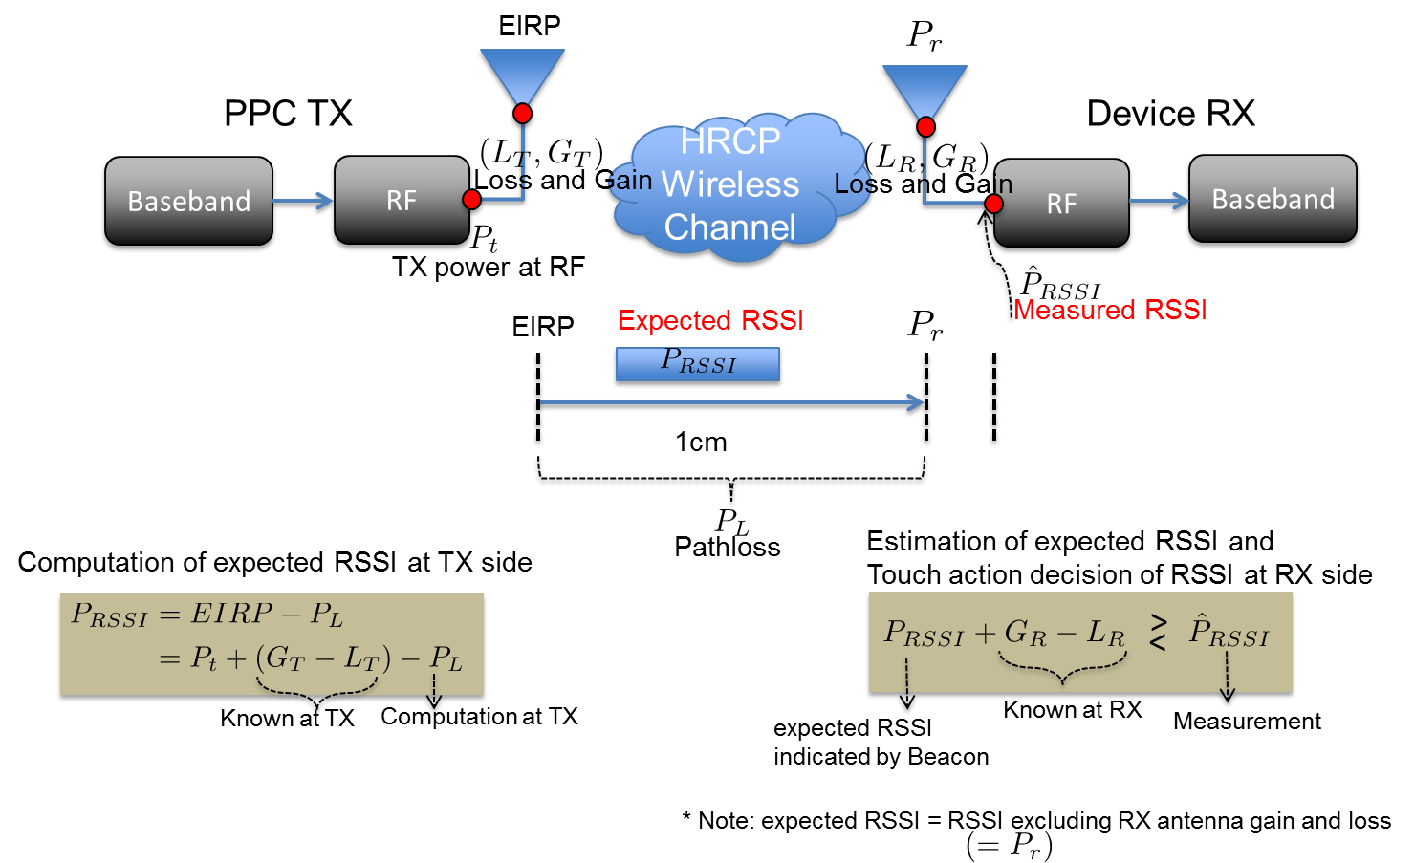
Relationship between Expected RSSI in beacon and measured RSSI at RX (1/2)

Slide 14
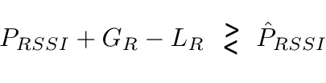
Relationship between Expected RSSI in beacon and measured RSSI at RX (2/2)
Calculation of expected RSSI at PPC TX side
  Excluding RX antenna gain and loss
RSSI measurement at Device RX side
  Estimating RSSI and compare itwith expected RSSI from PPC TX
Estimation error source
  Fading channel, other error(Tx Power, Gain, Loss and etc)
  ➔ channel(less than 0.5mm), other error(1.2mm with 1 dB error)

Slide 15
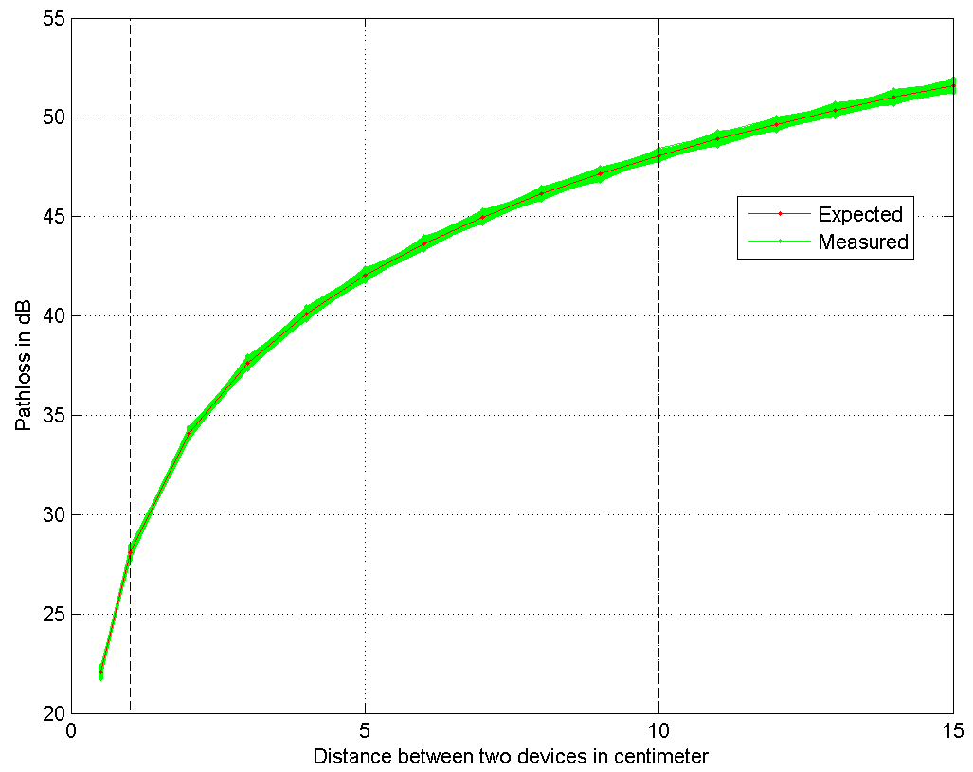
Simulation (1/2)
Range of PPC (10 cm)
Simulation Condition
fc = 60.48 GHz, fs = 1.76 GHz
SISO single Channel model (IEEE 802.15.3e)
TX & RX phase noise are considered
Measured RSSI using one OOK Preamble
Result
10,000 simulation run (RSSI measurement error variance is less than 0.5mm at 1cm)
Difference between measured RSSI values is negligible
Touch Action
Range (1cm)
28 dB
(expected RSSI value
at 1 cm indicated by the PPC)

Slide 16
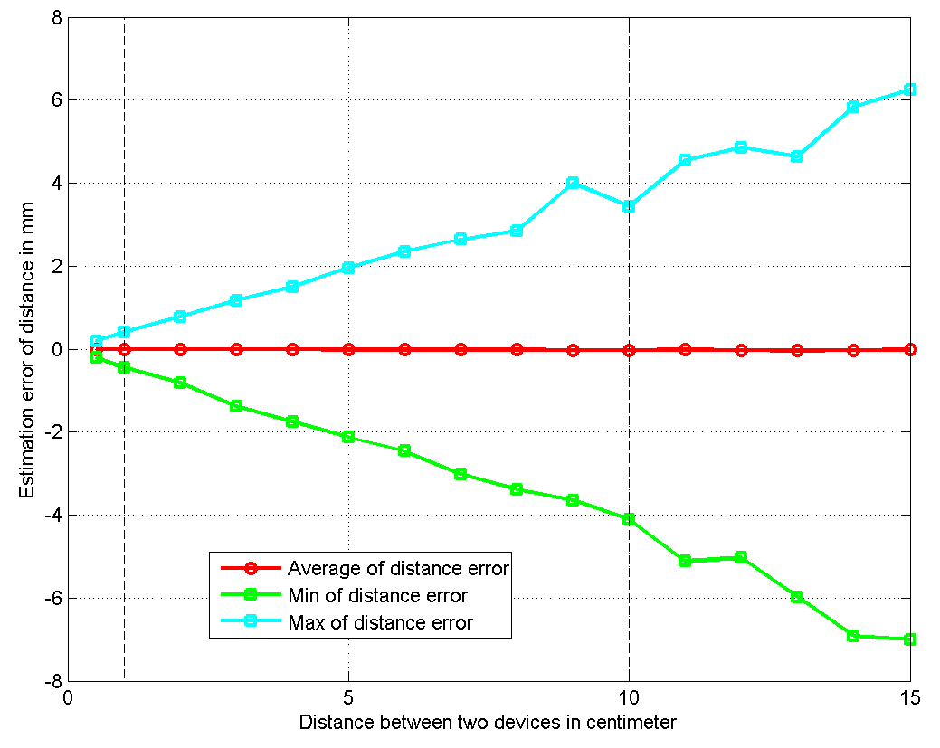
Simulation (2/2)
Simulation Condition
Estimation error is less than 0.5mm at 1cm

Slide 17
Proposed change to the draft
In 7.3.1.1:
The Expected RSSI field indicates the RSSI value of received signal at the antenna input of DEV located at specific distance from the PPC. EIRP and path loss between the PPC and the DEV can be used to determine the Expected RSSI value at the PPC. The DEV shall only send an Association Request command to the PPC when the actually measured RSSI level of the received beacon exceeds this value. The resolution of this field is 1dB and therefore has a range of [+30 to -226] dBm.
NOTE – Expected RSSI can be calculated at the PPC as follows: Expected RSSI = EIRP – Path Loss (This value equals to: TX Power at RF of the PPC + (antenna gain – cable loss at the PPC) – Path Loss) When the DEV measures the RSSI level of the received beacon, antenna gain and cable loss at the DEV should be considered in the decision on sending an Association Request. That is, the DEV transmits an Association Request when the following condition holds: Measured RSSI at the DEV >= Expected RSSI value indicated in the beacon + (antenna gain – cable loss at the DEV)

Slide 18
Supporting material on security

Slide 19
Security Issues related to Expected RSSI (1/4)
During the last September Bangkok meeting, ETRI commented that Wireless Storage Scenario requires longer ATP length
  It triggered discussion on security issues
  If the association timeout is too long, then it is possible that the session can be re-used by the next person
→ ETRI has concluded that it is not necessary to use longer ATP
length for wireless storage scenario
  No additional security issues specific to wireless storage scenario
In slide 7, we propose to use short ATP value
  Less than or equal to hundreds of ms
  If security is important in a specific service scenario, the PPC can set shorter ATP value

Slide 20
Security Issues related to Expected RSSI (2/4)
HRCP is fundamentally secure
  The range is very limited
  In order to eavesdrop HRCP frames, an attacker should be very close to the user which can be easily detected
  Man in the Middle attack or session hijacking is very difficult
  We concluded that security part of 15.3 should be removed from 15.3e during the conference call in October
  802.15-15-0801-00-003e Removal of security part from MAC
  Less demand from task group members
  Protection in an upper layer may be sufficient

Slide 21
Security Issues related to Expected RSSI (3/4)
Security services can be provided by upper layers or by applications
  Mutual authentication (e.g, P2P scenario) is outside of the scope of 15.3 baseline and it should be provided by applications
  Authorization is generally provided at the application level
  If end-to-end security at the upper layer is necessary, it should be provided by the upper layer
Kiosk downloading scenario
  Downloading public information from a Kiosk has no severe security issues
  For paid content downloading service from the Kiosk, user authentication, authorization, data encryption, can be provided by applications

Slide 22
Security Issues related to Expected RSSI (4/4)
Close Proximity P2P application
  Mutual authentication between devices or users is recommended to be performed before exchanging files
    It can be provided by P2P applications
Ticket gates scenario
  User authentication, authorization, data encryption, etc are needed
    They can be provided by applications
Wireless data storage
  For smart posters, the information is usually public so there is no severe security issues
  For wireless storage devices, mutual authentication between two devices may necessary to prevent other person from downloading files without permission
  Storage manager application may provide security services

Slide 23
Q & A

Slide 24
APPENDIX:
Expected RSSI Proposal in September 2015 meeting

Slide 25
September 2015
Touch Action (1/3)
Bringing the antennas to within about 1 cm should trigger the two devices to establish connection
PPC Indicates “Expected RSSI” value in the beacons for this purpose
  The Expected RSSI field in the beacon indicates the RSSI value of received signal at the antenna input of DEV
    Expected signal strength of the beacon frame from the viewpoint of other DEV that will receive the beacon at the connection establishment trigger boundary (1 cm)
    The manufacturer of the PPC presets the value (How to set the value is out of the scope of standardization)
  The DEV only transmits an Association Request command when the actual received RSSI level of the beacon measured by the DEV exceeds this value
octet: |  | 1 | 1 | 2
 | ……. | Expected RSSI | ……. | Recommended ATP
Various Authors (TG3e Proposal)

Slide 26
September 2015
September 2015
Touch Action (2/3)
DEV
PPC
Beacon indicating expected RSSI
DEV
If measured RSSI >=
expected RSSI value indicated
by the beacon, DEV triggers
connection establishment
DEV approaches to a PPC
DEV
DEV receives
beacons and
measures RSSI
Beacon indicating expected RSSI
Association Request
Association Response
Connection establishment trigger boundary
for touch action (1 cm )
Range of PPC (10 cm)
Various Authors (TG3e Proposal)
Various Authors (TG3e Proposal)

Slide 27
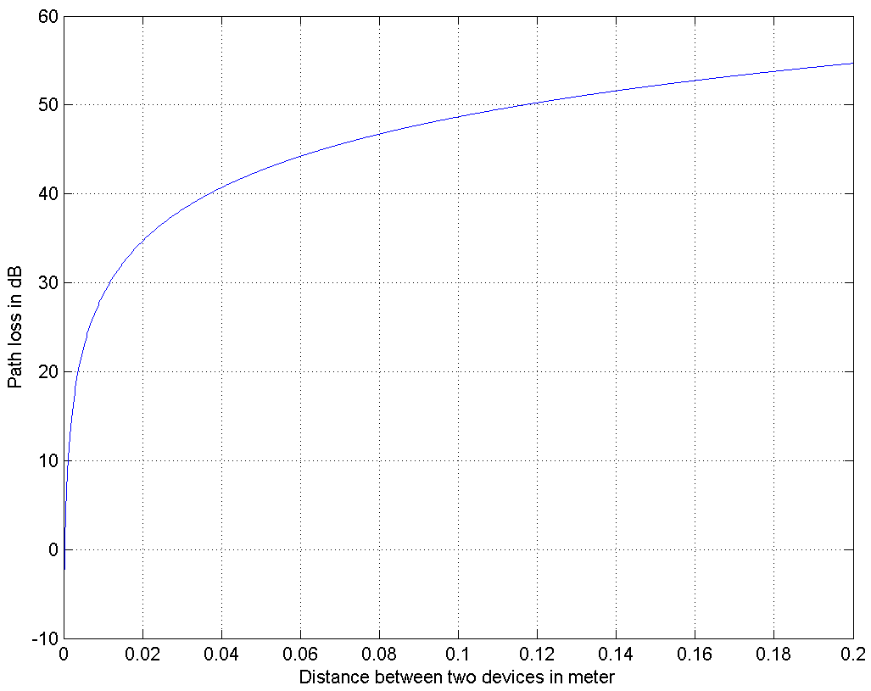
Touch Action (3/3)
Range of PPC (10 cm)
29 dB pathloss at 1 cm distance
Around the 1cm boundary (Green area), 1 dB measurement error by the DEV corresponds to just 2 mm error from the target touch action distance
In most implementations it is expected that a DEV can trigger connection around 1 cm boundary
A manufacturer may preset the expected RSSI value considering some margin (choose smaller value) to prevent the case in which a DEV cannot trigger connection (Implementation Issue)
Touch Action
Range (1cm)
29 dB
(expected RSSI value
at 1 cm indicated by the PPC)
DEV approaches to a PPC
Measured RSSI value
by the DEV

Slide 28
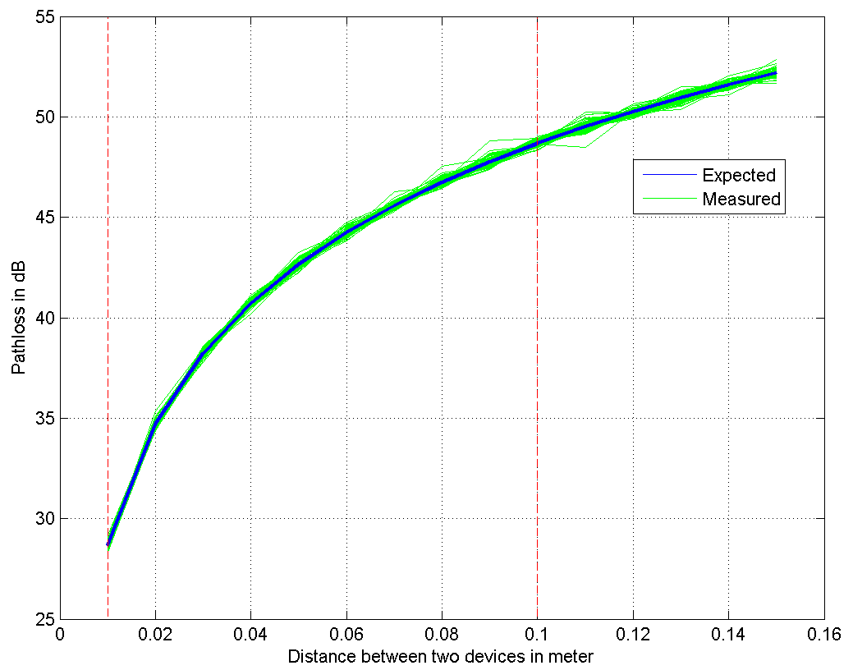
Simulation
Simulation Condition
fc = 64.8 GHz, fs = 1.76 GHz
SISO single Channel model (IEEE 802.15.3e)
TX & RX phase noise are considered
Measured RSSI using one OOK Preamble
Result
100 simulation run (RSSI error variance is max 0.05 dB)
Difference between measured RSSI values is negligible

Slide 29
Disconnection
A DEV should be able to disconnect promptly when devices draw apart beyond 10 cm
ATP (Association Timeout Period) field in the beacon can be used for this purpose
  ATP field exists in the legacy spec (15.3)
  maximum amount of time in milliseconds that the association relationship will be maintained in the absence of communication between the PNC and DEV (802.15.3 spec)
If a DEV moves out of the range of the lite-PNC (e.g, 10 cm), then frames cannot be exchanged and the DEV is disassociated after the timeout period indicated in the ATP field
  The range can be adjusted by the lite-PNC by transmit power control
  Timeout period can be adjusted by using ATP value

Slide 30
References
[1] TG3e Technical Guidance document, May, 2015
[2] TG3e Channel Modeling document, May, 2015
[3] IEEE 802.15.3 – 2003 Specification, September 2003
[4] IEEE 802.15.3b – 2005 Specification, May 2006
[5] IEEE 802.15.3c – 2009 Specification, October 2009

