Slide 1
Project: IEEE P802.15 Working Group for Wireless Personal Area Networks (WPANs)
Submission Title: Fraunhofer Preproposal in Response to TG7r1 CfP
Date Submitted: 11, November, 2015
Source: V. Jungnickel, D. Schulz, L. Grobe, J. Hilt, L. Fernandez, A. Paraskevopoulos, R. Freund
Company: Fraunhofer Heinrich Hertz Institut
Address: Einsteinufer 37, 10587 Berlin, Germany
Voice: :+49 30 31002 768, +49 162 255 2756, E-Mail: volker.jungnickel@hhi.fraunhofer.de
Re: Preproposal in response to TG7r1 CfP
Abstract: This document describes a network architecture and currently preferred technologies how to address all mandatory and optional features related to the High-rate PD communication in the TG7r1 TCD. All information is informal and incomplete. It may change in the full proposal.
Purpose: for discussion
Notice: This document has been prepared to assist the IEEE P802.15. It is offered as a basis for discussion and is not binding on the contributing individual(s) or organization(s). The material in this document is subject to change in form and content after further study. The contributor(s) reserve(s) the right to add, amend or withdraw material contained herein.
Release: The contributor acknowledges and accepts that this contribution becomes the property of IEEE and may be made publicly available by P802.15.

Slide 2
Outline
Integrated System Architecture for High-rate PD
Use Cases, Transmitter, Transfer Mode
Dimming, Multiuser, Asymmetric Link
Handover, Interference Coordination
Coexistence, Multiple Transmitters
Waveform, Metric reporting
Summary

Slide 3
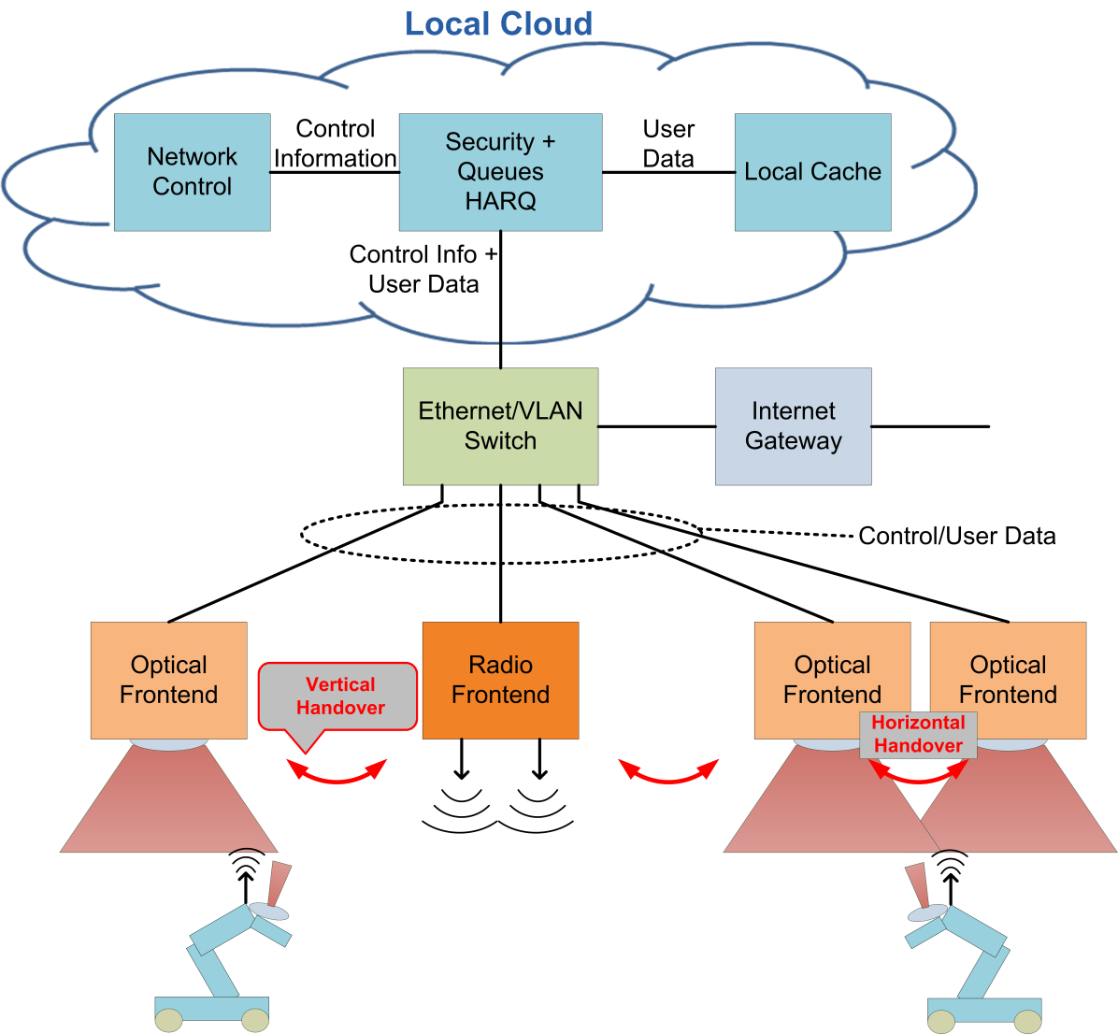
Integrated System Architecture for High-rate PD
Network Control (NC) in local cloud
Security, User Queues, HARQ
Handover and interference coordination
All transport is Ethernet with PoE
Optical wireless frontends
LED, PD, analog frontend
PHY and lower MAC
Optical wireless terminals
TG7r1 defines opt. wireless link
PHY and MAC for stand-alone links
Interface to NC for coordinated transmission

Slide 4
Use cases, Transfer Mode, Transmitter
Use cases: B1-B4, All light sources described in TCD
Transfer mode
bidirectional, continuous and packet-based
Transmitter
efficient usage of the optical bandwidth by using adaptive transmission
scalable from 1 Mbps to 10 Gbps, device classes with variable bandwidths
reliable transmission of feedback and control channels at low frequencies
devices from different classes use common signalling procedures
support for latency between 1 and 30 ms
feedback & control channels
data (class 1)
data (class 2)
time
frequency

Slide 5
Dimming, Multiuser, Asymmetric Link
Dimming (relevant for B1- B3)
generic design ideally independent from the waveform
at least applicable to DMT-based waveforms
Adaptive transmission
adapts e.g. used subcarriers, modulation, code rate based on feedback
according to frontend capabilities and the wireless channel
multiple user (MU) support: CSMA (stand-alone), TDMA + FDMA (coord.)
FDMA: multiuser diversity, low latency due to parallel sub-band transmissions
Asymmetric communication
depending on traffic load, power budget and channel properties
supported by different device classes and adaptive transmission concept
feedback & control channels
user 1 user 2
user 3
time
frequency

Slide 6
Handover, Interference Coordination
Network-layer functions
need support from PHY and MAC
PHY provides cell-specific reference signals (CRS)
CRS are reused in distant cells (as assigned by NC)
Terminal subscribes to the strongest cell
establish a link at PHY and MAC levels
NC decides what cell is serving and how it transmits
coordinate the interference in adjacent cells
provide user-specific reference signals (URS)
terminal measures EVM incl. interf. coordin. and provides URS feedback
NC adapts the transmission mode, data are sent/received via the serving cell

Slide 7
Coexistence, Multiple Transmitters
Coexistence with ambient light and other light sources
DC and modulation up to ~100 kHz cannot be used in practice
shot noise and ambient-light interference are included in EVM measurement
EVM-based metric report → robustness due to adaptive transmission
Simultaneous communication with multiple transmitters
transmitters provide specific sequences
reference signals are defined in time- and frequency domains
receiver measures the multilink channel → MIMO at the Rx, if applicable
channel state information is fed back via Ethernet/IP to the NC
NC coordinates the transmission of multiple transmitters
time
frequency

Slide 8
Waveform
Downlink (B1-B3)
high-power LEDs → high SNR at the receiver → use high spectral efficiency
discrete multitone (DMT) with constant bias as default waveform
allows scalable bandwidth, TDMA, FDMA and reduced complexity of MIMO
Uplink (B1-B3)
battery-powered devices → energy efficiency is important
DMT as default, improve power efficiency at the cost of spectral efficiency
SC/FDE, ACO, … as optinal waveforms, should be tested over reference link
Fraunhofer plans to evaluate existing PHYs from ITU G.hn standard
G.hn is planned to be further developed into G.vlc
new 200 MHz mode fits well to recent optical frontend designs
some functionality in the TCD is already supported
G.hn is fixed network technology not originally designed for mobile use cases

Slide 9
Metric reporting
Three metrics to be reported
Signal strengths of strongest cells
for initial link setup, best-cell selection and handover
very primitive+reliable signaling, results are passed via Ethernet/IP to NC
EVM vs. frequency (for each terminal)
based on URS: for adaptive transmission
URS feedback is directly used inside the MAC (in stand-alone links)
or transferred via Ethernet/IP to the NC for coordinated transmission
Channels state information for the strongest cells
based on CRS: only used for coordinated transmission
wireless transmission of feedback channel is orthogonal to other cells
feedback is passed via fixed Ethernet/IP link to NC

Slide 10
Summary
A partial preproposal was presented to TG7r1 in response to the CfP.
It explaines in principle how major requirements in the TCD for High-speed PD Communications can be met.
The proposal is open to be joined for other entities or to be merged with other proposals. In case, contact the proposers.
Parts of this proposal were already tested [1]
use of DMT for optical wireless links up to 1 Gbps
adaptive transmission in mobile scenarios with interference
coordination of multiple parallel links
efficient MAC and network routines for coordinated transmission
clustering of cells, user selection and rank adaptation
[1] This systen architecture has been developed in research projects funded by the German Ministry of Education and Research (BMBF) in the projects ScaleNet, EASY-C, CONDOR and OWICELLS, the German Research Council (DFG) in the projects CoMPImpairments and CoMPmobil and the European Union in the projects OMEGA, SODALES, OPTICWISE, iCirrus and CHARISMA. The authors thank all partners in these projects for their cooperation.

