Slide 1
What is the purpose of the randomly changing DevID?

Slide 2
Usage of Next DEVID
Next DEVID indicates the DEVID value which will be assigned to the next associating device.
When PPC creates a new session, PPC sends a Beacon with the new “Next DEVID. A device which wishes to associate to the PPC shall set its DEVID with the “Next DEVID” value.

Slide 3
The purpose of randomly changing DevID
If DevID is NOT changed, the previous DEV may continue to send frames to the PPC at any time even after the PPC has started a new P2P structure with new beacons.
→ DevID needs to change per session.
How to change the DevID
At random, with the value always changing.
Incremented by 1.
What initial value shall be set? Only initial value shall be set randomly?
→ Randomly changed DevID is better.

Slide 4
Beacon interval setting

Slide 5
Superframe Structure
Unassociated
Phase
Associated
Phase
Unassociated
Phase
Beacon
Setup Time < 2ms
-Stop Beacon
-Send Association Response instead.
PPC can send Beacon
with new Next DEVID
PPAP
PPAP
Multiple transmission of
Disassociation Request
under Np-Ack policy
are allowed.
Association
Response
Access
Slot
Access
Slot
Access
Slot
PPC
Beacon
Beacon
DEV
Disassociation
Request
SIFS
SIFS
SIFS
or
RIFS
Stk-Ack
Association
Request command

Slide 6
Beacon Interval
Beacon Interval consists of a SIFS and N AccessSlots.
Time length of AccessSlot is basically defined as time length of an Association Request command plus a SIFS.
Access
Slot
Access
Slot
Access
Slot
Beacon
Access
Slot
Access
Slot
Access
Slot
Beacon
PPC
Beacon
DEV
SIFS
SIFS
SIFS
Association
Request command

Slide 7
Time duration
Beacon, Association Request command:
about 3.2 us
MCS0, w/PW =2.2587Gbps
2.328 us
0.69 us
about 0.1 us
Long Preamble
PHY header
MAC Header
(10 oct)
Beacon payload (14 oct + IE)
Association Req (15 oct + IE)
FCS
(4 oct)
SIFS(default) :
2.5 us
AccessSlot:
about 5.7 us

Slide 8
Collision Probability of Association Request command (1/2)
Assumption
2 DEV’s which want to connect to a PPC are near the PPC.
No need to consider case of more than 2 DEV’s.
Collision avoidance probability should be kept above 90%.
1) a DEV is near a PPC
2) 2DEV’s are near a PPC
PPC
PPC
less than 10cm
DEV1
Collision does not occur
DEV1
DEV2

Slide 9
Example
1) K =1
Expected Duration
Beacon
Access Slot
Beacon
Access Slot
Beacon
Access Slot
Beacon
PPC
SIFS
SIFS
SIFS
no collision
DEV1
DEV2
no collision probability = (N-1) / N
2) K =2
Expected Duration
Beacon
Access Slot
Beacon
Access Slot
Beacon
Access Slot
Beacon
PPC
SIFS
SIFS
SIFS
collision
no collision
collision probability = 1 / N
DEV1
DEV2
DEV1
DEV2
no collision probability = (N-1) / N

Slide 10
Collision Probability of Association Request command (2/2)
Relation between K and N to bring collision probability below 10%,
where N= number of AccessSlot
K = minimum number of Beacons necessary to bring collision probability below 10%.
Expected Duration(ED(K,N)) to bring collision probability below 10%,
ED(K,N) = K ×(Beacon + SIFS) +K×N×AccessSlot.
K
∑(1/N)^{i-1}((N-1)/N) >= 90%
i=1

Slide 11
Conclusion
Calculation Results
Conclusion
N=4 is optimum, where the expected duration becomes shortest.
When the number of AccessSlots per Beacon is set 4, then Beacon interval equals about 28.5us.
K | N | Expected duration (CP is less than 10%) | Value[us]
1 | 10 | 1 × (Beacon + SIFS) +10 × Access Slot | 62.7
2 | 9 | 2 × (Beacon + SIFS) + 18 × Access Slot | 114
2 | 5～8 | 2 × (Beacon + SIFS) + (10～16) × Access Slot | 68.4～102.6
2 | 4 | 2 × (Beacon + SIFS) + 8 × Access Slot | 57
3 | 3 | 3 × (Beacon + SIFS) + 9 × Access Slot | 68.4
4 | 2 | 4 × (Beacon + SIFS) + 8 × Access Slot | 68.4

Slide 12
Define a MAC/PHY interface for the OOK and SC PHYs.

Slide 13
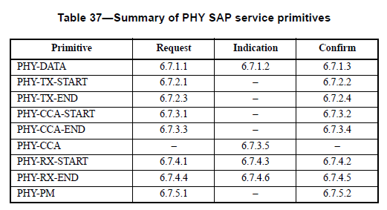
PHY SAP service Primitives
PHY-CCA primitives are not required, since HRCP does not use Carrier Sense mechanism.
Remove

Slide 14
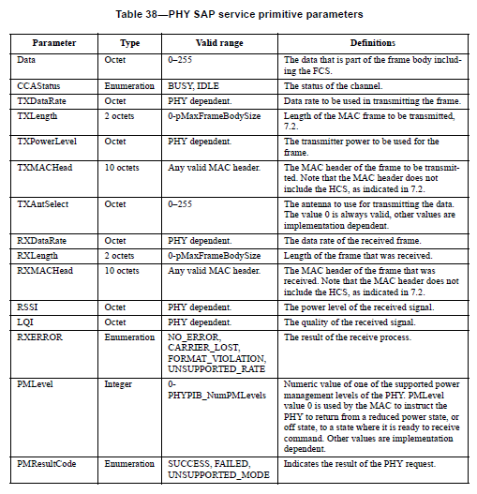
PHY SAP service Primitive Parameters
CCA Status parameter is not required.
LQI (Link Quality Indication) is not required, since HRCP does not support TCM coded QAM mode using an SNR estimation.
SC, MIMO and OOK parameters may be added after completing
PHY discussion.
Remove
Remove

Slide 15
What is Link Quality indication?

Slide 16
Correcting the use of MLME Association.indication

Slide 17
Remove second MLME Associate.ind
DEV-1
DME
DEV-1
MAC/MLME
PPC
MAC/MLME
PPC
DME
Unassociated
Beacon
NEXT DEVID = 0xZZ
KEY
req=request
ind=indication
rsp=response
cfm=confirm
addr=address
MLME-ASSOCIATE.req
Association Request command
DEVID = 0xZZ
DEV addr =DEV-1 addr
AssocTimout
MLME ASSOCIATE.ind
DEVID = 0xZZ
DEV addr =DEV-1 addr
MLME ASSOCIATE.rsp
DEVID = 0xZZ
DEV addr =DEV-1 addr
Association Response command
DEVID = 0xZZ
DEV addr =DEV-1 addr
Stop Beacon
Remove
AssocTimout
MLME ASSOCIATE.ind
DEVID = 0xZZ
DEV addr =DEV-1 addr
Stk-Ack
SrcID= 0xZZ
MLME-ASSOCIATE.cfm
- DEVID= 0xxZZ

Slide 18
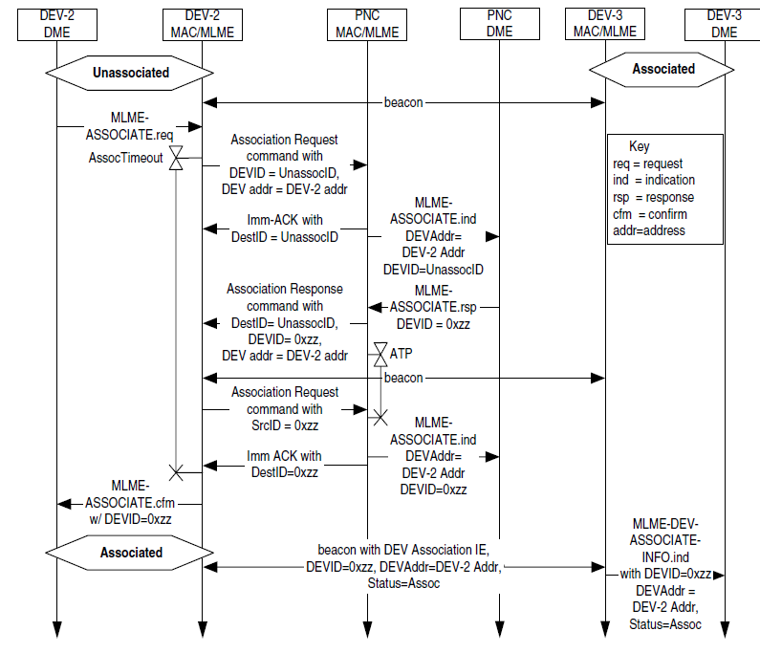
802.15.3 MLME Associate.ind process
DEVID= UnassocID
DEVID= 0xZZ

