Slide 1
Project: IEEE P802.15 Working Group for Wireless Personal Area Networks (WPANs)
Submission Title: Proposal for OCC application using mobile devices]
Date Submitted: [10 November 2015]
Source: [Yu Zeng] Company [China Telecom]
Address []
Voice:[0086-10-58552080], FAX: [], E-Mail:[:[zengyu@ctbri.com.cn]
Re: []
Abstract: [Proposal for OCC application using mobile devices]
Purpose: []
Notice: This document has been prepared to assist the IEEE P802.15. It is offered as a basis for discussion and is not binding on the contributing individual(s) or organization(s). The material in this document is subject to change in form and content after further study. The contributor(s) reserve(s) the right to add, amend or withdraw material contained herein.
Release: The contributor acknowledges and accepts that this contribution becomes the property of IEEE and may be made publicly available by P802.15.

Slide 2
Proposal for OCC application using mobile devices

Slide 3


Firmly leverage the Opportunities of “Internet+”
Future Opportunities …
“Made-in-China 2025” “Internet+”
Family Internet
Big Data
“Internet+” Applications
Industrial Internet
Cloud Computing
Internet Finance
Mobile Internet
Internet of Things
Achieve scale
breakthrough
Lift corporate vibrancy
Improve operating efficiency
Create value chains

Slide 4
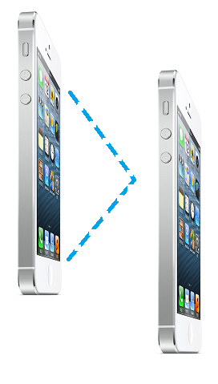
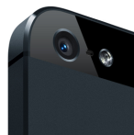
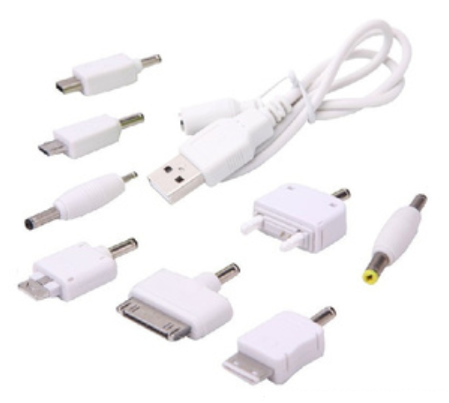


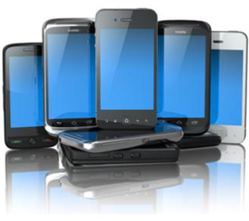
Optical Camera Communication
Optical Camera Communication (OCC) is part of Visible Light Communication(VLC) application. OCC employ screen/display of mobile device as transmitter and optical camera as receiver to establish data link.
Advantages
Low cost, low power
License free
No RF interference
Secure link
Unified link interface

Slide 5
3 Major Areas
LiFi
IOT
Applications
Mobile
D2D
China Telecom OCC interests
LBS

Slide 6

Daily Query Interface
Monthly Query Interface
D2D
IoT
Threshold Interface
Node Query Interface
Warning Interface
IOT Query system
WebService（SOAP)
ChinaNet
Telecom
Interface
Carrier network
IOT

Slide 7
Potential OCC Services Applications
Safety
Tourist
Public Service
Lift safety
Asset management
Fire monitoring
LBS
Tour guide
Streetlight monitoring
Meter reading
EMC
Information
Finance
Others
LED ID
Contents delivery
Payment
Tax refund
Smart Agriculture
Smart Energy

Slide 8

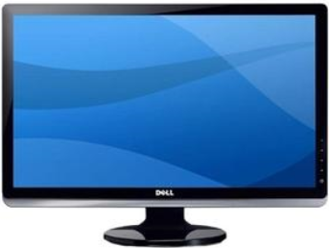








Deployed Services - LBS
Tourist
Text
Text
Image
Image
OCC
Audio
Audio
Video
Video
The Great Wall park and museum (Beijing)
(8 million visits yearly)
E-ticket system
OCC tourist guide
Visitor analysis

Slide 9

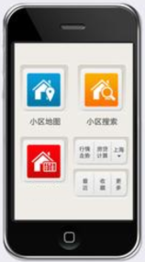
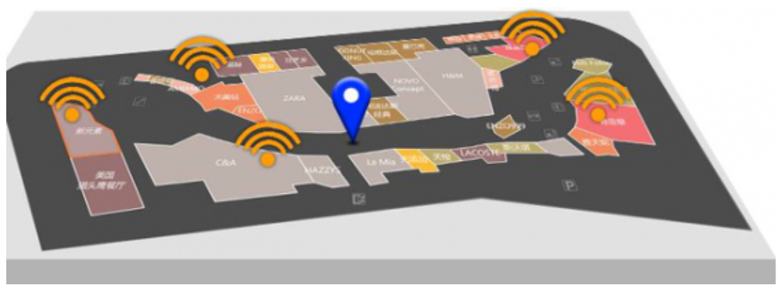

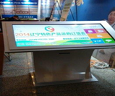

Deployed Services - LBS
update
LBS
Request
mapping
OCC Data
Liaoning Exhibition Center (Shenyang)
(2 main halls + 2000 retail shops)
LBS ad system
OCC data push
APP
Map database
OCC Display

Slide 10

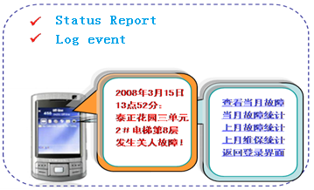
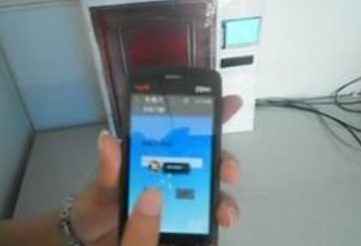
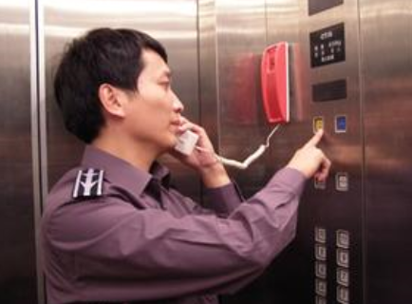
Future D2D Services - Safety
Lift Monitoring
OCC can be deployed on existing lift monitoring platform. Early signs of operation warning can be read using OCC D2D mobile device for further maintenance.
Current Coverage
Currently, China Telecom operates lift monitoring service in Nanjing, Taizhou, Yancheng, Changzhou, Xuzhou, Wuxi, Suzhou. More 10000 lift monitoring system to be installed in Taicang and connect with M2M platform for service payment

Slide 11
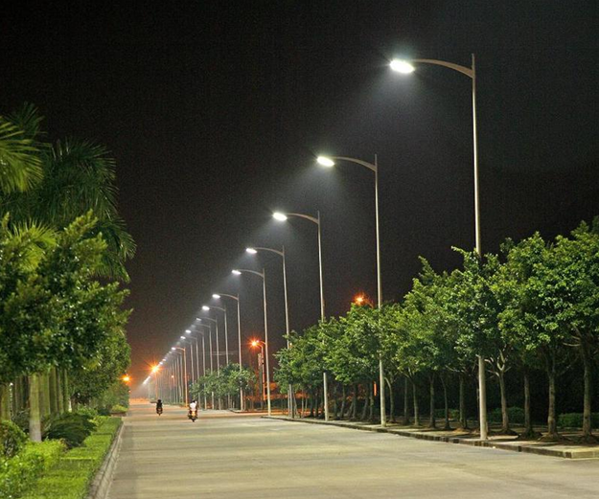
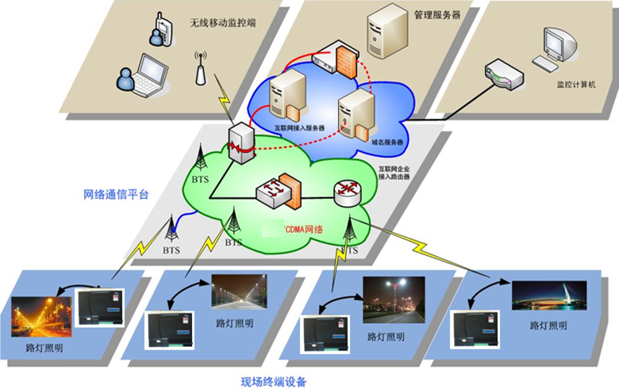
Future D2D Services – Street Lighting Management
Background
Lighting take 10％～20％ of total energy supply. Street lighting consists of 30％ lighting。Most area use manual control management, more maintenance staffs were needed in severe weather condition. The condition and operating status can not be collected.
Possible Solution
Information of operation can be delivered through OCC D2D device, and further relayed to CDMA network. Thus shorten the respond time.
City with lighting management：Nanjing, Yangzhou、Zhenjiang, Taizhou, Wuxi, Suzhou, the connection is through 10649 model M2M

Slide 12
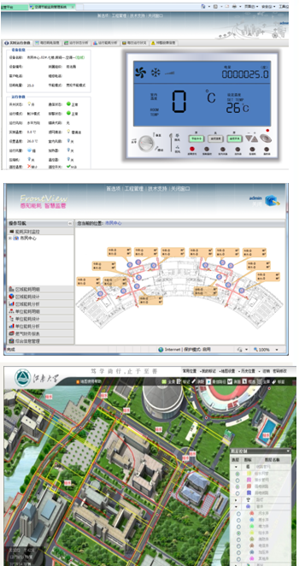
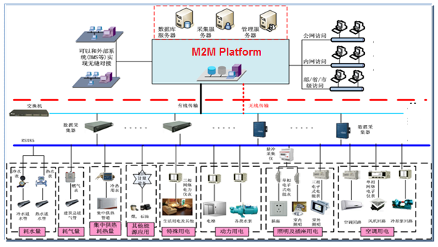
Future D2D Services – Energy Management
Platform
Energy management, including meter reading etc. By using OCC D2D devices, system complexity and cost can be lowered. Payment breakdown, real-time analysis and policy can be provided through existing M2M Platform. Currently there are 100 Universities installed.

Slide 13


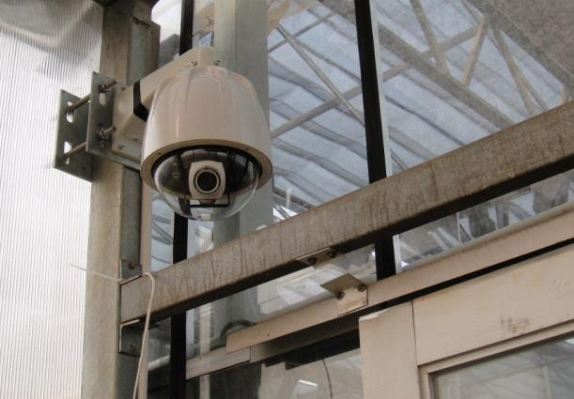

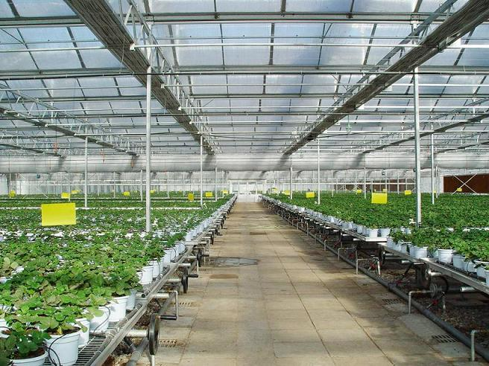

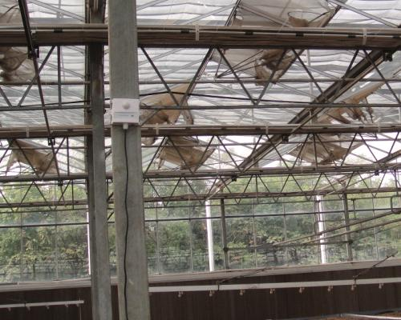

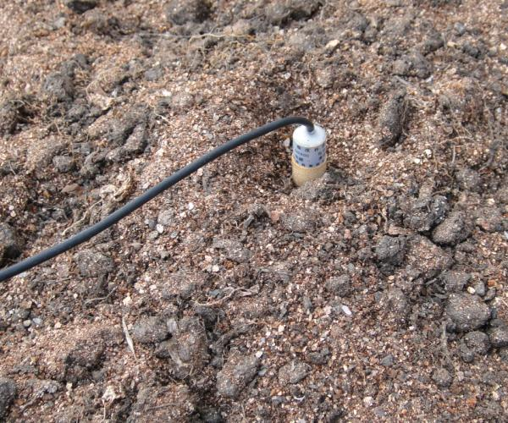
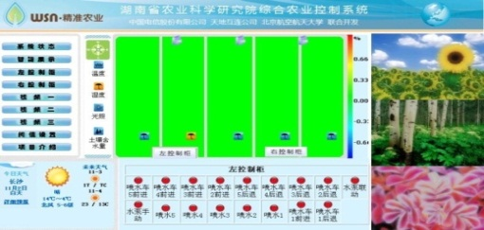
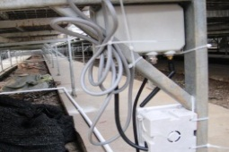
Future D2D Services – Smart Agriculture
Platform
Sensors are used to collect temperature, humidity, lighting, plant growth data，OCC D2D enabled device can read these data and transmit via CDMA network to the smart agriculture platform (SAP). The SAP can then provide remote monitoring, control and warning functions. Currently, Suzhou and Zhenjiang deployed these system.
IPv6 camera
Temperature, humidity, lighting monitoring
IPv6/v4
Light sensor
Humidity
Web Remote Control
Temperature

Slide 14
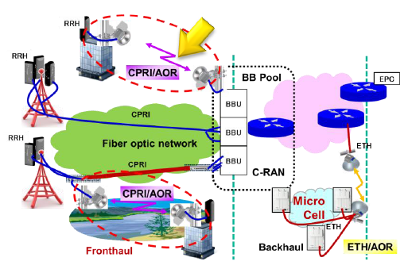
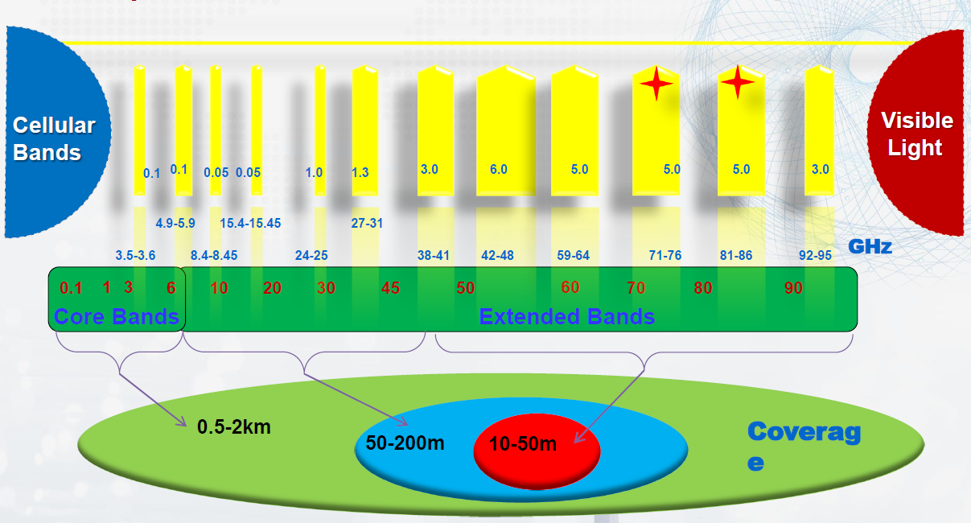
Future Services – VLC combined Base Station Network Forwarding
CPRI specification V6.0
--Option 1: 614.4 Mbit/s
--Option 2: 1228.8 Mbit/s
--Option 3: 2457.6 Mbit/s
--Option 4: 3072.0 Mbit/s
--Option 5: 4915.2 Mbit/s
--Option 6: 6144.0 Mbit/s
--Option 7: 9830.4 Mbit/s
--Option 8: 10137.6 Mbit/s
Optical Fiber and Wireless CPRI
Wireless CPRI transmission scenario exist when optical fiber cannot meet CPRI transmitting requirements. With the fast growth of mobile bandwidth demand, VLC can be a candidate for future base station network forwarding.
CPRI= (Common Public Radio Interface)

Slide 15
Future Direction
… combine OCC with existing platform and interface
IOT Interface
Platform
“Internet+”: Target 4 key strategic areas & 10 major projects to promote upgrade of traditional industries
Core Functionality
Account Management: manage and analysis user behavior
OCC Frame Code: coding and modulation algorism
Combine OCC with existing interface: To strengthen capability on product development for Cloud, Big Data, Internet of Things
LBS: expend LBS functionality
Transmission Speed: purpose designed device can provide higher speed
Payment Support: compatible with payment system
Device Compatibility
: more device can be supported

