Slide 1
Project: IEEE P802.15 Working Group for Wireless Personal Area Networks (WPANs)
Submission Title: Additional Information for Secret key agreement protocol for IEEE 802.15.8 PAC
Date Submitted: November 2015
Source: [Byung-Jae Kwak]¹, [Sangseok Yun, Sanghun Im, Jeongseok Ha]²
Company [ETRI, Daejeon, Korea]¹, [KAIST, Daejeon, Korea]²
Address [218 Gajeong-ro, Yuseong-gu, Daejeon, Korea]¹, [291 Daehak-ro, Yuseong-gu, Daejeon, Korea]²
Voice: [+82-42-860-6618]¹, [+82-42-350-7524]²
E-Mail: [bjkwak@etri.re.kr]¹, [ssyun@kaist.ac.kr]²
Re:
Abstract: Additional information for secret key agreement protocol in PHY for IEEE 802.15.8 PAC.
Purpose: Approval
Notice: This document has been prepared to assist the IEEE P802.15. It is offered as a basis for discussion and is not binding on the contributing individual(s) or organization(s). The material in this document is subject to change in form and content after further study. The contributor(s) reserve(s) the right to add, amend or withdraw material contained herein.
Release: The contributor acknowledges and accepts that this contribution becomes the property of IEEE and may be made publicly available by P802.15.

Slide 2
Additional Information for Secret key agreement protocol for
IEEE 802.15.8 PAC
Nov. 2015

Slide 3
Introduction
“Secret key agreement protocol for IEEE 802.15.8 PAC” has been approved during Sept. 2015 meeting. (15-15-0728-01-0008)
Comments
  “Needs to provide some information that facilitates implementation” → The BER (bit error rate) performance for various channel condition has been extensively studied
  “BCH does not exist for every possible (n,k,t)” → See below.
  “Define how to build Toeplitz matrix” → See below.
  “Needs to specify Huffman coding” → See below

Slide 4
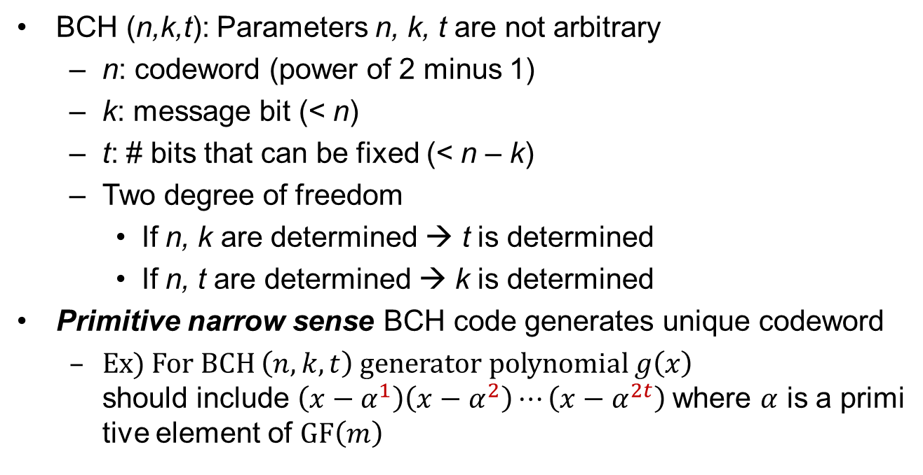
Generating BCH codes
BCH (n,k,t): Parameters n, k, t are not arbitrary
  n: codeword (power of 2 minus 1)
  k: message bit (< n)
  t: # bits that can be fixed (< n – k)
  Two degree of freedom
    If n, k are determined → t is determined
    If n, t are determined → k is determined
Primitive narrow sense BCH code generates unique codeword
  Ex) For BCH $\left(n,k,t\right)$ generator polynomial $g\left(x\right)$
  should include $\left(x−α^{1}\right)\left(x−α^{2}\right)⋯\left(x−α^{2t}\right)$where $α$ is a primitive element of $GF\left(m\right)$

Slide 5
How to build the Toeplitz Matrix

Slide 6
Huffman Coding
Huffman codes with an alphabet size of 1 byte
without reordering
  Ex) If two alphabet have same weight (probability), let the smaller one in base 10 has priority (considered as having heavy weight) than the bigger one
Alphabet | Weight (probability)
00111001 | 0.0020
10001001 | 0.0005
11101101 | 0.0005
Huffman Tree
...
...
57₍₁₀₎
00111001
…
11101101
137₍₁₀₎
10001001
237₍₁₀₎
…
...
...

Slide 7
Motion
“Accept the text in DCN 15-15-0903-00-0008 to be added to P802.15.8 PAC Draft D0.16.0.”

Slide 8
Extra Slides

Slide 9
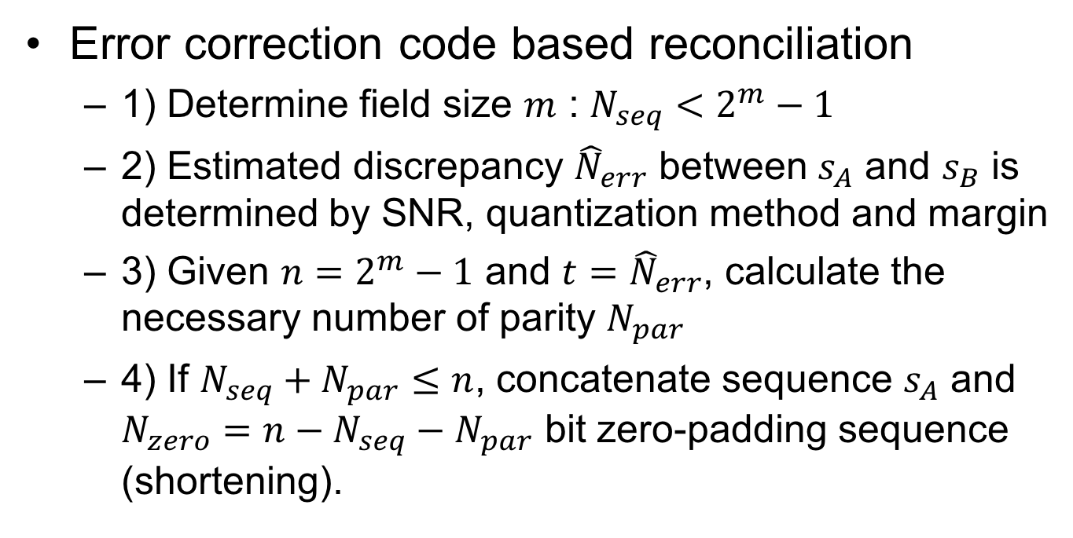





Information Reconciliation
Error correction code based reconciliation
  1) Determine field size $m$ : $N_{seq}<2^{m}−1$
  2) Estimated discrepancy ${\hat{N}}_{err}$ between $s_{A}$ and $s_{B}$ is determined by SNR, quantization method and margin
  3) Given $n=2^{m}−1$ and $t={\hat{N}}_{err}$, calculate the necessary number of parity $N_{par}$
  4) If $N_{seq}+N_{par}≤n$, concatenate sequence $s_{A}$ and $N_{zero}=n−N_{seq}−N_{par}$ bit zero-padding sequence (shortening).
$$2^{m}−1$$
$$N_{seq}$$
$$N_{zero}$$
$$N_{par}$$
$$2^{m−1}−1$$

Slide 10


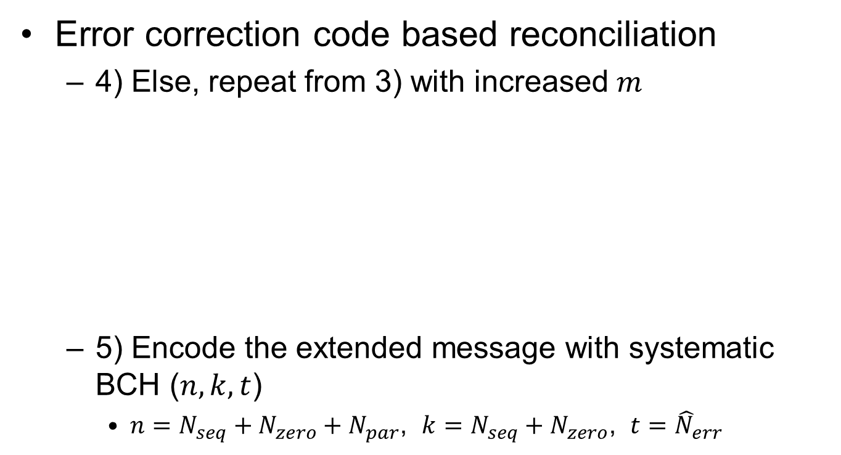





Information Reconciliation
Error correction code based reconciliation
  4) Else, repeat from 3) with increased $m$
  5) Encode the extended message with systematic BCH ($n,k,t$)
    $n=N_{seq}+N_{zero}+N_{par}$, $k=N_{seq}+N_{zero}$, $t={\hat{N}}_{err}$
$$2^{m}−1$$
$$N_{seq}$$
$$N_{par}$$
$$2^{m−1}−1$$
$$m^{′}=m+1$$
$$2^{m^{′}}−1$$
$$N_{seq}$$
$$N_{zero}$$
$$N_{par}$$
$$2^{m^{′}−1}−1$$

