Slide 1
Project: IEEE P802.15 Working Group for Wireless Personal Area Networks (WPANs)
Submission Title: [Northumbria University and Czech Technical University Preproposal]
Date Submitted: [10, November, 2015]
Source: [Zabih Ghassemlooy and Stanislav Zvanovec]
Company: [Northumbria University and Czech Technical University]
Address: [Newcastle-upon-Tyne, NE1 8ST, U.K., Technicka 2, 16627 Prague, Czech Republic]
Voice: :[+44191 2274902, +420 224 355 966], FAX: [+441912273684, +420 233 339 958], E-Mail:[z.ghassemlooy@northumbria.ac.uk, xzvanove@fel.cvut.cz]
Re: Preproposal according to TG7r1 CfP
Abstract: [This Intent-for-Proposal Form highlights methods and especially technologies the proposers from NU and CTU want to support requirements listed in the Technical Considerations Document.]
Purpose: see abstract
Notice: This document has been prepared to assist the IEEE P802.15. It is offered as a basis for discussion and is not binding on the contributing individual(s) or organization(s). The material in this document is subject to change in form and content after further study. The contributor(s) reserve(s) the right to add, amend or withdraw material contained herein.
Release: The contributor acknowledges and accepts that this contribution becomes the property of IEEE and may be made publicly available by P802.15.

Slide 2
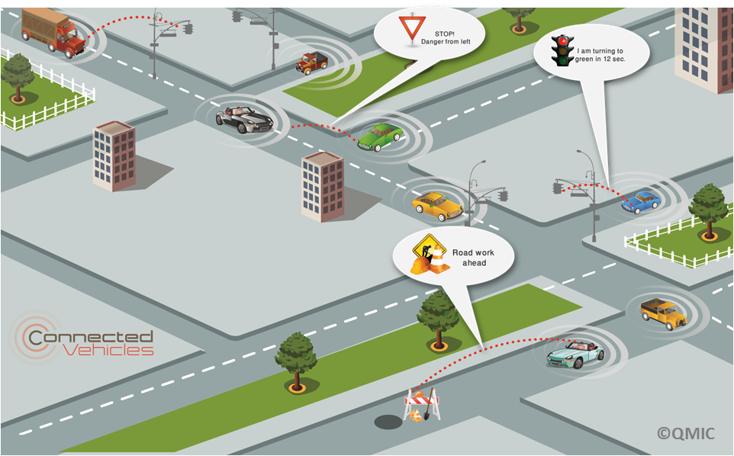
Intelligent Transport Systems (ITS)
Vehicular networking is an essential component of ITSs requiring vehicle-to-vehicle (V2V) and vehicle-to-infrastructure (V2I) communications to enable vehicles to communicate with each other and with roadside units installed along the road ‎[1].
The information gathered via V2X communications provide the drivers with a real-time information on traffic and roads conditions including collisions, congestion, surface condition, traffic signal violations, emergency brakes, etc.
[1]- www.its.dot.gov/research/v2v.htm,
(last accessed, 20/11/2013).

Slide 3
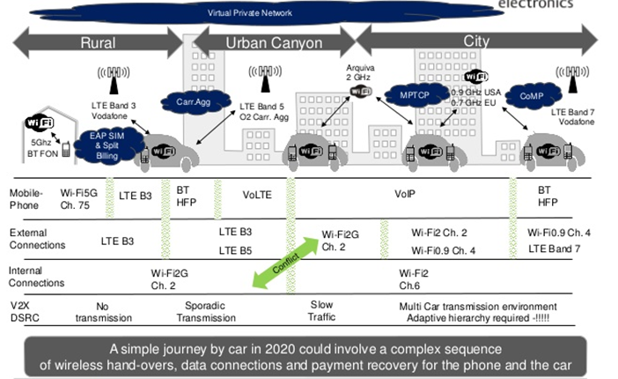
Vehicular Communications
Is it a simple journey?

Slide 4
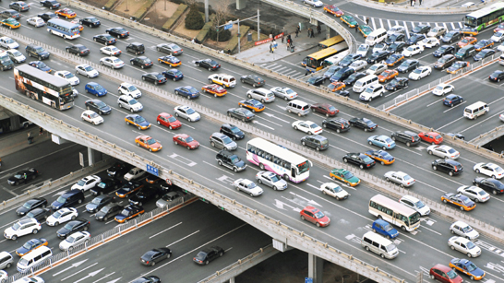


What are the problems?
Traffic Congestions and its social and economical consequences
Building more roads is not the option. So what else can be done?
1.8 m
3.5 m
45.5 m
5 m
At 100 km/h, the road surface utilization: 5%
Reduce the gap between cars - Longitudinal control (adaptive cruise control)
Reduce lane width – Use automatic steering mechanism
Reduce the aerodynamic drag – Adopt car platoons, saving up to 20% in the total energy use
Introduce Intelligent Transportation Systems

Slide 5
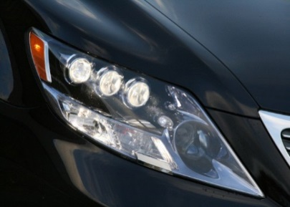
VLC - Smart Automotive Lightning: Transmitters
Illumination + Signaling
Communications
Positioning
Sensing – Road surface
LED Car Headlamp
LED Car Taillight

Slide 6
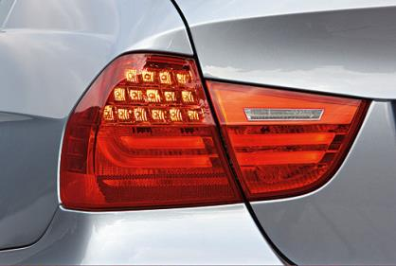
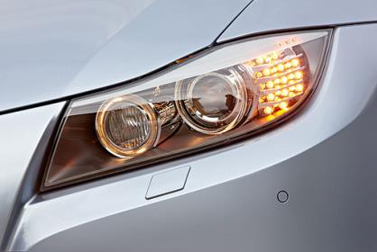
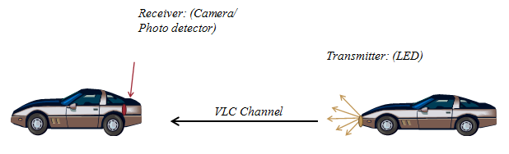
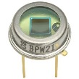
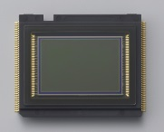
Receivers
Transmitter
LED Lights
Photodiode
Camera Sensor
Receiver | Data Rate | Number of pixels | Cost
Photodiode | Up to several Mb/s | 1 | Extra
Camera sensor | A few Bytes/s (ok for short traffic messages) | Millions | Use existing cameras

Slide 7
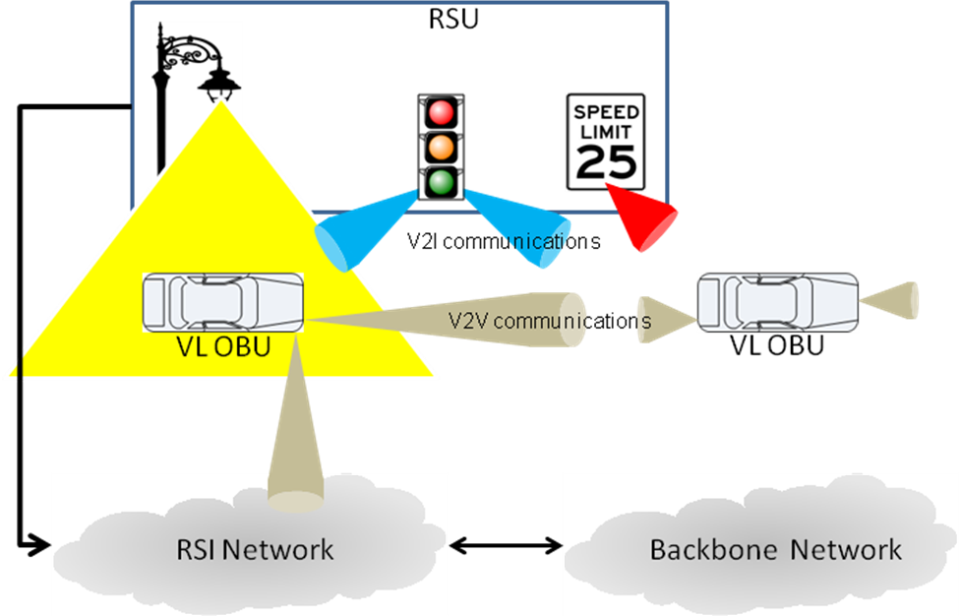
Vehicular VLC Network

Slide 8
V2V
A typical V2V VLC system with interference from nearby lights

Slide 9
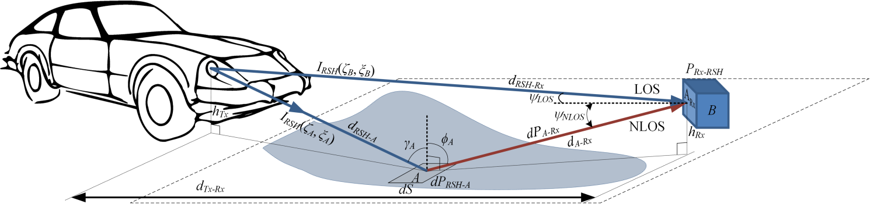
V2V: LOS and NLOS
Configuration of C2C VLC system - rays from the right headlamp to the receiver are illustrated).

Slide 10
C2C - MIMO
Block diagram of a 2×2 MIMO link of C2C VLC system.
In order to retrieve the orignal data from Y, de-multiplexing process is needed. The estamated signal X_{est} can be obtained by:
P. Luo, Z. Ghassemlooy, H. L. Minh, E. Bentley, A. Burton, and X. Tang, "Performance analysis of a car to car visible light communication system," Applied Optics, 2015.
Notice that to successfully calculate X_{est}, the channel matrix H must be full rank

Slide 11
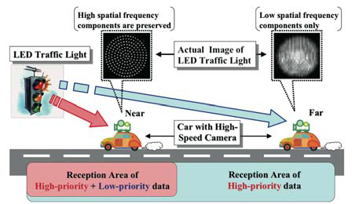


LED based Traffic Light and High-speed Camera
Camera with a wide viewing angle can recognize the position of LEDs array.
If each LED in traffic and brake lights is individually modulated, parallel communications are possible.
Disadvantages:
When camera is far from LEDs array, the received images are blurred
High spatial frequency components of images are lost.
However, received images still contain low spatial frequency components.
Received images: (a) 10m (b) 70m
Toru NAGURA, et al, 2013

Slide 12
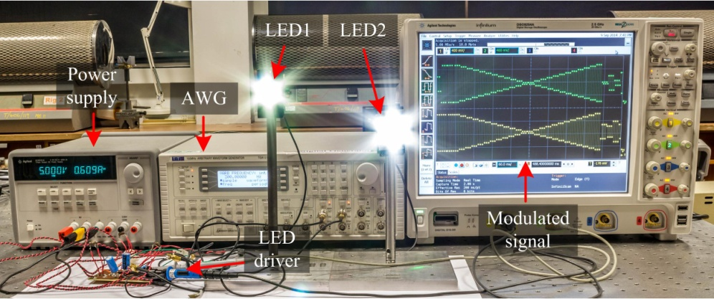
1024-QAM Camera Communication System
Constellations of the received signal different order UPQAMSM and different compensation techniques:
the 1st row M = 256, 2nd row M = 512, 3rd row M = 1024;
1st column - original received signal w/o compensation, 2nd column - signal processed by pre-compensation,
3rd column - signal processed by post-compensation.

Slide 13
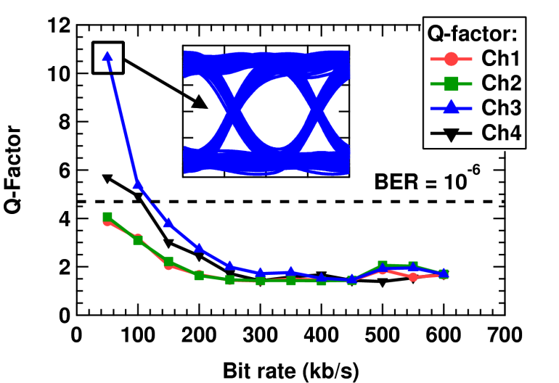
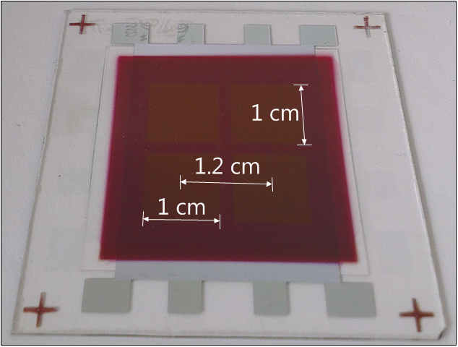
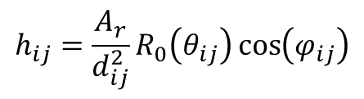

OLEDs: Challenges, Data Rate, MIMO
$$h_{ij}=\frac{A_{r}}{d_{ij}^{2}}R_{0}\left(θ_{ij}\right)\cos\left(φ_{ij}\right)$$
OPD
$$P_{rx}=HP_{tx}+n$$
Paul Anthony Haigh, Zabih Ghassemlooy, Ioannis Papakonstantinou, Francesco Arca, Sandro Francesco Tedde, Oliver Hayden and Sujan Rajbhandari, A MIMO-ANN System for Increasing Data Rates in Organic Visible Light Communications Systems, IEEE, ICC, 2013

Slide 14
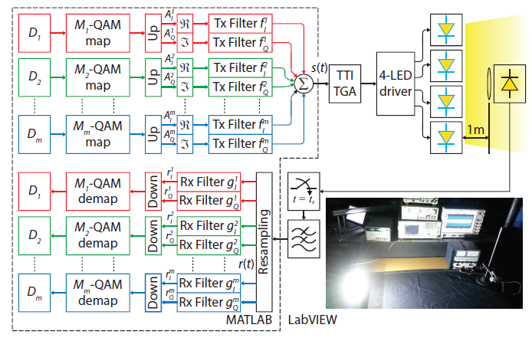
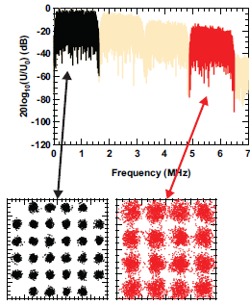
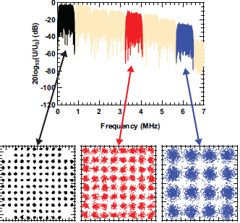
Multiband Carrier-less Amplitude and Phase Modul.
m-CAP, where number of subcarriers are m = 1, 2, 5 and 10.
Subcarrier bandwidths of 6:5; 1:625 and 0:8125 MHz

Slide 15
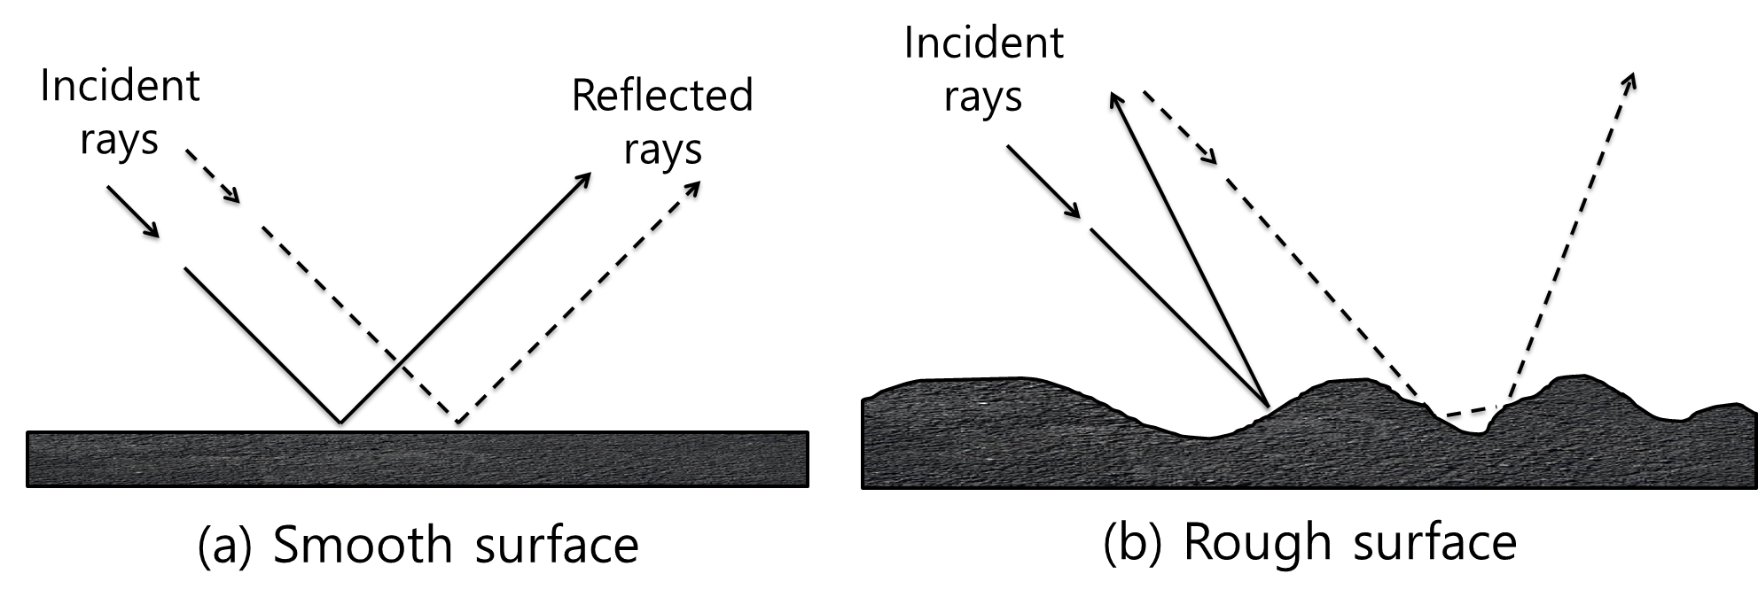
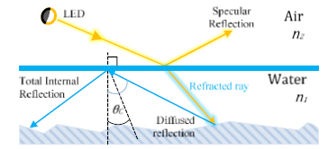
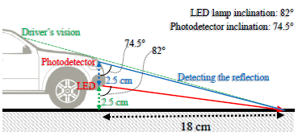
Road Surface Detection and Communications

Slide 16
Measurement Results
5 different levels of road wetness
  dry,
  barely wet (no water puddle),
  wetness less than 1mm,
  water puddle < 1mm
  Water puddle 15 mm-deep
Approx. 12 lux for dry condition
About 7 lux for wet condition

