Slide 1
Project: IEEE P802.15 Working Group for Wireless Personal Area Networks (WPANs)
Submission Title: [Spectral mask for 60 GHz in ITU-R]
Date Submitted: [10 November 2015]
Source: [Makoto Noda]
Company: [Sony Corporation]
Address¹: [1-7-1 Konan, Minato-ku, Tokyo 108-0075]
E-Mail¹: [MakotoB.Noda at jp.sony.com]
Abstract: This document shows spectral masks for 60 GHz wave band defined in ITU-R M.2003-1.
Purpose: A technical contribution to help for defining spectral masks in TG3e.
Notice: This document has been prepared to assist the IEEE P802.15. It is offered as a basis for discussion and is not binding on the contributing individual(s) or organization(s). The material in this document is subject to change in form and content after further study. The contributor(s) reserve(s) the right to add, amend or withdraw material contained herein.
Release: The contributors acknowledge and accept that this contribution becomes the property of IEEE and may be made publicly available by P802.15.

Slide 2
Introduction
In TG3e proposal, spectral masks for channel bonding have not been defined.
To help for defining spectral masks in TG3e, this document provides spectral masks for 60 GHz wave band defined in International Telecommunication Union, Radiocommunication Sector (ITU-R) M.2003-1.
<https://www.itu.int/rec/R-REC-M.2003-1-201501-I/en>

Slide 3
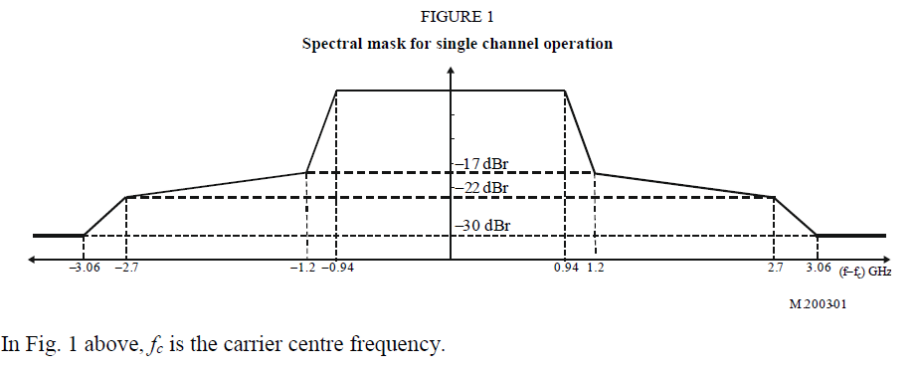
Spectral mask for a single channel in ITU-R
(same as that in TG3e proposal in 15-0662/r01 and 15-0665/r01)

Slide 4
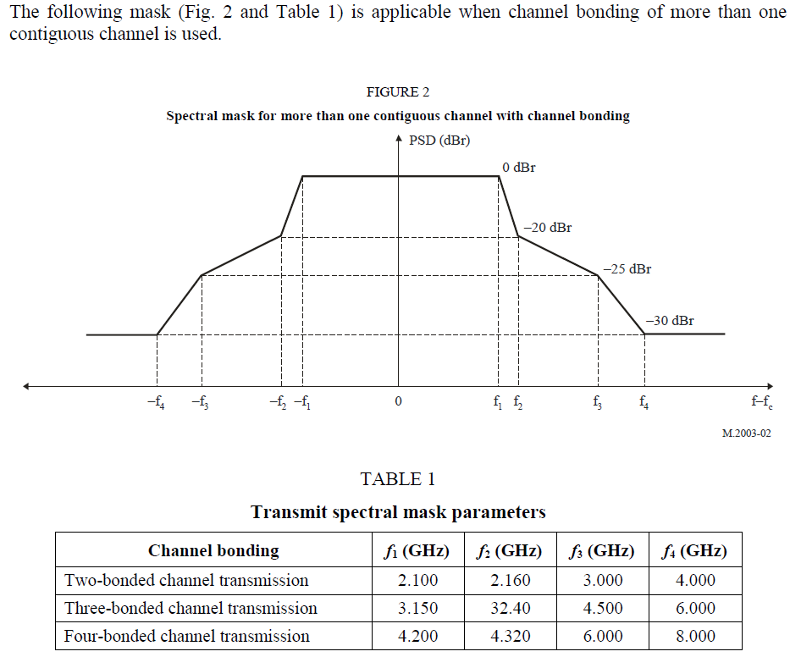
Spectral mask for channel bonding in ITU-R

