Slide 1
Project: IEEE P802.15 Working Group for Wireless Personal Area Networks (WPANs)
Submission Title: Channel Model for Outdoor Free-space Transmission
Date Submitted: November 9, 2015
Source: Nan Chi, Junwen Zhang, Fudan University
Address: Fu Dan University, 220 Handan Rd., Yangpu District, Shanghai
Voice: Tel: 0086-21-65642983, E-Mail: nanchi@fudan.edu.cn hustzjw@gmail.com
Abstract: In response to «Call for Proposals for OWC Channel Models» issued by 802.15.7r1, this contribution studies on outdoor free space VLC long distance transmission model for high rate PD
communication in wireless backhaul (mobile back haul).
Purpose: To introduce reference channel models for the evaluation of different PHY proposals.
Notice: This document has been prepared to assist the IEEE P802.15. It is offered as a basis for discussion and is not binding on the contributing individual(s) or organization(s). The material in this document is subject to change in form and content after further study. The contributor(s) reserve(s) the right to add, amend or withdraw material contained herein.
Release: The contributor acknowledges and accepts that this contribution becomes the property of IEEE and may be made publicly available by P802.15.

Slide 2
Channel Model Study for Outdoor Free Space Transmission

Slide 3
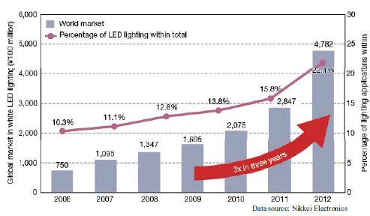
Background
LED lighting in the global market
Expand the spectrum for the next generation of broadband communications
Combine lighting with communication, bringing unique advantages
By 2018, the semiconductor lighting penetration will reach 80%. With the popularity of LED lighting process, VLC will be standing on the shoulders of giants.

Slide 4
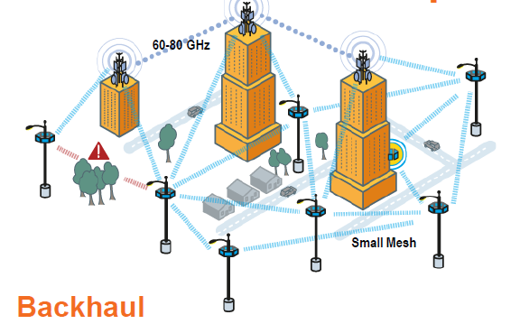
Background
VLC outdoor free-space high speed PD communication for mobile backhaul
It shares the same CAPEX/OPEX advantages with mmW
More competitive with lower device cost
Characters:
Large indoor/outdoor public spaces
Distance: ~50 m~1 km
Speed: ~Gbps
Link: mainly Point-to-point
*A typical mmW backhaul link
Backhaul is a top priority for small cell deployments
•80% of small cells will have wireless backhaul
•Cost of fiber is ~4x greater than wireless (cumulative CAPEX/OPEX)
•Small Cell mesh inter-connectivity over ~250m
•Large indoor and outdoor public spaces
* According to InterDigital Whitepaper 2013
Notes:
The white light is safe for human eyes
No electromagnetic interference, applications in the electromagnetic-sensitive environment (airplane, hospital, etc)
Energy conservation because of providing with functions of illumination, communication and control positioning
Spectrum license free
Suitable for security communication

Slide 5
Background Noise
Turbulence
Transmitter
Channel Model
Receiver
Channel Model Study
Transmitter： LED response, Tx Angle of Half, Wavelength
Free Space Channel： Turbulence, Background Noise, Distance
Receiver: Rx Angle of Half, diversity technology and receiver filter

Slide 6
Research Route
VLC Free Space Transmission Channel Model
LED Modulation Property
LED dimming property
Atmospheric turbulence model
Background Noise
Key Technique for High Speed Outdoor VLC Transmission System
Modulation formats
Multiplexing Technology
Pre Equalization and post-equalization
Diversity reception technology
Simulation for Outdoor Long Distance VLC Transmission System
System Structure and Simulation Parameters
Simulation Results and Analysis
Outdoor Transmission Experiments
System Structure
Results and Analysis

Slide 7
The research directions
LED visible light communication
Channel Model Study
Modulation
coding/equalization
multiplexing
material/chip
OOK
PPM
OFDM: ACO, DFTS, 2FFT, PTS, SLM, PC
CAP: single-band and multi-band
Nyquist SC-FDE
Quasi-balanced coding
STBC
Software equalization
Hardware equalization
FDM
WDM: RGB Spatial division multiplexing: MIMO
Polarization division multiplexing
Micro-LED
GaAlAs Blue narrow-band detector
LED array
Detector array
System and Networking Study

Slide 8
Atmospheric turbulence model
Negative Exponential Model：Strong Turbulence
Log-Normal Model: Weak Turbulence
Gamma-Gamma Model: From weak to strong
turbulence
Scintillation index (S.I.) and Rytov Variation vs distance
Comparison of 3 Models PDF (Probability density function)
Scintillation index (S.I.) and Rytov Variation vs Wavelength
For distance less than 1000 m, mainly on weak turbulence effect

Slide 9
Atmospheric turbulence model
Negative Exponential Model：Strong Turbulence
Log-Normal Model: Weak Turbulence
Gamma-Gamma Model: From weak to strong Turbulence
Turbulence affect light intense and BER Gamma-Gamma are preferred over other model
Noise Power N
BER under different Model

Slide 10
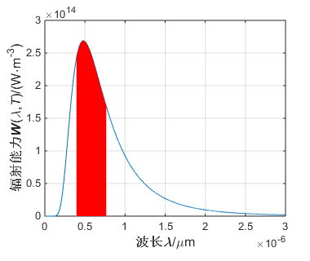
Background Noise
Background Noise Impact：
Saturate Receiver
Affect Receiver Sensitivity
Sun Noise Model：
Black Body Radiation Model
Sun Radiation vs Wavelength
Reduce Background Impact：
Reduce Receiver View Angle
Optimize the Receiver Antenna Size
Use sun-cap
Choose Proper Optical Bandpass Filter
Use different color LED

Slide 11
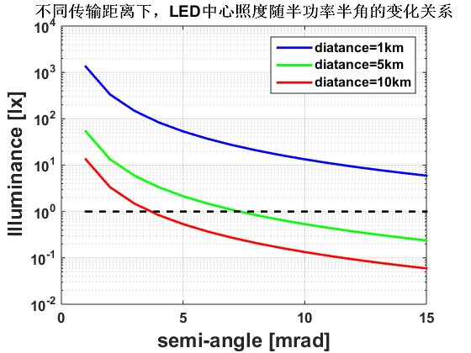
Reduce the Transmitter and Receiver view-angle
Lambertian illumination model：
Background Noise Power (uw)
Semi-angle (mrad)
Transmitter and Receiver view-angle has great impact on the noise power

Slide 12
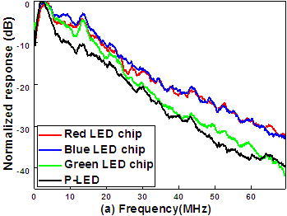
LED modulation Model
The fitting channel response
Blue phosphor LED 10dB bandwidth is around 15MHz
RGB LED 10dB bandwidth is around 25MHz
Large attenuation at high frequency
Narrow bandwidth & Nonliearity

Slide 13
LED Modulation Model
LED nonlinearity
LED nonlinearity
LED nonlinearity seriously degrades the system performance;
The LED forward current exhibits strong nonlinearity with the bias voltage;
Two factors dominate the nonlinear effects: DC bias voltage and the input signal peak-to-peak value (Vpp);
Y. Wang, et al, IEEE Photonics Research 7(13), 2015.

Slide 14
Background Noise
Turbulence
Transmitter
Channel Model
Receiver
Simulation
Modulation： 4-PPM
Pre-Equalization： FIR pre-equ
Turbulence Model： Gamma-Gamma
Diversity and number paths： 4 MRC

Slide 15
BER comparison
Diversity reception technology
Space Linear diversity ：
MRC：High Gain, High Complexity
EGC：Gain less than MRC，lower complexity
SC：Minimum Complexity，worst Gain
MRC sub path vs BER

Slide 16
Background vs Minimum Transmission Power
Semi-angle (mrd) | 10~20
Modulation format | 4PPM
Distance(m) | 1000
Order of Pre-Equ | 5
Mod. Bandwidth（MHz） | 400
Background Noise (uw) | 20-80
Turbulence Model | Gamma-Gamma
Transmission Power
Transmission Power
Transmission Power
X 2 diversity receiver
X 4 diversity receiver

Slide 17
In conclusion:
In the outdoor high-speed VLC link, the model with Tx, FSO link and Rx is presented
Turbulence model is added, and weak turbulence model is preferred for short distance
Background noise is a key issue for the outdoor link, solutions:
Reduce Tx and Receiver View Angle
Use sun-cap
Choose Proper Optical Bandpass Filter
Use different color LED
Diversity reception technology is included
Equalization and compensation is essential for high rate PD communication
WDM is a effect way to increase the capacity to ~Gbps
Fogy channel should be added in future;

Slide 18
Research Route
VLC Free Space Transmission Channel Model
LED Modulation Property
LED dimming property
Atmospheric turbulence model
Background Noise
Key Technique for High Speed Outdoor VLC Transmission System
Modulation formats
Multiplexing Technology
Pre Equalization and post-equalization
Diversity reception technology
Simulation for Outdoor Long Distance VLC Transmission System
System Structure and Simulation Parameters
Simulation Results and Analysis
Outdoor Transmission Experiments
System Structure
Results and Analysis

