Slide 1
Project: IEEE P802.15 Working Group for Wireless Personal Area Networks (WPANs)
Submission Title: [PHY Model for OFDM Intensity Modulation Incorporating PWM]
Date Submitted: [06, November, 2015]
Source: [Hany Elgala University at Albany and Thomas Little Boston University]
Address [8 Saint Mary’s St. Boston MA 02215]
Voice:[617-353-9877], FAX: [617-353-6440], E-Mail:[tdcl@bu.edu, helgala@alabany.edu]
Re: []
Abstract: [This is a PHY protocol for achieving OFDM intensity modulation with wide-range dimming through PWM while insuring full dynamic-range utilization and data rate consistency.]
Purpose: [We seek to include the proposed technique in the revised standard in order to enable dimming under an OFDM modulation technique when lights or lighting are used to deliver VLC.]
Notice: This document has been prepared to assist the IEEE P802.15. It is offered as a basis for discussion and is not binding on the contributing individual(s) or organization(s). The material in this document is subject to change in form and content after further study. The contributor(s) reserve(s) the right to add, amend or withdraw material contained herein.
Release: The contributor acknowledges and accepts that this contribution becomes the property of IEEE and may be made publicly available by P802.15.

Slide 2


Use Case
Operating Scenario
Network
Primarily downlink model
Gigabit applications
While supporting (our use case):
  Illumination functionality
    Color tunable
    Dimmable
  High quality lighting
    CCR
    CRI
  High-speed VLC downlink using OFDM
Optical
User 1
Cell 2

Slide 3
Optical OFDM formats and constraints
Average
Peak
Optical
Power
-1 + 1i
Complex
Conjugate
IFFT
-1 - 1i
Bipolar DC biased optical OFDM (DCO-OFDM)
Dynamic Range
Peak
Average
Other unipolar formats:
Spectral and energy efficient OFDM (SEE-OFDM)
Polar-OFDM (P-OFDM)
Unipolar OFDM (U-OFDM)
Position modulation OFDM (PM-OFDM)
Unipolar Asymmetric clipped optical OFDM (ACO-OFDM)

Slide 4
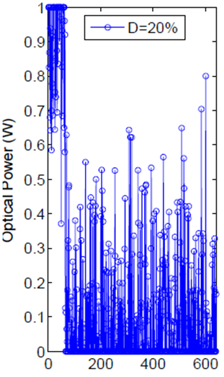
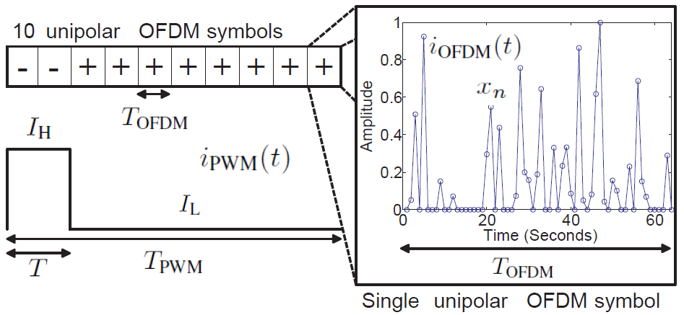
Reverse polarity modulation
Existing solutions:
Superposition only during the PWM-”on”
OFDM signal sampling using the PWM
Average power reduction per OFDM symbol
Reverse polarity OFDM solution:
Continuous OFDM transmission!
Example: 20% duty cycle @ 15dBm OFDM average power

Slide 5
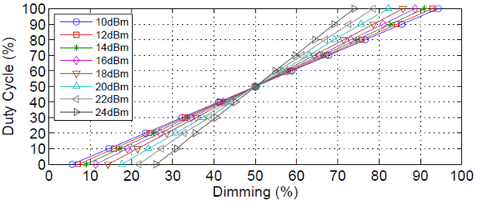
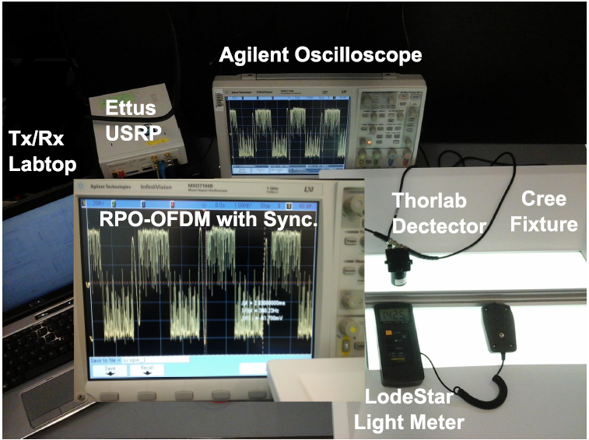
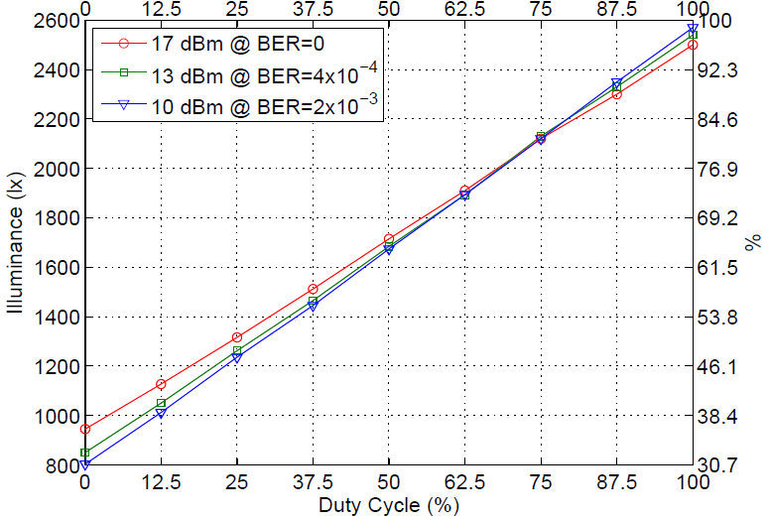
Reverse polarity modulation (PWM+OFDM) proof-of-concept setup
Simulation
Dimming vs. duty cycle; different average OFDM signal power
Experimental
Illuminance/dimming percentage vs. duty cycle; different average OFDM signal power/BER

Slide 6
Conclusion
Reverse Polarity OFDM Modulation:
  Dimming can be linearly adjusted
  Performance does not need to be reduced proportional to intensity
  Bit-error performance is sustained over a large fraction of the dimming range
  A practical approach; capacity is not limited by the PWM frequency
  Implemention using any optical OFDM formats

