Slide 1
Project: IEEE P802.15 Working Group for Wireless Personal Area Networks (WPANs)
Submission Title: Discussion on Channel Model for B4
Date Submitted: November 9, 2015
Source: V. Jungnickel, D. Schulz, J. Hilt, C. Alexakis, M. Schlosser, A. Paraskevopoulos,
L. Grobe, R. Freund
Company: Fraunhofer HHI
Address: Einsteinufer 37, 10587 Berlin, Germany, Voice: +49 30 31002 768
mail: volker.jungnickel@hhi.fraunhofer.de
Re: Agenda item for Monday Nov. 9, PM2 session
Abstract: Fudan University proposed that an additional channel model should be developed for scenario B4. Fraunhofer provides insights into recent work on that issue as a basis for discussion.
Purpose: Discussion
Notice: This document has been prepared to assist the IEEE P802.15. It is offered as a basis for discussion and is not binding on the contributing individual(s) or organization(s). The material in this document is subject to change in form and content after further study. The contributor(s) reserve(s) the right to add, amend or withdraw material contained herein.
Release: The contributor acknowledges and accepts that this contribution becomes the property of IEEE and may be made publicly available by P802.15.

Slide 2
Outline
  Low-cost short-range backhaul
  Initial results
  Long-term outdoor measurements
  Model for optimized link design
  Results with optimized link design
  Conclusions

Slide 3
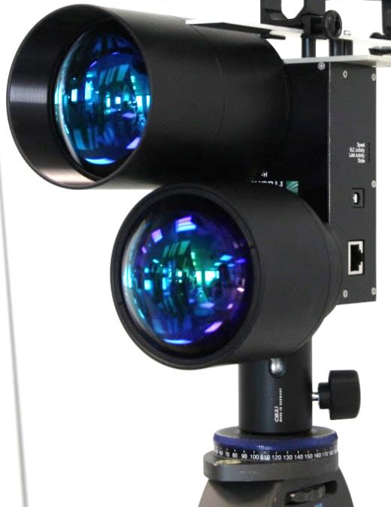
Low-cost short-range backhaul
  Increasing amounts of data over mobile networks
  Small cells are the main capacity scaling factor
V. Jungnickel et al., ”The role of small cells, coordinated multipoint, and massive MIMO in 5G,” IEEE Communications Magazine, Special Issue on 5G Wireless Communication Systems: Prospects and Challenges, vol.52, no.5, pp.44-51 (2014).
  5G: Up to 50/10 indoor/outdoor small cells per sector
    Urban areas (Germany): Typical inter-site distance is 500 m
    Small-cell backhaul distance is 50-250 m
    High line-of-sight probability
  New idea: Use LED-based optical wireless link as low-cost backhaul solution for small radio cells
  V. Jungnickel, D. Schulz, N. Perlot, K.-D. Langer, W. Störmer, „Optical Wireless as a Low-Cost Small-Cell Backhaul Solution,” 8. ITG Fachtagung Photonische Netze und Systeme, Berlin, 1.-2. April 2014

Slide 4
Laser vs. LED
  Laser: Gaussian beam profile
    Sensitive against misalignment
    Needs tracking
    Needs exe safety
  LED: Flat-top beam profile
    Easy alignment
    No more tracking is needed
    Very robust link
    Lamp posts, etc.

Slide 5
Initial results
  3”, f=10/8,5 cm lens at Tx/Rx
  Single-color infrared LED
  7x7 mm² emitting area
  14 mm effective PD diameter
  7x7 m² beam area at 100 m
  More focused beam
  Better usage of optical bandwidth

Slide 6
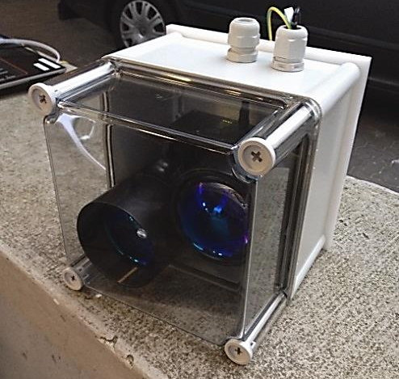
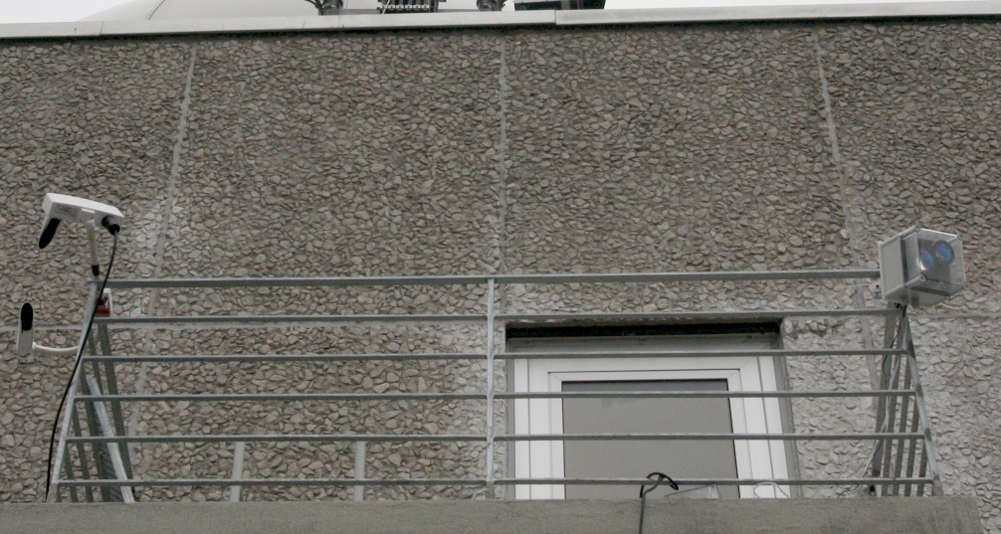
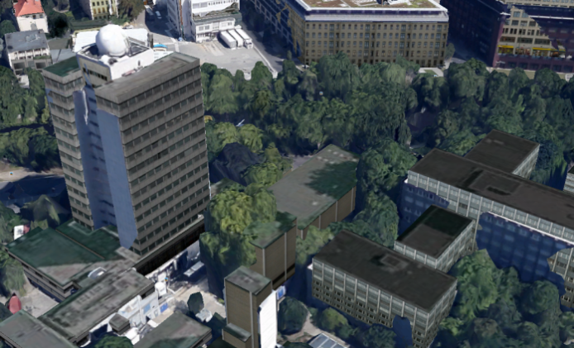
Long-term outdoor experiment
  Evaluate the impact of fog and sunlight
  Measured both, visibility range and data rate
  5-month trial during winter term
    Nov. 2014 – April 2015
Visibility range
OW Link
100m

Slide 7
Measured cumulative long-term statistics
  Cumulative statistics of visibility and
  data rate for 5 months
  Visibility was never below 180 m
    High availability for short distances
  Rate adaptation: Data rate was for
    On average more than 100 Mbps
    99% more than 39 Mbps
    99,9% more than 22 Mbps
    More than 6 Mbps at any time
  No outage at all
    Thanks to rate-adaptive system concept

Slide 8
Analytical model for optimized link design
Received power
PD area, sensitivity
Focal length and diameter of lens
Rx bandwith
LED power, active area, beam width
Focal length and diameter of lens
Visibility range
Shot noise due to sunlight
  Model computes finally the electrical SNR_{el} at the receiver
  Measured statistics of visibility and sunlight can be inserted into the model
  Capacity estimated with modified Shannon‘s formula C = B*log₂(1+SNR_{el}/Γ)
  Determine empirical parameter Γ from system measurements

Slide 9
Increase bandwidth: 1 Gbps baseband chip
  Standard RFC 2544 test
    electrical back-to-back measurements
    Electrical gross data rate ~950 Mbps
    Optical gross data rate ~850 Mbps
  Throughput results
    Is smaller for smaller frame sizes
    Max. reached for frame size ≥ 512 byte
    230% increased net rate with new chip
  Latency results
    (10±1) ms for 500 Mbps chip for frame size ≥ 512 byte
    < 2 ms for 1 Gbps chip, independent of the frame size
2.3x

Slide 10
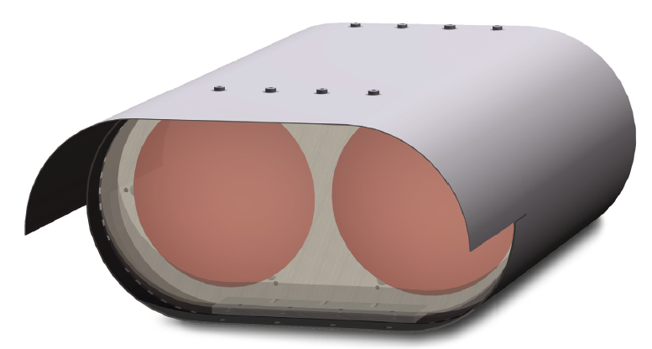
Results with optimized backhaul link
  4” f=10 cm lenses at Tx and Rx, single-color IR LED
  1x1 m² at 100 m → higher SNR
  New baseband chip → Higher throughput, lower latency

Slide 11
Summary
  Initial work using LED-based optical wireless link for the backhaul of small radio cells (WiFi, LTE) was presented, useful for distances < 200m.
  Long-term outdoor trial indicates the impact of fog and sunlight.
  Analytical link model developed to optimize link parameters, aiming at 1Gbps over 100 m within available analog bandwidth (180 MHz).
  Optimized link with new baseband chip (using 100 MHz bandwidth only) was set up. 500 Mbps over 100 m were achieved.
  Potential towards 10G
    Replacing LED with laser (higher bandwidth) is preferred way forward.
    WDM may be critical as multiple colors increase receiver complexity.
    Maintain low-cost design while increasing the data rate.

