Slide 1
Project: IEEE P802.15 Working Group for Wireless Personal Area Networks (WPANs)
Submission Title: Decoupling Band and Channel Plan from PHY specifications in 15.4
Date Submitted: November 9, 2015
Source: Benjamin A. Rolfe Company: Blind Creek Associates
Address Post Box Seven Nine Eight, Lost Gatos, CA 95031
Voice:+1 408 395 7207 , FAX: Deprecated, E-Mail: ben @ blindcreek . com
Re: 802.15.4
Abstract: Suggests an approach to decouple the band and channel plan information from PHY specification, to simplify adopting new bands as regional regulations change when an existing PHY definition can otherwise support the requirements to operate in the band. Would also provide managed identifiers for bands and operating modes which may be useful in future MAC enhancements and/or by externally defined protocols.
Purpose: Suggest a useful enhancement to the standard which would be incorporated via and amendment or revision to the standard.
Notice: This document has been prepared to assist the IEEE P802.15. It is offered as a basis for discussion and is not binding on the contributing individual(s) or organization(s). The material in this document is subject to change in form and content after further study. The contributor(s) reserve(s) the right to add, amend or withdraw material contained herein. becomes
Release: The contributor acknowledges and accepts that this contribution the property of IEEE and may be made publicly available by P802.15.

Slide 2
Decoupling Band and Channel Plan from PHY specifications in 15.4
Or
Adding new band to an existing PHY shouldn’t be hard

Slide 3
Content
Current practice in the standard
What is the goal
Proposed solution and benefits
How we can do it (rough example)
Why we should do it
Q&A and presenter bash

Slide 4
Current Practice
Consolidated in “General PHY requirements” the list of band plans with clues which PHYs use which bands
Diversity in method of channel numbering
Recent additions trending towards more consistent scheme

Slide 5
Channel Numbering Example
Frequency band (MHz) | Modulation | ChanSpacing (MHz) | TotalNumChan | ChanCenterFreq0 (MHz)
169.400–169.475 | SUN FSK operating mode #1 & #2 & #3 | 0.0125 | 6 | 169.40625
450–470 | SUN FSK operating mode #1 & #2 | 0.0125 | 1599 | 450.00625
…
ChanCenterFreq = ChanCenterFreq0 + NumChan × ChanSpacing

Slide 6
What’s the Goal?
802.15.4 is widely adopted
In many regional bands
Many applications, and
By many other specifications and standards
Things change
Regional regulations add, and sometimes move available bands
New regions become potential markets
Real world moves fast
Flexible low-cost RF implementation is common
Implementations follow perceived markets
Often without silicon changes
Non-standard extensions proliferate
Standard ‘lags’ need / interoperability may suffer
Enable a rapid adoption and/or adaptation of new frequency bands
Enable a rapid response to changes in regional regulations in available bands and/or usage constraints

Slide 7
Proposed solution and benefits
Reduce coupling between PHY definition and band details
Create annex to define band and operating modes
Move band plan details to annex
Define “operating class” for combination of PHY parameters that can be band independent
Process to facilitate simple and thus rapid adoption of new bands
More rapid response
Maintain technical validation of the 802 process

Slide 8
Annex Content
Tables to define bands and operating class
Text and/or tables to define channel allocation and numbering by band/PHY combinations

Slide 9
PHY/Band Dependencies
Band characteristics PHY definitions depend on:
Channel spacing available
Total bandwidth available
Regional restrictions
Several (most) PHYs can operate in multiple bands and regions
Many bands can support multiple PHYs

Slide 10
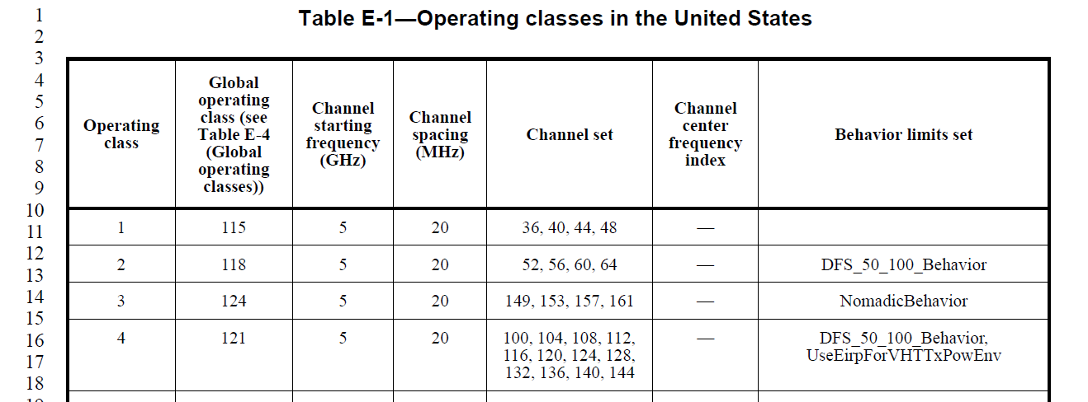
Precedent 802.11 Annex E
IEEE P802.11-REVmc/D4.0, January 2015

Slide 11
Possible Example 802.15.4
Band designation | Band Identifier Value | Frequency Range | Region(s)
169 MHz | 9 | 169.400–169.475
433 MHz | 7 | 433.05–434.79 | North America
450 MHz | 10 | 450–470
470 MHz | 11 | 470–510 | China
780 MHz | 8 | 779–787 | China
863 MHz |  | 863–870 | EU
868 MHz |  | 868–870 | EU
896 MHz |  | 896–901
901 MHz |  | 901–902
915 MHz | 1 | 902-928 | North America
917 MHz |  | 917–923.5
920 MHz | 2 | 920–928 | Japan
928 MHz |  | 928–960
1427 MHz |  | 1427–1518
2380 MHz |  | 2360–2400
2450 MHz | 3 | 2400–2483.5 | Global (almost)
HRP UWB | 4
HRP UWB | 5
HRP UWB | 6
LRP UWB | 8
TVWS

Slide 12
Possible Example 802.15.4
Operting Class Value | Channel Spacing | PHY Mode | Reference |  | Band Notes
0 | 5 MHz | O-QPSK 250kb/s | 12 |  | 250 kb/s: 2450 MHz, 915 MHz, 780 MHz, 2380
1 | 2 MHz | O-QPSK 250kb/s and 100 kb/s | 12 |  | 100 kb/s: 868 MHz band
2 | - | BPSK PHY 20 kb/s, 40 kb/s | 13 |  | 20 kb/s in 868 MHz band, 40 kb/s in 915 MHz band
3 | 5 MHz | CSSS 1Mb/s | 15 |  | 2450 MHz
4 | 5 MHz | CSS 250 kb/s | 15 |  | 2450 MHz
5 | 200 KHz | GFSK | 17
6 | 2 Mhz | MSK | 18
7 | 200 KHz | 2-FSK SUN 50 kb/s, MI=1.0 Mode #1 | 20 | Table 20-250 | Bands: 902-928, 920-928, 2400–2483.5 917–923.5, 470–510, 779–787,
8 | 400 KHz | 2-FSK SUN 150 kb/s, 200 kb/s MI=0.5 |  | Table 20-250 | Mode #2 in bands 902-928,

Slide 13
Process – band/channel plan maintenance
Additions or changes to band plan a maintenance item
When ONLY band/channel plan change needed (not new PHY)
Standing committee reviews and validates
Publish recommended change to band annex
WG Confirms (or not) recommendation
Que change for next revision cycle

Slide 14
Why we should do it
Things change
Makes technical sense
A number PHYs and PHY modes are suitable for many bands without significant changes
Implementers are ahead of the standard
Easier and quicker to standardize adaptation, adjust to reg changes
Reduce process overhead with no loss of quality control
Save work in future amendments and revisions
Further enhance the position of 15.4 as a foundation technology
1215

Slide 15
Q&A and presenter bash

Slide 16
Now What?
Queue up for next revision
Start work now in SCM
Develop process
OM addition?

