Slide 1
Project: IEEE P802.15 Working Group for Wireless Personal Area Networks (WPANs)
Submission Title: Decoupling Band and Channel Plan from PHY specifications in 15.4
Date Submitted: November 9, 2015
Source: Benjamin A. Rolfe Company: Blind Creek Associates
Address Post Box Seven Nine Eight, Lost Gatos, CA 95031
Voice:+1 408 395 7207 , FAX: Deprecated, E-Mail: ben @ blindcreek . com
Re: 802.15.4
Abstract: Suggests an approach to decouple the band and channel plan information from PHY specification, to simplify adopting new bands as regional regulations change when an existing PHY definition can otherwise support the requirements to operate in the band. Would also provide managed identifiers for bands and operating modes which may be useful in future MAC enhancements and/or by externally defined protocols.
Purpose: Suggest a useful enhancement to the standard which would be incorporated via and amendment or revision to the standard.
Notice: This document has been prepared to assist the IEEE P802.15. It is offered as a basis for discussion and is not binding on the contributing individual(s) or organization(s). The material in this document is subject to change in form and content after further study. The contributor(s) reserve(s) the right to add, amend or withdraw material contained herein. becomes
Release: The contributor acknowledges and accepts that this contribution the property of IEEE and may be made publicly available by P802.15.

Slide 2
Decoupling Band and Channel Plan from PHY specifications in 15.4
Or
Adding new band to an existing PHY shouldn’t be hard

Slide 3
Content
Current practice in the standard
What is the goal
Proposed solution and benefits
Why we should do it
How we can do it (rough example)
Q&A and presenter bash

Slide 4
Current Practice
Consolidated in “General PHY requirements” the list of band plans with clues which PHYs use which bands
Diversity in method of channel numbering
  Recent additions trending towards more consistent scheme

Slide 5
Channel Numbering Example
Frequency band (MHz) | Modulation | ChanSpacing (MHz) | TotalNumChan | ChanCenterFreq0 (MHz)
169.400–169.475 | SUN FSK operating mode #1 & #2 & #3 | 0.0125 | 6 | 169.40625
450–470 | SUN FSK operating mode #1 & #2 | 0.0125 | 1599 | 450.00625
…
ChanCenterFreq = ChanCenterFreq0 + NumChan × ChanSpacing

Slide 6
What’s the Goal?
802.15.4 is widely adopted
  In many regional bands
  Many applications, and
  By many other specifications and standards
Things change
  Regional regulations add, and sometimes move available bands
  New regions become potential markets
Real world moves fast
  Flexible low-cost RF implementation is common
  Implementations follow perceived markets
    Often without silicon changes
  Non-standard extensions proliferate
    Standard ‘lags’ need / interoperability may suffer
Enable a rapid adoption and/or adaptation of new frequency bands
Enable a rapid response to changes in regional regulations in available bands and/or usage constraints

Slide 7
Proposed solution and benefits
Reduce coupling between PHY definition and band details
Create annex to define band and operating modes
  Move band plan details to annex
  Define “operating class” for combination of PHY parameters that can be band independent
Process to facilitate simple and thus rapid adoption of new bands
  More rapid response
  Maintain technical validation of the 802 process

Slide 8
Annex Content
Tables to define bands and operating class
Text and/or tables to define channel allocation and numbering by band/PHY combinations

Slide 9
PHY/Band Dependencies
Band characteristics PHY definitions depend on:
  Channel spacing available
  Total bandwidth available
  Regional restrictions
Several (most) PHYs can operate in multiple bands and regions
Many bands can support multiple PHYs

Slide 10
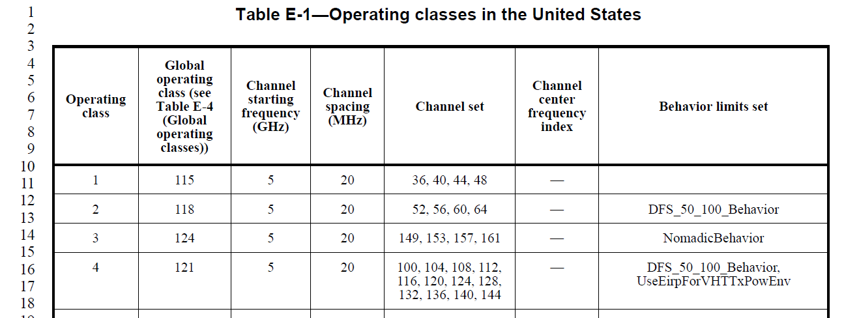
Precedent 802.11 Annex E
IEEE P802.11-REVmc/D4.0, January 2015

Slide 11
Possible Example 802.15.4
Band designation | Band Identifier Value | Frequency Range | Region(s)
169 MHz | 9 | 169.400–169.475
433 MHz | 7 | 433.05–434.79 | North America
450 MHz | 10 | 450–470
470 MHz | 11 | 470–510 | China
780 MHz | 8 | 779–787 | China
863 MHz |  | 863–870 | EU
868 MHz |  | 868–870 | EU
896 MHz |  | 896–901
901 MHz |  | 901–902
915 MHz | 1 | 902-928 | North America
917 MHz |  | 917–923.5
920 MHz | 2 | 920–928 | Japan
928 MHz |  | 928–960
1427 MHz |  | 1427–1518
2380 MHz |  | 2360–2400
2450 MHz | 3 | 2400–2483.5 | Global (almost)
HRP UWB | 4
HRP UWB | 5
HRP UWB | 6
LRP UWB | 8
TVWS

Slide 12
Possible Example 802.15.4
Operting Class Value | Channel Spacing | PHY Mode | Reference |  | Band Notes
0 | 5 MHz | O-QPSK 250kb/s | 12 |  | 250 kb/s: 2450 MHz, 915 MHz, 780 MHz, 2380
1 | 2 MHz | O-QPSK 250kb/s and 100 kb/s | 12 |  | 100 kb/s: 868 MHz band
2 | - | BPSK PHY 20 kb/s, 40 kb/s | 13 |  | 20 kb/s in 868 MHz band, 40 kb/s in 915 MHz band
3 | 5 MHz | CSSS 1Mb/s | 15 |  | 2450 MHz
4 | 5 MHz | CSS 250 kb/s | 15 |  | 2450 MHz
5 | 200 KHz | GFSK | 17
6 | 2 Mhz | MSK | 18
7 | 200 KHz | 2-FSK SUN 50 kb/s, MI=1.0 Mode #1 | 20 | Table 20-250 | Bands: 902-928, 920-928, 2400–2483.5 917–923.5, 470–510, 779–787,
8 | 400 KHz | 2-FSK SUN 150 kb/s, 200 kb/s MI=0.5 |  | Table 20-250 | Mode #2 in bands 902-928,

Slide 13
Process – band/channel plan maintenence
Additions or changes to band plan a maintenance item
  When ONLY band/channel plan change needed (not new PHY)
  Standing committee reviews and validates
  Publish recommended change to band annex
  WG Confirms (or not) recommendation
  Que change for next revision cycle

