Slide 1
Project: IEEE P802.15 Working Group for Wireless Personal Area Networks (WPANs)
Submission Title: [Removal of security part from MAC]
Date Submitted: [29 October 2015]
Source: [Keitarou Kondou⁽¹⁾, Makoto Noda, Hiroyuki Matsumura, Ken Hiraga, Itaru Maekawa, Ko Togashi, Kiyoshi Toshimitsu]
Company: [JRC, NTT, Toshiba, Sony¹]
Address¹: [1-7-1 Konan, Minato-ku, Tokyo 108-0075]
E-Mail¹: [Keitarou.Kondou at jp.sony.com]
Abstract: This document suggests the removal of security part from current proposal.
Purpose: To modify the current TG3e draft document.
Notice: This document has been prepared to assist the IEEE P802.15. It is offered as a basis for discussion and is not binding on the contributing individual(s) or organization(s). The material in this document is subject to change in form and content after further study. The contributor(s) reserve(s) the right to add, amend or withdraw material contained herein.
Release: The contributors acknowledge and accept that this contribution becomes the property of IEEE and may be made publicly available by P802.15.

Slide 2
Comment on TG3e proposal
Remove security part in 7.2.x and 7.3.x.
Reason
less demand from task group members
Protection in an upper layer may be sufficient.
Example: Near Field Communication (NFC)
- Security function in NFC is realized above the communication protocol layer.
4-way handshake to exchange security information takes a long time before transaction of data.
Security function can be employed in an future amendment by utilizing one of reserved bits as a indicator of security transaction, even if the implementation of security in the MAC layer is required.

Slide 3
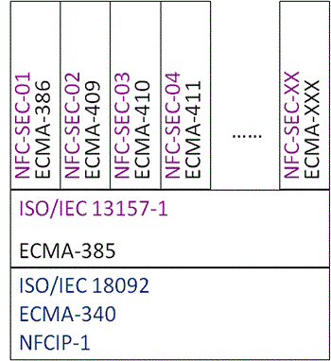
Example: NFC specifications
Security protocol is specified separately in NFC.
Encryption method, Key exchange protocol, etc
NFC-SEC:
NFCIP-1 Security Services and Protocol
NFCIP-1 : NFC Interface and Protocol-1
= Felica PHY + TypeA(MIFARE) PHY + Merged MAC I/F
Structural view of NFC specifications[1]
[1] http://www.ecma-international.org/news/Publication%20of%20ECMA%20NFC%20standards.htm

Slide 4
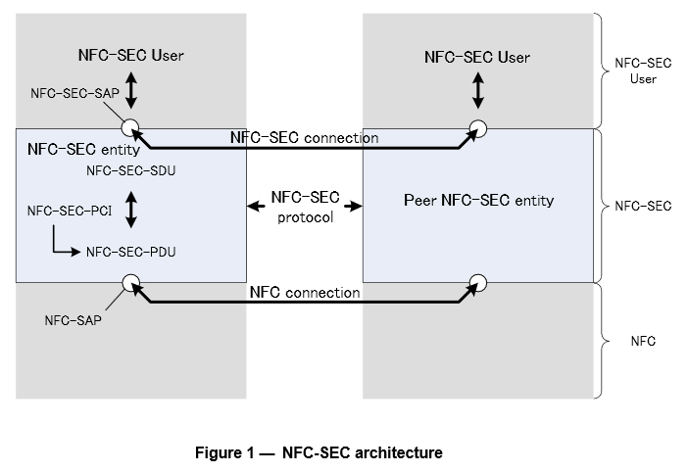
Example: NFC-IP and NFC-SEC Layer
NFC-SEC(ECMA-385) can only access NFC-IP layer(ECMA-340) via NFC-SAP.
[2]
[2] ECMA-385

Slide 5
Future security implementation
Employ security function in upper layer over 15.3e, when required.
Encryption, etc.
Any Security Service Layer
Out of Scope of
current 15.3e
15.3e MAC
In Scope
15.3e OOK PHY
15.3e SC
PHY
(a) NFC
(b) HRCP
Comparison of NFC and suggested HRCP specifications

