Slide 1
Project: IEEE P802.15 Working Group for Wireless Personal Area Networks (WPANs)
Submission Title: Proposed Resolution on some MCO comments(subclause 5.4.1.3) of LB 110
Date Submitted: Oct., 2015
Source: Sangjae Lee, Jaehwan Kim (ETRI), Jaebeom Kim, Jina Han, Youngbae Ko (Ajou Univ.), Soo-Young Chang (SYCA), and Sangsung Choi (ETRI)
Company: ETRI, Ajou Univ., SYCA
Address:
Voice: +82 42 850 5338, E-Mail: kimj@etri.re.kr
Re:
Abstract:
Purpose: To suggest a comment resolution for Letter Ballot #110
Notice: This document has been prepared to assist the IEEE P802.15. It is offered as a basis for discussion and is not binding on the contributing individual(s) or organization(s). The material in this document is subject to change in form and content after further study. The contributor(s) reserve(s) the right to add, amend or withdraw material contained herein.
Release: The contributor acknowledges and accepts that this contribution becomes the property of IEEE and may be made publicly available by P802.15.

Slide 2
Comment CID 1247
Commentor
Verotiana Rabarijaona
Related clause
5.4.1.3 P 37 line 44
Comment
"parent’s channel" s/b "the channel of the parent PAN"
Proposed Change
See comment

Slide 3
Proposed resolution for CID 1247
Accept: modify a related term.
[P 37 line 44] In this figure, each PAN coordinator uses the two channels: the channel of the parent PAN and the PAN coordinator’s own channel.

Slide 4
Comment CID 1253
Commentor
Verotiana Rabarijaona
Related clause
5.4.1.3 P 37 line 49
Comment
"communicate" s/b "exchange"? Is it a two-way beacon exchange?
Proposed Change
Replace with "exchange"

Slide 5
Proposed resolution for CID 1253
Accept: modify a related term
[P 37 line 49] A DBS is used to exchange beacons between the parent PAN coordinator and the child PAN coordinator.

Slide 6
Comment CID 1264
Commentor
Verotiana Rabarijaona
Related clause
5.4.1.3 P 38 line 33
Comment
"The device must send a TC IE using its all operation channels and device that receives a TC IE stores the channel information to NT."
Proposed Change
Explain how a device fills the MCO Descriptor in the TC IE before transmitting it in each different channel

Slide 7
Proposed resolution for CID 1264
Accept in Principle: add how to fill the MCO descriptor field
[P 38 line 33]
Resolve as in CID # 1267

Slide 8
Comment CID 1262
Commentor
Verotiana Rabarijaona
Related clause
5.4.1.3 P 38 line 31
Comment
"In this Multi-Channel Operation (MCO) in L2R, each device (including PAN coordinator and PAN device) exchanges the parent-channel and its own channel by using MCO Descriptor field in TC IE (6.2.2.2). The device must send a TC IE using its all operation channels and device that receives a TC IE stores the channel information to NT. For example, PAN ID 1 (Super PAN coordinator) in figure 2 sends a single TC IE, but PAN ID 2, 3, 4 and 5 send two TC IE by using its operation channels. If the ID 1 want to sends a packet to device 5-1 (t0), then it can directly send to next hop route PAN ID 4 (PAN coordinator). However, the forwarder device PAN ID 4 need to wait a next CAP&CFP periods because its current operation cannel is not same as next hop device PAN ID 5 (t1). PAN ID 5 also wait next periods to send a received packet for device 5-1 (t2). To identify the operation channel of the device with neighbor address, L2R store the operation channel of the device."
Some of this text is related to route establishment and should be moved to 5.2.4.3. And some are related to routing.
Route establishment uses TC IEs and RA IEs while routing uses L2R Routing IEs.
Refer to the other subclause on route establishment (5.2.x) and on routing (5.4.x) for examples
Proposed Change
Move the text related to route establishment to 5.2.4.3.
Describe the use of the L2R Routing IE for routing in this clause. Figure 23 should to be moved to 5.2.4.3 and "route construction" s/b "route establishment". A similar figure is needed in this clause describing routing.

Slide 9
Proposed resolution for CID 1262
Accept in Principle
Add additional arrows for routing procedure in figure 23.
Add a reference about MCO route establishment the figure 23 and its description in 5.2.4.3
The MCO route establishment and routing procedure can be readably described when theses terms are located in same section
See page 11

Slide 10
Comment CID 1271
Commentor
Verotiana Rabarijaona
Related clause
5.4.1.3 P 38 line 5
Comment
The red arrows represent the TC IE transmissions, however, a TC IE is transmitted in an EB. Is there a reason why they are transmitted in the CAP or CFP instead of during the beacon period?
Proposed Change
Double check the figure or describe in text that TC IE are sent in EBs that are different from the beacons sent during the beacon period

Slide 11
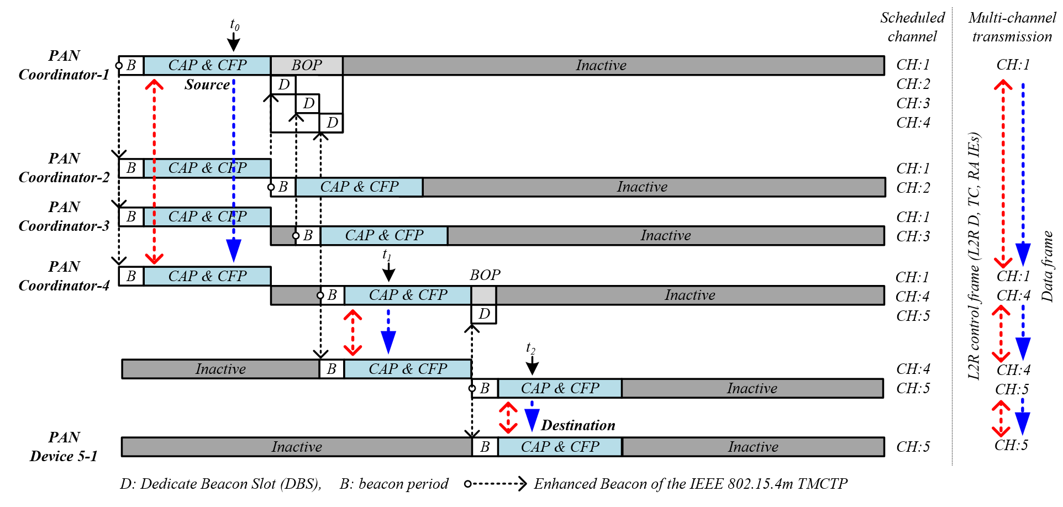
Proposed resolution for CID 1262, 1271
Accept in Principle: the figure 23 was modified.

Slide 12
Comment CID 1260
Commentor
Verotiana Rabarijaona
Related clause
5.4.1.3 P 38 line 29
Comment
There is no need to mention about the PAN coordinator 2 and 3.
Proposed Change
Only describe the figure itself, i.e. the communication between the SPC and PAN coordinator 4

Slide 13
Proposed resolution for CID 1260
Accept in Principle: we only describe the communication between the SPC and PAN coordinator 4.
“In this case, the super PAN coordinator operates on the dedicated channel, which is channel 1, and switches into the dedicated channel of the child PAN coordinator 4 at their Dedicate Beacon Slot (DBS).”
Rewrite the Subclause
See page 26

Slide 14
Comment CID 1263
Commentor
Verotiana Rabarijaona
Related clause
5.4.1.3 P 38 line 33
Comment
"The device must send a TC IE using its all operation channels and device that receives a TC IE stores the channel information to NT." should be rephrased
Proposed Change
Replace with "The device should send a TC IE in its own operation channel and in that of its parent and children PAN coordinators. When a device receives a TC IE, it stores the channel information into the NT.

Slide 15
Proposed resolution for CID 1263
Accept in Principle: related sentences are changed.
“Each PAN coordinator should send the duplicated L2R route establishment messages in its parent PAN coordinator's channel and own dedicated channel. When a device receives a L2R route establishment message, it stores the channel information into the NT.”
Rewrite the Subclause
See page 26

Slide 16
Comment CID 1266
Commentor
Verotiana Rabarijaona
Related clause
5.4.1.3 P 38 line 35
Comment
"PAN ID 1"
Proposed Change
Replace with "PAN coordinator 1". Same thing with PAN ID 2, 3, 4 and 5 here and in the rest of the clause

Slide 17
Proposed resolution for CID 1266
Accept: replace “PAN ID 1” with "PAN coordinator 1“ and same thing with PAN ID 2, 3, 4 and 5 here and in the rest of the clause
Rewrite the Subclause
See page 26

Slide 18
Comment CID 1267
Commentor
Verotiana Rabarijaona
Related clause
5.4.1.3 P 38 line 36
Comment
"send two TC IE by using its operation channels" should be rephrased
Proposed Change
If my understanding is correct this should be replaced with "send a TC IE in their parent PAN coordinator's channel and another TC IE in their own dedicated channel."

Slide 19
Proposed resolution for CID 1267
Accept in principle: related sentences are changed.
Replace:
The device must send a TC IE using its all operation channels and the device that receives a TC IE stores the channel information to NT.
With:
“Each PAN coordinator should send the duplicated L2R route establishment messages in its parent’s PAN coordinator's channel and its own dedicated channel.”
Rewrite the Subclause
See page 26

Slide 20
Comment CID 1268
Commentor
Verotiana Rabarijaona
Related clause
5.4.1.3 P 38 line 36
Comment
"If the ID 1" s/b "If the PAN coordinator 1"
Proposed Change
See comment

Slide 21
Proposed resolution for CID 1268
Accept: replace “If the ID 1” with “If PAN coordinator 1”
Rewrite the Subclause
See page 26

Slide 22
Comment CID 1270
Commentor
Verotiana Rabarijaona
Related clause
5.4.1.3 P 38 line 36
Comment
"If the ID 1 want to sends a packet to device 5-1 (t0), then it can directly send to next hop route PAN ID 4 (PAN coordinator). However, the forwarder device PAN ID 4 need to wait a next CAP&CFP periods because its current operation cannel is not same as next hop device PAN ID 5 (t1). PAN ID 5 also wait next periods to send a received packet for device 5-1 (t2)."
Rephrase without the academic writing style.
Proposed Change
Describe the routing in series of events.
E.g.: If PAN coordinator 1 wants to send a frame to Device 5-1 at t0, it forwards the frame to PAN coordinator 4 while they are operating on channel 1.
PAN coordinator 4 waits for the next CAP or CFP in channel 4 and forwards the frame to PAN coordinator 5 at t1. PAN coordinator 5 finally transmits the frame to Device 5-1 during or CAP or the CFP of channel 5 at t2.

Slide 23
Proposed resolution for CID 1270
Accept: related sentences are changed as follows:
“The detail of data forwarding in MCO environment is as below. If PAN coordinator 1 wants to send a frame to Device 5-1 at t0, it forwards the frame to PAN coordinator 4 while they are operating on channel 1. PAN coordinator 4 waits for the next CAP or CFP in channel 4 and forwards the frame to PAN coordinator 5 at t1. PAN coordinator 5 finally transmits the frame to Device 5-1 during or CAP or the CFP of channel 5 at t2.”
Rewrite the Subclause
See page 26

Slide 24
Comment CID 1272
Commentor
Verotiana Rabarijaona
Related clause
5.4.1.3 P 39 line 40
Comment
Indicate that the synchronization and the channel switch is described in 15.4
Proposed Change
Add the relevant cross reference to 15.4

Slide 25
Proposed resolution for CID 1272
Accept: add the relevant cross reference to 15.4
“Figure 23 shows an example of the multichannel routing in TMCTP topology (the details related to superframe scheduling and multichannel topology construction is described in IEEE std. 802.15.4m-2014 5.1.14) as presented in Figure 22.”
Rewrite the Subclause
See page 26

Slide 26
Proposed resolution for CID 1260, 1263, 1266−1268, 1270, 1272
Accept: several comments related to 5.4.1.3 section are resolved.
Figure 23 shows an example of the multichannel routing in TMCTP topology (the details related to superframe scheduling and multichannel topology construction is described in IEEE std. 802.15.4m-2014 5.1.14) as presented in Figure 22. In this case, the super PAN coordinator operates on the dedicated channel, which is channel 1, and switches into the dedicated channel of the child PAN coordinator 4 at their Dedicate Beacon Slot (DBS). Similarly the PAN coordinator 4 operates on the dedicated channel, which is channel 4, and switches into the dedicated channel of the child PAN coordinator 5 at its DBS.
The detail of route establishment procedure is as below. In this Multi-Channel Operation (MCO) in L2R, each device (including PAN coordinator and PAN device) exchanges the parent-channel and its own channel by using MCO Descriptor field in L2R route establishment messages such as L2R-D, TC, and P2P-RQ IEs. Each PAN coordinator should send the duplicated L2R route establishment messages in its parent PAN coordinator's channel and own dedicated channel. When a device receives a L2R route establishment message, it stores the channel information into the NT. For example, PAN coordinator 1 (Super PAN coordinator) in figure 23 sends a TC IE, but PAN coordinator 2, 3, 4 and 5 send duplicated TC IE L2R route establishment messages by using its operation channels.
The detail of data forwarding in MCO environment is as below. If PAN coordinator 1 wants to send a frame to Device 5-1 at t0, it forwards the frame to PAN coordinator 4 while they are operating on channel 1. PAN coordinator 4 waits for the next CAP or CFP in channel 4 and forwards the frame to PAN coordinator 5 at t1. PAN coordinator 5 finally transmits the frame to Device 5-1 during or CAP or the CFP of channel 5 at t2. To identify the operation channel of the device with neighbor address, L2R store the operation channel of the device.

