Slide 1
Project: IEEE P802.15 Working Group for Wireless Personal Area Networks (WPANs)
Submission Title: Proposed Resolution on some P2P comments of LB 110
Date Submitted: Oct., 2015
Source: Jaehwan Kim, Sangjae Lee (ETRI), Jaebeom Kim, Jina Han, Youngbae Ko (Ajou Univ.), Soo-Young Chang (SYCA), and Sangsung Choi (ETRI)
Company: ETRI, Ajou Univ., SYCA
Address:
Voice: +82 42 850 5338, E-Mail: kimj@etri.re.kr
Re:
Abstract:
Purpose: To suggest a comment resolution for Letter Ballot #110
Notice: This document has been prepared to assist the IEEE P802.15. It is offered as a basis for discussion and is not binding on the contributing individual(s) or organization(s). The material in this document is subject to change in form and content after further study. The contributor(s) reserve(s) the right to add, amend or withdraw material contained herein.
Release: The contributor acknowledges and accepts that this contribution becomes the property of IEEE and may be made publicly available by P802.15.

Slide 2
Comment CID 1212
Commentor
  Verotiana Rabarijaona
Related clause
  5.2.6 P 31 line 28
Comment
  How is the TTL initialized?
Proposed Change
  Add details on the TTL initialization

Slide 3
Proposed resolution for CID 1212
Accept: add details on the TTL initialization
[P 31 line 28] …..it attempts to discover a path to the desired destination by transmitting a P2P-RQ IE addressed accordingly and with the TTL field initialized. The default value of the TTL is set to l2rDefaultTTL in l2rMeshDescriptionList. The TTL in SSPAN relies on the implementer and is out of the scope of this recommended practice.

Slide 4
Comment CID 1216
Commentor
  Verotiana Rabarijaona
Related clause
  5.2.6 P 31 line 37
Comment
  "If the Request Direct Response field in the P2P-RQ IE is set to 1 and if an intermediate device has a path to the requested destination, it does not propagate the P2P-RQ IE but replies with a P2P-RP IE."
  What happens if the intended destination receives the P2P-RQ IE from another device later and replies with its own P2P-RP IE?
Proposed Change
  Explain what happens if the original source receives several P2P-RP IEs for the same destination?

Slide 5
Proposed resolution for CID 1216
Accept: add and explain about the case that the original source receives several P2P-RP IEs for the same destination
[P 31 line 37] If the Request Direct Response field in the P2P-RQ IE is set to 1 and if an intermediate device has a path to the requested destination, it does not propagate the P2P-RQ IE but replies with a P2P-RP IE. If the original source receives several P2P-RP IEs, it selects latest P2P-RP IE for P2P route construction.

Slide 6
Comment CID 1217
Commentor
  Verotiana Rabarijaona
Related clause
  5.2.6 P 31 line 47
Comment
  "Figure 19 shows an example of the P2P route establishment between devices D and H when direct response is enabled."
  There should be an illustration for both cases, i.e. with direct response enabled and disabled, within one or two figures. See the figures for US route establishment with sibling routing enabled and disabled for your reference
Proposed Change
  Modify Figure 19 to illustrate the direct response disabled case as well or add a new figure for the direct response disabled case

Slide 7
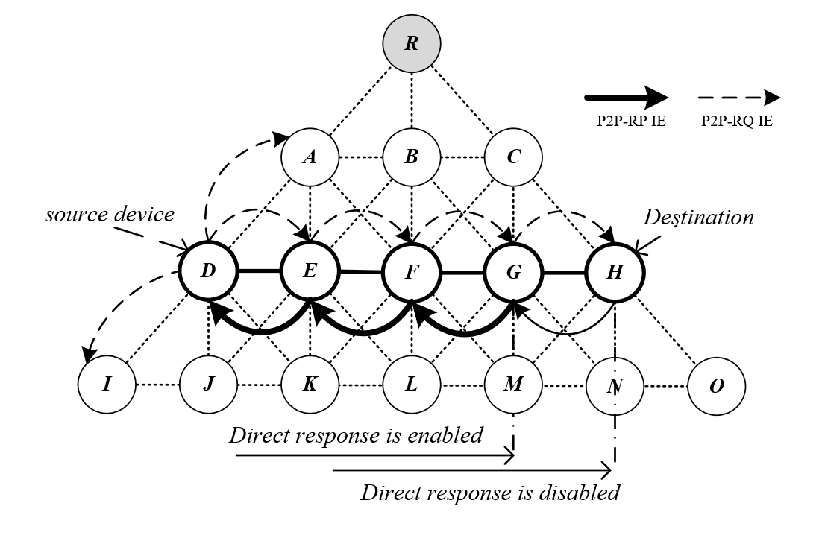
Proposed resolution for CID 1217
Accept: modify Figure 19 to illustrate the direct response disabled case

Slide 8
Comment CID 1395
Commentor
  Tero Kivinen
Related clause
  6.2.6.2 P 62 line 20
Comment
  How does the receiver know to which mesh this message belongs to. I mean there might be two L2R meshes around, one using short addresses one using long addresses, and the neighbor who sent this message might also belong to both of them.
Proposed Change
  I think we need to add Address Mode field to the Descriptor to specify format of the Address fields inside this IE.

Slide 9
Proposed resolution for CID 1395
Accept:
[P 62 line 20] by adding Address Mode field to the Descriptor to specify format of the Address fields inside this IE as the commenter suggested.
The Mesh Root Address Mode is set to 1, the address in the P2P-RQ is extended address mode. Otherwise, short address mode.
The P2P-RQ Address mode is set to 1, the source address in the P2P-RQ is extended address. Otherwise, short address mode.
Bits: 0 | 1 | 2 | 3-7
Request Direct Response | Mesh Root Address Mode | P2P-RQ Address Mode | Reserved
Figure 50—Format of the Descriptor field in the P2P-RQ IE

Slide 10
Comment CID 1396
Commentor
  Verotiana Rabarijaona
Related clause
  6.2.6.1 P 62 line 16
Comment
  Describe the case when the field is set to 0
Proposed Change
  See comment

Slide 11
Proposed resolution for CID 1396
Accept: add description about the case when the field is set to 0
[P 62 line 16] When the Request Direct Response field is set to 1, a device that receives the P2P-RQ IE and has routing information to the destination inquired may reply directly with a P2P-RP IE instead of propagating the P2PRQ IE even if it is not the route destination. When the Request Direct Response field is set to 0, P2P-RQ IE is propagated to the final destination.

Slide 12
Comment CID 1397
Commentor
  Tero Kivinen
Related clause
  6.2.7.1 P 63 line 23
Comment
  How does the receiver know to which mesh this message belongs to. I mean there might be two L2R meshes around, one using short addresses one using long addresses, and the neighbor who sent this message might also belong to both of them. How does it know whether this mesh uses short or extended addresses.
Proposed Change
  This is harder to fix as there is no Descriptor where we can add the Address Mode field. Perhaps we need to add Descriptor field and add Address Mode field in to it.

Slide 13
Proposed resolution for CID 1397
Accept in principle: additional description was added.
[P 63 line 23]
6.2.7.1 Route Destination Address field
The Route Destination Address field contains the address of the device that the source wanted to reach with the P2P-RQ IE. If the received P2P-RQ uses EUI-64s, this field is encoded as a string. If short addresses are used, this field is encoded as an unsigned integer.
6.2.7.2 Route Source Address field
The Route Source Address field contains the address of the device originating the P2P-RQ IE to which the P2P-RP IE is addressed. If the received P2P-RQ uses EUI-64s, this field is encoded as a string. If short addresses are used, this field is encoded as an unsigned integer.

Slide 14
Comment CID 1398
Commentor
  Tero Kivinen
Related clause
  6.2.7.3 P 63 line 35
Comment
  How does the receiver know to which mesh this message belongs to. I mean there might be two L2R meshes around, one using MCO and another not using it. There is no Mesh Root Address in these IEs so the receiver cannot check out the MT table to find out mesh parameters.
Proposed Change
  Perhaps we need to add Descriptor field and add MCO field in to it. Actually I would think it would be better to add MCO field to all Descriptor fields where there is MCO Descriptor in the IE. This includes TC IE, RA IE, P2P-RQ IE, P2P-RP IE. Now at least P2P-RQ and this P2P-RP are missing the Mesh Root Address, so they cannot know which mesh this message belongs to.

Slide 15
Proposed resolution for CID 1398
Accept: we added “Mesh Root Address” field.
Octets: 1 | 2/8 | 2/8 | 2/8 | 1 | 1 | 2 | 0/10 | 0/1 | 0/Variable
Descriptor | Mesh Root Address | Route Destination Address | Route Source Address | Hop Count | TTL | LSN | MCO Descriptor | Number of Intermediate Addresses | Intermediate Address List
Figure 49—Format of the P2P-RQ IE
2/8 | 2/8 | 2/8 | 0/10 | 0/1 | 0/Variable
Mesh Root Address | Route Destination Address | Route Source Address | MCO Descriptor | Number of Intermediate Addresses | Intermediate Address List
Figure 49—Format of the P2P-RQ IE
Mesh root address: Indicates the address mode of the mesh root. If SHORT, a short address is used. If LONG, a 64-bit address is used.

Slide 16
Comment CID 1399
Commentor
  Verotiana Rabarijaona
Related clause
  6.2.7 P 63 line 16
Comment
  The P2P-RP IE should have a LSN field
Proposed Change
  Insert an "LSN" field after the Route Source Address, and the corresponding description in a new subclause 6.2.7.3

Slide 17
Proposed resolution for CID 1399
Reject
[P 63 line 16] the LSN of P2P-RP IE is same as the LSN of P2P-RQ IE. Therefore, LSN field is not necessary in P2P-RP IE.

