Slide 1
Project: IEEE P802.15 Working Group for Wireless Personal Area Networks (WPANs)
Submission Title: Channel Model for Image Sensor and Low Rate PD Communication
Date Submitted: September 16, 2015
Source: Yu Zeng (China Telecom), Yeong Min Jang (Kookmin University), Hideki Aoyama (Panasonic), Rick Roberts (Intel),Jaesang Cha (SNUST),Soo-Young Chang (SYCA)
Address:
Voice: Tel: 0086-10-50902080, E-Mail: zengyu@ctbri.com.cn, yjang@kookmin.ac.kr, aoyama.hideki@jp.panasonic.com, richard.d.roberts@intel.com ,chajs@seoultech.ac.kr, sychang@gaia.ecs.csus.edu
Abstract: This document provides an overview of optical channel modeling methods and proposes a flexible and efficient channel modelling approach for visible light communications using optical camera communication
Purpose: To introduce reference channel models for the evaluation of different PHY proposals.
Notice: This document has been prepared to assist the IEEE P802.15. It is offered as a basis for discussion and is not binding on the contributing individual(s) or organization(s). The material in this document is subject to change in form and content after further study. The contributor(s) reserve(s) the right to add, amend or withdraw material contained herein.
Release: The contributor acknowledges and accepts that this contribution becomes the property of IEEE and may be made publicly available by P802.15.

Slide 2
Channel Model for Image Sensor and Low Rate PD Communication

Slide 3
After discussion, the group member concluded that a Channel Model for Image Sensor and Low Rate PD Communication is not needed

Slide 4
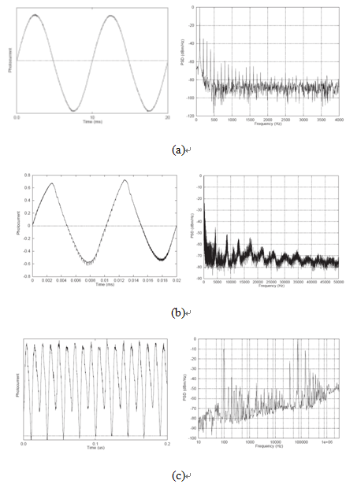
Channel Interference

