Slide 1
Project: IEEE P802.15 Working Group for Wireless Personal Area Networks (WPANs)
Submission Title: Secret key agreement protocol for IEEE 802.15.8 PAC
Date Submitted: September 2015
Source: [Byung-Jae Kwak]¹, [Sangseok Yun, Sanghun Im, Jeongseok Ha]²
Company [ETRI, Daejeon, Korea]¹, [KAIST, Daejeon, Korea]²
Address [218 Gajeong-ro, Yuseong-gu, Daejeon, Korea]¹, [291 Daehak-ro, Yuseong-gu, Daejeon, Korea]²
Voice: [+82-42-860-6618]¹, [+82-42-350-7524]²
E-Mail: [bjkwak@etri.re.kr]¹, [ssyun@kaist.ac.kr]²
Re:
Abstract: Proposal of the secret key agreement protocol in PHY for IEEE 802.15.8 PAC.
Purpose: Approval
Notice: This document has been prepared to assist the IEEE P802.15. It is offered as a basis for discussion and is not binding on the contributing individual(s) or organization(s). The material in this document is subject to change in form and content after further study. The contributor(s) reserve(s) the right to add, amend or withdraw material contained herein.
Release: The contributor acknowledges and accepts that this contribution becomes the property of IEEE and may be made publicly available by P802.15.

Slide 2
Secret key agreement protocol for IEEE 802.15.8 PAC
Sept. 2015

Slide 3
Most Popular Passwords
 | 2012 | 2013 | 2014
1 | password | 123456 | 123456
2 | 123456 | Password | password
3 | 12345678 | 12345678 | 12345
4 | abc123 | qwerty | 12345678
5 | qwerty | abc123 | qwerty
6 | monkey | 123456789 | 123456789
7 | letmein | 111111 | 1234
8 | dragon | 1234567 | baseball
9 | 111111 | iloveyou | dragon
10 | baseball | adobe123 | Football

Slide 4
Introduction
This document presents a secret key agreement protocol using physical layer features
This document proposes a secret key distribution protocol using channel impulse responses
By taking advantage of channel reciprocity and sequential key distillation, a pair of legitimate users can remotely share a secret key without resorting to a key management infrastructure
Specified methods are proposed and expected performances are evaluated

Slide 5
General Secret Key Agreement Protocol
Maurer proposed a new approach to generate a random sequence achieving the perfect security [1]
The process of generating a shared secret key consists of 3 phases
Randomness Sharing
Information Reconciliation
Privacy Amplification
Share the common randomness between Alice and Bob
Alice & Bob agree on an identical random sequence
Hash function provides the perfect secrecy
Channel response between Alice & Bob can be seen as the common randomness

Slide 6
Secret Key Agreement Protocol
Alice (STA1)
Channel Probing
Bob (STA1)
Channel Estimation
Channel Estimation
Randomness Sharing Protocol
Quantizer
Quantizer
$N_{seq}$-bits
$N_{seq}$-bits
Reconciliation
Syndrome
Reconciliation
Agree/Disagree
Post Processing Protocol For Key Extraction
$N_{seq}$-bits
$N_{seq}$-bits
Privacy Amplification
(w/ compression)
$N_{seq}+\left(N_{seq}−N_{leak}−N_{sec}\right)−1$-bits
Privacy Amplification
(w/ compression)
$β\left(N_{seq}−N_{leak}−N_{sec}\right)$-bits
$β\left(N_{seq}−N_{leak}−N_{sec}\right)$-bits
Secret key, $k$
Secret key, $k$

Slide 7
Randomness Sharing Protocol
Mode 1
Mode 2
Alice
Bob
Alice
Bob
RTS ($i$)
process
Probe Request (1)
process
process
CTS ($i$)
Channel estimation
$$\left\{{\hat{H}}_{b,1}, {\hat{H}}_{b,2}, …, {\hat{H}}_{b,m}\right\}$$
process
Probe Response (1)
Channel estimation
$$\left\{{\hat{H}}_{b,1}, {\hat{H}}_{b,2}, …, {\hat{H}}_{b,m}\right\}$$
Channel estimation
$$\left\{{\hat{H}}_{a,1}, {\hat{H}}_{a,2}, …, {\hat{H}}_{a,m}\right\}$$
Channel estimation
$$\left\{{\hat{H}}_{a,1}, {\hat{H}}_{a,2}, …, {\hat{H}}_{a,m}\right\}$$
Data Transmission
Extract distinctive feature
(freq. $→$ time domain)
$$\left\{{\hat{h}}_{a,1},{\hat{h}}_{a,2}, …,{\hat{h}}_{a,p}\right\}$$
Extract distinctive feature
(freq. $→$ time domain)
$$\left\{{\hat{h}}_{a,1},{\hat{h}}_{a,2}, …,{\hat{h}}_{a,p}\right\}$$
Extract distinctive feature
(freq. $→$ time domain)
$$\left\{{\hat{h}}_{a,1},{\hat{h}}_{a,2}, …,{\hat{h}}_{a,p}\right\}$$
Extract distinctive feature
(freq. $→$ time domain)
$$\left\{{\hat{h}}_{a,1},{\hat{h}}_{a,2}, …,{\hat{h}}_{a,p}\right\}$$
process
$$⋯$$
$$⋯$$
$$b_{1}=\left[b_{1}, b_{2},…, b_{n_{1}}\right]$$
Quantization
$$\left\{b_{1},b_{2},…, b_{n_{i}}\right\}$$
Quantization
$$\left\{b_{1},b_{2},…, b_{n_{i}}\right\}$$
Quantization
$$\left\{a_{1},a_{2},…, a_{n_{i}}\right\}$$
Quantization
$$\left\{a_{1},a_{2},…, a_{n_{i}}\right\}$$
RTS ($j$)
$$⋯$$
Probe Request $\left(j\right)$
process
$$⋯$$
process
$$b_{j}=\left[b_{1}, b_{2},…, b_{n_{j}}\right]$$
CTS ($j$)
process
$$a_{j}=\left[a_{1}, a_{2},…, a_{n_{j}}\right]$$
Probe Response $\left(j\right)$
process
$$s_{B}=\left\{b_{1},b_{2},…, b_{n_{j}}\right\}$$
Stop probing if $N_{seq}≤\sum_{i=1}^{j}{n_{i}}$
$$s_{A}=\left\{a_{1},a_{2},…, a_{n_{j}}\right\}$$
Data Transmission
Pass the latest $N_{seq}$ quantized bits
Gathering Enough $N_{seq}$-bits
Gathering Enough $N_{seq}$-bits
Pass the latest $N_{seq}$ quantized bits
Post
processing
Post
processing
$$s_{A}=\left\{a_{1},…, a_{N}\right\}$$
$$s_{B}=\left\{b_{1},…, b_{N}\right\}$$
$k=\left\{k_{0},k_{1},…, k_{S}\right\}$ : secret key
$k=\left\{k_{0},k_{1},…, k_{S}\right\}$ : secret key

Slide 8
Randomness Sharing
The reciprocity of the propagation channel [2]
Used as a source of common randomness
Spatial de-correlation assumption
Channel responses are location-specific feature
A secret key is extracted by exploiting random fluctuation of the wireless channel
Pilot symbols are used for estimating channel
For randomness sharing, pilot symbols are located at all subcarriers except DC and guard subcarriers (i.e. 52 subcarriers)

Slide 9
Channel Correlation Issue (1/2)
Residual channel correlation
[3] reports there exists a strong correlation in measurements observed by adversaries located greater than a half-wavelength away from legitimate devices.
However, this work does not consider the effect of the large scale fading on the channel correlation

Slide 10
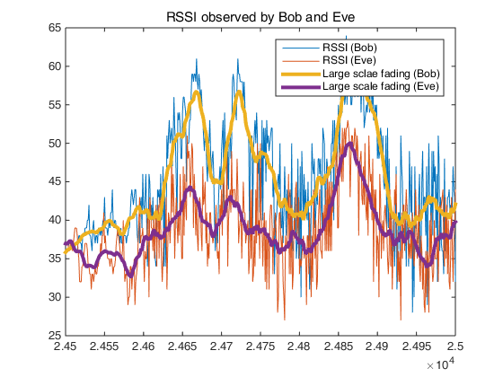
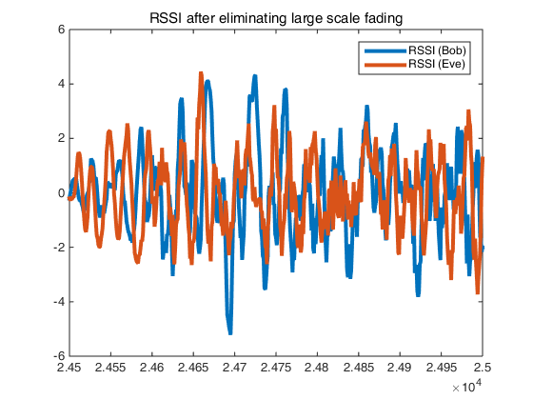
Channel Correlation Issue (2/2)
If the large scale fading is included, there exist a strong correlation in RSSI observed by Bob and Eve
To minimize the channel correlation, eliminating the large scale fading is essential

Slide 11
Hardware Experiment
Center frequency : 5.2GHz ($λ=5.6$cm)
The distance between Bob and Eve is 1m
Alice moves arbitrarily around the indoor office

Slide 12
Hardware Experiment
The channel correlation between the RSSI observed at each node after eliminating the large scale fading
Channel | Correlation
Main channel | 0.9661
Wiretap channel | 0.0839

Slide 13
Effect of Channel Correlation
Mutual information between correlated random variables
Let $X,Y$ be random variables of normal distribution, and the correlation between $X$ and $Y$ be $ρ_{XY}$, then $η=I\left(f\left(X\right);Y\right)≤I\left(X;Y\right)=−\frac{1}{2}\log\left(1−ρ_{XY}^{2}\right)$ where $f\left(⋅\right)$ represents post processing function (by “data processing inequality”)
Ex) $ρ_{XY}=0.3$, then $η=I\left(f\left(X\right);Y\right)≤0.068$

Slide 14
Randomness Sharing (1/3)
Subcarrier allocation
Both of channel amplitude and phase can be quantized
We use BPSK
52 Pilot subcarriers
Guard subcarriers
…
…
Left 26
Right 26
64 Subcarriers
DC subcarrier

Slide 15
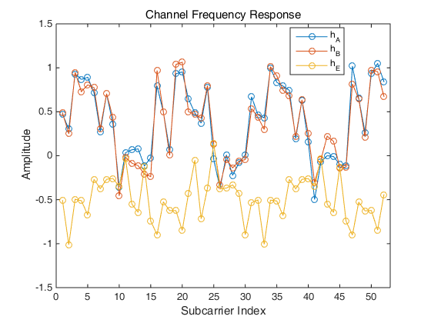
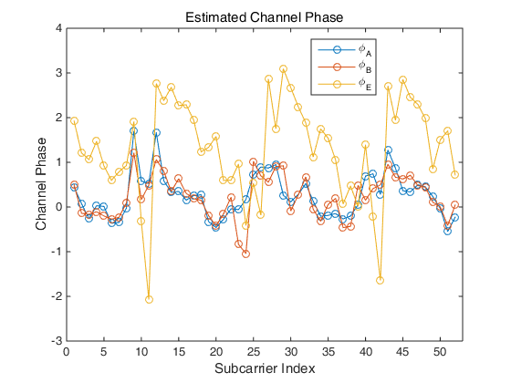
Randomness Sharing (2/3)
ITU Pedestrian B Channel Model
Channel between Alice and Bob is highly correlated

Slide 16
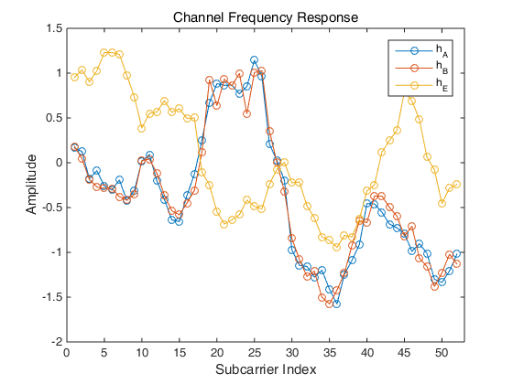
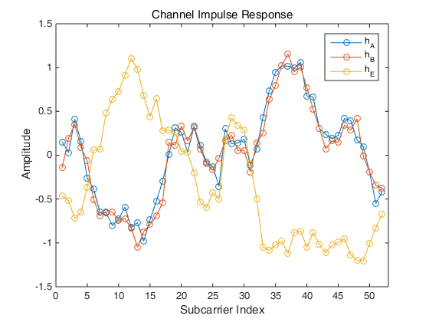
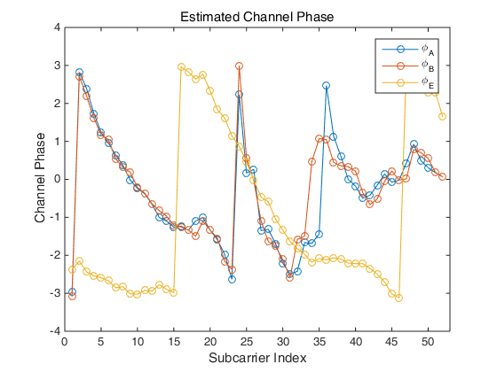
Randomness Sharing (3/3)
IEEE 802.11 Channel Model
Channel between Alice and Bob is highly correlated

Slide 17
Secret Key Agreement Protocol
Alice (STA1)
Channel Probing
Bob (STA1)
Channel Estimation
Channel Estimation
Randomness Sharing Protocol
Quantizer
Quantizer
$$s_{A}$$
$N_{seq}$-bits
$N_{seq}$-bits
$$s_{B}$$
Reconciliation
Syndrome
Reconciliation
Agree/Disagree
Post Processing Protocol For Key Extraction
$N_{seq}$-bits
$N_{seq}$-bits
Privacy Amplification
(w/ compression)
$N_{seq}+\left(N_{seq}−N_{leak}−N_{sec}\right)−1$-bits
Privacy Amplification
(w/ compression)
$β\left(N_{seq}−N_{leak}−N_{sec}\right)$-bits
$β\left(N_{seq}−N_{leak}−N_{sec}\right)$-bits
Secret key, $k$
Secret key, $k$

Slide 18
Common Key Extraction Protocol
Information reconciliation
Random bit sequence for extracting secret key is obtained from channel impulse responses with quantization
In the quantization process, the random bit sequences at legitimate parities may have discrepancy
Such discrepancy can be removed by performing the information reconciliation [4, 5]

Slide 19
Information Reconciliation (1/3)
Error correction code based reconciliation
1) Determine field size $m$ : $N_{seq}<2^{m}−1$
2) Estimated discrepancy ${\hat{N}}_{err}$between $s_{A}$ and $s_{B}$ is determined by SNR, quantization method and margin
3) Given $n=2^{m}−1$ and $t={\hat{N}}_{err}$, calculate the necessary number of parity $N_{par}$
4) If $N_{seq}+N_{par}≤n$, concatenate sequence $s_{A}$ and $N_{zero}=n−N_{seq}−N_{par}$ bit zero-padding sequence (shortening).
$$2^{m}−1$$
$$N_{seq}$$
$$N_{zero}$$
$$N_{par}$$
$$2^{m−1}−1$$

Slide 20
Information Reconciliation (2/3)
Error correction code based reconciliation
5) Else, repeat from 3) with increased $m$
6) Encode the extended message with systematic BCH ($n,k,t$)
$n=N_{seq}+N_{zero}+N_{par}$, $k=N_{seq}+N_{zero}$, $t={\hat{N}}_{err}$
$$2^{m}−1$$
$$N_{seq}$$
$$N_{par}$$
$$2^{m−1}−1$$
$$m^{′}=m+1$$
$$2^{m^{′}}−1$$
$$N_{seq}$$
$$N_{zero}$$
$$N_{par}$$
$$2^{m^{′}−1}−1$$

Slide 21
Information Reconciliation (3/3)
Error correction code based reconciliation
7) Alice sends parity parts of the codeword to Bob using public perfect channel
8) If the number of discrepancy is smaller than error correction capability, i.e. $N_{err}≤t$, the errors in the sequence can be corrected.
9) Then the legitimate parties have exactly same sequence $s$

Slide 22
Secret Key Agreement Protocol
Alice (STA1)
Channel Probing
Bob (STA1)
Channel Estimation
Channel Estimation
Randomness Sharing Protocol
Quantizer
Quantizer
$$s_{A}$$
$N_{seq}$-bits
$N_{seq}$-bits
$$s_{B}$$
Reconciliation
Syndrome
Reconciliation
Agree/Disagree
Post Processing Protocol For Key Extraction
$$s$$
$N_{seq}$-bits
$N_{seq}$-bits
Privacy Amplification
(w/ compression)
$N_{seq}+\left(N_{seq}−N_{leak}−N_{sec}\right)−1$-bits
Privacy Amplification
(w/ compression)
$β\left(N_{seq}−N_{leak}\right)$-bits
$β\left(N_{seq}−N_{leak}\right)$-bits
Secret key, $k$
Secret key, $k$

Slide 23
Privacy Amplification (1/9)
Privacy amplification
The parity part of the codeword is also open to the eavesdropper during public discussion
There must be an additional procedure aiming to extract secret key of which the eavesdropper is totally ignorant

Slide 24
Privacy Amplification (2/9)
The number of disclosed bits
Syndrome vector is determined by column combination of parity check matrix with received codeword
Since the last $n−k$ bit of the codeword, i.e. the parity is disclosed to Eve, there will be an equivocation of $k$ bits
$$n$$
$$n−k$$
$$k$$
$$n−k$$
$$×$$
$$=$$
$$n−k$$
Ambiguous part
Parity check matrix
$$n−k$$
Syndrome
Disclosed part

Slide 25
Privacy Amplification (3/9)
The number of disclosed bits
The parity check matrix of BCH code is full rank (i.e. it can be reduced by row/column permutation)
The equivocation is reduced from $k$ bits to $2k−n$ bits, i.e. $n−k$ bits are leaked to Eve
$$n$$
$$n−k$$
$$n−k$$
$$n−k$$
$$×$$
$$=$$
Reducible part
$$n−k$$
$$2k−n$$
$$n−k$$
Ambiguous part
Parity check matrix
$$n−k$$
Syndrome
Disclosed part

Slide 26
Privacy Amplification (4/9)
Privacy amplification
The number of disclosed bits during public discussion is $n−k=N_{par}$
Moreover, because of the channel correlation, $ηN_{seq}$ bits are disclosed during randomness sharing process
$N_{leak}=ηN_{seq}+N_{par}$

Slide 27
Privacy Amplification (5/9)
Privacy amplification
The leaked information about the shared sequence can be removed by using universal hash function
Ex) the disclosed bit information is eliminated by binary summation
1
?
1 bit equivocation over 2 bit
?
1 bit equivocation over 1 bit

Slide 28
Privacy Amplification (6/9)
Privacy amplification
Privacy amplification can be performed with universal hash function (Toeplitz matrix) [6][7]
Suppose that Alice and Bob have $N_{seq}$ bits after error correction and Eve knows $N_{leak}$ bits
Choose $N_{sec}$ as a security parameter
Applying universal hash function $F$ $f∈F, F:{\left\{0,1\right\}}^{N_{seq}}→{\left\{0,1\right\}}^{N_{key}}, N_{key}=N_{seq}−\left(N_{leak}+N_{sec}\right)$
The remained mutual information about whole secret key after privacy amplification is less than $\frac{2^{−N_{sec}}}{\ln{2}}$

Slide 29
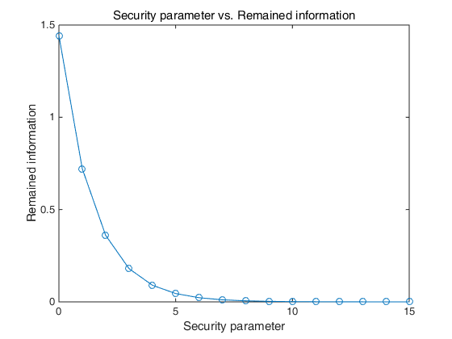
Privacy Amplification (7/9)
Privacy amplification

Slide 30
Privacy Amplification (8/9)
Privacy amplification
Alice (or Bob) transmits randomly generated $N_{seq}+\left(N_{seq}−N_{leak}−N_{sec}\right)−1$ bit sequence
Alice and Bob generate $N_{seq}×\left(N_{seq}−N_{leak}−N_{sec}\right)$ Toeplitz matrix $T$ and eliminating the disclosed bits by calculating $\tilde{k}=sT$
Then the legitimate parties have exactly same $\left(N_{seq}−N_{leak}−N_{sec}\right)$ bit secret key $\tilde{k}$

Slide 31
Privacy Amplification (9/9)
Correlation elimination
In slow fading channel, channel observation between two adjacent subcarriers are correlated
To guarantee perfect security, these correlation should be eliminated
Entropy coding is performed to eliminate the correlation between observed sequence
Huffman coding with a dictionary generated by empirical distribution of quantized bits
Let $β$ is compression efficiency
The length of final key $k$ is $β\left(N_{seq}−N_{leak}−N_{sec}\right)$

Slide 32
Information Leakage
Alice (STA1)
Channel Probing
Bob (STA2)
Channel Estimation
Channel Estimation
Randomness Sharing Protocol
The amount of information disclosed to Eve
Quantizer
Quantizer
$ηN_{seq}$-bits
$N_{seq}$-bits
$N_{seq}$-bits
$ηN_{seq}$-bits
$ηN_{seq}+N_{par}$-bits
Reconciliation
Syndrome
Reconciliation
$N_{par}$-bits
Agree/Disagree
Post Processing Protocol For Key Extraction
$N_{seq}$-bits
$N_{seq}$-bits
$N_{seq}+\left(N_{seq}−N_{leak}−N_{sec}\right)−1$-bits
Privacy Amplification
(w/ compression)
Privacy Amplification
(w/ compression)
$0$-bits
$β\left(N_{seq}−N_{leak}−N_{sec}\right)$-bits
Secret key, $k$
Secret key, $k$

Slide 33
Performance of Proposed Protocol
Experiment results based on computer simulation

Slide 34
Experimental Environment (1/2)
Experiment setup
ITU Ped. B / IEEE 802.11 channel model
IEEE 802.15.8 Low-mobility PHY parameters
The target secret key length per 10 packet exchanges (including post-processing) is 128 bits
Starting with 6 consecutive observations (i.e. $N_{seq}=312=52×6$)
Randomness sharing
Quantizing channel frequency response
1bit quantization is performed in 1 subcarrier (to be optimized with SNR)

Slide 35
Experimental Environment (2/2)
Experiment setup
Information reconciliation
Shortened BCH code
Overestimated parity bit (lower bound on secret key rate)
Privacy amplification
Universal hash function (Toeplitz matrix) is applied with the security parameter $N_{sec}=10$
Residual channel correlation is assumed 0.3 $\left(η=0.068\right)$
Correlation elimination
Entropy coding (Huffman coding)

Slide 36
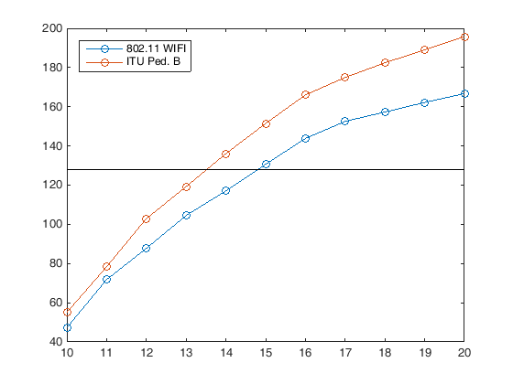
Simulation Results
Target key length
SNR

Slide 37
Conclusion
It is possible for legitimate terminals to share a 128-bit secret key in fully distributed network by exploiting the channel reciprocity and the post processing within 10 packet exchanges
128-bit secret key is strong enough to encrypt secret message [8]
It is expected that secret key extraction rate can be further increased when we optimize the proposed method using channel information

Slide 38
Motion
“Accept the text proposal in DCN 15-15-727-01-0008 to be added to P802.15.8 PAC Draft D0.14.0.”

Slide 39
References
[1] U. Maurer, “Secret key agreement by public discussion from common information,” IEEE Tans. Information Theory, vol. 39, pp. 733-742, May 1993.
[2] G. S. Smith, “A direct derivation of a single-antenna reciprocity relation for the time-domain,” IEEE Trans. Antennas Propagate., vol. 52, no. 6, pp. 1568-1577, Jun. 2004.
[3] Matthew Edman, Aggelos Kiayias, Bulent Yener, “On Passive Inference Attacks Against Physical-layer Key Extraction,” EUROSEC 11, 2011.
[4] C. H. Bennett, E. Bessette, G. Brassard, L. Salvail and J. Smolin, “Experimental quantum cryptography,” Journal of Cryptography, vol. 5, no. 1, pp. 3-28, 1992.
[5] G. Brassard and L. Savail, “Secret-key reconciliation by public discussion,” In Advances in cryptology EUROCRYPT ‘93, Lecture Notes in Computer Science, vol. 765, pp. 410-423, Springer-Verlag, New York, 1994.
[6] Chi-Hang Fred Fung, Xiongfeng Ma, H. F. Chau, “Practical issues in quantum-key-distribution post-processing,” arXiv:0910.0312
[7] Hui, Qiao, Xiao-yu Chen, “Simulation of BB84 Quantum Key Distribution in depolarizing channel,” proc. In 14th Youth Conference on Communication, 2009
[8] Seagate, “128-Bit Versus 256-bit AES Encryption,” http://www.axantum.com/AxCrypt/etc/seagate128vs256.pdf

