Slide 1
Project: IEEE P802.15 Working Group for Wireless Personal Area Networks (WPANs)
Submission Title: Random access scheme for CAP and Peering Period
Date Submitted: Sept. 2015
Source: [Byung-Jae Kwak]¹,
[Junhyuk Kim, Nah-Oak Song, June-Koo Kevin Rhee]²
Affiliation: [ETRI, Korea]¹, [KAIST, Korea]²
Address: [218 Gajeong-ro, Yuseong-gu, Daejeon, Korea]¹, [291 Daehak-ro, Yuseong-gu, Daejeon, Korea]²
Voice: +82-42-860-6618
E-Mail: [bjkwak@etri.re.kr],
[kim.jh@kaist.ac.kr, nsong@kaist.ac.kr, rhee.jk@kaist.edu]
Re:
Abstract: Draft text for random access schemes for IEEE 802.15.8 PAC CAP and Peering Period.
Purpose: Approval
Notice: This document has been prepared to assist the IEEE P802.15. It is offered as a basis for discussion and is not binding on the contributing individual(s) or organization(s). The material in this document is subject to change in form and content after further study. The contributor(s) reserve(s) the right to add, amend or withdraw material contained herein.
Release: The contributor acknowledges and accepts that this contribution becomes the property of IEEE and may be made publicly available by P802.15.

Slide 2
Random Access Scheme for CAP and Peering Period
Sept. 2015
Bangkok

Slide 3
Introduction
Ref. (simulation results and details, etc.):
  15-15-0425-00-0008
  15-14-0687-00-0008
  15-15-0582-00-0008
Random access scheme for CAP and Peering Period
  Different from the random access scheme used in the Sync Period (different requirements)
  Different parameters for CAP and Peering Period (different traffic model)

Slide 4
p-EIED in a Nutshell
  p: Probability of packet transmission in the next backoff slot; p = p_{basic} / sqrt(L₂ / L₁)
T_{T}: Target idle-time between packets
T_{M}: Measured idle-time between packets
(See 15-15-0425-00-0008 for more details)
Adaptive to
packet length
(cost of collision)
if (T_{M} < T_{T})
increase p_{basic};
else if (T_{M} ≈ T_{T})
no change to p_{basic};
else /* T_{M} > T_{T} */
decrease p_{basic};
Adaptive to
contention
(i.e., # active
neighboring PDs)

Slide 5
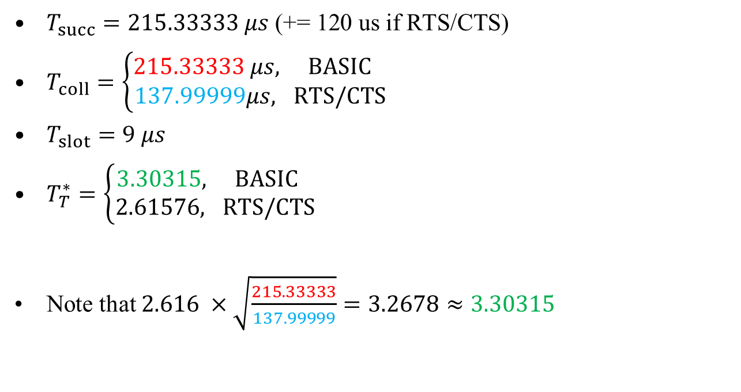
Optimization of p-EIED – Peering Period
$T_{succ}=215.33333 μs\text{ (+= 120 }\text{us} \text{if} \text{RTS}\text{/}\text{CTS}\text{)}$
$T_{coll}=\left\{\begin{aligned}215.33333 μs, BASIC \\ &137.99999μs, RTS/CTS\end{aligned}\right.$
$T_{slot}=9 μs$
$T_{T}^{∗}=\left\{\begin{aligned}3.30315, BASIC \\ &2.61576, RTS/CTS\end{aligned}\right.$
Note that $2.616 ×\sqrt{\frac{215.33333}{137.99999}}=3.2678≈3.30315$

Slide 6
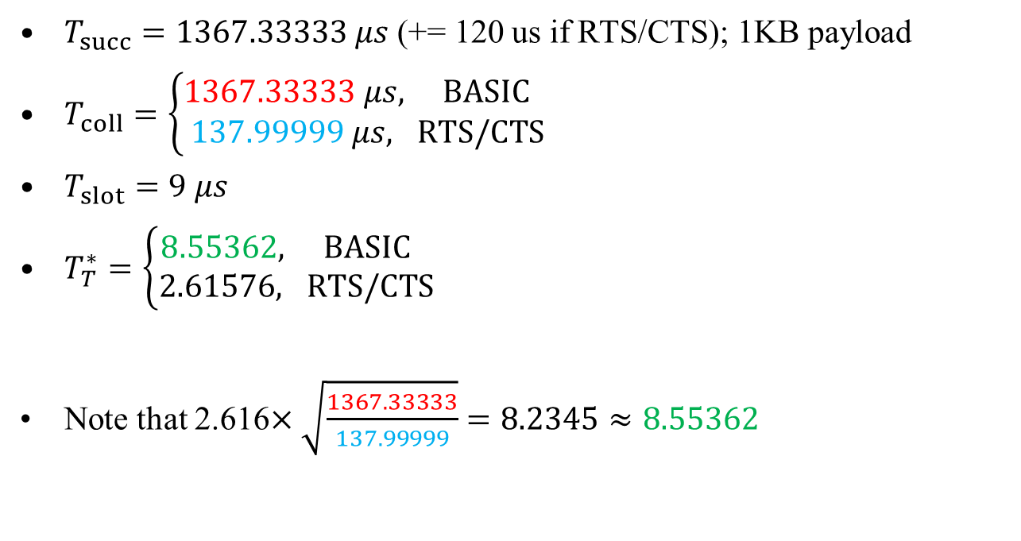
Optimization of p-EIED – CAP
$T_{succ}=1367.33333 μs$ (+= 120 us if RTS/CTS); 1KB payload
$T_{coll}=\left\{\begin{aligned}1367.33333 μs, BASIC \\ &137.99999 μs, RTS/CTS\end{aligned}\right.$
$T_{slot}=9 μs$
$T_{T}^{∗}=\left\{\begin{aligned}8.55362, BASIC \\ &2.61576, RTS/CTS\end{aligned}\right.$
Note that 2.616$×\sqrt{\frac{1367.33333}{137.99999}}=8.2345≈8.55362$

Slide 7
Features of p-EIED
p-EIED is designed to be scalable: supports a large # PDs
p-EIED is designed to be used in dynamic network environments
  Use p instead of CW
  Adaptive to # active neighboring PDs
  Maintain performance even when network environment changes abruptly
Handles different packet lengths (cost of collision to be precise)
  Through scaling
  Same p-EIED for Peering Period and CAP, but each period maintains their own T_{M} and p_{basic}, because of different transmission history
  (See early contributions for simulations results.)

Slide 8
Motion
“Accept the text proposal in DCN 15-15-0724-00-0008 to be added to P802.15.8 PAC Draft D0.14.0.”

