Slide 1
Project: IEEE P802.15 Working Group for Wireless Personal Area Networks (WPANs)
Submission Title: [Proposal for IEEE802.15.3e – Connection establishment using expected RSSI]
Date Submitted: [10 September 2015]
Source: [Jae Seung Lee, Ken Hiraga, Itaru Maekawa, Makoto Noda, Ko Togashi⁽¹⁾, (representative contributors), all contributors are listed in “Contributors” slide]
Company: [ETRI¹, JRC, NTT, Sony, Toshiba]
Address¹: [218 Gajeong-ro, Yuseong-gu, Daejeon, 305-700, Korea]
E-Mail¹: [jasonlee@etri.re.kr (all contributors are listed in “Contributors” slide)]
Abstract: This document is a supporting material on connection establishment using expected RSSI of the full MAC/PHY proposal for HRCP regarding touch action.
Purpose: To propose a full set of specifications for TG3e.
Notice: This document has been prepared to assist the IEEE P802.15. It is offered as a basis for discussion and is not binding on the contributing individual(s) or organization(s). The material in this document is subject to change in form and content after further study. The contributor(s) reserve(s) the right to add, amend or withdraw material contained herein.
Release: The contributors acknowledge and accept that this contribution becomes the property of IEEE and may be made publicly available by P802.15.

Slide 2
Contributors
Name | Affiliation | Email
Jae Seung Lee | ETRI | jasonlee@etri.re.kr
Moon-Sik Lee | ETRI | moonsiklee@etri.re.kr
Itaru Maekawa | Japan Radio Corporation | maekawa.itaru@jrc.co.jp
Lee Doohwan | NTT Corporation | lee.doohwan@lab.ntt.co.jp
Ken Hiraga | NTT Corporation | hiraga.ken@lab.ntt.co.jp
Masashi Shimizu | NTT Corporation | masashi.shimizu@upr-net.co.jp
Keitarou Kondou | Sony Corporation | Keitarou.Kondou@jp.sony.com
Hiroyuki Matsumura | Sony Corporation | Hiroyuki.Matsumura@jp.sony.com
Makoto Noda | Sony Corporation | MakotoB.Noda at jp.sony.com
Masashi Shinagawa | Sony Corporation | Masashi.Shinagawa@jp.sony.com
Ko Togashi | Toshiba Corporation | ko.togashi@toshiba.co.jp
Kiyoshi Toshimitsu | Toshiba Corporation | kiyoshi.toshimitsu@toshiba.co.jp

Slide 3
Proposal for IEEE802.15.3e
High-Rate Close Proximity System
(Connection Establishment using Expected RSSI)
September 15, 2015

Slide 4
September 2015
Touch Action (1/3)
Bringing the antennas to within about 1 cm should trigger the two devices to establish connection
PPC Indicates “Expected RSSI” value in the beacons for this purpose
  The Expected RSSI field in the beacon indicates the RSSI value of received signal at the antenna input of DEV
    Expected signal strength of the beacon frame from the viewpoint of other DEV that will receive the beacon at the connection establishment trigger boundary (1 cm)
    The manufacturer of the PPC presets the value (How to set the value is out of the scope of standardization)
  The DEV only transmits an Association Request command when the actual received RSSI level of the beacon measured by the DEV exceeds this value
octet: |  | 1 | 1 | 2
 | ……. | Expected RSSI | ……. | Recommended ATP
Various Authors (TG3e Proposal)

Slide 5
September 2015
September 2015
Touch Action (2/3)
DEV
PPC
Beacon indicating expected RSSI
DEV
If measured RSSI >=
expected RSSI value indicated
by the beacon, DEV triggers
connection establishment
DEV approaches to a PPC
DEV
DEV receives
beacons and
measures RSSI
Beacon indicating expected RSSI
Association Request
Association Response
Connection establishment trigger boundary
for touch action (1 cm )
Range of PPC (10 cm)
Various Authors (TG3e Proposal)
Various Authors (TG3e Proposal)

Slide 6
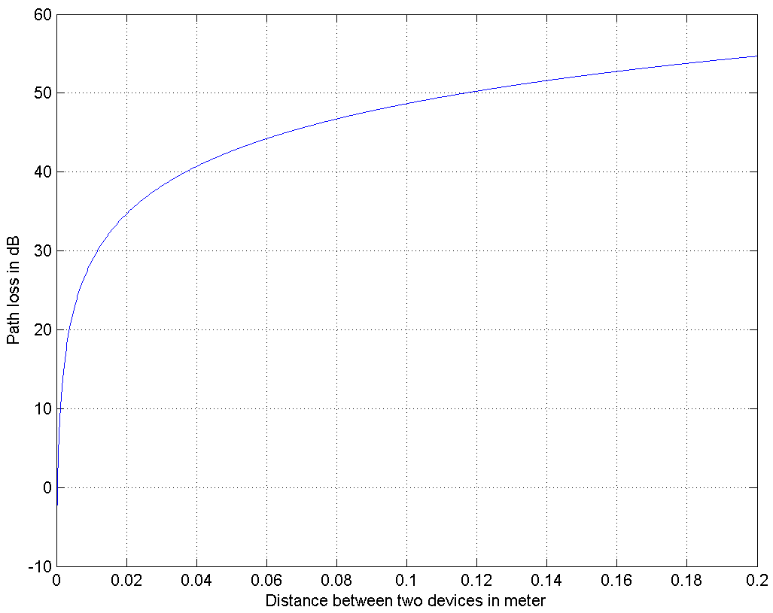
Touch Action (3/3)
Range of PPC (10 cm)
29 dB pathloss at 1 cm distance
Around the 1cm boundary (Green area), 1 dB measurement error by the DEV corresponds to just 2 mm error from the target touch action distance
In most implementations it is expected that a DEV can trigger connection around 1 cm boundary
A manufacturer may preset the expected RSSI value considering some margin (choose smaller value) to prevent the case in which a DEV cannot trigger connection (Implementation Issue)
Touch Action
Range (1cm)
29 dB
(expected RSSI value
at 1 cm indicated by the PPC)
DEV approaches to a PPC
Measured RSSI value
by the DEV

Slide 7
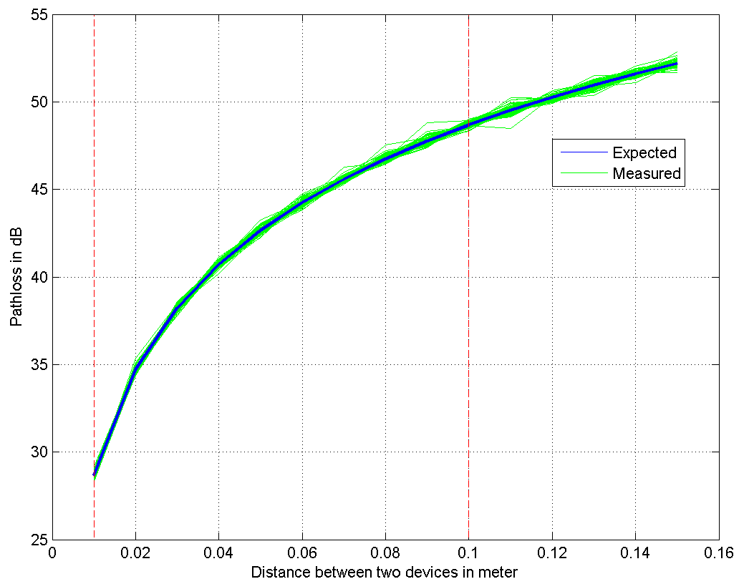
Simulation
Simulation Condition
fc = 64.8 GHz, fs = 1.76 GHz
SISO single Channel model (IEEE 802.15.3e)
TX & RX phase noise are considered
Measured RSSI using one OOK Preamble
Result
100 simulation run (RSSI error variance is max 0.05 dB)
Difference between measured RSSI values is negligible

Slide 8
Disconnection
A DEV should be able to disconnect promptly when devices draw apart beyond 10 cm
ATP (Association Timeout Period) field in the beacon can be used for this purpose
  ATP field exists in the legacy spec (15.3)
  maximum amount of time in milliseconds that the association relationship will be maintained in the absence of communication between the PNC and DEV (802.15.3 spec)
If a DEV moves out of the range of the lite-PNC (e.g, 10 cm), then frames cannot be exchanged and the DEV is disassociated after the timeout period indicated in the ATP field
  The range can be adjusted by the lite-PNC by transmit power control
  Timeout period can be adjusted by using ATP value

Slide 9
References
[1] TG3e Technical Guidance document, May, 2015
[2] TG3e Channel Modeling document, May, 2015
[3] IEEE 802.15.3 – 2003 Specification, September 2003
[4] IEEE 802.15.3b – 2005 Specification, May 2006
[5] IEEE 802.15.3c – 2009 Specification, October 2009

Slide 10
Q & A

