Slide 1
Project: IEEE P802.15 Working Group for Wireless Personal Area Networks (WPANs)
Submission Title: Channel Model for Outdoor Freespace Transmission
Date Submitted: July 15, 2015
Source: Nan Chi, Fu Dan University, Yu Zeng, China Telecom
Address: Fu Dan University, 220 Handan Rd., Yangpu District, Shanghai
Voice: Tel: 0086-21-65642983, E-Mail: nanchi@fudan.edu.cn, zengyu@ctbri.com.cn
Abstract: In response to «Call for Proposals for OWC Channel Models» issued by 802.15.7r1, this contribution proposes LiFi reference channel models for indoor environments such as office, home and hospital.
Purpose: To introduce reference channel models for the evaluation of different PHY proposals.
Notice: This document has been prepared to assist the IEEE P802.15. It is offered as a basis for discussion and is not binding on the contributing individual(s) or organization(s). The material in this document is subject to change in form and content after further study. The contributor(s) reserve(s) the right to add, amend or withdraw material contained herein.
Release: The contributor acknowledges and accepts that this contribution becomes the property of IEEE and may be made publicly available by P802.15.

Slide 2
Channel Model for Outdoor Free Space Transmission

Slide 3
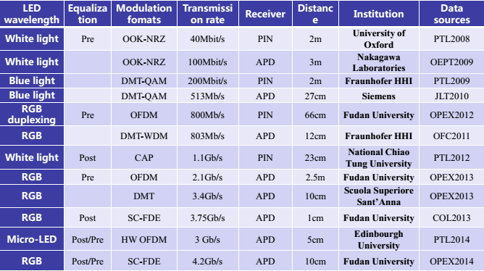
Background
Different Modulation Scheme
Data Rate Increasing
Outdoor VLC case is not as popular as Indoor VLC

Slide 4
Research Route
VLC Free Space Transmission Channel Model
LED Modulation Property
LED dimming property
Atmospheric turbulence model
Background Noise
Key Technique for Outdoor VLC Transmission System
PPM Modulation
Pre Equalization
Diversity reception technology
Simulation for Outdoor Long Distance VLC Transmision System
System Structure and Simulation Parameters
Simulation Results and Analysis
100Mbps OOK Realtime Transmission Experiments
System Structure
Results and Analysis

Slide 5
Atmospheric turbulence model
Negative Exponential Model：Strong Turbulence
Log-Normal Model: Weak Turbulence
Gamma-Gamma Model: From weak to strong
turbulence
Scintillation index (S.I.) and Rytov Variation vs distance
Comparison of 3 Models PDF (Probability density function)
Scintillation index (S.I.) and Rytov Variation vs Wavelength

Slide 6
Atmospheric turbulence model
Negative Exponential Model：Strong Turbulence
Log-Normal Model: Weak Turbulence
Gamma-Gamma Model: From weak to strong Turbulence
Turbulence affect light intense and BER Gamma-Gamma are preferred over other model。
Noise Power N
BER under different Model

Slide 7
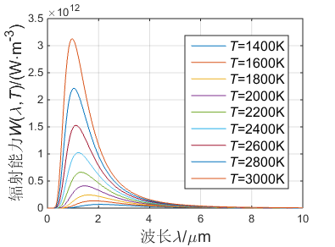
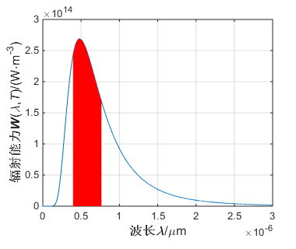
Background Noise
Background Noise Impact：
Saturate Receiver
Affect Receiver Sensitivity
Black Radiation vs Wavelength
Sun Noise Model：
Black Body Model
Reduce Background Impact：
Reduce Receiver View Angle
Reduce Receiver Antenna Size
Choose Proper Optical Bandpass Filter
Sun Radiation vs Wavelength

Slide 8
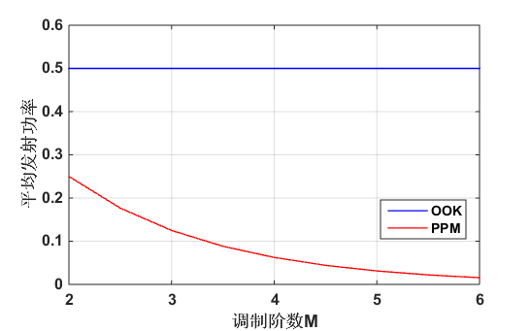
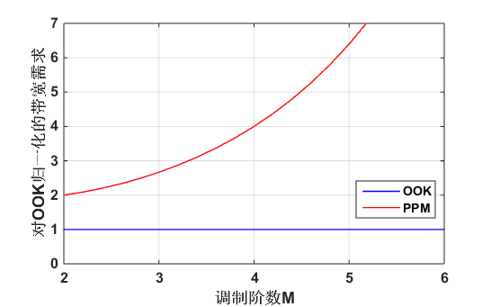
Modulation
PPM：
Immunity to Certain Interference
Power Efficient
Bandwidth Requirements
Average Power Comparison of PPM and OOK
Bandwidth Requirements Comparison of OOD and PPM
OOK、2PPM、4PPM BER vs SNR

Slide 9
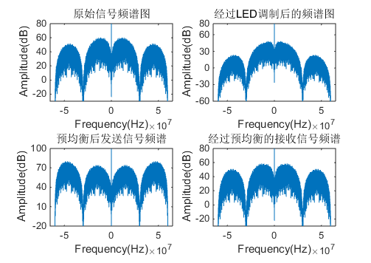
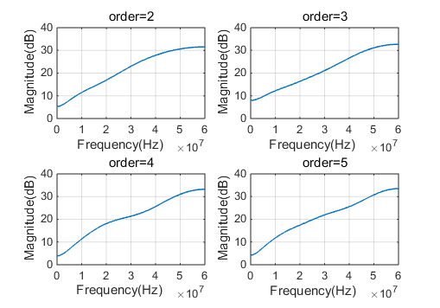
Pre equalization
Original Signal
LED Modulated Signal
analog circuit
digital circuit
Pre - equalizer based on FIR filter
Pre-Equalized Transmission Signal
Pre-Equalized Received Signal

Slide 10
After pre-equalization BER is significantly reduced, when the signal to noise ratio is less than 10 the 7% FEC error threshold cna still met
Equalized
Un-Equalized

Slide 11
BER comparison
Diversity reception technology
Space Linear diversity ：
MRC：High Gain, High Complexity
EGC：Gain less than MRC，lower complexity
SC：Minimum Complexity，worst Gain
MRC sub path vs BER

Slide 12
Background Noise
Turbulence
Transmitter
Channel Model
Receiver
Simulation
Modulation： 4-PPM
Pre-Equalization： FIR pre-equ
Turbulence Model： Gamma-Gamma
Diversity and number paths： 4 MRC

Slide 13
Background vs Minimum Transmission Power
Angle of Half(deg) | 45
LED Number | 3600
Distance(m) | 1000
Order of Pre-Equ | 5
Bandwidth（MHz） | 400
，
Every 10μW Noise power increase will results individual LED minimum Transmission Power increase 5mW
Transmission Power
Transmission Power
Receiver angle of 33°，BER vs Transmission Power under different Interference
Receiver angle 115°， BER vs Transmission Power under different Interference

Slide 14
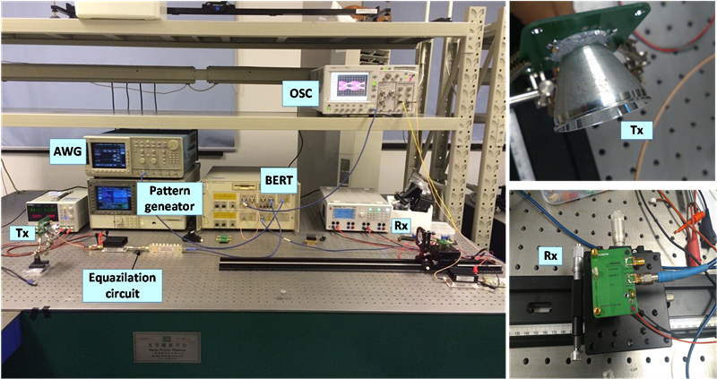
OOK
Red LED
Pre-Equalized LED
Realtime Transmission

Slide 15
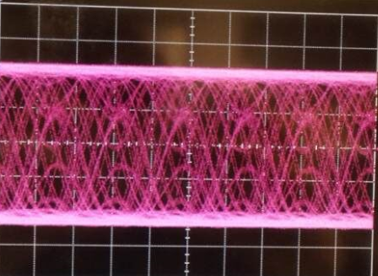
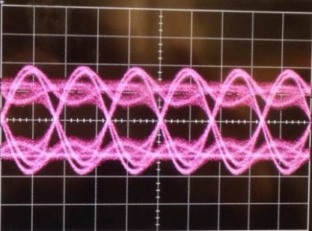
Higher Driver voltage Reduce BER, but should under safe LED driver voltage limit
（a）Eye diagram no Equalization
Driving Voltage
300MHz，variation angel 5°；400MHz，variation angel 3°。
（b）Eye diagram with Equalization
Effective Results
Receiver Angel

Slide 16
Conclusion
Creative Points
Results
Simulation：
VLC Outdoor Transmission Model
Transmission Key poings
VLC Outdoor Free Space Transmission Model
Experiment：
100Mbps OOK Realtime transmission system
Future work：
More improvement
Setup long distance VLC Platform
Pilot study on Outdoor Free Space VLC Transmission
Paper:
Jiayi Zhao, Nan Chi. Indoor LED location technique comparison study[J]. Light and lighting ,2015,01:34-41

