Slide 1
doc.: IEEE 802.15-15- 0718 -00-007a
Project: IEEE P802.15 Working Group for Wireless Personal Area Networks (WPANs)
Submission Title: Channel Modeling for Image Sensor based Sea and Digital Signage Communication
Date Submitted: September 2015
Source: Trang Nguyen, Mohammad Arif Hossain, Yeong Min Jang [Kookmin University] and Jaesang Cha[SNUST]
Contact: +82-2-910-5068 E-Mail: yjang@kookmin.ac.kr
Re:
Abstract: This contribution presents a proposed timeline with milestones. It is offered to the committee which can adopt, modify or ignore the suggested timeline.
Purpose: Call for Channel Models Response
Notice: This document has been prepared to assist the IEEE P802.15. It is offered as a basis for discussion and is not binding on the contributing individual(s) or organization(s). The material in this document is subject to change in form and content after further study. The contributor(s) reserve(s) the right to add, amend or withdraw material contained herein.
Release: The contributor acknowledges and accepts that this contribution becomes the property of IEEE and may be made publicly available by P802.15.
Submission

Slide 2
doc.: IEEE 802.15-15- 0718 -00-007a
Field of Application
Our Proposed Channel Model is proposed considering the A8 (Sea Communication) and A11 (Digital Signage) of Application and Use cases for Image Sensor Communications.
• Sea Communication might be used in night time. Consequently, daylight interference in the communication medium is neglected.
• LED Signage will be used indoor system. So, the effect sunlight can also be omitted.
• The LED source for sea communication is considered as circular sized while the digital signage will be in flat and rectangular in size.
Submission

Slide 3
doc.: IEEE 802.15-15- 0718 -00-007a
Channel Models
Transmitter:
  Circular LED (Seaside Communication)
  LED Signage (Digital Signage)
Channel Medium:
  We have considered only Line of Sight (LOS) communication channel. The reflected portion of light (NLOS channel) is discarded by using image processing method.
Receiver:
  Rolling Shutter Camera
  Global Shutter Camera
We use extra zoom functionality for long distance communication in sea communication.
Submission

Slide 4


doc.: IEEE 802.15-15- 0718 -00-007a
Scenario 1: Ship-to-Ship
Low power transmission at night
Medium: Fog/Rain/Snow
Distance: < kilometer
Flicker mode: Allowed
Submission

Slide 5
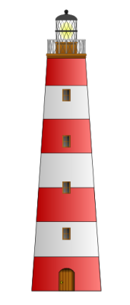

doc.: IEEE 802.15-15- 0718 -00-007a
Scenario 2: Lighthouse-to-Ship
Beam forming (α)
High power transmission at night
Medium: Fog/Rain/Snow
Distance: several kilometers
Non-Flicker
Submission

Slide 6
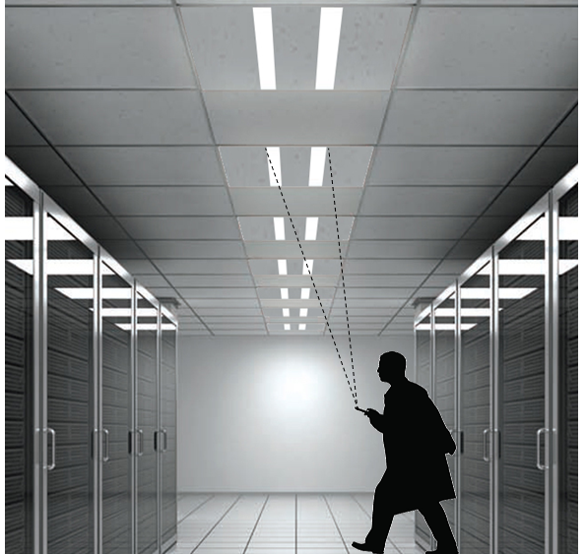
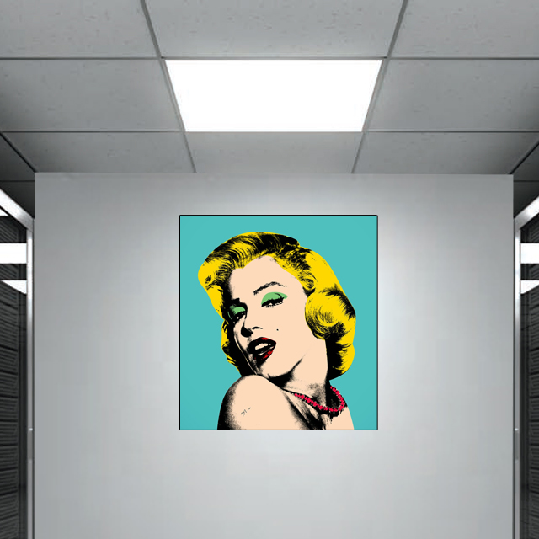


doc.: IEEE 802.15-15- 0718 -00-007a
Scenario 3: Indoor Digital Signage
LED tube/panel transmitter
Transmission Distance: <3m
Submission

Slide 7
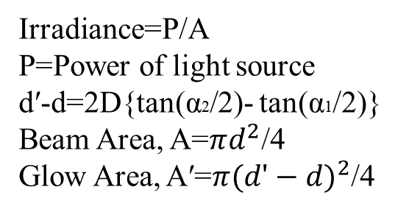
doc.: IEEE 802.15-15- 0718 -00-007a
Medium Modeling for LOS Link
Glow
LED
d
Beam
dʹ
α2
α1
Fresnel lens
(optional)
D
Irradiance=P/A
P=Power of light source
dʹ-d=2D{tan(α2/2)- tan(α1/2)}
Beam Area, A=$πd^{2}$/4
Glow Area, Aʹ=$π{(dʹ−d)}^{2}$/4
The distance between Tx and Rx: D
Angle of FOV for beam:α1
Angle of FOV for glow:α2
Fresnel Lens is used to form the beam.
Submission

Slide 8
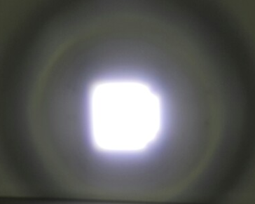
doc.: IEEE 802.15-15- 0718 -00-007a
Experimental Illustration
3.5 m
LED
1m
Experimental Parameters (LED product of Kimin Electronics):
LED Diameter: 11.5 cm
Transmission Distance: 10m
Beam Radius: 1m
Glow Radius: 3.5 m
Power of LED: 48W
Submission

Slide 9


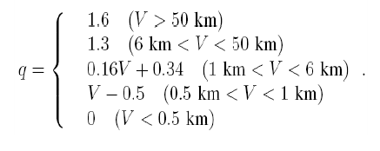
doc.: IEEE 802.15-15- 0718 -00-007a
Medium Modeling (Fog)
The Fog attenuation Coefficient,
Considering, 5% transmission threshold we can write
V is visibility range in km
λ is transmission wavelength in nm
q is the size distribution coefficient
Reference: Muhammad Saleem Awan et al.“Characterization of Fog and Snow Attenuations for Free-Space Optical Propagation” http://ojs.academypublisher.com/index.php/jcm/article/view/0408533545/491
Submission

Slide 10


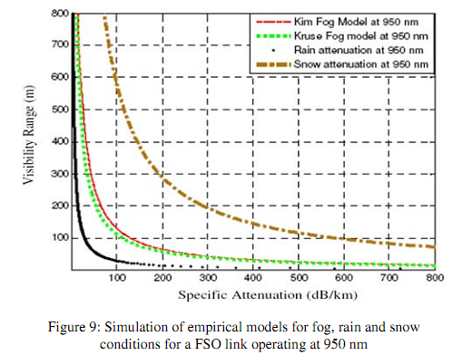
doc.: IEEE 802.15-15- 0718 -00-007a
Medium Modeling (Rain + Snow)
The Snow attenuation Coefficient,
The Rain attenuation Coefficient,
Reference: Muhammad Saleem Awan et al.“Characterization of Fog and Snow Attenuations for Free-Space Optical Propagation” http://ojs.academypublisher.com/index.php/jcm/article/view/0408533545/491
Submission

Slide 11
doc.: IEEE 802.15-15- 0718 -00-007a
Receiver Modeling
1- Imaging based Communication
LED
Image Sensor
The LED transmitter is in focus range and can be captured by image sensor.
2- Non-Imaging based Communication
LED
Image Sensor
The LED transmitter is out of focus range and the incoming beam to Image Sensor covers the entire of sensor.
Submission

Slide 12
doc.: IEEE 802.15-15- 0718 -00-007a
Conclusion
Channel modeling for Image Sensor Communications in Sea environment at night under presence of Snow/Rain/Fog is considered.
The distance of transmission depends on the power of LED. The beam forming technique is considered to enhance transmission distance.
Out-of-focus Image Sensor Communications is of interest.
Indoor Digital Signage scenario is of interest.
Submission

