Slide 1
Project: IEEE P802.15 Working Group for Wireless Personal Area Networks (WPANs)
Submission Title: [TG4r Opening and Closing for Sept 2015 Session]
Date Submitted: [14 September 2015]
Source: [Benjamin Rolfe] Company [Blind Creek Associates]
Address [Los Gatos, CA, USA]
Voice:[+1. 408 . 395 . 7207], E-Mail:[ben.rolfe@ieee.org]
Re: [TG4r Opening and Closing Report for Sept 2015 Session.]
Abstract: [Report to the working group]
Purpose: [To keep Rick from nagging me about closing reports]
Notice: This document has been prepared to assist the IEEE P802.15. It is offered as a basis for discussion and is not binding on the contributing individual(s) or organization(s). The material in this document is subject to change in form and content after further study. The contributor(s) reserve(s) the right to add, amend or withdraw material contained herein.
Release: The contributor acknowledges and accepts that this contribution becomes the property of IEEE and may be made publicly available by P802.15.

Slide 2
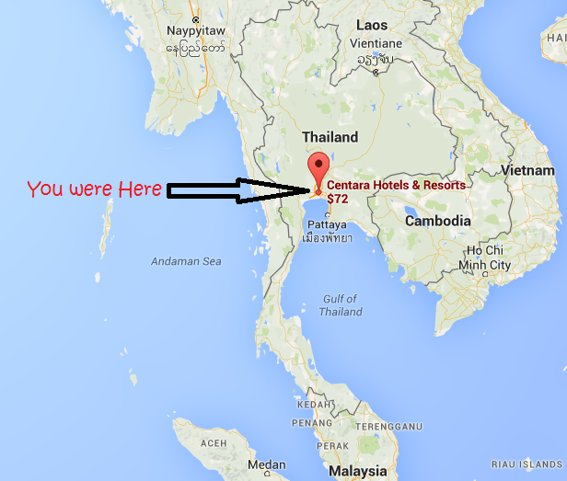
Task Group 4
Closing Report
Slide 2
Notes:
September 15
Page 2

Slide 3
Intro
Acting Chair, Secretary, et al: Ben Rolfe
Agenda: 15-15-0646-00-004r
https://mentor.ieee.org/802.15/dcn/15/15-15-0646-00-004r-tg4r-agenda-july-2015.xlsx
Slide 3

Slide 4
Opening Slides

Slide 5
Instructions for the WG Chair
The IEEE-SA strongly recommends that at each WG meeting the chair or a designee:
Show slides #1 through #4 of this presentation
Advise the WG attendees that:
The IEEE’s patent policy is described in Clause 6 of the IEEE-SA Standards Board Bylaws;
Early identification of patent claims which may be essential for the use of standards under development is strongly encouraged;
There may be Essential Patent Claims of which the IEEE is not aware. Additionally, neither the IEEE, the WG, nor the WG chair can ensure the accuracy or completeness of any assurance or whether any such assurance is, in fact, of a Patent Claim that is essential for the use of the standard under development.
Instruct the WG Secretary to record in the minutes of the relevant WG meeting:
That the foregoing information was provided and that slides 1 through 4 (and this slide 0, if applicable) were shown;
That the chair or designee provided an opportunity for participants to identify patent claim(s)/patent application claim(s) and/or the holder of patent claim(s)/patent application claim(s) of which the participant is personally aware and that may be essential for the use of that standard
Any responses that were given, specifically the patent claim(s)/patent application claim(s) and/or the holder of the patent claim(s)/patent application claim(s) that were identified (if any) and by whom.
The WG Chair shall ensure that a request is made to any identified holders of potential essential patent claim(s) to complete and submit a Letter of Assurance.
It is recommended that the WG chair review the guidance in IEEE-SA Standards Board Operations Manual 6.3.5 and in FAQs 14 and 15 on inclusion of potential Essential Patent Claims by incorporation or by reference.
Note: WG includes Working Groups, Task Groups, and other standards-developing committees with a PAR approved by the IEEE-SA Standards Board.
(Optional to be shown)

Slide 6
Participants, Patents, and Duty to Inform
All participants in this meeting have certain obligations under the IEEE-SA Patent Policy.
Participants [Note: Quoted text excerpted from IEEE-SA Standards Board Bylaws subclause 6.2]:
“Shall inform the IEEE (or cause the IEEE to be informed)” of the identity of each “holder of any potential Essential Patent Claims of which they are personally aware” if the claims are owned or controlled by the participant or the entity the participant is from, employed by, or otherwise represents
“Should inform the IEEE (or cause the IEEE to be informed)” of the identity of “any other holders of potential Essential Patent Claims” (that is, third parties that are not affiliated with the participant, with the participant’s employer, or with anyone else that the participant is from or otherwise represents)
The above does not apply if the patent claim is already the subject of an Accepted Letter of Assurance that applies to the proposed standard(s) under consideration by this group
Early identification of holders of potential Essential Patent Claims is strongly encouraged
No duty to perform a patent search
Slide #1

Slide 7
Patent Related Links
All participants should be familiar with their obligations under the IEEE-SA Policies & Procedures for standards development.
Patent Policy is stated in these sources:
IEEE-SA Standards Boards Bylaws
http://standards.ieee.org/develop/policies/bylaws/sect6-7.html#6
IEEE-SA Standards Board Operations Manual
http://standards.ieee.org/develop/policies/opman/sect6.html#6.3
Material about the patent policy is available at
http://standards.ieee.org/about/sasb/patcom/materials.html
If you have questions, contact the IEEE-SA Standards Board Patent Committee Administrator at patcom@ieee.org or visit http://standards.ieee.org/about/sasb/patcom/index.html
This slide set is available at https://development.standards.ieee.org/myproject/Public/mytools/mob/slideset.ppt
Slide #2

Slide 8
Call for Potentially Essential Patents
If anyone in this meeting is personally aware of the holder of any patent claims that are potentially essential to implementation of the proposed standard(s) under consideration by this group and that are not already the subject of an Accepted Letter of Assurance:
Either speak up now or
Provide the chair of this group with the identity of the holder(s) of any and all such claims as soon as possible or
Cause an LOA to be submitted
Slide #3

Slide 9
Other Guidelines for IEEE WG Meetings
All IEEE-SA standards meetings shall be conducted in compliance with all applicable laws, including antitrust and competition laws.
Don’t discuss the interpretation, validity, or essentiality of patents/patent claims.
Don’t discuss specific license rates, terms, or conditions.
Relative costs, including licensing costs of essential patent claims, of different technical approaches may be discussed in standards development meetings.
Technical considerations remain primary focus
Don’t discuss or engage in the fixing of product prices, allocation of customers, or division of sales markets.
Don’t discuss the status or substance of ongoing or threatened litigation.
Don’t be silent if inappropriate topics are discussed … do formally object.
---------------------------------------------------------------
See IEEE-SA Standards Board Operations Manual, clause 5.3.10 and “Promoting Competition and Innovation: What You Need to Know about the IEEE Standards Association's Antitrust and Competition Policy” for more details.
Slide #4

Slide 10
Closing Slides

Slide 11
Status
Conducted 1 meeting this week
AM1 Tuesday
Meeting goals
Status of project and discussion
Further scope and direction discussion
Accomplished goals

Slide 12
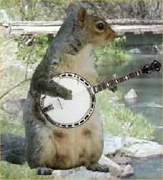
Thank You

