Slide 1
Project: IEEE P802.15 Working Group for Wireless Personal Area Networks (WPANs)
Submission Title: Response to Call for Interest(CFI) of IEEE802 IG-DEP Case 9
Date Submitted: September 15, 2015
Source: Ryuji Kohno(YNU/CWC-Nippon), Manabu Yagi (NEC)
Contact: Ryuji Kohno(YNU/CWC-Nippon), Manabu Yagi (NEC)
Voice: :+358-8-553-2849, E-Mail: kohno@ynu.ac.jp, m-yagi@bx.jp.nec.com
Re: IG DEP Responses to Call for Interest(CFI)
Abstract: Responses to Call for Interest(CF-DEP
Purpose:
Notice: This document has been prepared to assist the IEEE P802.15. It is offered as a basis for discussion and is not binding on the contributing individual(s) or organization(s). The material in this document is subject to change in form and content after further study. The contributor(s) reserve(s) the right to add, amend or withdraw material contained herein.
Release: The contributor acknowledges and accepts that this contribution becomes the property of IEEE and may be made publicly available by P802.15.
Slide 1
Slide 1
Notes:
Jul 12, 2010
Page 1

Slide 2
Response to Call for Interest(CFI) of IEEE802 IG-DEP
Case 9
Bangkok, Thailand
September 15, 2015
Ryuji Kohno(YNU/CWC-Nippon), Manabu Yagi (NEC)

Slide 3
Objectives
Response to Call for Interest(CFI) from NEC is reported to make sure demands and major requirement for wireless dependability in disaster prevention and rescue and others,
This could be involved in requirement and applications for a new standard of wireless dependability for IoT, M2M, and other ecosystems for social services and infrastructures.

Slide 4
Future Vision of Dependable Social Infrastructures Based on Advanced ICT
Major 5 Infrastructures of Communications, Transportation, Energy, Commerce and Medicine
A. Information Traffic（Telecommunications）
B. Vehicular Traffic（Transportation）
C. Energy Traffic(Power & Energy Supply）
D. Money Traffic（Commerce）
E. Patient, Drag Traffic(Medicine)
should be integrated to control all flows in future infrastructure
（Example）
A+B ➔ ITS (Intelligent Transport System)
A+C ➔ Smart Grid (Flexible Energy Network)
A+D ➔ E-Commerce (Borderless Secure Trade)
A+E ➔ Medicine ICT (Ubiquitous Medicine)
To Dependable Wireless
Medical Service
Medical ICT
Ubiquitous Medical Care
Medicine
Medical ICT
Ubiquitous Medical Care
Human being
Human
Commerce
Energy Supply
Telecommunications
Disaster Prevention
Environment
Money
Information
Energy
ICT
Regiom
Information
Earth
E-commerce
E-Money
Vehicle
Deserster Prevension ICT
Sensor Network, Prediction
Smart Grid
Common Network for Electricity and Infrmation
Nation
ITS
Telecommunications and Transprotation
Environment ICT
Green and Eco Network
Transportation
Defense ICT
Strategic Information Control
Politics

Slide 5


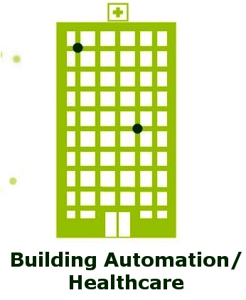

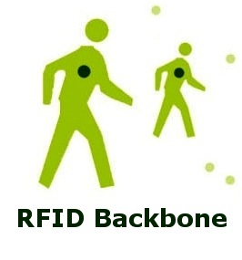

Internet of Things (Scale Merit)
Machine/Device Centric Network (Internet of Everything)
Internet of Things = 10¹²
Fringe Internet = 10⁹
Core Internet = 10⁶
Human Centric Network
Slide 5

Slide 6
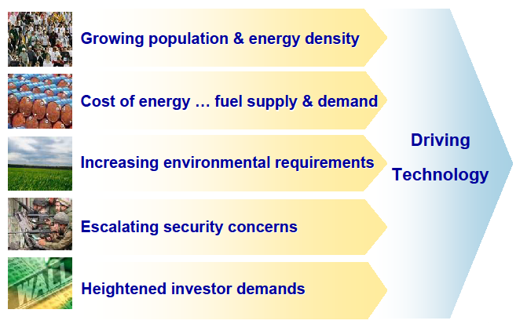
Demands for Dependable Wireless
6
Population Ageing & Medical crisis
Healthcare Service(Medical ICT)
Energy Network(Smart Grid)
Dependable Wireless BAN:
IoT & M2M
CO₂ Reduction, Green Innovation
Public Safety, National Defense
Global Borderless Economics

Slide 7

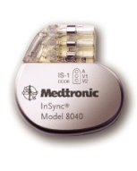
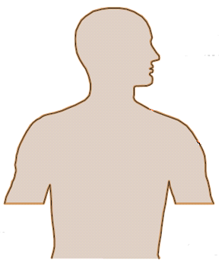
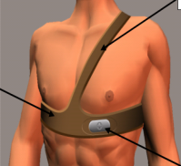
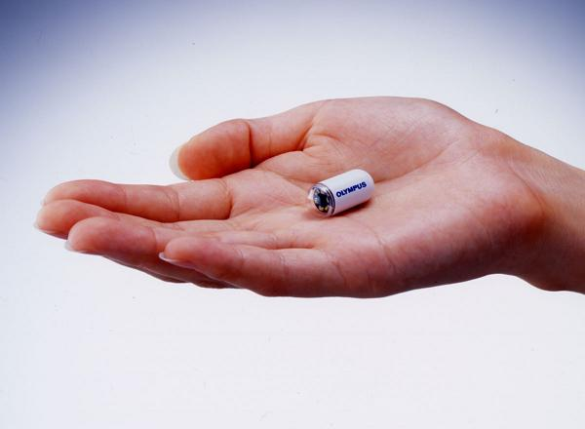
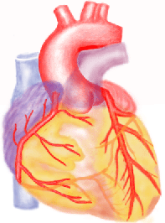
Medical Body Area Network (BAN)
Effective medical treatment is provided by vital information monitoring through wireless BAN.
Network
Healthcare management, advice, and medical treatment
Telemonitoring
Rehabilitation support
BAN
BAN
Wireless ICT pace maker using BAN
Actuator and sensor
Wireless BAN coordinator
Wireless BAN coordinator
Wearable BAN Ex. Vital Sign Monitor, Surgery Robot Control
Implanted BAN Ex. Capsule Endoscope, Hart Pace Maker, ICD
Capsule Endoscope

Slide 8
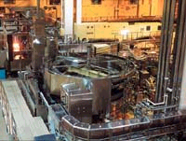


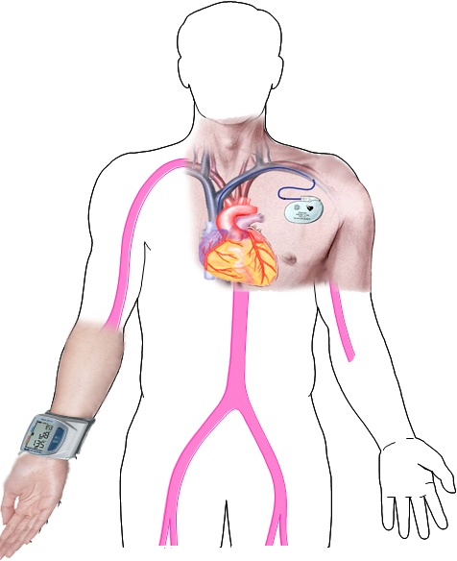

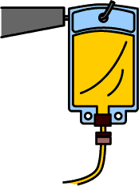


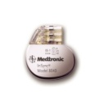


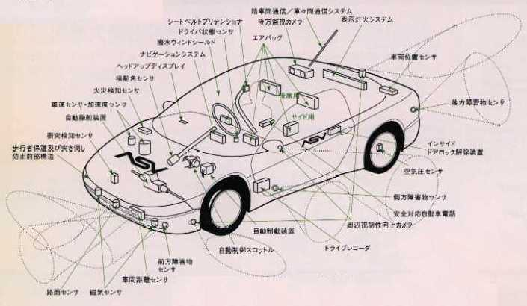
Demands for Highly Dependable Communications for Controlling
Collision Avoidance Using inter-vehicle and roadside networks
Collision Avoidance and safe driving by inter-vehicle networks
Inter-module wireless Networks
A車
Road to car networks
B車
Inter-vehicle networks
Car LAN & Wireless Harness
Car Navigation & Collision Avoidance Radar
Factory Automation (FA)
Dependable Wireless Networks for Transportation
Dependable Wireless Sensing & Controlling for Manufacturing (CIM)
Wearable BAN
Implant BAN
Tele-metering vital data
Tele-controlling
implant devices
EEG.
ECG,
Blad Pressure
Temperatute
MRI images
Etc.
Silicon Bsee
UWB can solve
such a problem
that radio interferes
a human body and
medical equipments
MMIC
(Flip Chip)
On Chip Antenna and
Wireless Network in chio
Pacemaker with IAD
Silicon Base
Multi-layer BCB
Dependable Network among vital
sensors, actuators, robots
Capsule Endoscope
Micor Machine Fablication
Dependable Wireless System Clock in
Micro Circuit & Network in Devices
Dependable BAN for Medical Healthcare

Slide 9
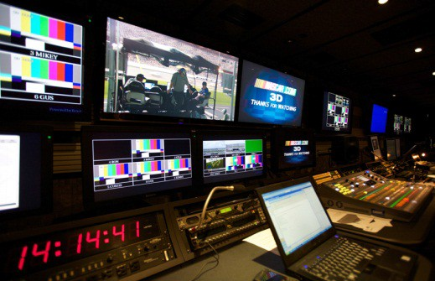
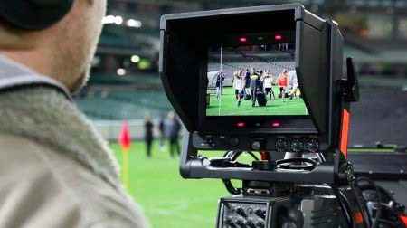
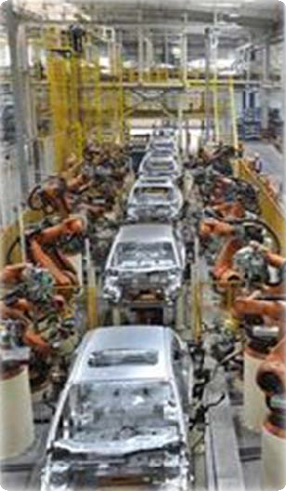
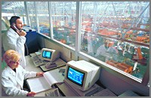
Demands for Dependable BAN or IoT in Industrial Automation and Broadcast
Demands for Internet of Things increase but Machine-to-Machine (M2M) should be reliable and secure, so Dependable BAN for Medicine must be good matched with Dependable BAN of Things.

Slide 10
Scalable Applications of Dependable BAN(1/2)
Clinical Check & Treatment (Patients)
Home Medical Therapy
Surgery Operation
Health Advise Service
Hospital Clinical Service
Fitness, Massage
& Sauna
Clinical Check
TV Games,
Net Cruising
Rehabilitation
Home, Office,
School(Active)
Hospital
(Passive)
Sport Training & Education
Sports: Walking, Jogging,
Bicycling, Hiking, Skiing etc
Sport Play & Game
Social Events: Air Guitar Contest etc
Sport Events: Ice Hockey, Soccer etc
Leisure & Entertainment (Healthy Citizens)

Slide 11
Ubiquitous Medicine & Healthcare
by Silmee for Healhy Daily Life
Scalable Applications of Dependable BAN(2/2)
Fitness, Sport and Game with Safe Protection
by Silmee for Healthy Daily Life
Clinical Check & Treatment (Patients)
Home Medical Therapy
Surgery Operation
Health Advise Service
Hospital Clinical Service
Car, Bldg Care
business
Public Safety & Emergency
Rescue By Siilmee
Regulatory Compliance
Test
Clinical Check
Rehabilitation
TV Games,
Net Cruising
Home, Office,
School(Active)
Hospital
(Passive)
Sport Training & Education
Sports: Walking, Jogging,
Bicycling, Hiking, Skiing etc
Sport Play & Game
Bio Informatics
Data Mining
Social Events: Air Guitar Contest etc
Sport Events: Ice Hockey, Soccer etc
Entertainment business
Leisure & Entertainment (Healthy Citizens)

Slide 12
 | Dependable Wireless Networks (DWN)
 | Medical ICT as supportive to | Disaster Prevention ICT | Defence ICT as supportive to
Key technology in Physical Layer Expertise 1 : Ultra Wide Band (UWB) e.g. WPAN, WBAN | No Invasion to body and interfernce to medical devices Ultra high rate transmission and high accuracy ranging | *Localization of disaster victim and sensing health condition Low power sensor network for prediction Instantaneous ad-hoc robust network | Undetectable and anti-jamming defecing and attacking network Precise ranging and geolocation Active jamming and secure network
Key technology in MAC and Network Layer Expertise 2: Redundancy, Buffer, Falut Tolerance e.g network coding | Hybrid MAC protocal according to priority and emergency levels Redundant routing and links for fault tolerance | * Emergency rescue, prediction and recover using instantaneous robust ad-hoc network by multi-hop, buffering, collaborative sensing and coding | Undetectable and anti-jamming defencing and offencing network Accurate ranging and positioning enemy
Key technology in Application Layer Expertise 3: Encryptiion and Authentication | * Secure vital sensing and data base management for hospital and medical networks | * Secure and robust remote sensing and controlling machines in dengerous environment | Secure and robust detecting and defencing networks Hiding and cracking systems

Slide 13
 | Dependable Wireless Networks (DWN)
 | Medical ICT as supportive to | Disaster Prevention ICT | Defence ICT as supportive to
Key technology in Physical Layer (e.g. UWB, Array, SDR, Cognitive, Collaborative) | * Ubiquitious reliable medical Hearcare with diversity and cancellation technologies robust against noise and interference | * Disaster Prediction using sensing with cognitive and acurate geolocation and transmission technologies in dirty environment | * Detection of enemy and ptotection of high priority points using anti-jamming radio technologies in critical environment
Key technology in Data Link Layer (e.g. Hybrid Contension free & base protocols) | * Priority traffic control according to emergency and life critical communications | * Triage and rescue according to priority order of life critisism * Traffic control of information and logistics | * Priority order of tactics for defense and attack assuming intensive contension and jamming
Key technology in Network Layer (e.g. Fault-tolerant network and rooting etc) | * Falut tolerant network with redundant routes and links in hospital and medical networks | * Fault tolerant netwroks with quick and redundant routing in disaster | * Robust network with undetectable and anti-jamming adaptability
Key technology in Application Layer (e.g. Authentication and Encryption etc) | * Secure Vaital data processing with encription considering specific requitement for medicine | * Secure sensing and controlling against unpredictable damages and terrorism | * Secure networks and infrastructure against attack and intersive jamming

Slide 14
DWN in Disaster Prediction(Phase 1)
Specific requirements
  Huge scare of low power and cost sensing networks and sophysticated sytems to predict different types of disasters any time and anywhere, e.g. world scale earthquake forecast network.
  Remote sensing and maintainance networks of bldgs infrastructures and e.g. NDI: Non Destructive Inspection
Key technology requirements
(a) Available technologies:expensive sensor networks. Satellite and helicopter sensing and monitoring.
(b) Lack of technologies: Low cost and long life safe, reliable sensor and maintainance networks.
Potential industrial parties (financing expected)
(1) Government (Public safty and awareness)
(2) Network carrier operators and manufactures
(3) Sensor manufacturers

Slide 15
DWN in Emergency Rescure (Phase 2)
Specific requirements
  Instantenious ad-Hoc rescure network must be emergently established when infrastrure networks e.g. cellphone network and internet , and vehicle traffic control netwroks have been corrupted.
Key technology requirements
(a) Available technologies: short rage consumer networks. e.g. WLAN, sensor network, twitter
(b) Lack of technologies: instantaniously available reliable and robust networks while they may be useful in usual living or non-emergency case.
Potential industrial parties (financing expected)
(1) Local government (ambulance, fireengine etc)
(2) Network carrier operators and manufactures
(3) Special vehicle manufacturers

Slide 16
DWN in Disaster Recovering (Phase 3)
Specific requirements
  Enable technolgies to design safe and secure social infrastructure for high QoL against disaters.
  Adaptive reconfigurability according to variance of liveing and working condition. Total design of ready existing and newly buiding system.
Key technology requirements
(a) Available technologies: design technology for assumed case and predictable case.
(b) Lack of technologies:cognitive and reconfigurable technology in case beyond assumed and predictable cases.
Potential industrial parties (financing expected)
(1) Government (houses, roads, infra building etc)
(2) Infra and Building contructures,
(3) Network infra operators and manufactures

Slide 17
(Case 9) Would a good wireless solution benefit your application?
If yes, please describe the benefits you would like to realize
Killer applications for
Disaster such as earthquake, tsunami, typhoon, hurricane, water flood etc:
  Disaster prevention
  Rescue and evacuation
  Recovery
Social service infrastructures:
  Water supply and control networks
  Gus supply and control networks
  Electricity supply and control networks
  Other city services

Slide 18
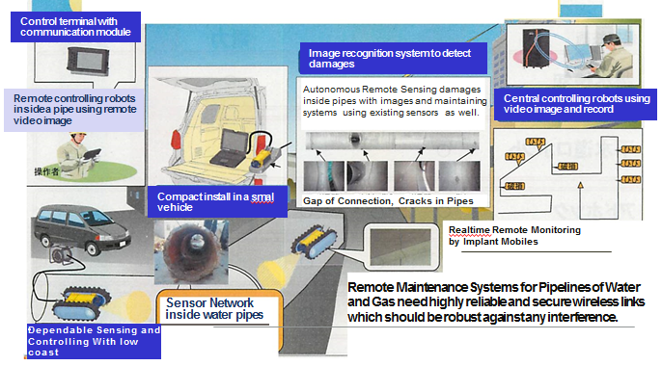
Water Pipeline Maintenance System

Slide 19
(Case 9) Have you tried wireless solutions?
What worked and what did not (be specific).
Several trials using existing wireless technologies of
  Mobile phones (3G, 4G),
  WiFi, Bluetooth,
  900MHz public services
for mature and reasonable cost technologies.
Designed and implemented some prototypes for
  Disaster rescue
  City social services such as water supply and maintenance
Required dependable performance has not been satisfied.
Radio regulations do not approve for frequency allocation.

Slide 20
(Case 9) What is missing with what you tried?.
Social insurance services request much reliable and secure wireless connection and permissible feedback delay in sensing and controlling than existing CE applications.
Performance not sufficient for their requirements
  Guaranteed network connection not sufficiently robust.
  Localization and Ranging capability of damage position should be accurate with permissible delay in real time monitoring and maintaining systems.

Slide 21
(Case 9) What are the essential performance requirements for your applications’ communications link, whether that link is wired or wireless?
Pseudo real time sensing and controlling with permissible in disaster places and social service infrastructure systems.
Federal and local government have to guarantee such emergency public safety and public supply services.
Collaborative sensing with sensor arrays and sensor networks can solve these problems technically but radio regulation may not assume reasonable topologies such as star, tree, multi-layer topologies.
  Multiple access control scheme matched with wireless remote sensing and controlling systems with limited feedback delay.
Applicable for both emergency case and ususal case.

Slide 22
(Case 9) Also please indicate if you would be interested in participation of the development of this standard.
Yes.
Contact: Mr. Manabu Yagi (NEC)
E-Mail: m-yagi@bx.jp.nec.com

