Slide 1
Project: IEEE P802.15 Working Group for Wireless Personal Area Networks (WPANs)
Submission Title: [Proposal for IEEE802.15.3e – Single Carrier PHY]
Date Submitted: [10 September 2015]
Source: [Makoto Noda⁽¹⁾, Ken Hiraga, Jae Seung Lee, Itaru Maekawa, Ko Togashi, (representative contributors), all contributors are listed in “Contributors” slide]
Company: [Sony¹, ETRI, JRC, NTT, Toshiba]
Address¹: [1-7-1 Konan, Minato-ku, Tokyo 108-0075]
E-Mail¹: [MakotoB.Noda at jp.sony.com (all contributors are listed in “Contributors” slide)]
Abstract: This document presents a Single-Carrier PHY of the full MAC/PHY proposal for HRCP.
Purpose: To propose a full set of specifications for TG 3e.
Notice: This document has been prepared to assist the IEEE P802.15. It is offered as a basis for discussion and is not binding on the contributing individual(s) or organization(s). The material in this document is subject to change in form and content after further study. The contributor(s) reserve(s) the right to add, amend or withdraw material contained herein.
Release: The contributors acknowledge and accept that this contribution becomes the property of IEEE and may be made publicly available by P802.15.

Slide 2
Contributors
Name | Affiliation | Email
Jae Seung Lee | ETRI | jasonlee@etri.re.kr
Moon-Sik Lee | ETRI | moonsiklee@etri.re.kr
Itaru Maekawa | Japan Radio Corporation | maekawa.itaru@jrc.co.jp
Lee Doohwan | NTT Corporation | lee.doohwan@lab.ntt.co.jp
Ken Hiraga | NTT Corporation | hiraga.ken@lab.ntt.co.jp
Masashi Shimizu | NTT Corporation | masashi.shimizu@upr-net.co.jp
Keitarou Kondou | Sony Corporation | Keitarou.Kondou at jp.sony.com
Hiroyuki Matsumura | Sony Corporation | Hiroyuki.Matsumura at jp.sony.com
Makoto Noda | Sony Corporation | MakotoB.Noda at jp.sony.com
Masashi Shinagawa | Sony Corporation | Masashi.Shinagawa at jp.sony.com
Ko Togashi | Toshiba Corporation | ko.togashi@toshiba.co.jp
Kiyoshi Toshimitsu | Toshiba Corporation | kiyoshi.toshimitsu@toshiba.co.jp

Slide 3
Proposal for IEEE802.15.3e
High-Rate Close Proximity System
September 10, 2015

Slide 4
Single Carrier (SC) PHY
Extremely high PHY-SAP payload-bit rates outperforming those of 15.3c
Min. 2 Gb/s and Max. 13 Gb/s, using a single channel with 2.16 GHz bandwidth
Reusing the best error-correction code respecting 15.3c
Reusing the rate-14/15 low-density parity-check (LDPC) code
Introducing a new rate-11/15 LDPC code whose decoder compatible with that for the rate-14/15 LDPC code to obtain moderate bit rates
New preamble, comparing 15.3c:
Decrease the length
Double the zero-auto correlation zone of the channel-estimation sequence
MIMO in SC PHY for 100 Gb/s is described in other material (15-0661/r1).
SC PHY proposal is also described in a draft version (15-0665/r1).

Slide 5
Index for HRCP-SC PHY
Channelization of HRCP-SC PHY
Modulation and coding
Frame format
Preamble
MCS Evaluation

Slide 6
Index for HRCP-SC PHY
Channelization of HRCP-SC PHY
Modulation and coding
Frame format
Preamble
MCS Evaluation

Slide 7
Channel assignments for a single channel
CHNL_ID | Start frequencyª | Center frequency | Stop frequencyª
1 | 57.240 | 58.320 | 59.400
2 | 59.400 | 60.480 | 61.560
3 | 61.560 | 62.640 | 63.720
4 | 63.720 | 64.800 | 65.880
ª The start and stop frequencies are nominal values. The frequency spectrum of the transmitted signal needs to conform to the transmit spectral mask as well as any regulatory requirement.

Slide 8
Transmit spectral mask for a single channel
(same as that in 802.11ad)
Power (dB)
(–0.94, 0)
0
(0.94, 0)
–10
(–1.2, –17)
(1.2, –17)
(–2.7, –22)
–20
(2.7, –22)
(–3.06, –30)
–30
(3.06, –30)
–3
–2
–1
0
1
2
3
(f – f_{c}) (GHz)

Slide 9
Index for HRCP-SC PHY
Channelization of HRCP-SC PHY
Modulation and coding
Frame format
Preamble
MCS Evaluation

Slide 10
Modulation and coding scheme (MCS)
Minimum 2 Gb/s and Maximum 13 Gb/s MCSs using a single channel
MCS identifier | single-carrier modulation | FEC Rate | PHY-SAP payload-bit rate (Gb/s)
 |  |  | w/o PW | w/ PW
0 | π/2 QPSK | 11/15 | 2.5813 | 2.2587
1 | π/2 QPSK | 14/15 | 3.2853 | 2.8747
2 | 16QAM | 11/15 | 5.1627 | 4.5173
3 | 16QAM | 14/15 | 6.5707 | 5.7493
4 | 64QAM | 11/15 | 7.7440 | 6.7760
5 | 64QAM | 14/15 | 9.8560 | 8.6240
6 | 256QAM | 14/15 | 13.1413 | 11.4987
PW: pilot word
PW length/sub-block length = 0.125

Slide 11
Forward Error Correction
Reuse the 14/15 LDPC code and a new 11/15 LDPC code with the best code efficiencies.
Gap between SNR_{r}* obtained by floating point simulation and the Shannon limit in binary AWGN channel for codes employed in standards.
code standard rate SNR_{r}
Shannon
limit
gap
(dB)
(dB)
(dB)
RS(240,224) on GF(2⁸) T J 0.933 9.77 6.51 –3.26
LDPC(1440,1344) 15.3c 0.933 8.46 6.51 –1.96
LDPC(672,588) 15.3c 0.875 7.55 5.27 –2.28
LDPC(672,546) 11ad 0.813 6.96 4.26 –2.70
LDPC(672,504) 11ad 0.750 5.91 3.39 –2.53
LDPC(1440,1056) New 0.733 5.36 3.17 –2.20
rate
14/15
rate
11/15
SNR_{r}*: signal-to-noise ratio required for a bit-error rate of 10^{–6}

Slide 12
Proposed Overlaid-rate-compatible (ORC) LDPC Codes
A check matrix of a high-rate code composed of overlay of sub-matrices in a check matrix of a low-rate code. This structure enables to share a belief-propagation decoder for the high-rate and low-rate LDPC codes.
1 0 0 0 0 0 0
0 1 0 0 0 0 0
0 0 1 0 0 0 0
0 0 0 1 0 0 0
0 0 0 0 1 0 0
0 0 0 0 0 1 0
0 0 0 0 0 0 1
0 0 0 0 1 0 0
0 0 0 0 0 1 0
0 0 0 0 0 0 1
1 0 0 0 0 0 0
0 1 0 0 0 0 0
0 0 1 0 0 0 0
0 0 0 1 0 0 0
0 0 0 0 0 0 1
1 0 0 0 0 0 0
0 1 0 0 0 0 0
0 0 1 0 0 0 0
0 0 0 1 0 0 0
0 0 0 0 1 0 0
0 0 0 0 0 1 0
0 0 0 0 0 1 0
0 0 0 0 0 0 1
1 0 0 0 0 0 0
0 1 0 0 0 0 0
0 0 1 0 0 0 0
0 0 0 1 0 0 0
0 0 0 0 1 0 0
0 0 0 0 0 0 1
1 0 0 0 0 0 0
0 1 0 0 0 0 0
0 0 1 0 0 0 0
0 0 0 1 0 0 0
0 0 0 0 1 0 0
0 0 0 0 0 1 0
1 0 0 0 0 0 0
0 1 0 0 0 0 0
0 0 1 0 0 0 0
0 0 0 1 0 0 0
0 0 0 0 1 0 0
0 0 0 0 0 1 0
0 0 0 0 0 0 1
0 0 0 0 1 0 0
0 0 0 0 0 1 0
0 0 0 0 0 0 1
1 0 0 0 0 0 0
0 1 0 0 0 0 0
0 0 1 0 0 0 0
0 0 0 1 0 0 0
0 1 0 0 0 0 0
0 0 1 0 0 0 0
0 0 0 1 0 0 0
0 0 0 0 1 0 0
0 0 0 0 0 1 0
0 0 0 0 0 0 1
1 0 0 0 0 0 0
A low-rate parity-check matrix, as a simplified example of an 11/15 LDPC code
1 0 0 0 0 0 1
1 1 0 0 0 0 0
0 1 1 0 0 0 0
0 0 1 1 0 0 0
0 0 0 1 1 0 0
0 0 0 0 1 1 0
0 0 0 0 0 1 1
1 0 0 0 1 0 0
0 1 0 0 0 1 0
0 0 1 0 0 0 1
1 0 0 1 0 0 0
0 1 0 0 1 0 0
0 0 1 0 0 1 0
0 0 0 1 0 0 1
0 0 0 0 1 0 1
1 0 0 0 0 1 0
0 1 0 0 0 0 1
1 0 1 0 0 0 0
0 1 0 1 0 0 0
0 0 1 0 1 0 0
0 0 0 1 0 1 0
0 1 0 0 0 1 0
0 0 1 0 0 0 1
1 0 0 1 0 0 0
0 1 0 0 1 0 0
0 0 1 0 0 1 0
0 0 0 1 0 0 1
1 0 0 0 1 0 0
A high-rate parity-check matrix, as a simplified example of a 14/15 LDPC code

Slide 13
A Simple LDPC encoder
A systematic (n, k) quasi-cyclic code, such that every cyclic shift of a codeword by p symbols yields another codeword, can be encoded by using p generator polynomials and an (v = n–k+p–1)-stage shift register*.
information bits
information bits
(for x⁰)
(for x¹)
…
(for x^{v– 1})
parity bits
+
D
+
D
+
D
0
…
(Zero is selected after k information bits are received)
Select a generator polynomial g_{(n– i–1)modp}*x^{p–1–{(n–i–1)modp}} at time i, where i = 0 is defined as the time that the first v information bits are stored in the v-stage shift registers; v = 96+15–1 = 110 for a rate-14/15 LDPC code and v = 96*4+15–1 = 398 for a rate-11/15 LDPC code.
* H. Yamagishi and M. Noda, Proc. IEEE, pp.78-83, Sep. 2008

Slide 14
Performance comparison of LDPC decoders
A quasi-cyclic LDPC code with a regular structure simplifies the decoder
Okada,
2013 [1]
Hung,
2010 [2]
Coz,
2011 [3]
codeword length (bits)
1440
672
1944
IEEE802 standard
15.3c
15.3c
11n
max. user rate (Gb/s)
6.45
5.79
0.693
CMOS process
40nm LP
65nm LP
SOI 65nm LP
core area (mm²)
0.46
1.56
2
supply voltage (V)
1.1
1.0
1.2
operation frequency (MHz)
288
197
360
power at BER = 10^{–6} (mW)
76
361
288
energy efficiency (pJ/bit)
11.8
1/5
62.4
1/35
416
error floor at BER = 10^{–11}
none
not confirmed
not confirmed
chip configuration
all BB
LDPC only
LDPC only
[1] K. Okada, et al., IEEE J. Solid State Circuits, vol. 48, no.1, pp. 46-65, Jan. 2013
[2] S-Y. Hung, et al., Proc. IEEE (ASSCC), Nov. 2010.
[3] J.L. Coz, et al., ISSCC Dig, pp.336-337, Feb. 2011

Slide 15
Index for HRCP-SC PHY
Channelization of HRCP-SC PHY
Modulation and coding
Frame format
Preamble
MCS Evaluation

Slide 16
Frame header construction process
PHY header
MAC header
HCS
caluculation
Append and scramble
scrambled
PHY
header
Stuff bits
HCS
MAC
header
scramble
Extended Hamming
encode
Scrambled
stuff
bits
coded
scrambled
PHY
header
HCS
MAC
header
Spreader
π/2-shift BPSK
mapper
Subblock
builder

Slide 17
PHY header format
Field Name | Number of bits | Start bit | Description
MCS | 3 | 0 | Index into the Modulation and Coding Scheme table
Pilot word | 1 | 3 | Shall be set to 1 if the pilot word is used
Scrambler seed ID | 4 | 4 | The initial state for payload scrambling
Reserved | 4 | 8 | Set to 0, ignored by the receiver
Frame length | 20 | 13 | Number of data octets in the PSDU

Slide 18
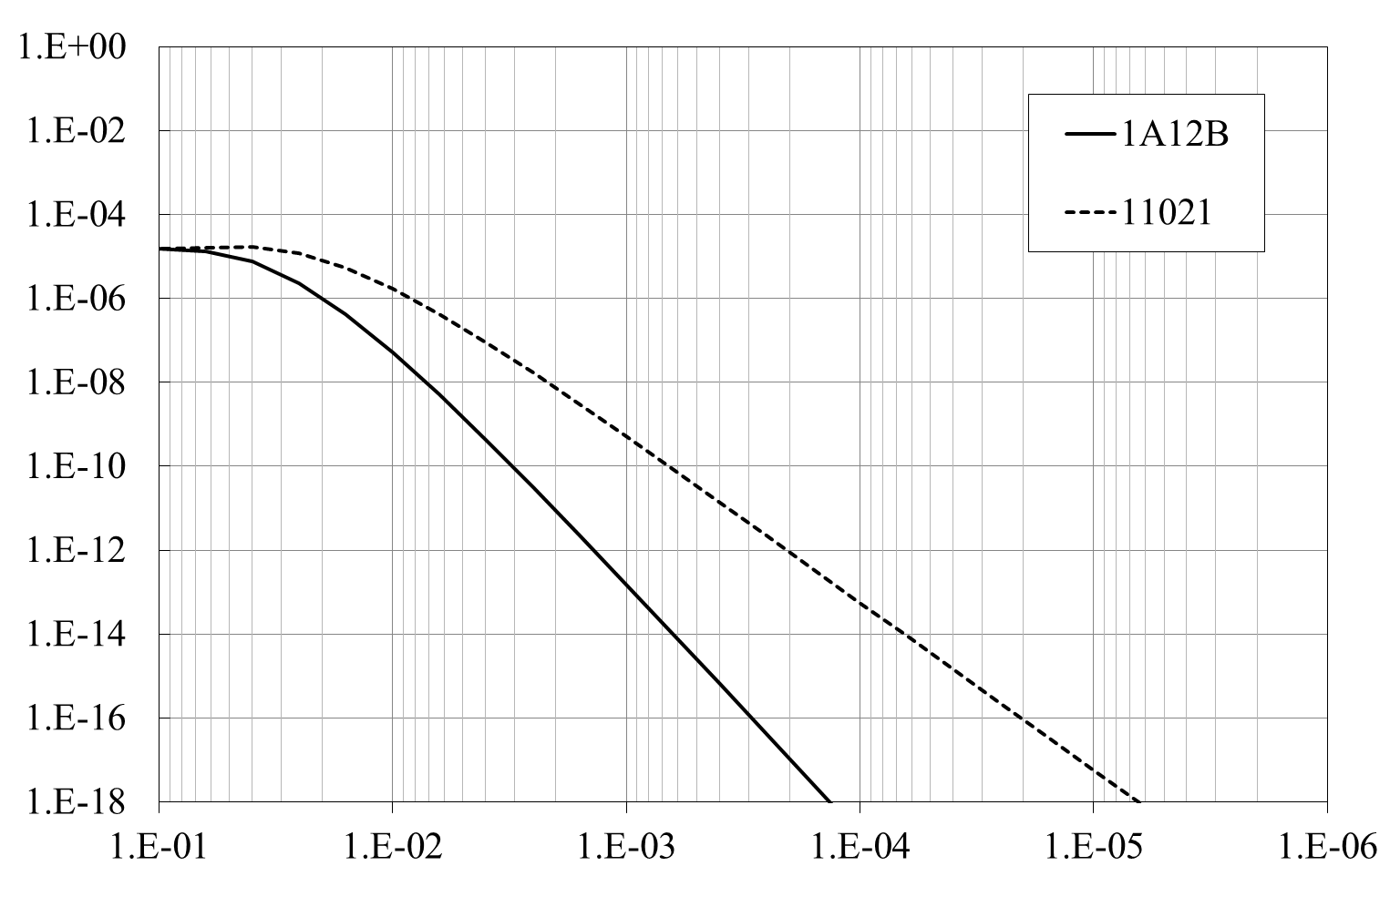
16-bit Header CRC for HCS
generator polynomial: 1A12B (TG3e, d_{min} = 6), 11021 (ITU-T, d_{min} = 4)
Undetected Error Probability
1-error event/10 years
for 1 G packets/day
Bit-error Rate, bER
CRC: cyclic-redundancy-check code
d_{min}: minimum Hamming distance
code-word length = 128 bits

Slide 19
Header FEC: (8, 4) Extended Hamming (EH) Code
Table for encoding
Why EH Code ?
a code with a short codeword length
reasonable minimum Hamming distance of four
Easy to soft decode by using:
complete maximum likelihood decoding or
simplified version such as Chase algorithm*
-> approx. 3 dB gain compared with spreading
* D. Chase, IEEE Trans. Info. Theory, vol. 18, no. 1, pp. 170-182, Jan. 1972.
source bits |  |  |  | parity bits
i₀ | i₁ | i₂ | i₃ | p₀ | p₁ | p₂ | p₃
0 | 0 | 0 | 0 | 0 | 0 | 0 | 0
0 | 0 | 0 | 1 | 1 | 1 | 1 | 0
0 | 0 | 1 | 0 | 1 | 0 | 1 | 1
0 | 0 | 1 | 1 | 0 | 1 | 0 | 1
0 | 1 | 0 | 0 | 0 | 1 | 1 | 1
0 | 1 | 0 | 1 | 1 | 0 | 0 | 1
0 | 1 | 1 | 0 | 1 | 1 | 0 | 0
0 | 1 | 1 | 1 | 0 | 0 | 1 | 0
1 | 0 | 0 | 0 | 1 | 1 | 0 | 1
1 | 0 | 0 | 1 | 0 | 0 | 1 | 1
1 | 0 | 1 | 0 | 0 | 1 | 1 | 0
1 | 0 | 1 | 1 | 1 | 0 | 0 | 0
1 | 1 | 0 | 0 | 1 | 0 | 1 | 0
1 | 1 | 0 | 1 | 0 | 1 | 0 | 0
1 | 1 | 1 | 0 | 0 | 0 | 0 | 1
1 | 1 | 1 | 1 | 1 | 1 | 1 | 1
source data
coded data
4-bit source word
4-bit parities
Schematic view for header encoding

Slide 20
Simple receiver: advantage of short coded header
received signal
Preamble
MCS
Length etc.
Payload
L
L: demod delay
(a) conventional
L
(b) improved
Timing diagram of header/payload mod
This block can be removed.
received signal
MUX
Demod
Sync &
Header
Dec
Payload
Dec
received data
D^{L}
header/payload timing
D: delay operator
header/payload mod
A block diagram of a receiver

Slide 21
Index for HRCP-SC PHY
Channelization of HRCP-SC PHY
Modulation and coding
Frame format
Preamble
MCS Evaluation

Slide 22
Proposed preamble structure
first transmitted
transmission order
last transmitted
Frame format
Preamble
Header
Payload
128*26 = 3328 chips: 1.89 µs
SYNC
14 GCSs
SFD
1 GCS
CES
11 GCSs
TG3e
a
a
a
–a
b
a
b
a
–b
a
b
–a
b
a
b
128*27 = 3456 chips: 1.96 µs
SYNC
14 GCSs
SFD
4 GCSs
CES
9 GCSs
reference:
IEEE 802.15.3c SC, HR
a
a
a
–a
–a
a
a
b
a
–b
a
b
a
–b
a
b
GCS: Golay complementary sequence, a or b, here 128-bit length
SYNC: synchronization sequence
SFD: start frame delimiter
CES: channel-estimation sequence

Slide 23
Proposed Golay Complementary Sequences (GCSs)
Two complementary form of the GCSs a₁₂₈ and b₁₂₈ with a length of 128
The GCSs are transmitted from left to right, up to down
a₁₂₈ | b₁₂₈
+1 –1 +1 –1 –1 +1 –1 +1 –1 +1 –1 +1 –1 +1 –1 +1 –1 +1 +1 –1 –1 +1 +1 –1 +1 –1 –1 +1 –1 +1 +1 –1 +1 +1 –1 –1 –1 –1 +1 +1 –1 –1 +1 +1 –1 –1 +1 +1 –1 –1 –1 –1 –1 –1 –1 –1 +1 +1 +1 +1 –1 –1 –1 –1 –1 –1 –1 –1 +1 +1 +1 +1 +1 +1 +1 +1 +1 +1 +1 +1 +1 +1 –1 –1 +1 +1 –1 –1 –1 –1 +1 +1 +1 +1 –1 –1 –1 +1 +1 –1 +1 –1 –1 +1 +1 –1 –1 +1 +1 –1 –1 +1 +1 –1 +1 –1 +1 –1 +1 –1 –1 +1 –1 +1 +1 –1 +1 –1 | +1 –1 +1 –1 –1 +1 –1 +1 –1 +1 –1 +1 –1 +1 –1 +1 –1 +1 +1 –1 –1 +1 +1 –1 +1 –1 –1 +1 –1 +1 +1 –1 +1 +1 –1 –1 –1 –1 +1 +1 –1 –1 +1 +1 –1 –1 +1 +1 –1 –1 –1 –1 –1 –1 –1 –1 +1 +1 +1 +1 –1 –1 –1 –1 +1 +1 +1 +1 –1 –1 –1 –1 –1 –1 –1 –1 –1 –1 –1 –1 –1 –1 +1 +1 –1 –1 +1 +1 +1 +1 –1 –1 –1 –1 +1 +1 +1 –1 –1 +1 –1 +1 +1 –1 –1 +1 +1 –1 –1 +1 +1 –1 –1 +1 –1 +1 –1 +1 –1 +1 +1 –1 +1 –1 –1 +1 –1 +1
Hexadecimal form of the GCSs a₁₂₈ and b₁₂₈ with a length of 128
The GCSs are transmitted from left to right where the left-most bit is transmitted first in time.
a₁₂₈ | b₁₂₈
A5556696C33300F00FFFCC3C6999AA5A | A5556696C33300F0F00033C3966655A5

Slide 24
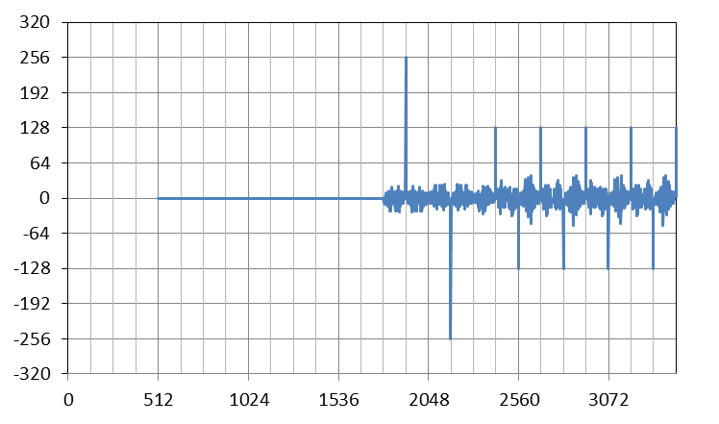
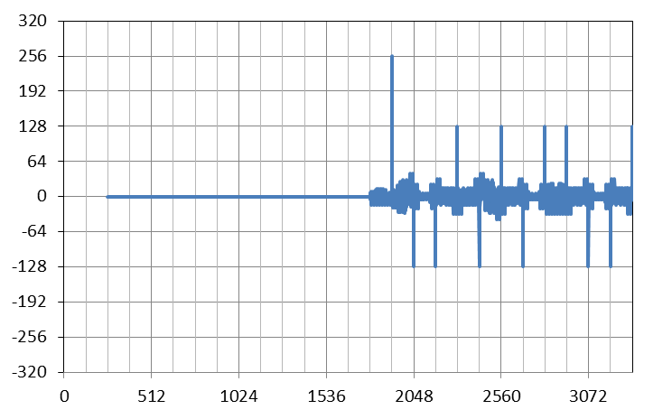
Side-lobe comparison of SFD
The new Golay sequence reduces the side-lobe level of SFD by 36%
r: a noiseless received sequences
R: a reference sequence= [a₁₂₈ –a₁₂₈]
The last 3 GCS of SFD in 15.3c are used for detection of the header rate, either medium rate (MR) or high rate (HR).
SYNC
SFD
CES
SYNC
SFD
CES
+256
+256
Cross Correlation of
r and R
+22
Cross Correlation of
r and R
–36 %
+14
–26
–38 %
–16
Time Slot
Time Slot
(a) 15.3c
(b) TG3e

Slide 25
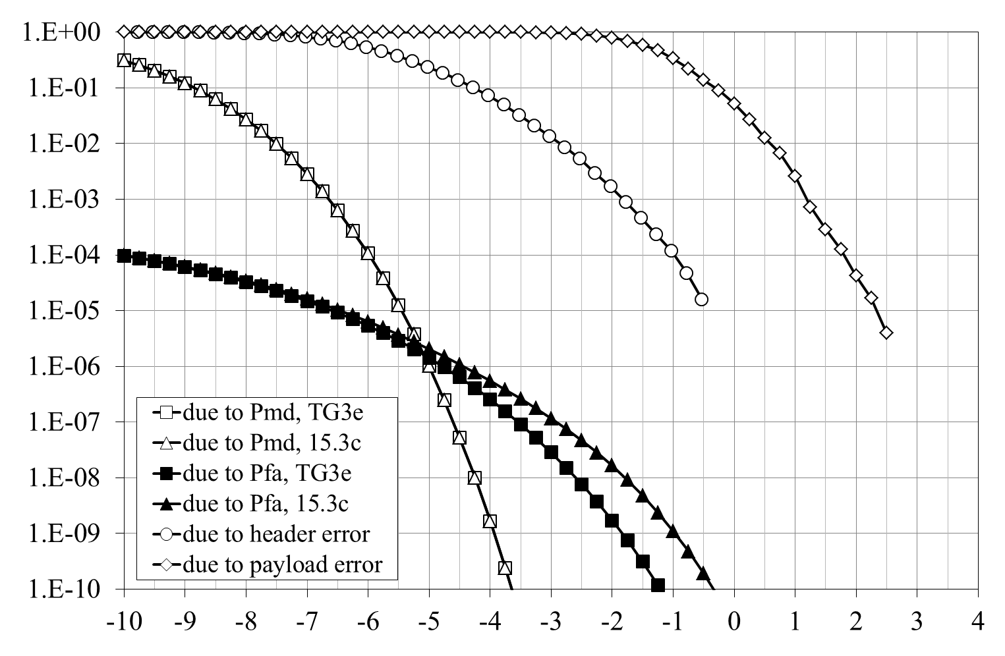
Performance of SFD and header FEC
P_{md}: calculated missed detection probability (failure at the correct position)
P_{fa}: calculated false alarm probability (failure at the incorrect position)
a threshold for SFD detection: 80
payload: MCS0 10 octets
Frame-error Rate, FER
0.9 dB gain
Carrier to Noise Ratio, CNR (dB)
CNR dependence of FER

Slide 26
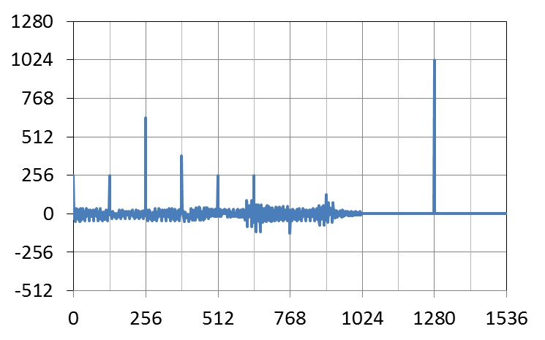
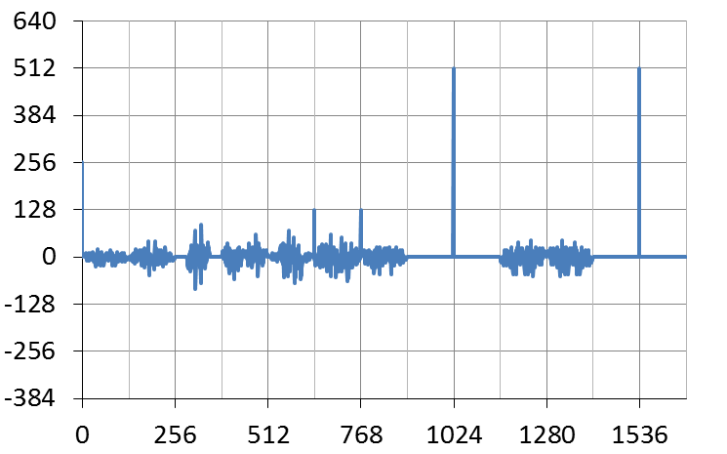
Performance comparison of channel estimation
The new CES doubles the zero-cross correlation (ZCC) zone
SYNC
SFD
CES
SYNC
SFD
CES
a₁₂₈
a₁₂₈
–a₁₂₈
–a₁₂₈
a₁₂₈
a₁₂₈
b₁₂₈
a₁₂₈
–b₁₂₈
a₁₂₈
b₁₂₈
a₁₂₈
–b₁₂₈
a₁₂₈
b₁₂₈
a₁₂₈
a₁₂₈
a₁₂₈
–a₁₂₈
b₁₂₈
a₁₂₈
b₁₂₈
a₁₂₈
–b₁₂₈
a₁₂₈
b₁₂₈
–a₁₂₈
b₁₂₈
a₁₂₈
b₁₂₈
a₂₅₆
b₂₅₆
a₂₅₆
b₂₅₆
b₁₂₈
–b₂₅₆
a₅₁₂
b₅₁₂
a₂₅₆
single peak with 1024
±256-symbol ZCC
dual peak with 512
±128-symbol ZCC
Cross Correlation
Cross Correlation
Time Slot
Time Slot
(a) 15.3c
(b) TG3e

Slide 27
Index for HRCP-SC PHY
Channelization of HRCP-SC PHY
Modulation and coding
Frame format
Preamble
MCS Evaluation

Slide 28
Channel model used in PHY evaluation*
*K. Hiraga, 15-0656/r00
Channel model
Sample# (oversample=4) | Time [nsec] | Average Level [dB] | K-factor [dB] | Phase
1 | 0.000 | 0.0 | 24.0 | 0°
2 | 0.145 | -5.4 | 20.0 | random
3 | 0.290 | -16.0 | 15.5 | random
4 | 0.435 | -27.3 | 0.0 | random
5 | 0.580 | -36.2 | 8.5 | random
6 | 0.725 | -39.0 | 9.0 | random
7 | 0.870 | -39.6 | 14.5 | random
8 | 1.015 | -46.5 | 12.0 | random
9 | 1.160 | -53.2 | 0.0 | random
10 | 1.305 | -47.4 | 17.5 | random
11 | 1.450 | -55.5 | 0.0 | random
12 | 1.595 | -48.7 | 17.0 | random
13 | 1.740 | -51.1 | 11.0 | random
14 | 1.885 | -51.6 | 12.5 | random
15 | 2.030 | -55.6 | 10.3 | random
16 | 2.175 | -53.7 | 20.0 | random
17 | 2.320 | -56.1 | 18.0 | random
18 | 2.465 | -56.6 | 16.5 | random
19 | 2.610 | -57.2 | 20.0 | random
20 | 2.755 | -58.1 | 17.5 | random
Power delay profile obtained from the measurement1

Slide 29
Parameters used for power-amplifier and phase-noise models
Power Amplifier
Phase Noise
parameter | value
G | 3.3
p | 4.2
Vsat | 1.413 V (13 dBm)
α | 8.2 x 10⁵
β | 0.326
q₁ | 10.6
q₂ | 8.0
Output Back off from Vsat | 15 dB
AM-AM:
AM-PM:
parameter | value
Modulation | QPSK, 16QAM, 64QAM | 256QAM
PSD(0) | −90 dBc/Hz
f_{z} | 8.1 × 10⁷ Hz | 5.18 × 10⁷ Hz
f_{p} | 5.79 × 10⁵ Hz | 2.60 × 10⁵ Hz
PSD(1MHz) | −96 dBc/Hz* | −102 dBc/Hz
PSD( Infinity). | −133 dBc/Hz | −136 dBc/Hz
*Musa, et al., IEEE ASSC, 2010

Slide 30












AM-PM/AM-AM 2-tone measurement setup
Baseband Signal
RF Signal
Agilent
M8190A
AWG
12 GS/s
ATT
Ich
60GHz RF Tx
Spectrum Analyzer
20Hz – 67GHz
Horn Ant.
24dBi
Rohde & Schwarz
FSU67
Qch
5mm
AM-AM distortion is derived by sets of baseband and RF signal power
AM-PM distortion φ in degree can be calculated as*:
*C. F. Campbell and S. A. Brown, IEEE Symp. on Emerging Tech., 2001.
$$Δ_{in}^{USB}=20dB$$
$$Δ_{out}^{USB}$$
$$Δ_{out}^{LSB}$$
$$f_{in}$$
$$f_{in}+f_{m}$$
$$f_{LO}$$
$$f_{in}+f_{LO}{−f}_{m}$$
$$f_{in}+f_{LO}{+f}_{m}$$
$$f_{in}+f_{LO}$$
$$f_{in}:fundamental frequency(100MHz)$$
$$f_{m}:offset frequency(10MHz)$$
$$f_{LO}:LO frequency(60.48GHz)$$
Baseband Signal
$$Ich:A_{0}\left\{cos2πf_{in}+0.1\cos\left(2π\left(f_{in}+f_{m}\right)t\right)\right\}$$
$$Qch:A_{0}\left\{sin2πf_{in}+0.1\sin\left(2π\left(f_{in}+f_{m}\right)t\right)\right\}$$
RF Signal
$$Φ\left(P_{drive}\right)=6.6\int_{−∞}^{P_{drive}}{kdP_{in}}$$
$$k=±2\sqrt{{10}^{{(Δ}_{in}^{USB}−Δ_{out}^{LSB})/10}−{\left\{1+{10}^{Δ_{in}^{USB}/10}\left({10}^{−Δ_{out}^{LSB}/10}−{10}^{−Δ_{out}^{USB}/10}\right)\right\}}^{2}/4}$$
An example combination of base band signal and resulting RF signal in AM-PM measurement

Slide 31
AM-AM/AM-PM measurement results for a direct-conversion 60 GHz CMOS RF transceiver*
*S. Kawai, et al., RFIC Symp., pp. 137-140, June 2013.

Slide 32
Block diagram of simulator
Tx phase noise
PA non-linearity
payload symbols
frame
symbols
baseband signal
user data
coded data
ECC
ENC
MOD
CES/Pw
Ins.
Tx
Filter
Tx signal
received
baseband signal
received
payload
symbols
Rx signal
received
frame
recovered
frame
received
coded data
received user data
Ch. Model
Rx filter
PLL
FDE
DEM
ECC DEC
AWGN
Rx phase noise
Ch. Estimate

Slide 33
MCS performance, FER v.s. E_{b}/N₀ with RF impairments and channel model
frame length = 2¹⁴ B
Frame-error Rate, FER (dB)
FER = 0.08
E_{b}/N₀ (dB)

Slide 34
MCS performance, FER v.s. E_{b}/N₀ in AWGN
frame length = 2¹⁴ B
Frame-error Rate, FER (dB)
FER = 0.08
E_{b}/N₀ (dB)

Slide 35
Link budget of SC PHY using a single channel
MCS |  | MCS0 | MCS1 | MCS2 | MCS3 | MCS4 | MCS5 | MCS6
Tx | frequency for CH4 (GHz) | 64.8 | 64.8 | 64.8 | 64.8 | 64.8 | 64.8 | 64.8
 | PHY-SAP bit rate (Gb/s) | 2.5813 | 3.2853 | 5.1627 | 6.5707 | 7.7440 | 9.8560 | 13.1413
 | Tx power (dBm) | -23.72 | -20.57 | -16.98 | -13.69 | -10.92 | -7.4 | -1.62
 | Tx antenna gain (dBi) | 6 | 6 | 6 | 6 | 6 | 6 | 6
channel | distance(m) | 0.1 | 0.1 | 0.1 | 0.1 | 0.1 | 0.1 | 0.1
 | 1m loss (dB) | 68.67 | 68.67 | 68.67 | 68.67 | 68.67 | 68.67 | 68.67
 | path Loss (dB) | -20.00 | -20.00 | -20.00 | -20.00 | -20.00 | -20.00 | -20.00
 | propagation loss index | 2 | 2 | 2 | 2 | 2 | 2 | 2
 | Rx input level (dBm) | -66.39 | -63.24 | -59.65 | -56.36 | -53.59 | -50.07 | -44.29
 | average noise power per bit (dBm) | -79.88 | -78.83 | -76.87 | -75.82 | -75.11 | -74.06 | -72.81
Rx | Rx antenna gain (dBi) | 6 | 6 | 6 | 6 | 6 | 6 | 6
 | noise figure (dB) | 8 | 8 | 8 | 8 | 8 | 8 | 8
 | implementation loss (dB) | 6 | 6 | 6 | 6 | 6 | 6 | 6
 | shadowing margin (dB) | 1 | 1 | 1 | 1 | 1 | 1 | 1
 | receiving Eb/N0 (dB) | 4.49 | 6.59 | 8.22 | 10.46 | 12.52 | 14.99 | 19.52
required Eb/N0* |  | 4.49 | 6.59 | 8.22 | 10.46 | 12.52 | 14.99 | 19.52
margin |  | 0.00 | 0.00 | 0.00 | 0.00 | 0.00 | 0.00 | 0.00
*incorporating RF impairments and channel model

Slide 36
END

