Slide 1
Project: IEEE P802.15 Working Group for Wireless Personal Area Networks (WPANs)
Submission Title: [Proposal for IEEE802.15.3e – Single Carrier PHY]
Date Submitted: [10 September 2015]
Source: [Makoto Noda⁽¹⁾, Ken Hiraga, Jae Seung Lee, Itaru Maekawa, Ko Togashi, (representative contributors), all contributors are listed in “Contributors” slide]
Company: [ETRI, JRC, NTT, Toshiba, Sony¹]
Address¹: [1-7-1 Konan, Minato-ku, Tokyo 108-0075]
E-Mail¹: [MakotoB.Noda at jp.sony.com (all contributors are listed in “Contributors” slide)]
Abstract: This document presents a Single-Carrier PHY of the full MAC/PHY proposal for HRCP.
Purpose: To propose a full set of specifications for TG 3e.
Notice: This document has been prepared to assist the IEEE P802.15. It is offered as a basis for discussion and is not binding on the contributing individual(s) or organization(s). The material in this document is subject to change in form and content after further study. The contributor(s) reserve(s) the right to add, amend or withdraw material contained herein.
Release: The contributors acknowledge and accept that this contribution becomes the property of IEEE and may be made publicly available by P802.15.

Slide 2
Contributors
Name | Affiliation | Email
Jae Seung Lee | ETRI | jasonlee@etri.re.kr
Moon-Sik Lee | ETRI | moonsiklee@etri.re.kr
Itaru Maekawa | Japan Radio Corporation | maekawa.itaru@jrc.co.jp
Lee Doohwan | NTT Corporation | lee.doohwan@lab.ntt.co.jp
Ken Hiraga | NTT Corporation | hiraga.ken@lab.ntt.co.jp
Masashi Shimizu | NTT Corporation | masashi.shimizu@upr-net.co.jp
Keitarou Kondou | Sony Corporation | Keitarou.Kondou at jp.sony.com
Hiroyuki Matsumura | Sony Corporation | Hiroyuki.Matsumura at jp.sony.com
Makoto Noda | Sony Corporation | MakotoB.Noda at jp.sony.com
Masashi Shinagawa | Sony Corporation | Masashi.Shinagawa at jp.sony.com
Ko Togashi | Toshiba Corporation | ko.togashi@toshiba.co.jp
Kiyoshi Toshimitsu | Toshiba Corporation | kiyoshi.toshimitsu@toshiba.co.jp

Slide 3
Proposal for IEEE802.15.3e
High-Rate Close Proximity System
September 10, 2015

Slide 4
Single Carrier (SC) PHY
Extremely high PHY-SAP payload-bit rates outperforming those of 15.3c
Min. 2 Gb/s and Max. 13 Gb/s, using a single channel with 2.16 GHz bandwidth
Reusing the best error-correction code respecting 15.3c
Reusing the rate-14/15 low-density parity-check (LDPC) code
Introducing a new rate-11/15 LDPC code whose decoder compatible with that for the rate-14/15 LDPC code to obtain moderate bit rates
New preamble, comparing 15.3c:
Decrease the length
Double the zero-auto correlation zone of the channel-estimation sequence
MIMO in SC PHY for 100 Gb/s is described in 15-0661/r0.
SC PHY proposal is also described in a draft version.

Slide 5
Introduction
A full PHY/MAC proposal, as a final version
Extremely high PHY-SAP payload-bit rates outperforming those of 15.3c
Min. 2 Gb/s and Max. 13 Gb/s, using a single channel with 2.16 GHz bandwidth
Max. 100 Gb/s, using MIMO and a channel aggregation
Reusing the best error-correction code respecting 15.3c
Reusing the rate-14/15 low-density parity-check (LDPC) code
Introducing a new rate-11/15 LDPC code whose decoder compatible with that for the rate-14/15 LDPC code to obtain moderate bit rates
Simple PHY/MAC format enabling low-power system
Fulfills TG3e’s requirements in the technical guidance document (TGD)

Slide 6
Channel assignments
MmWave-PHY channelization
CHNL_ID | Start frequencyª | Center frequency | Stop frequencyª
1 | 57.240 | 58.320 | 59.400
2 | 59.400 | 60.480 | 61.560
3 | 61.560 | 62.640 | 63.720
4 | 63.720 | 64.800 | 65.880
ª The start and stop frequencies are nominal values. The frequency spectrum of the transmitted signal needs to conform to the transmit spectral mask as well as any regulatory requirement.

Slide 7
Transmit spectral mask
Power (dB)
(same as that in 802.11ad)
(–0.94, 0)
0
(0.94, 0)
–10
(–1.2, –17)
(1.2, –17)
(–2.7, –22)
–20
(2.7, –22)
(–3.06, –30)
–30
(3.06, –30)
–3
–2
–1
0
1
2
3
(f – f_{c}) (GHz)

Slide 8
Modulation and coding scheme (MCS)
Minimum 2 Gb/s and Maximum 13 Gb/s MCSs using a single channel
MCS identifier | single-carrier modulation | FEC Rate | PHY-SAP payload-bit rate (Gb/s)
 |  |  | w/o PW | w/ PW
0 | π/2 QPSK | 11/15 | 2.5813 | 2.2587
1 | π/2 QPSK | 14/15 | 3.2853 | 2.8747
2 | 16QAM | 11/15 | 5.1627 | 4.5173
3 | 16QAM | 14/15 | 6.5707 | 5.7493
4 | 64QAM | 11/15 | 7.7440 | 6.7760
5 | 64QAM | 14/15 | 9.8560 | 8.6240
6 | 256QAM | 14/15 | 13.1413 | 11.4987
PW: pilot word
PW length/sub-block length = 0.125

Slide 9
Forward Error Correction
Reuse the 14/15 LDPC code and a new 11/15 LDPC code with the best code efficiencies.
Gap between SNR_{r}* obtained by floating point simulation and the Shannon limit in binary AWGN channel for codes employed in standards.
code standard rate SNR_{r}
Shannon
limit
gap
(dB)
(dB)
(dB)
RS(240,224) on GF(2⁸) T J 0.933 9.77 6.51 –3.26
LDPC(1440,1344) 15.3c 0.933 8.46 6.51 –1.96
LDPC(672,588) 15.3c 0.875 7.55 5.27 –2.28
LDPC(672,546) 11ad 0.813 6.96 4.26 –2.70
LDPC(672,504) 11ad 0.750 5.91 3.39 –2.53
LDPC(1440,1056) New 0.733 5.36 3.17 –2.20
rate
14/15
rate
11/15
SNR_{r}*: signal-to-noise ratio required for a bit-error rate of 10^{–6}

Slide 10
MCS performance, FER v.s. E_{b}/N₀
Frame length = 2¹⁴ B
Frame-error Rate, FER (dB)
FER = 0.08
E_{b}/N₀ (dB)
(incorporating RF impairments and channel model)

Slide 11
Link budget of SC PHY using a single channel
MCS |  | MCS0 | MCS1 | MCS2 | MCS3 | MCS4 | MCS5 | MCS6
Tx | frequency for CH4 (GHz) | 64.8 | 64.8 | 64.8 | 64.8 | 64.8 | 64.8 | 64.8
 | PHY-SAP bit rate (Gb/s) | 2.5813 | 3.2853 | 5.1627 | 6.5707 | 7.7440 | 9.8560 | 13.1413
 | Tx power (dBm) | -23.54 | -20.55 | -16.4 | -13.71 | -9.82 | -7.61 | -1.7
 | Tx antenna gain (dBi) | 6 | 6 | 6 | 6 | 6 | 6 | 6
channel | distance(m) | 0.1 | 0.1 | 0.1 | 0.1 | 0.1 | 0.1 | 0.1
 | 1m loss (dB) | 68.67 | 68.67 | 68.67 | 68.67 | 68.67 | 68.67 | 68.67
 | path Loss (dB) | -20.00 | -20.00 | -20.00 | -20.00 | -20.00 | -20.00 | -20.00
 | propagation loss index | 2 | 2 | 2 | 2 | 2 | 2 | 2
 | Rx input level (dBm) | -66.21 | -63.22 | -59.07 | -56.38 | -52.49 | -50.28 | -44.37
 | average noise power per bit (dBm) | -79.88 | -78.83 | -76.87 | -75.82 | -75.11 | -74.06 | -72.81
Rx | Rx antenna gain (dBi) | 6 | 6 | 6 | 6 | 6 | 6 | 6
 | noise figure (dB) | 8 | 8 | 8 | 8 | 8 | 8 | 8
 | implementation loss (dB) | 6 | 6 | 6 | 6 | 6 | 6 | 6
 | shadowing margin (dB) | 1 | 1 | 1 | 1 | 1 | 1 | 1
 | receiving Eb/N0 (dB) | 4.67 | 6.61 | 8.80 | 10.44 | 13.62 | 14.78 | 19.44
required Eb/N0 |  | 4.67 | 6.61 | 8.8 | 10.44 | 13.62 | 14.78 | 19.44
margin |  | 0.00 | 0.00 | 0.00 | 0.00 | 0.00 | 0.00 | 0.00
*incorporating RF impairments and channel model

Slide 12
PHY header format
Field Name | Number of bits | Start bit | Description
MCS | 3 | 0 | Index into the Modulation and Coding Scheme table
Pilot word | 1 | 3 | Shall be set to 1 if the pilot word is used
Scrambler seed ID | 4 | 4 | The initial state for payload scrambling
Reserved | 4 | 8 | Set to 0, ignored by the receiver
Frame length | 20 | 13 | Number of data octets in the PSDU

Slide 13
Frame header construction process
PHY header
MAC header
HCS
caluculation
Append and scramble
scrambled
PHY
header
Stuff bits
HCS
MAC
header
scramble
Extended Hamming
encode
Scrambled
stuff
bits
coded
scrambled
PHY
header
HCS
MAC
header
Spreader
π/2-shift BPSK
mapper
Subblock
builder

Slide 14
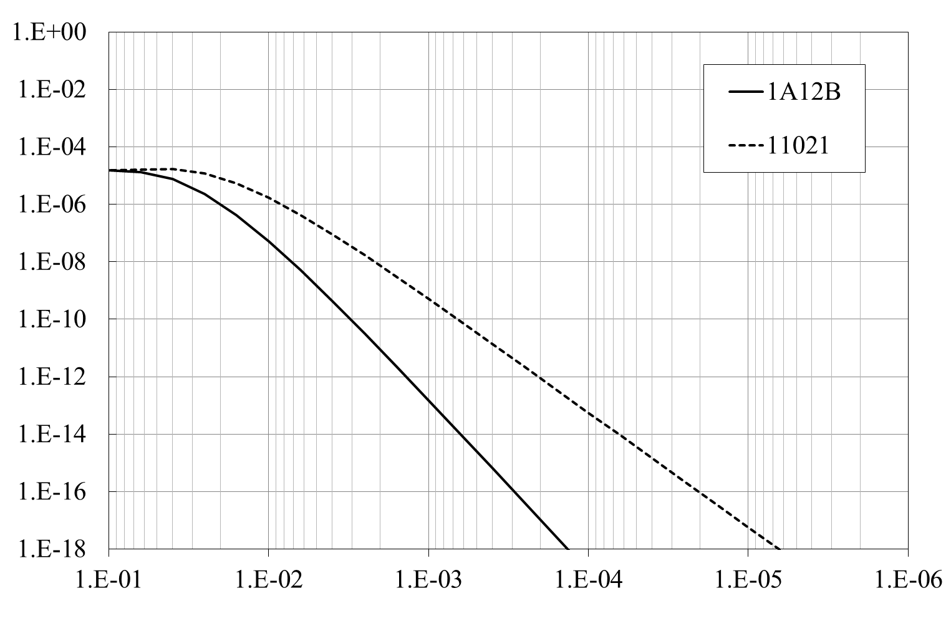
16-bit Header CRC* for HCS
generator polynomial: 1A12B (TG3e, d_{min}^{*2} = 6), 11021 (ITU-T, d_{min}^{*2} = 4)
Undetected Error Probability
1-error event/10 years
for 1 G packets/day
Bit-error Rate, bER
*1 CRC: cyclic-redundancy-check code
*2 d_{min}: minimum Hamming distance
code-word length = 128 bits

Slide 15
Proposed preamble structure
first transmitted
transmission order
last transmitted
Frame format
Preamble
Header
Payload
128*26 = 3328 chips: 1.89 µs
SYNC
14 GCSs
SFD
1 GCS
CES
11 GCSs
TG3e
a
a
a
–a
b
a
b
a
–b
a
b
–a
b
a
b
128*27 = 3456 chips: 1.96 µs
SYNC
14 GCSs
SFD
4 GCSs
CES
9 GCSs
reference:
IEEE 802.15.3c SC, HR
a
a
a
–a
–a
a
a
b
a
–b
a
b
a
–b
a
b
GCS: Golay complementary sequence, a or b, here 128-bit length
SYNC: synchronization sequence
SFD: start frame delimiter
CES: channel-estimation sequence

Slide 16
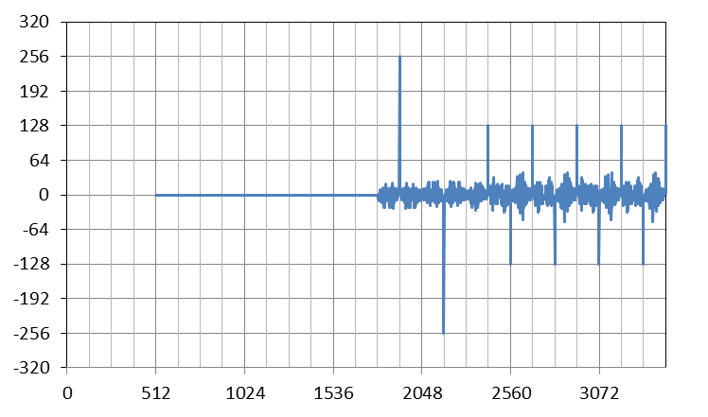
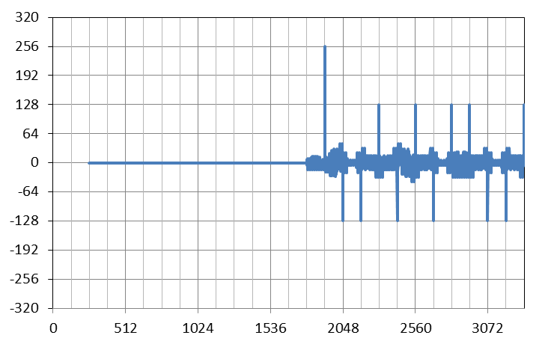
Cross-correlation Properties
r: a noiseless received sequences
R: a reference sequence
SYNC
SFD
CES
SYNC
SFD
CES
+256
+256
Cross Correlation of
r and R
+22
–36 %
Cross Correlation of
r and R
+14
–26
–38 %
–16
Time Slot
Time Slot
R = [a₁₂₈ –a₁₂₈]
R = [a₁₂₈ –a₁₂₈]
(a) 15.3c
(b) TG3e
The last 3 GCS of SFD in 15.3c are used for detection of the header rate, either medium rate (MR) or high rate (HR).

Slide 17
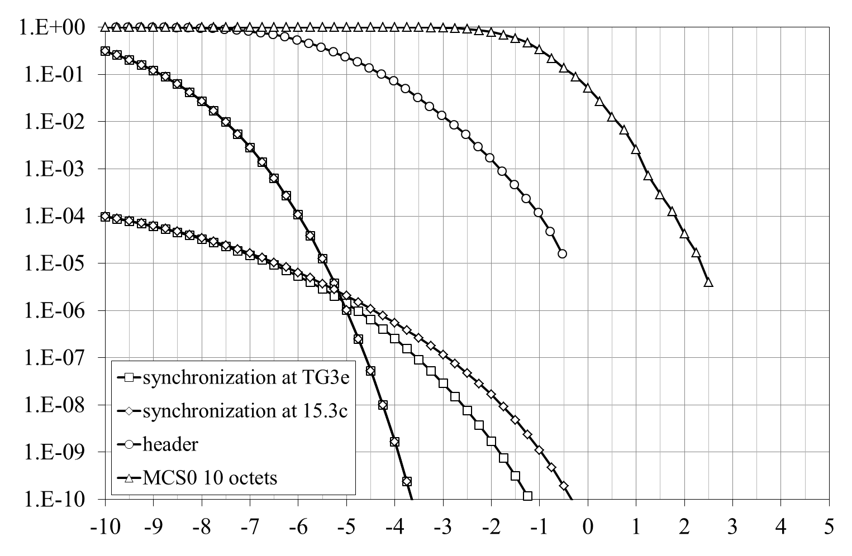
Performance of Frame synchronization
Missed detection^{*1}
Frame-error Rate, FER
False alarm^{*2}
(extrapolated)
(extrapolated)
0.9 dB gain for 15.3c
Estimated > 3 dB margin for header
Carrier to Noise Ratio, CNR (dB)
*1: the probability of a correlation between a received sequence and a reference sequence being below a threshold at the correct timing position.
*2: the probability of a correlation between a received sequence and a reference sequence being above a threshold at the incorrect timing position.
The threshold of sync. detection: 80
CNR dependence of FER due to synchronization or header or payload

Slide 18
Extended Hamming encoder
Table for encoding
i0 | i1 | i2 | i3 | p0 | p1 | p2 | p3
0 | 0 | 0 | 0 | 0 | 0 | 0 | 0
0 | 0 | 0 | 1 | 1 | 1 | 1 | 0
0 | 0 | 1 | 0 | 1 | 0 | 1 | 1
0 | 0 | 1 | 1 | 0 | 1 | 0 | 1
0 | 1 | 0 | 0 | 0 | 1 | 1 | 1
0 | 1 | 0 | 1 | 1 | 0 | 0 | 1
0 | 1 | 1 | 0 | 1 | 1 | 0 | 0
0 | 1 | 1 | 1 | 0 | 0 | 1 | 0
1 | 0 | 0 | 0 | 1 | 1 | 0 | 1
1 | 0 | 0 | 1 | 0 | 0 | 1 | 1
1 | 0 | 1 | 0 | 0 | 1 | 1 | 0
1 | 0 | 1 | 1 | 1 | 0 | 0 | 0
1 | 1 | 0 | 0 | 1 | 0 | 1 | 0
1 | 1 | 0 | 1 | 0 | 1 | 0 | 0
1 | 1 | 1 | 0 | 0 | 0 | 0 | 1
1 | 1 | 1 | 1 | 1 | 1 | 1 | 1
The frame header shall be encoded with the (8,4) extended hamming code.
For every input 4-bit sequence, denoted as {i0, i1, i2, i3}, the encoder shall outputs the sequence followed by a 4-bit-parity sequence {p0, p1, p2, p3} determined by the table.
input data
output data
input 4-bit seq.
4-bit parity seq.

Slide 19
Performance of Header Coding
Proposed Header MCS is more robust than the lowest MCS for payload

Slide 20
A Simple LDPC encoder
A systematic (n, k) quasi-cyclic code, such that every cyclic shift of a codeword by p symbols yields another codeword, can be encoded by using p generator polynomials and an (v = n–k+p–1)-stage shift register*.
information bits
information bits
(for x⁰)
(for x¹)
…
(for x^{v– 1})
parity bits
+
D
+
D
+
D
0
…
(Zero is selected after k information bits are received)
Select a generator polynomial g_{(n– i–1)modp}*x^{p–1–{(n–i–1)modp}} at time i, where i = 0 is defined as the time that the first v information bits are stored in the v-stage shift registers; v = 96+15–1 = 110 for a rate-14/15 LDPC code and v = 96*4+15–1 = 398 for a rate-11/15 LDPC code.
* H. Yamagishi and M. Noda, Proc. IEEE, pp.78-83, Sep. 2008

Slide 21
Proposed Overlaid-rate-compatible (ORC) LDPC Codes
A check matrix of a high-rate code composed of overlay of sub-matrices in a check matrix of a low-rate code. This structure enables to share a belief-propagation decoder for the high-rate and low-rate LDPC codes.
1 0 0 0 0 0 0
0 1 0 0 0 0 0
0 0 1 0 0 0 0
0 0 0 1 0 0 0
0 0 0 0 1 0 0
0 0 0 0 0 1 0
0 0 0 0 0 0 1
0 0 0 0 1 0 0
0 0 0 0 0 1 0
0 0 0 0 0 0 1
1 0 0 0 0 0 0
0 1 0 0 0 0 0
0 0 1 0 0 0 0
0 0 0 1 0 0 0
0 0 0 0 0 0 1
1 0 0 0 0 0 0
0 1 0 0 0 0 0
0 0 1 0 0 0 0
0 0 0 1 0 0 0
0 0 0 0 1 0 0
0 0 0 0 0 1 0
0 0 0 0 0 1 0
0 0 0 0 0 0 1
1 0 0 0 0 0 0
0 1 0 0 0 0 0
0 0 1 0 0 0 0
0 0 0 1 0 0 0
0 0 0 0 1 0 0
0 0 0 0 0 0 1
1 0 0 0 0 0 0
0 1 0 0 0 0 0
0 0 1 0 0 0 0
0 0 0 1 0 0 0
0 0 0 0 1 0 0
0 0 0 0 0 1 0
1 0 0 0 0 0 0
0 1 0 0 0 0 0
0 0 1 0 0 0 0
0 0 0 1 0 0 0
0 0 0 0 1 0 0
0 0 0 0 0 1 0
0 0 0 0 0 0 1
0 0 0 0 1 0 0
0 0 0 0 0 1 0
0 0 0 0 0 0 1
1 0 0 0 0 0 0
0 1 0 0 0 0 0
0 0 1 0 0 0 0
0 0 0 1 0 0 0
0 1 0 0 0 0 0
0 0 1 0 0 0 0
0 0 0 1 0 0 0
0 0 0 0 1 0 0
0 0 0 0 0 1 0
0 0 0 0 0 0 1
1 0 0 0 0 0 0
A low-rate parity-check matrix, as a simplified example of an 11/15 LDPC code
1 0 0 0 0 0 1
1 1 0 0 0 0 0
0 1 1 0 0 0 0
0 0 1 1 0 0 0
0 0 0 1 1 0 0
0 0 0 0 1 1 0
0 0 0 0 0 1 1
1 0 0 0 1 0 0
0 1 0 0 0 1 0
0 0 1 0 0 0 1
1 0 0 1 0 0 0
0 1 0 0 1 0 0
0 0 1 0 0 1 0
0 0 0 1 0 0 1
0 0 0 0 1 0 1
1 0 0 0 0 1 0
0 1 0 0 0 0 1
1 0 1 0 0 0 0
0 1 0 1 0 0 0
0 0 1 0 1 0 0
0 0 0 1 0 1 0
0 1 0 0 0 1 0
0 0 1 0 0 0 1
1 0 0 1 0 0 0
0 1 0 0 1 0 0
0 0 1 0 0 1 0
0 0 0 1 0 0 1
1 0 0 0 1 0 0
A high-rate parity-check matrix, as a simplified example of a 14/15 LDPC code

Slide 22
Simple receiver: advantage of short coded header
received signal
Preamble
MCS
Length etc.
Payload
L
L: demod delay
(a) conventional
L
(b) improved
Timing diagram of header/payload mod
This block can be removed.
received signal
MUX
Demod
Sync &
Header
Dec
Payload
Dec
received data
D^{L}
header/payload timing
D: delay operator
header/payload mod
A block diagram of a receiver

