Slide 1
Project: IEEE P802.15 Working Group for Wireless Personal Area Networks (WPANs)
Submission Title: [Proposal for IEEE802.15.3e – MAC:Superframe and Association]
Date Submitted: [10 September, 2015]
Source: [Kiyoshi Toshimitsu⁽¹⁾(representative contributors), Ken Hiraga, Jae Seung Lee, Itaru Maekawa, Makoto Noda, all contributors are listed in “Contributors” slide]
Company [Toshiba¹, ETRI, JRC, NTT, Sony]
Address [1-1 Shibaura 1-chome, Minato-ku, Tokyo, Japan]
E-Mail:[kiyoshi.toshimitsu@toshiba.co.jp]
Abstract: [This document presents HRCP superframe and Association/Disassociatoin.]
Purpose: [To propose a full set of specifications for TG 3e]
Notice: This document has been prepared to assist the IEEE P802.15. It is offered as a basis for discussion and is not binding on the contributing individual(s) or organization(s). The material in this document is subject to change in form and content after further study. The contributor(s) reserve(s) the right to add, amend or withdraw material contained herein.
Release: The contributor acknowledges and accepts that this contribution becomes the property of IEEE and may be made publicly available by P802.15.
Kiyoshi Toshimitsu(Toshiba)

Slide 2
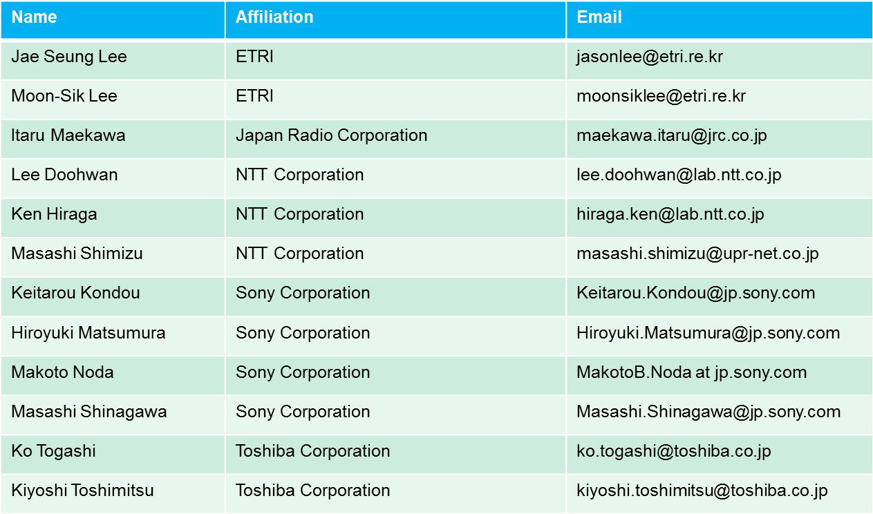
Contributors
Kiyoshi Toshimitsu(Toshiba)

Slide 3
Agenda (Updated items in red)
New HRCP Superframe structure
  Defined PPAP(P2P access period) for Association Phase
Shortened beacon interval
  No change from Waikoloa
Proposed setup procedure without exchange of DEVID
  No change from Waikoloa
Proposed DEVID exchange sequence
  No change from Waikoloa
Next DEVID field in beacon
  Changed the DEVID assignment method
Proposed Association/Disassociation procedures
  Changed the association/disassociation frame exchange
Kiyoshi Toshimitsu(Toshiba)

Slide 4
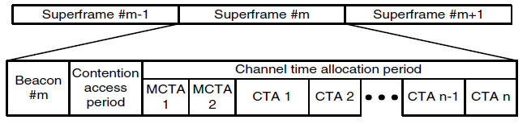

1. HRCP Superframe structure
Current
802.15.3
Superframe
Association Request Command
HRCP Superframe
during Unassociated
phase
Access Slot
Superframe duration < 1ms
If Recovery is needed
SIFS
SIFS
HRCP Superframe
during Associated
phase
RIFS
…
Frame #1
Frame #3
Frame#2
Superframe duration equals to infinity
Kiyoshi Toshimitsu(Toshiba)

Slide 5
One cycle of PPAP
Unassociated
Associated
Unassociated
Asynchronous Phase
Synchronous Phase
Asynchronous Phase (If recovery is needed)
Asynchronous Phase
Setup Time < 2ms
Change the Beacon Interval to “infinity”.
Beacon
Stop beacon after association
PPC may send Beacon
with new Next DEVID
Data Transfer Phase
Association
Response
Disassociation
Request
PPC
Beacon
Access Slot
Beacon
Beacon
Device
Association
Request
SIFS
or
RIFS
SIFS
SIFS
or
RIFS
Stk-Ack
Kiyoshi Toshimitsu(Toshiba)

Slide 6
5. Next DEVID field in the Beacon（1/2)
PPC creates a “Next DEVID” (1 Octet) field within the beacon frame. This Next DEVID value indicates the DEVID which will be assigned to the next associating device.
The value of Next DEVID is generated randomly, but after sending a new beacon, the PPC shall not change the value during this session.
A device that wishes to associate with the PPC shall assign its own DEVID value as the received “Next DEVID”.
The PPC shall change the beacon interval value to infinity inside the last beacon sent just prior to sending Association Response command.
After association, the beacon (carrying the “Next DEVID” field) is turned off.
If the PPC does not receive frames from the associated device for the Association Timeout Period(ATP), the session is terminated by the PPC.
  ATP is a variable value and negotiated between the PPC and the associated DEV.
Kiyoshi Toshimitsu(Toshiba)

Slide 7
Next DEVID field in the Beacon（2/2)
When the PPC creates a new session, the “Next DEVID” within the new beacon shall be generated randomly for this next session. This value is different from the previous DEVID.
In case the previous device tries to come back and reconnect to the PPC, the PPC will refuse and reconnection will be blocked since the DEVID of the old device is no longer the current Next DEVID.
  The old device shall reassign the current Next DEVID to reconnect the PPC
Kiyoshi Toshimitsu(Toshiba)

Slide 8
Blocking a reconnection
New Session
Beacon
[Next DevID=N]
New Beacon
[Next DevID= M ( different from N) ]
Session
Closed
PPC
PPC
Associated
Reconnection
refused
Associated
DevID=[]
DevID=N
DevID=M
[ ]
N
N
M
Device
disappeared
Device
N
Kiyoshi Toshimitsu(Toshiba)

Slide 9
6. Proposed Association procedures
Unassociated
Associated
Asynchronous Phase
Synchronous Phase
Asynchronous Phase (If recovery is needed)
Setup Time < 2ms
Change the Beacon Interval to “infinity”.
Beacon
Stop beacon after association
Data Transfer Phase
Association
Response
PPC
Beacon
Access Slot
Beacon
Beacon
Device
Association
Request
SIFS
or
RIFS
SIFS
Stk-Ack
Kiyoshi Toshimitsu(Toshiba)

Slide 10
Proposed Disassociation procedures
Synchronous Phase
Stk-Ack
PPC
Frame #m+1
SIFS
Device
Frame #m
SIFS
SIFS
Disassociation
Request
Disassociation Timeout Timer
(did not receive Stk-Ack)
Asynchronous Phase
Stk-Ack
PPC
SIFS
Device
Frame #m
RIFS
Disassociation
Request
Disassociation Timeout Timer
(did not receive Stk-Ack)
Kiyoshi Toshimitsu(Toshiba)

