Slide 1
Project: IEEE P802.15 Working Group for Wireless Personal Area Networks (WPANs)
Submission Title: [Proposal for IEEE802.15.3e – OOK PHY]
Date Submitted: [10 September 2015]
Source: [Jae Seung Lee, Ken Hiraga, Itaru Maekawa, Makoto Noda, Ko Togashi⁽¹⁾, (representative contributors), all contributors are listed in “Contributors” slide]
Company: [ETRI¹, JRC, NTT, Sony, Toshiba]
Address¹: [218 Gajeong-ro, Yuseong-gu, Daejeon, 305-700, Korea]
E-Mail¹: [jasonlee@etri.re.kr (all contributors are listed in “Contributors” slide)]
Abstract: This document presents OOK PHY part of the full MAC/PHY proposal for HRCP.
Purpose: To propose a full set of specifications for TG3e.
Notice: This document has been prepared to assist the IEEE P802.15. It is offered as a basis for discussion and is not binding on the contributing individual(s) or organization(s). The material in this document is subject to change in form and content after further study. The contributor(s) reserve(s) the right to add, amend or withdraw material contained herein.
Release: The contributors acknowledge and accept that this contribution becomes the property of IEEE and may be made publicly available by P802.15.

Slide 2
Contributors
Name | Affiliation | Email
Jae Seung Lee | ETRI | jasonlee@etri.re.kr
Moon-Sik Lee | ETRI | moonsiklee@etri.re.kr
Itaru Maekawa | Japan Radio Corporation | maekawa.itaru@jrc.co.jp
Lee Doohwan | NTT Corporation | lee.doohwan@lab.ntt.co.jp
Ken Hiraga | NTT Corporation | hiraga.ken@lab.ntt.co.jp
Masashi Shimizu | NTT Corporation | masashi.shimizu@upr-net.co.jp
Keitarou Kondou | Sony Corporation | Keitarou.Kondou@jp.sony.com
Hiroyuki Matsumura | Sony Corporation | Hiroyuki.Matsumura@jp.sony.com
Makoto Noda | Sony Corporation | MakotoB.Noda at jp.sony.com
Masashi Shinagawa | Sony Corporation | Masashi.Shinagawa@jp.sony.com
Ko Togashi | Toshiba Corporation | ko.togashi@toshiba.co.jp
Kiyoshi Toshimitsu | Toshiba Corporation | kiyoshi.toshimitsu@toshiba.co.jp

Slide 3
Proposal for IEEE802.15.3e
High-Rate Close Proximity System
(Presentation on OOK PHY Part)
September 10, 2015

Slide 4
Overview
OOK PHY part of the Full MAC/PHY Proposal for HRCP
  HRCP PHY for cost effective devices (low power, low complexity)
HRCP-OOK PHY
  OOK has been already adopted in 15.3c for low complexity and low power consumption
    Low complexity: OOK is the simplest modulation scheme – suitable for low-end devices
    Low power: Transmit power can be saved since NO carrier when the device wants to send a ‘0’
  The basic design of 15.3c OOK PHY is inherited and simplified
  Additional support of channel bonding for higher throughput

Slide 5
HRCP-OOK PHY Features (1/2)
Low complexity, simple design
  Single modulation scheme: OOK
  Single FEC is used: RS (240, 224)
Channel Bonding for High throughput
  Up to 4 Channels
  4 channel bonding is necessary to achieve high throughput
  Channel bonding is easier than channel aggregation for OOK
    No ADC/DAC issues in OOK
MIMO is not used
  We proposed a simple 2X2 MIMO scheme using polarization separation in July meeting, but it has been removed
  For low complexity and simple design

Slide 6
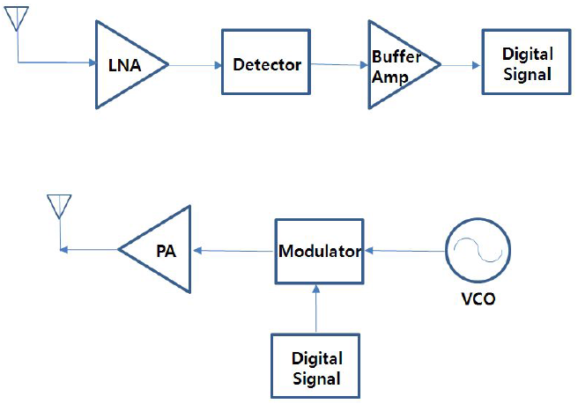
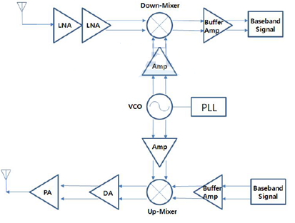
HRCP-OOK PHY Features (2/2)
OOK enables simplest Radio Architecture
  OOK device: Much simpler than FSK/PSK devices
OOK vs. FSK/PSK

Slide 7
Channel Bonding (1/2)
Ch2 is the default channel (specified in TGD)
  Ch2 and Ch3 are used for 2 channel bonding (specified in TGD): Japan, Europe, US/Canada, South Korea, China
    Ch2 should be always included in the bonded channel (default channel)
    Only channel 2 is used for single channel transmission
    Since the range of Close Proximity Peer Network is very limited, the channel can be assumed to be always available
  Ch1, Ch2, and Ch3 are used for 3 channel bonding (Japan, Europe, US/Canada, Korea)
  4 channel bonding: Japan, Europe, and South Korea
Channel 1
Channel 2
Channel 3
Channel 4
Japan (57.00
-
66.00 GHz)
Europe (57.00
-
66.00 GHz)
U.S. and Canada (57.05
-
64.00 GHz)
South Korea (57.00
-
66.00 GHz)
China (59.00
-
64.00 GHz)
Australia
(59.40
-
62.90 GHz)
57.00
57.24
58.32
59.40
60.48
61.56
62.64
63.72
64.80
65.88
66.00
Frequency
[GHz]

Slide 8
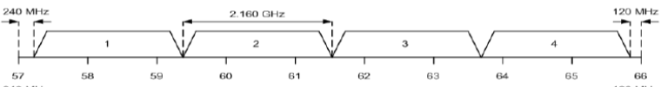
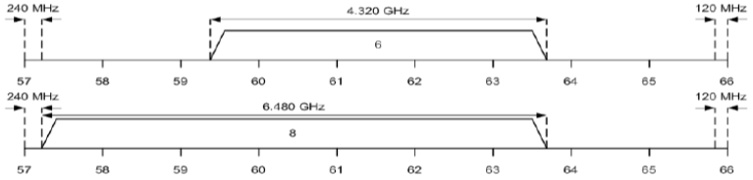
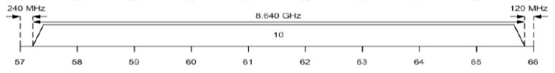
Channel Bonding (2/2)
HRCP PHY Channel numbering
CHNL_INDEX | Start frequency | Center frequency | Stop frequency | Remarks
1 | 59.400 GHz | 60.480 GHz | 61.560 GHz | No channel bonding (Use only Channel 2 - the default channel)
2 | 59.400 GHz | 61.560 GHz | 63.720 GHz | Two channel bonding (Channel 2 and Channel 3)
3 | 57.240 GHz | 60.480 GHz | 63.720 GHz | Three channel bonding (Channel 1, 2 and 3)
4 | 57.240 GHz | 61.560 GHz | 65.880 GHz | Four channel bonding (Channel 1,2,3 and 4)

Slide 9
HRCP-OOK PHY frame format (1/3)
  PHY frame format is similar to 15.3c OOK PHY
  Preamble Structure (single format)

Slide 10
HRCP-OOK PHY frame format (2/3)
  Preambles shall be modulated in OOK waveform
  Each field consists of 128 bit Golay sequence a₁₂₈ & b₁₂₈
  SNYC field consists of 16 code repetitions of Golay sequence a₁₂₈
    The SYNC field is used primarily for frame detection
  SFD consists of 4 code repetitions of Golay sequence a₁₂₈
    1 for delimiter and CES selection
    3 for indicating OOK MCS related parameters including number of bonded channels and the spreading factor
Sequence name | Sequence value
a₁₂₈ | 0x0536635005C963AFFAC99CAF05C963AF
b₁₂₈ | 0x0A396C5F0AC66CA0F5C693A00AC66CA0

Slide 11
HRCP-OOK PHY frame format (3/3)
  The usage of the four SFD codes:
    SFD 1 is the delimiter. The values are:
    . - a₁₂₈ : delimiter indication & indicates that CES shall not be adopted
    . - b₁₂₈: delimiter indication & indicate that CES shall be adopted
    SFD 2, 3, 4 indicate OOK MCS related parameters (number of bonded channel & Spreading Factor indication)
SFD pattern (SFD2, SFD3, SFD4) | Meaning
+a₁₂₈+a₁₂₈+a₁₂₈ | No channel bonding, SF=1
+a₁₂₈+a₁₂₈-a₁₂₈ | Two channel bonding, SF=2
+a₁₂₈-a₁₂₈+a₁₂₈ | Two channel bonding, SF=1
+a₁₂₈-a₁₂₈-a₁₂₈ | Three channel bonding, SF=2
-a₁₂₈+a₁₂₈+a₁₂₈ | Three channel bonding, SF=1
-a₁₂₈+a₁₂₈-a₁₂₈ | Four channel bonding, SF=2
-a₁₂₈-a₁₂₈+a₁₂₈ | Four channel bonding, SF=1
-a₁₂₈-a₁₂₈-a₁₂₈ ~ -b₁₂₈-b₁₂₈-b₁₂₈ | Reserved

Slide 12
Preamble Repetition
  If channel bonding is used, each subfield of the preamble is repeated n times for higher robustness
    CES sequence (8 code repetition) is repeated n times (n: number of bonded channel): 128 bit Golay sequence * n times
    SFD (4 code repetition), SYNC (16 code repetition) are also repeated n times
    Duration of preamble, SYNC, SFD, and CES (T_{pre}, T_{SYNC} , T_{SFD,} T_{CES}) remains unchanged when the channel bonding is used

Slide 13
HR-OOK PHY Header format
  MCS is omitted since it is signaled using SFD
  32 bit length
Scrambler Seed ID: contains the scrambler seed identifier value
Aggregation: set to 1 if aggregation is used
The Frame Length: an unsigned integer equal to the number of octets in the MAC frame body including frame payload(s), MAC subheader(s) in the aggregated frames, and FCS(s), but not including the frame header and the preamble
bits:4 | 23 | 1 | 4
Reserved | Frame Length | Aggregation | Scrambler Seed ID

Slide 14
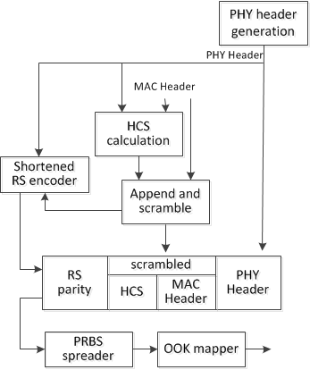
Frame Header construction (1/2)

Slide 15
Frame Header construction (2/2)
Construct the PHY header based on information provided by the MAC
Compute the 16 bit HCS over the combined PHY and MAC headers
  using ITU-T CRC-16
Scramble the combined MAC header and HCS
Compute the 128 bit RS parity bits
  RS(n+16, n) (n is the number of octets in the frame header) is used
Form the frame header by concatenating the PHY header, scrambled MAC header, scrambled HCS, and RS parity bits.
Spread the frame header with a PRBS generated using an LFSR
  Spreading Factor: 16 (For high robustness)
Map the frame header onto OOK waveform
The block length of the frame header: 512 chips
Pilot symbols are not used in the frame header
Total Frame Header length: 32 octet
  32 bit PHY header + 80 bit MAC header + 16bit HCS + 128 bit parity
  always aligned with block boundary (No stuff bit is necessary)

Slide 16
HRCP-OOK PHY Payload field
Scramble the MAC frame body
Encode the scrambled MAC frame body using RS(240,224)
Stuff bits are added to the end of the encoded MAC frame body
  Add stuff bits to the end of the encoded MAC frame body until the number of the encoded data bits including the added stuff bits reaches an integer multiple of 508
If SF= 2, spread the encoded and scrambled MAC frame body using bit repetition: each bit is repeated twice
Map the resulting MAC frame body onto OOK waveform
Build blocks from the resulting MAC frame body

Slide 17

Blocks and Pilot Symbol
  Similar with 15.3c OOK PHY
  Transmit symbols is divided into block of length N = 508 × SF (Spreading Factor)
    appended with pilot symbol
  Pilot symbols: for timing tracking, compensation for clock drift, compensation for frequency offset error, and frequency domain equalization
  Pilot symbols consist of a sequence of length Np = 4 × SF
Spreading Factor | Pilot symbols
1 | 1010
2 | 11001100

Slide 18
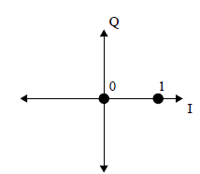
Modulation
  HRCP-OOK frames are modulated using OOK
  binary '1' with the presence of the signal, and a binary '0' with the absence of it
  K_{MOD}: SQRT (2)

Slide 19


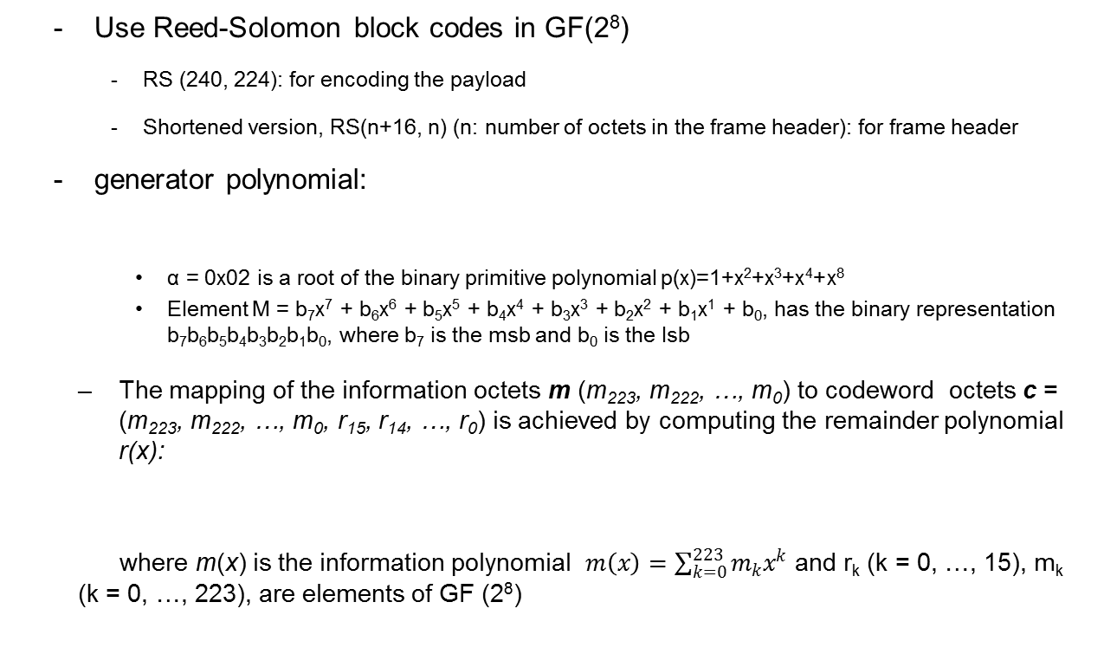
Forward Error Correction (1/2)
  Use Reed-Solomon block codes in GF(2⁸)
    RS (240, 224): for encoding the payload
    Shortened version, RS(n+16, n) (n: number of octets in the frame header): for frame header
  generator polynomial:
    α = 0x02 is a root of the binary primitive polynomial p(x)=1+x²+x³+x⁴+x⁸
    Element M = b₇x⁷ + b₆x⁶ + b₅x⁵ + b₄x⁴ + b₃x³ + b₂x² + b₁x¹ + b₀, has the binary representation b₇b₆b₅b₄b₃b₂b₁b₀, where b₇ is the msb and b₀ is the lsb
  The mapping of the information octets m (m₂₂₃, m₂₂₂, …, m₀) to codeword octets c = (m₂₂₃, m₂₂₂, …, m₀, r₁₅, r₁₄, …, r₀) is achieved by computing the remainder polynomial r(x):
  where m(x) is the information polynomial $m\left(x\right)=\sum_{k=0}^{223}{m_{k}x^{k}}$ and r_{k} (k = 0, …, 15), m_{k} (k = 0, …, 223), are elements of GF (2⁸)

Slide 20
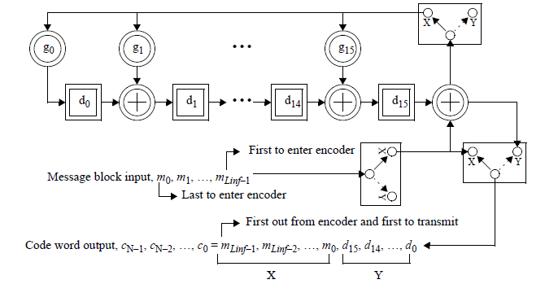
Forward Error Correction (2/2)
For a shortened RS(L_{inf} + 16, L_{inf}), 224- L_{inf} zero elements are appended to the incoming L_{inf} octet message as follows: m_{k} = 0, k = L_{inf}, …, 223
These inserted zero elements are not transmitted
(Source: 802.15.3c spec)

Slide 21
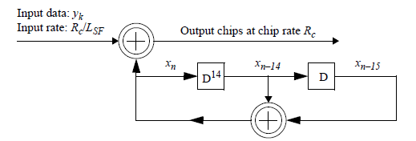
Code Spreading
To increase robustness in frame header and MAC frame body, code spreading is used
PRBS codes by LFSR is applied for code spreading for HRCP-OOK frame header
  Spreading Factor: 16
  The 15 bit seed value of the LFSR shall be:
  [x_{–1}, x_{–2}, …, x_{–15}] = [0101 0000 0011 111]
Simple bit repetition in which each bit is repeated twice, is applied for code spreading for HRCP-OOK payloads
.

Slide 22
Scrambling
Use the same scrambling scheme in 15.3c spec
  The frames are scrambled by modulo-2 addition of the data with the output of a PRBS generator
  Used for the MAC header, HCS, and MAC frame body
    PHY preamble, PHY header, and RS bits are not scrambled
The polynomial for the PRBS generator used by the scrambler
  g(D) = 1 + D¹⁴ + D¹⁵ where D is a single bit delay element
Corresponding PRBS, is generated: x_{n} = x_{n – 14} ⊕ x_{n – 15}, n = 0, 1, 2, ...
Init sequence: x_{init} = [ x_{–1}x_{–2}x_{–3}x_{–4}x_{–5}x_{–6}x_{–7}x_{–8}x_{–9}x_{–10}x_{–11}x_{–12}x_{–13}x_{–14}x _{–15} ]
Scrambled data bits: s_{n} = b_{n} ⊕ x_{n} (b_{n}: unscrambled data bits)
The 15 bit seed value: computed from the Scrambler Seed ID field by the following equation:
  [x_{–1}x_{–2}…x_{–15}] = [11010000101 S1 S2 S3 S4]
For a Scrambler Seed ID field set to all zero, the first 16 bits should be:
  [x₀x₁…x₁₅] = [0001111000111010]

Slide 23
HR-OOK PHY MCS
Mode | MCS identifier | Data rate (Mb/s) | Modulation | Spreading factor, L_{SF} | FEC type
Mode 1 (No channel bonding) | 1 | 1630 | OOK | 1 | RS (240,224)
Mode 2 (2 channel bonding) | 0 | 1630 |  | 2
 | 1 | 3260 |  | 1
Mode 3 (3 channel bonding) | 0 | 2445 |  | 2
 | 1 | 4890 |  | 1
Mode 4 (4 channel bonding) | 0 | 3260 |  | 2
 | 1 | 6519 |  | 1
L_{SF}=1 : Block length L_{block} =512 chips, Pilot symbol length L_{P} = 4 bits
L_{SF}=2: L_{block} =1024 chips, Pilot symbol length L_{P} = 8 bits

Slide 24
Header Rates
Channel Bonding | Header rate (Mb/s) | Modulation | Spreading factor, L_{SF} | Pilot symbol length, L_{P} | Coded bits per block, L_{CBPB} | Number of occupied blocks, L_{block_hdr} | Number of stuff bits, L_{STUFF}
No channel bonding | 55 | OOK | 16 | 0 | 32 | 8 | 0
2 channel bonding | 110
3 channel bonding | 165
4 channel bonding | 220
RS (32, 16) is used in the calculation
The MAC Subheaders in each aggregated subframes uses the same MCS for the MAC frame body

Slide 25
Timing related Parameters
Parameter | Description | Value |  |  |  | Unit | Formula
R_{c} | Chip rate | 1760 (1 channel) | 3520 (2 channel) | 5280 (3 channel) | 7040 (4 channel) | Mchip/s
T_{c} | Chip duration | 0.568 | 0.284 | 0.189 | 0.142 | ns | 1/ R_{c}
L_{block} | Block length | 512 (Frame header or Payload with SF=1) |  | 1024 (Payload with SF=2) |  | chips
L_{P} | Pilot symbol length | 4 |  | 8 |  | chips
T_{P} | Pilot symbol duration | 2.273, 1.136, 0.758, 0.568 |  | 2.273, 1.515, 1.136 |  | ns
L_{DC} | Length of data chips per subblock | 508 |  |  |  | chips
T_{block} | Block duration | 290.9 | 145.5 | 97.0 | 72.7 | ns | L_{block X} T_{c}

Slide 26
Frame related Parameters
Parameter | Description | Value
N_{SYNC} | Number of code repetitions in the SYNC sequence | 16
T_{SYNC} | Duration of the SYNC sequence | 1.16 us
N_{SFD} | Number of code repetitions in the SFD | 4
T_{SFD} | Duration of the SFD | 0.29 us
N_{CES} | Number of code repetitions in the CES | 8
T_{CES} | Duration of the CES | 0.58 us
N_{pre} | Number of code repetitions in the PHY preamble | 28
T_{pre} | Duration of the PHY preamble | 2.036 us
L_{hdr} | Length of the base headers in octets | 32
N_{block_hdr} | Number of blocks in the base frame header | 8
T_{hdr} | Duration of the base frame header | N_{block_hdr} X T_{block}
L_{payload} | Length of frame payloads in octets | variable
L_{FCS} | Length of FCS in octets | 4
L_{MFB} | Length of the MAC frame body in octets | L_{payload} + L_{FCS}
L_{CBPS} | Number of coded bits per block in the MAC frame body | 508
N_{block_MFB} | Number of blocks for the MAC frame body | CEIL[(L_{MFB} X 8)/(R_{FEC} X L_{CBPS})] (R_{FEC} : FEC rate)
T_{MFB} | Duration of the MAC frame body including Pilot symbols | N_{block_MFB} X T_{block}
T_{datafield} | Duration of the PHY Payload field | N_{block_MFB} X T_{block}
T_{frame} | Duration of the frame | T_{pre} + T_{hdr} + T_{datafield}

Slide 27
PHY Layer Timing, IFS Parameters
PHY parameter | Value | Subcluase
pPHYSIFSTime | 0.2 us, 2.0 us, 2.5 us (default) | 12a.3.6.3
pCCADetectTime | 4 us | 12a.3.4.4
MAC parameter | Corresponding PHY parameter | Definition
SIFS | pPHYSIFSTime | 12a.3.6.3
pBackoffslot | pPHYSIFSTime + pCCADetectTime | 12a.3.6.3, 12a.3.6.4
BIFS | pPHYSIFSTime + pCCADetectTime | 12a.3.6.3, 12a.3.6.4
IIFS | pPHYSIFSTime | 12a.3.6.3, 12a.3.6.4
RIFS | 2 X pPHYSIFSTime + pCCADetectTime | 12a.3.6.3, 12a.3.6.4

Slide 28
Simulation and Performance Evaluation
Modulation scheme: OOK with RS(240,224)
AWGN and SISO channels are tested.
  Channel Parameters: Initial decay (2.85 dB), Decay factor(0.167ns),
  Rice factor(8.09 dB), One cluster(Max delay 1ns)
Signal Bandwidth: 1.76 GHz~4*1.76 GHz
Assumptions
  Perfect synchronization
  No FDE, Carrier frequency offset (0 ppm)
  TX & RX Phase Noise for 60GHz
  PA nonlinearity: (AM-AM with p = 2)
    Output backoff from full saturation
  TX/RX ANT gain are introduced
Payload length = 16 Kbytes(=2¹⁴ bytes)
FER @ 8% are adopted as target for required Eb/No

Slide 29
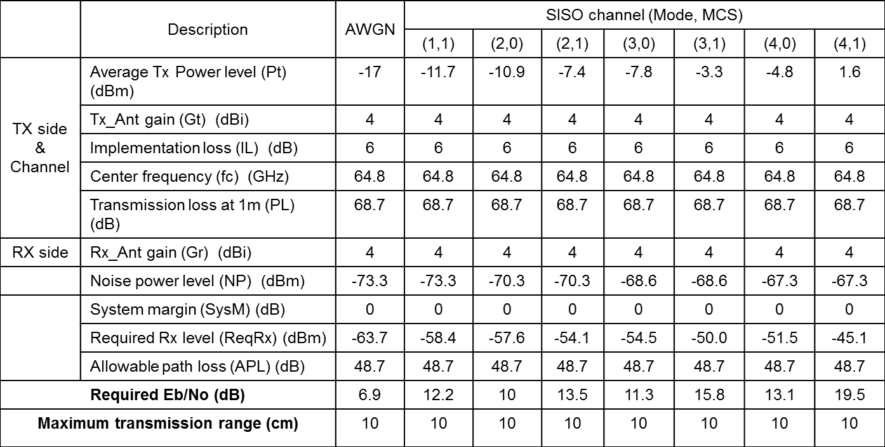
Link Budget Margin (OOK)
OBO(Output Back Off) from full saturation: 0 dB

Slide 30
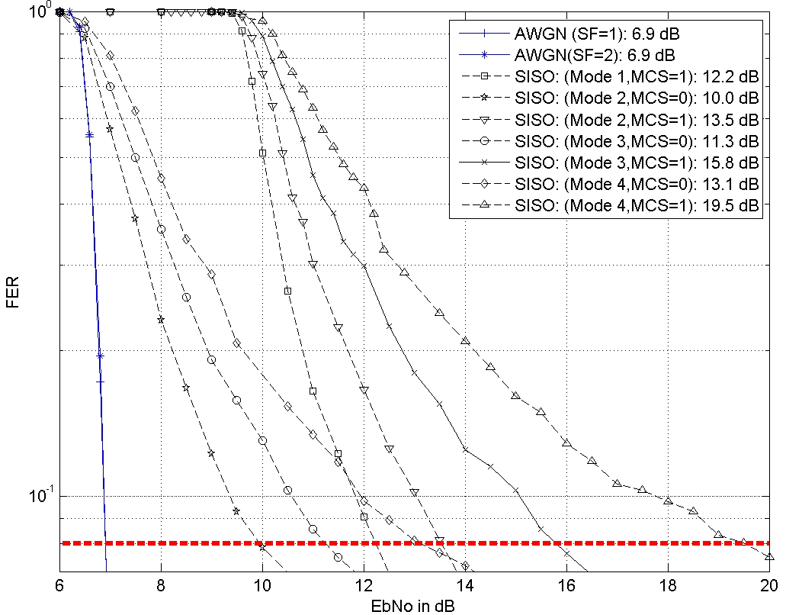
Performance (FER vs. Eb/No) in Channel

Slide 31
Technical Requirements
2.2 Performance Requirements
2.2.1 Operation frequency band
The system shall use the 60 GHz unlicensed band. The channel plan is based on that of IEEE802.15.3c. Ch2 is the default channel. Ch2 and Ch3 in this band are designated as unlicensed bands in many countries. Hence the system should support the use of these two channels. Channel bonding or aggregation may be used.
→ Satisfied by PHY Proposal. PHY proposal uses 60 GHz band, and includes channel bonding schemes. See slide 7~8

Slide 32
Technical Requirements
2.2 Performance Requirements
2.2.5 Link budget
The proposal should include evidence that the system meets the requirement in Section 2.2.2 (Transmission range)
See Link Budget Margin table in Slide 29

Slide 33
Regulatory Requirements
3. Regulatory requirements
The output RF power levels and other regulations for each country which allow the use of the unlicensed 60 GHz band shall be followed
→ RF power levels used in slide 29 are much lower than regulations for each country. RF power levels and regulation related parameters can be adjusted to meet the requirement by the application or manufacturers.

Slide 34
Evaluation Criteria - PHY
1. Communication distance: Must demonstrate link budget values at a distance of 10 cm based on simulation.
See Link Budget Margin table in the Proposal
2. Frequency: Shall operate within the 60GHz unlicensed band
Satisfied by the Proposal.
3. Interference: Shall be able to operate in dense environments without mutual interference among 3e devices
→ Due to the limited range of 3e devices, 3e devices can operate without mutual interference among 3e devices
4. Coexistence: Shall be able to coexist with other systems in the same band when operating without any beamforming technology
→ Due to the limited range of 3e devices, 3e devices can coexist with other systems without beamforming

Slide 35
Evaluation Criteria - PHY
5. Calculated data rate at the PHY SAP: At least one mode shall be capable of achieving 100 Gbps satisfying the common frequency regulations of US, EU, Korea, and Japan
→ Satisfied by other HRCP-PHY Proposal. Not in the Scope of OOK PHY since the purpose of the OOK PHY is for low complexity
6. Antenna form factor: The antenna used for satisfying the other PHY criteria shall be small enough for placement and operation inside a mobile device, including smartphones. →OOK PHY uses only one antenna so the antenna form factor is small enough

Slide 36
Evaluation Criteria – System Criteria
Touch action: Bringing the antennas to within about 1 cm shall trigger the two devices to establish connection. Accurate spatial alignment shall not be required.→ satisfied by other Proposal
2. Disconnection: Shall be able to disconnect promptly when devices draw apart beyond 10 cm → Due to the range limitation of 10 cm, if a DEV moves beyond 10cm, then it will be disassociated due to association time out since the DEV cannot communicate beyond 10 cm

Slide 37
Evaluation Criteria – System Criteria
3. Efficient Design: System shall achieve high throughput and low latency using simple design → Satisfied by the proposal. The system provides OOK based PHY which is based on the simplest modulation method. Channel bonding is used for high throughput which is very simple to implement
4. Mobile devices should be energy-efficient → Satisfied by PHY Proposal since the proposal includes OOK PHY which is very energy efficient

Slide 38
Summary
OOK PHY part of the Full MAC/PHY Proposal for HRCP
  HRCP PHY for cost effective devices (low power, low complexity)
HRCP-OOK PHY
  The basic design of 15.3c OOK PHY is inherited and simplified
  Additional support of channel bonding for higher throughput
Low complexity, simple design
  Single modulation scheme: OOK
  Single FEC is used: RS (240, 224)
Channel Bonding (up to 4 channels)

Slide 39
References
[1] TG3e Technical Guidance document, May, 2015
[2] TG3e Channel Modeling document, May, 2015
[3] IEEE 802.15.3 – 2003 Specification, September 2003
[4] IEEE 802.15.3b – 2005 Specification, May 2006
[5] IEEE 802.15.3c – 2009 Specification, October 2009
[6] IEEE 802.11 REVmc D4.0, January 2015
[7] 15-14-0639-03-003d, FCC NOI on Frequencies Above 24 GHz, FCC-14-154A1, GN Docket No. 14-177, November 2014
      [8] Ken Hiraga et. al, On the Transmission Method for Short-Range MIMO Communication, IEEE TRANSACTIONS ON VEHICULAR TECHNOLOGY, VOL. 60, NO. 3, MARCH 2011
      [9] Manabe, T. et. al, Polarization dependence of multipath propagation and high-speed taransmission characteristics of indoor milimeter-wave channel at 60 GHz, IEEE Transactions on Vehicular Technology, 44(2), 268-274
      [10] 15-15-0476-00-003e, ETRI Proposal for Close Proximity PHY, July 2015

Slide 40
Q & A

