Slide 1
Project: IEEE P802.15 Working Group for Wireless Personal Area Networks (WPANs)
Submission Title: [TG4r Closing for July 2015 Session]
Date Submitted: [11 Julyuary2015]
Source: [Benjamin Rolfe] Company [Blind Creek Associates]
Address [Los Gatos, CA, USA]
Voice:[+1. 408 . 395 . 7207], E-Mail:[ben.rolfe@ieee.org]
Re: [TG4r Closing Report for July 2015 Session.]
Abstract: [Report to the working group]
Purpose: [To complete the mandatory meeting preamble, establish the goals for the week and for other purposes]
Notice: This document has been prepared to assist the IEEE P802.15. It is offered as a basis for discussion and is not binding on the contributing individual(s) or organization(s). The material in this document is subject to change in form and content after further study. The contributor(s) reserve(s) the right to add, amend or withdraw material contained herein.
Release: The contributor acknowledges and accepts that this contribution becomes the property of IEEE and may be made publicly available by P802.15.

Slide 2
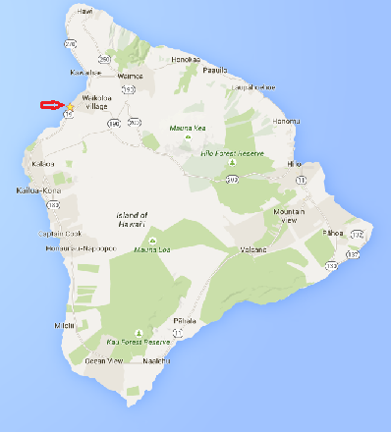
Task Group 4
Closing Report
July 2015
D’Big Island
Slide 2
Notes:
July 15
Page 2

Slide 3
Intro
Acting Chair, Secretary: Ben Rolfe
Agenda: 15-15-0525-00-004r
https://mentor.ieee.org/802.15/dcn/15/15-15-0525-00-004r-tg4r-agenda-july-2015.xlsx
Opening Report: 15-15-0562-00-004r
https://mentor.ieee.org/802.15/dcn/15/15-15-0562-00-004r-tg4r-opening-report-and-more.pptx
Slide 3

Slide 4
Status
Conducted 1 meeting this week
PM2 Tuesday
Meeting goals
Discuss future of the TG and prepare recommendation to the Working Group
Accomplished goals
Reported status since January
Discussed progress and changing environment
Heard presentations on ideas to refocus TG for broader participation
Discussed
Prepared recommendation to WG

Slide 5
TG Recommendation
Task group 4r recommends that WG begin the process for terminating the task group

Slide 6
Process
Announce intention to request EC withdraw the PAR
Inform WG members beyond TG attendance
Provides opportunity for action in Sept
Discuss response (if any) in Sept
WG decision accordingly
Recommendation to EC
Earliest EC action would be November

Slide 7
Thank You

