Slide 1
Project: IEEE P802.15 Working Group for Wireless Personal Area Networks (WPANs)
Submission Title: Updates on the random access scheme for PAC with simulations
Date Submitted: May, 2015
Source: [Byung-Jae Kwak]¹,
[Junhyuk Kim, Nah-Oak Song, June-Koo Kevin Rhee]²
Affiliation: [ETRI, Korea]¹, [KAIST, Korea]²
Address: [218 Gajeong-ro, Yuseong-gu, Daejeon, Korea]¹, [291 Daehak-ro, Yuseong-gu, Daejeon, Korea]²
Voice: +82-42-860-6618
E-Mail: [bjkwak@etri.re.kr],
[kim.jh@kaist.ac.kr, nsong@kaist.ac.kr, rhee.jk@kaist.edu]
Re:
Abstract: Presents more simulation results since May 2015 meeting for discussion of the optimization issue of scalable random access scheme for fully distributed D2D communications.
Purpose: Discussion
Notice: This document has been prepared to assist the IEEE P802.15. It is offered as a basis for discussion and is not binding on the contributing individual(s) or organization(s). The material in this document is subject to change in form and content after further study. The contributor(s) reserve(s) the right to add, amend or withdraw material contained herein.
Release: The contributor acknowledges and accepts that this contribution becomes the property of IEEE and may be made publicly available by P802.15.

Slide 2
Updates on the Random Access Scheme for PAC with Simulations
July 2015
Hawaii

Slide 3
Recap 15-14-0687-00-0008 (1/4)
Random access is used in Peering Period and CAP as well as in distributed synchronization.
But the requirements for Peering Period and CAP are different from those for distributed synchronization
Synchronization Signals | Messages
Transmitted by all PDs | Transmitted by PDs with messages
Transmitted always | Transmitted only when needed
Stable | Dynamic
Criterion: Stability, simplicity | Criterion: Adaptability, performance

Slide 4
Recap 15-14-0687-00-0008 (2/4)
Distributed synchronization
  i-EIED (called EIED in 687r0)
  “i-” stands for idle-time
  CW (contention window) is updated using EIED (exponential increase exponential decrease) backoff algorithm
  CW is updated based on the idle-time between packets (i.e., inter-arrival time)
Messages in Peering Period and CAP
  p-EIED (aka adaptive p-persistent in 687r0)
  “p-” stands for persistent
  Instead of CW, use probability of transmission p (≈ 1/CW)
  p is updated based on the idle-time between packets

Slide 5
Recap 15-14-0687-00-0008 (3/4)
Simulation results: Basic access, #PDs: 50 → 200

Slide 6
Recap 15-14-0687-00-0008 (4/4)
Simulation results: RTS/CTS, #PDs: 50 → 200

Slide 7
p-EIED in a Nutshell
  p: Probability of packet transmission in the next backoff slot; p = p_{basic} / sqrt(L₂ / L₁)
T_{T}: Target idle-time between packets
T_{M}: Measured idle-time between packets
(See 15-15-0425-00-0008 for more details)
if (T_{M} < T_{T})
increase p_{basic};
else if (T_{M} ≈ T_{T})
no change to p_{basic};
else /* T_{M} > T_{T} */
decrease p_{basic};

Slide 8
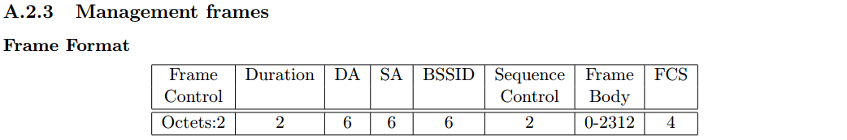
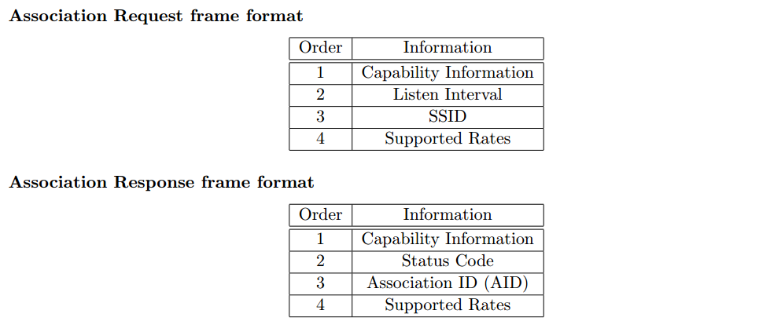
Message Size Info.
In 802.11
Oct.
2
2
2+4
2+8
Oct.
2
2
2
2+8

Slide 9
Simulation Environment
Multi-hop
Clustered random drop
Tx range

Slide 10
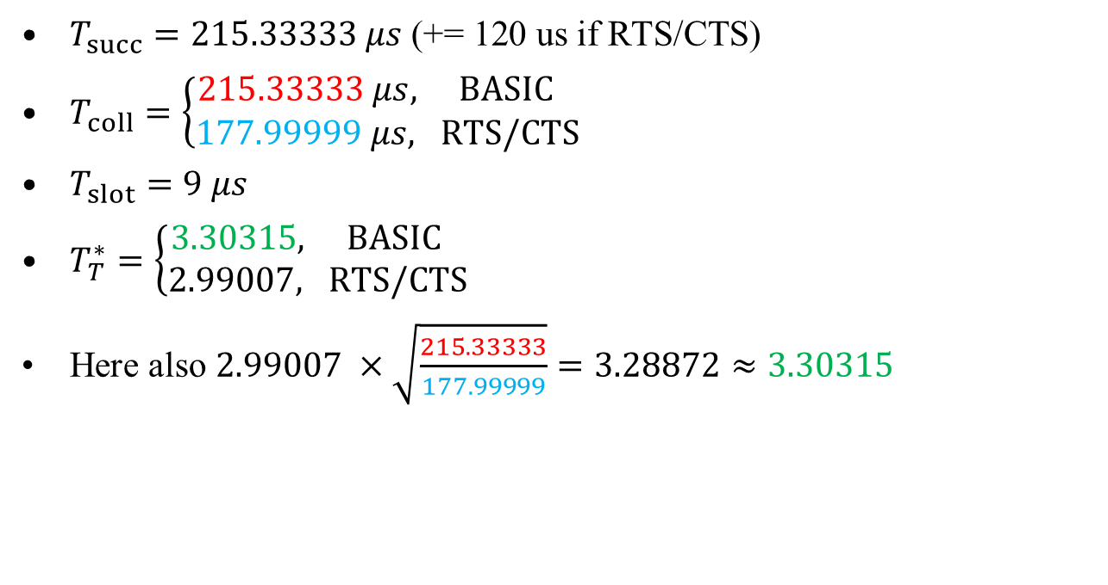
Simulation Results – Peering Period
$T_{succ}=215.33333 μs\text{ (+= 120 }\text{us} \text{if} \text{RTS}\text{/}\text{CTS}\text{)}$
$T_{coll}=\left\{\begin{aligned}215.33333 μs, BASIC \\ &177.99999 μs, RTS/CTS\end{aligned}\right.$
$T_{slot}=9 μs$
$T_{T}^{∗}=\left\{\begin{aligned}3.30315, BASIC \\ &2.99007, RTS/CTS\end{aligned}\right.$
Here also $2.99007 ×\sqrt{\frac{215.33333}{177.99999}}=3.28872≈3.30315$

Slide 11
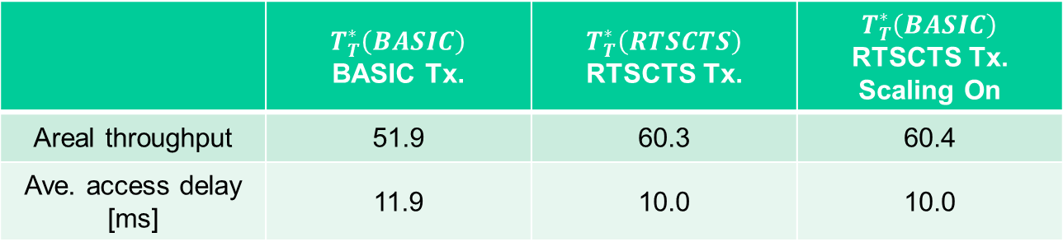
Simulation Results – Peering Period
 | $$T_{T}^{∗}\left(BASIC\right)$$ BASIC Tx. | $$T_{T}^{∗}\left(RTSCTS\right)$$ RTSCTS Tx. | $$T_{T}^{∗}\left(BASIC\right)$$ RTSCTS Tx. Scaling On
Areal throughput | 51.9 | 60.3 | 60.4
Ave. access delay [ms] | 11.9 | 10.0 | 10.0

Slide 12
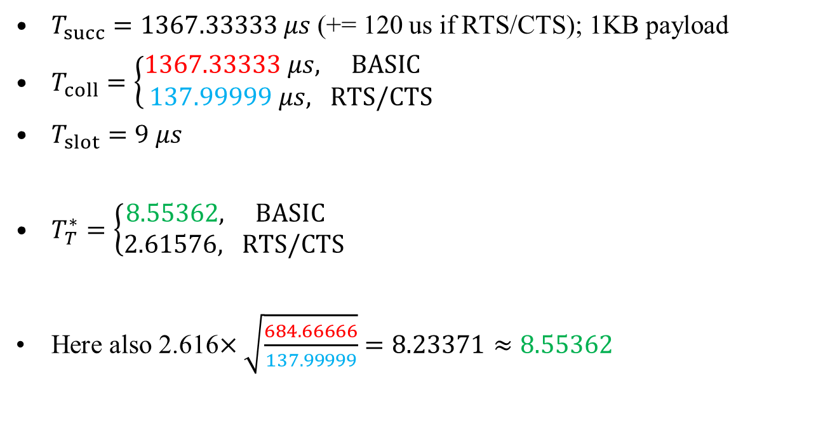
Simulation Results – CAP
$T_{succ}=1367.33333 μs$ (+= 120 us if RTS/CTS); 1KB payload
$T_{coll}=\left\{\begin{aligned}1367.33333 μs, BASIC \\ &137.99999 μs, RTS/CTS\end{aligned}\right.$
$T_{slot}=9 μs$
$T_{T}^{∗}=\left\{\begin{aligned}8.55362, BASIC \\ &2.61576, RTS/CTS\end{aligned}\right.$
Here also 2.616$×\sqrt{\frac{684.66666}{137.99999}}=8.23371≈8.55362$

Slide 13
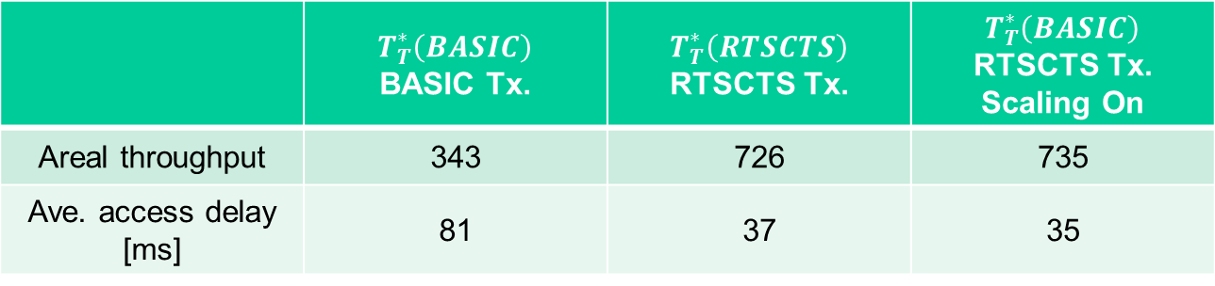
Simulation Results – CAP
 | $$T_{T}^{∗}\left(BASIC\right)$$ BASIC Tx. | $$T_{T}^{∗}\left(RTSCTS\right)$$ RTSCTS Tx. | $$T_{T}^{∗}\left(BASIC\right)$$ RTSCTS Tx. Scaling On
Areal throughput | 343 | 726 | 735
Ave. access delay [ms] | 81 | 37 | 35

Slide 14
Conclusion
p-EIED is designed to be used in Peering Period and CAP
Traffic model (average packet length) in Peering Period and CAP are expected to be quite different
In the simulation
  Message size equivalent to WLAN Association messages was used for Peering Period
  1KB payload assumed for CAP
Message size different from the above can be handled efficiently by scaling p
Benefit of RTS/CTS exchange is clear in CAP (big payload), while less significant in Peering Period (small payload)

