Slide 1
Project: IEEE P802.15 Working Group for Wireless Personal Area Networks (WPANs)
Submission Title: [ Security for PAC devices ]
Date Submitted: [ July 15th, 2015 ]
Source: [Marco Hernandez, Huan-Bang Li, Igor Dotlić, Ryu Miura ]
Company: [NICT]
Address: [3-4 Hikarino-oka, Yokosuka, 239-0847, Japan]
Voice:[+81 46-847-5439] Fax: [+81 46-847-5431] E-Mail:[]
Re: [In response to call for technical contributions TG8]
Abstract: [ ]
Purpose: [Material for discussion in 802.15.8 TG]
Notice: This document has been prepared to assist the IEEE P802.15. It is offered as a basis for discussion and is not binding on the contributing individual(s) or organization(s). The material in this document is subject to change in form and content after further study. The contributor(s) reserve(s) the right to add, amend or withdraw material contained herein.
Release: The contributor acknowledges and accepts that this contribution becomes the property of IEEE and may be made publicly available by P802.15.

Slide 2
Security protocol
Also known as cipher suite consists of:
Key establishment (typically a Diffie-Hellman variant or RSA)
Authentication (by certificate)
Confidentiality/encryption (by a symmetric cipher)
Integrity (by a hash function)
There are two types of ciphers typically used:
block ciphers and stream ciphers.
In a block cipher, the data is broken up into blocks (fixed size) and each block is encrypted.
In a stream cipher, the data is encrypted one byte at a time.

Slide 3
Ciphers
Both types of ciphers have pros and cons:
block ciphers are generally fast in hardware, while stream ciphers are often fast in software.
A popular block cipher is AES.
Already implemented in hardware (Intel’s Westmare).
The 256 bits key version is very fast and very secure.
AES is used in most modern computers: servers, desktops, laptops.
But AES is not ideal in old computers and mobile devices.
No hardware support. Cipher suits are implemented in software.
AES is costly in battery life.
A low cost stream cipher would be ideal.

Slide 4
Ciphers
The standardized stream cipher RC4 is not considered secure anymore.
A recent popular security suite choice for low power consumption, as alternative to AES for mobile devices is:
Cha-cha20 (stream cipher) with Poly1305 (code authenticator).
These have been tested and proven to be fast and secure (no known attack), especially for mobile devices by the academy and industry.
The ChaCha20 cipher is designed to provide 256-bit security.
The Poly1305 authenticator is designed to ensure that forged messages are rejected.

Slide 5
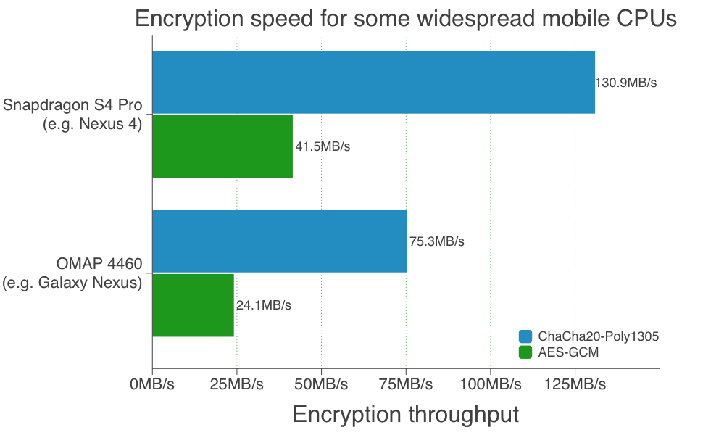
Ciphers
ChaCha20-Poly1305 combines encryption and authentication together.
Encrypt-then-authenticate or authenticate-then-encrypt is phased out.
Performance:
ChaCha20-Poly1305 is three times faster than AES-GCM (128 bits).

Slide 6
Cryptographic Keys
Regardless of symmetric, asymmetric or combination of both, encryption, the employed key(s) must be prevented from being guessed. That is, such keys need to be generated truly randomly and contain sufficient entropy.
Easier said than done.
The problem of how to securely generate truly random keys is difficult.
There is a bunch of work in the literature, but out of scope here.
What is used in modern computers is cryptographically secure pseudo-random number generators (CSPRG).

Slide 7
Cryptographic Keys
Example of a CSPRG (Fortuna) for cryptographic keys generation:
“enough” randomness and entropy
Other CSPRGs have been standardized.

Slide 8
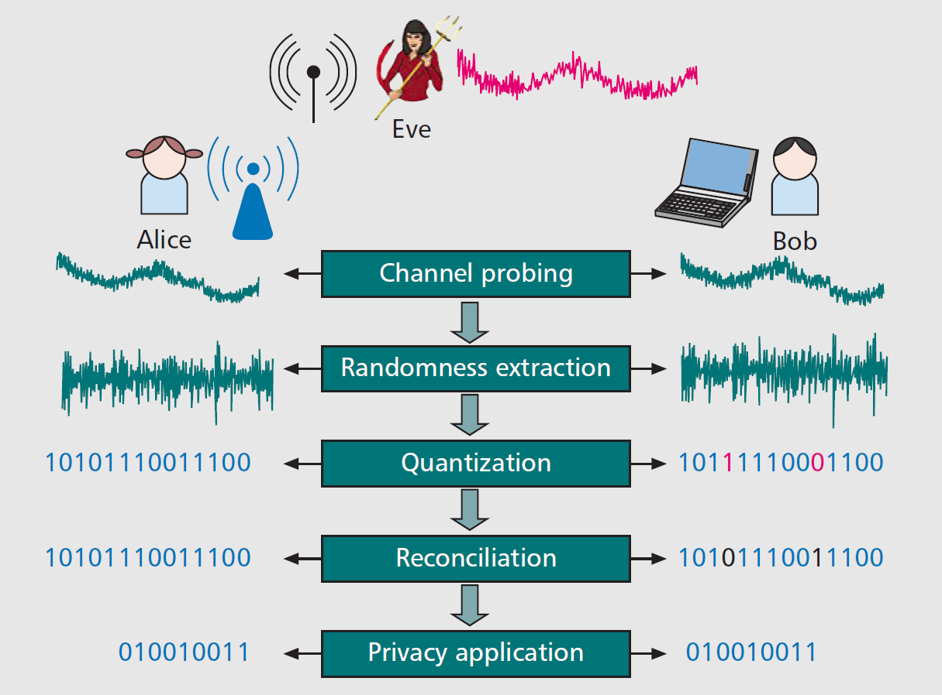
PHY key generation
Already presented by BJ.
We present passive attacks.
Challenges and open issues in practice.

Slide 9
PHY key generation
Channel probing (pilots and channel estimates)
Only possible in TDD.
Two devices must have a communication link for channel estimates.
Randomness extraction (extract fast fading only)
Subtract slow fading (path-loss).
The need for devices to move around is self-explanatory: the fast fading must generate enough randomness and entropy for the keys to be secure.
Extracting secure keys from quasi-stationary channels is an open problem.
Quantization

Slide 10
PHY key generation
Information reconciliation
Due to imperfect channel reciprocity, bit errors are corrected by FEC.
This can generate overhead and ease for an attacker to jam it.

Slide 11
PHY key generation
Privacy amplification
How to eliminate partial information (correlated bits) by a passive attacker eavesdropping during probing and reconciliation.
In practice, it is very hard to estimate how much information is leaked to a eavesdropper.
Consequently, privacy amplification becomes nontrivial, hard to decide, and unclear if it is effective.

Slide 12
PHY key generation
This uncertainty on leaked information is a bigger problem:
Experimental work has shown strong correlation in measurements by eavesdroppers located [significantly] greater than λ/2 from legitimate devices.
Poor multipath scattering, interference scenario are unpredictable.
There is no clear safeguard distance to ensure secure key generation.
Secure key generation by PHY is still an open issue.
Group key generation is an open problem too.

Slide 13
Active attacks
The current work on PHY key generation focuses on security analysis under passive attacks.
Research on PHY key generation/protocol under active attacks is largely open. For instance:
Disruptive jamming: it aims to disrupt the key generation rate by injecting jamming signals during probing.
Manipulative jamming: Controlling the channel measurements at legitimate users, compromising the generated keys.
Channel manipulation: Controlling the channel between users, and so the generated keys.
Details of the attacks can be found in the literature.

Slide 14
Conclusion
As an alternative to CSPRG for key generation, this PHY proposal seems to be in the realm of academic research and currently it does not seem ready for a practical and secure implementation for PAC or anything else.

Slide 15
Conclusion II
Even assuming secure keys generation, the keys’ management protocol is the real problem to solve for PAC.
The key management protocol is responsible for the creation, revocation and secure distribution of keys (from higher layers).
Currently, the weakest point for encryption is the asymmetric handshake that begins the session. If the key for the symmetric encryption is lost/compromised when it is handed off, the rest of the session is insecure, regardless of the method of encryption.
In TG9, keys generation is out of the scope of the recommendation as well as encryption algorithms.
Maybe we can adopt TG9 specification as the key management protocol.

