Slide 1
Project: IEEE P802.15 Working Group for Wireless Personal Area Networks (WPANs)
Submission Title: [An Interference Estimation Method in WLAN]
Date Submitted: [15 July, 2015]
Source: [Hirozumi Yamaguchi] Company [Osaka University]
Address [1-5 Yamadaoka, Suita, Osaka 565-0871, Japan]
Voice:[+81-6-6879-4556], FAX: [+81-6-6879-4559], E-Mail:[h-yamagu@ist.osaka-u.ac.jp]
Re: []
Abstract: [This document introduces an interference estimation technique in IEEE802.11. This is informative to discuss significance of spectrum resource measurement in IEEE802.15 TG4s.]
Purpose: [For discussion]
Notice: This document has been prepared to assist the IEEE P802.15. It is offered as a basis for discussion and is not binding on the contributing individual(s) or organization(s). The material in this document is subject to change in form and content after further study. The contributor(s) reserve(s) the right to add, amend or withdraw material contained herein.
Release: The contributor acknowledges and accepts that this contribution becomes the property of IEEE and may be made publicly available by P802.15.

Slide 2
An Interference Estimation Method in WLAN
Authors:

Slide 3
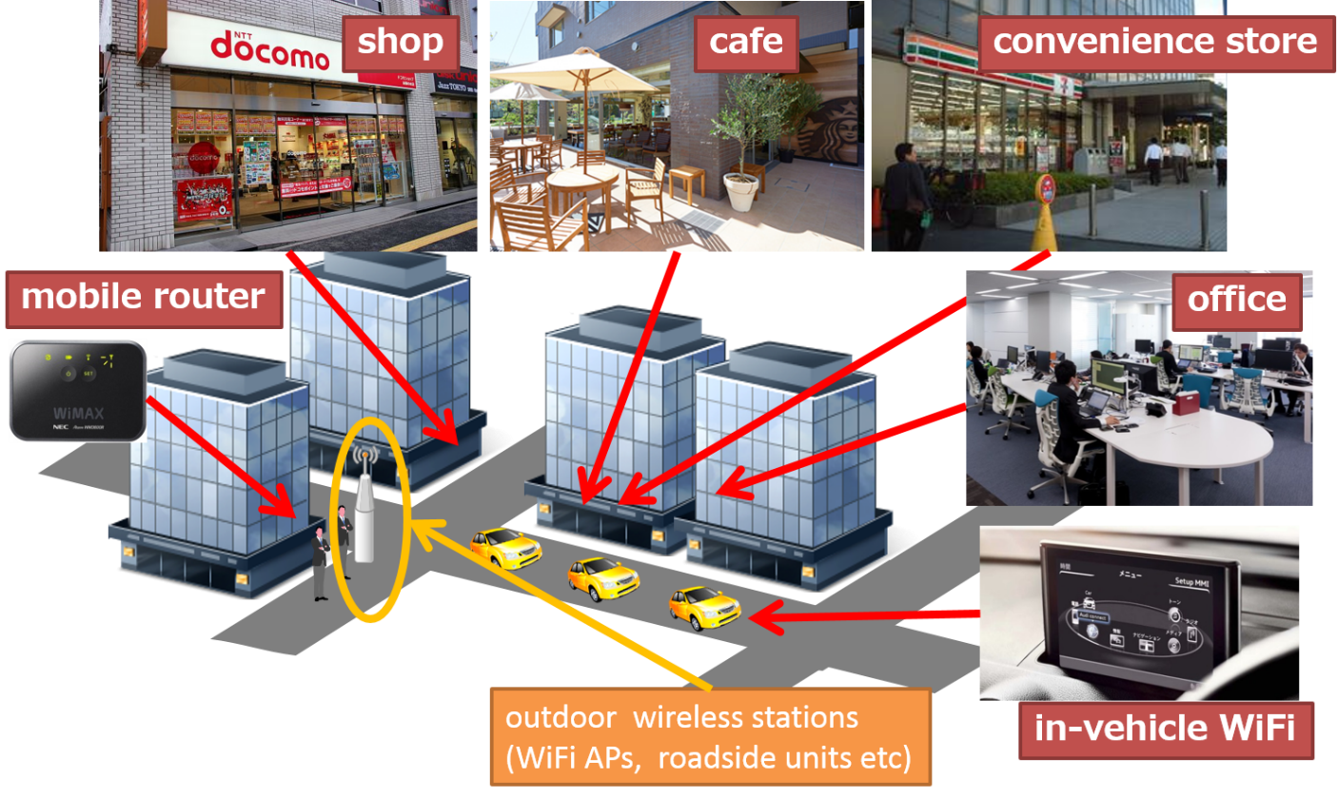
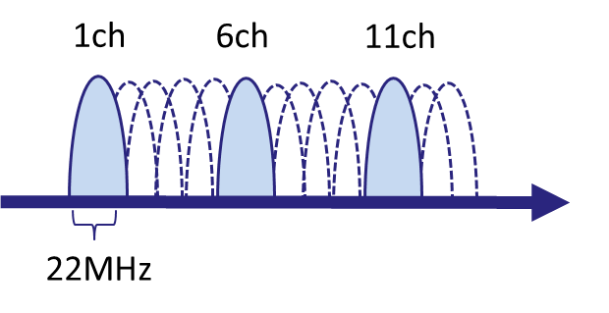
Situation
In WLAN, many APs are deployed in an uncoordinated way, which causes complicated interference relation
WiFi traffic in adjacent channels interfere with each other

Slide 4
How to know channel interference status
Active Probing
  tests channels by real frame transmission
  (+) obtains more “direct” status
  (-) forces a communication peer to join test
Passive Monitoring
  estimates channel status by monitoring
  (+) simpler than active probing case
  (self-monitoring)
  (-) less information than active probing case

Slide 5
Approach to Interference Estimation
take passive monitoring approach, but need to estimate interference more accurately
obtain dataset samples by exhaustive (precise) simulations with a variety of scenarios
apply regression analysis to obtain functions that explain correction between traffic measurement and interference affect

Slide 6
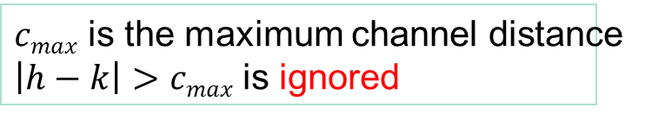
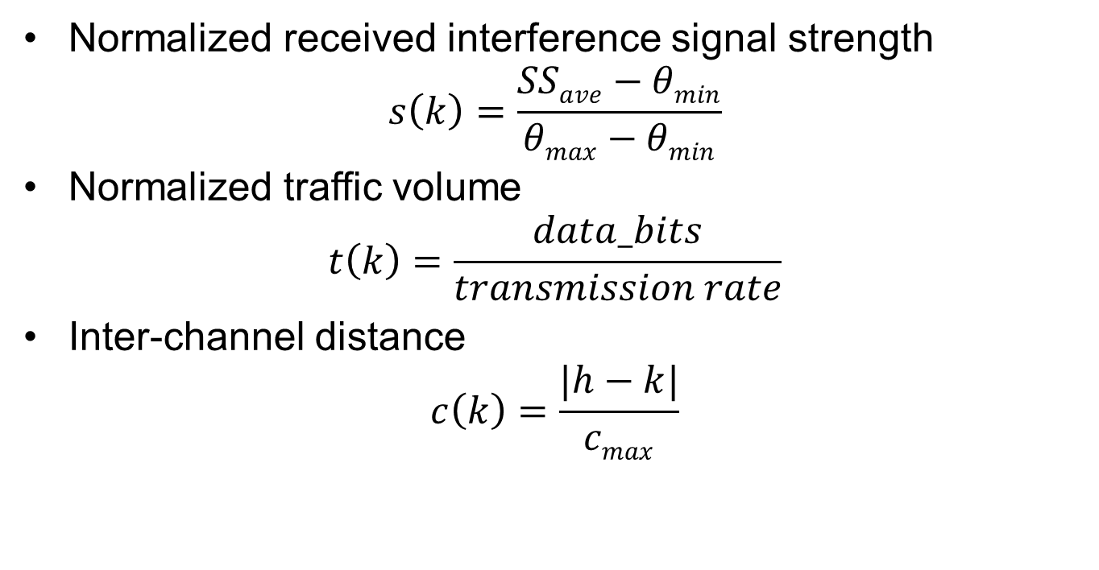
Traffic Measurement
(Explanation Variables)
Normalized received interference signal strength
$s\left(k\right)=\frac{SSave−θmin}{θmax−θmin}$
Normalized traffic volume
$$t\left(k\right)=\frac{data_bits}{transmission rate}$$
Inter-channel distance
$c\left(k\right)=\frac{|h−k|}{cmax}$
$cmax$ is the maximum channel distance
$\left|h−k\right|>cmax$ is ignored

Slide 7
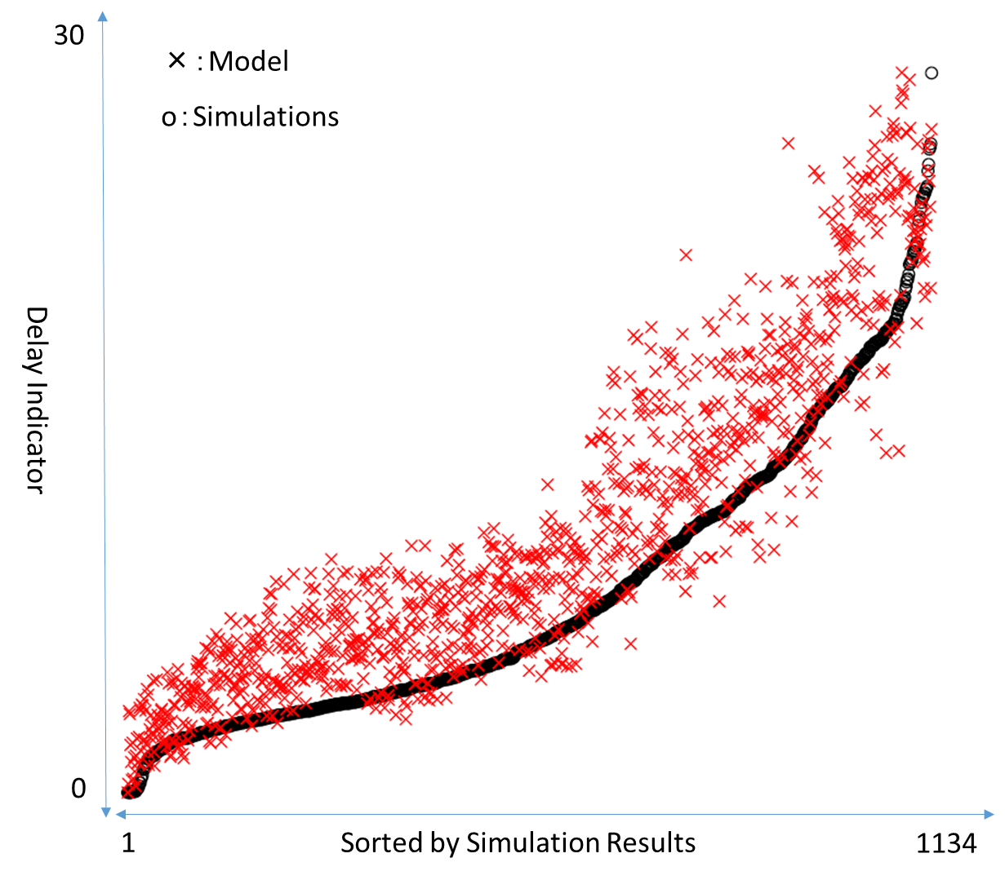
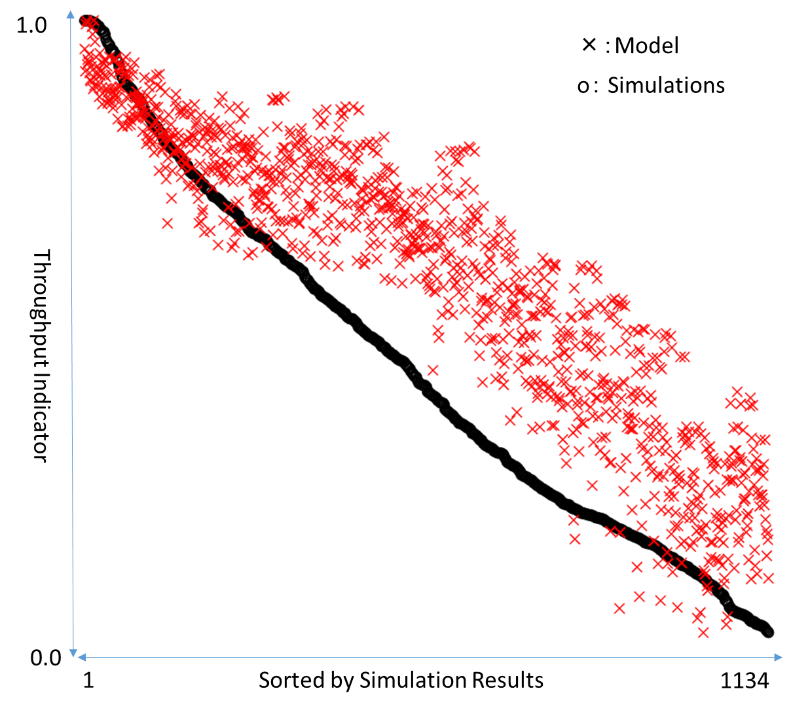
Regression Analysis Results
(sorted by function output)

Slide 8
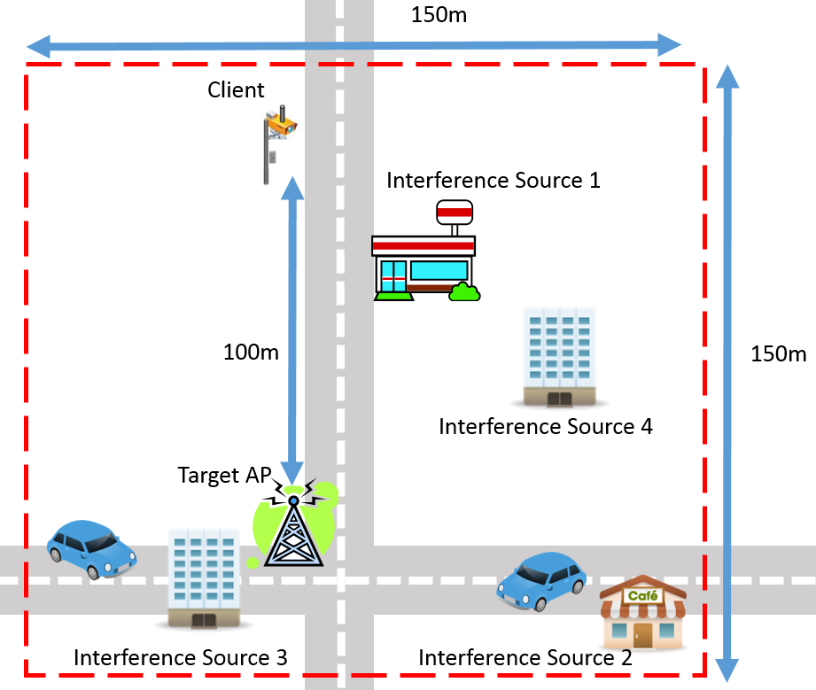
Performance Evaluation
Target AP monitors the 13 channels each
and applies scoring function
We have compared the ranking of score
and that of the real performance metrics
interference | channel | traffic
source 1 | 1 | 1.5 Mbps
source 2 | 7 | 3.0 Mbps
source 3 | 7 | 2.0 Mbps
source 4 | 11 | 3.0 Mbps

Slide 9
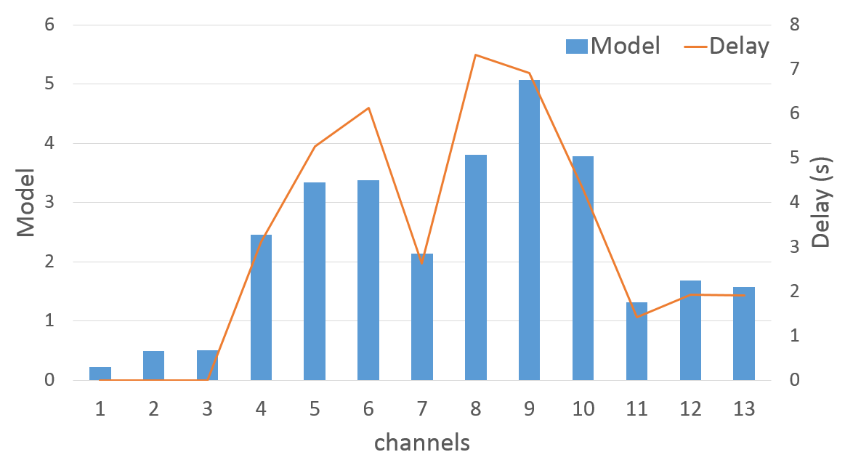
The trends over 13 channels well-match the actually simulated performance
The Spearman’s rank correlations are 0.965035 (very high correlation)

Slide 10
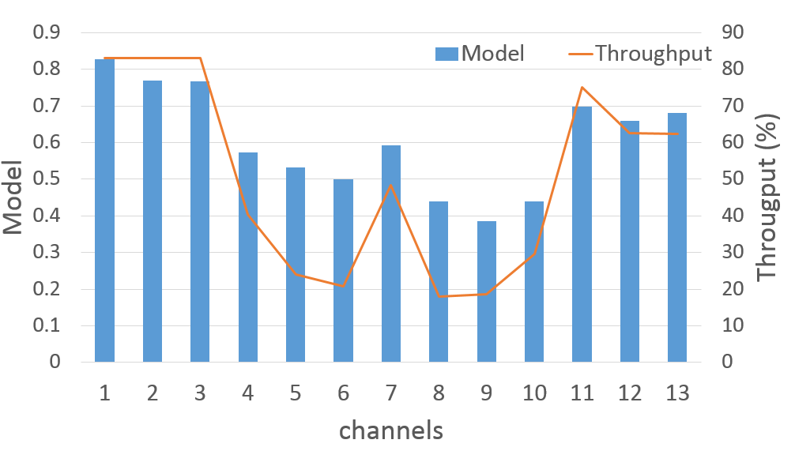
Scoring function can estimate the top-ranked channel and the whole ranking
The ranking provides useful information for target AP to move to another channel

Slide 11
Summary and Discussion
simple L2 traffic measurement (channel occupancy) and RSS is helpful to estimate interference
information from PHY is more informative (noise, etc)
peer-coordinated SRM is significant for more precise estimation of interference (increased spatial coverage)
Shugo Kajita, Hirozumi Yamaguchi, Teruo Higashino, Shigeki Umehara, Fumiya Saitou, Hirofumi Urayama, Masaya Yamada, Taka Maeno, Shigeru Kaneda, Mineo Takai
A Channel Selection Strategy for WLAN in Urban Areas by Regression Analysis
Proceedings of the 2014 IEEE 10th International Conference on Wireless and Mobile Computing, Networking and Communications (WiMob2014), pp. 646-651, October 2014

