Slide 1
Project: IEEE P802.15 Working Group for Wireless Personal Area Networks (WPANs)
Submission Title: Fraunhofer HHI 2nd Response to 15.7r1 CFA
Date Submitted: July 11, 2015
Source: M. Ayyash, M. Rahaim, S. Shao, A. Khreishah, H. Elgala, T. Little, D. Schulz, V. Jungnickel
Company: Boston University, New Jersey Inst. of Technology, Chicago State University, Fraunhofer HHI
Address: Einsteinufer 37, 10587 Berlin, Germany, Voice: +49 30 31002 768
Mail: volker.jungnickel@hhi.fraunhofer.de
Re: IEEE802.15.7a CFA
Abstract: CFA Response
Purpose: CFA Response
Notice: This document has been prepared to assist the IEEE P802.15. It is offered as a basis for discussion and is not binding on the contributing individual(s) or organization(s). The material in this document is subject to change in form and content after further study. The contributor(s) reserve(s) the right to add, amend or withdraw material contained herein.
Release: The contributor acknowledges and accepts that this contribution becomes the property of IEEE and may be made publicly available by P802.15.

Slide 2
Coexistence of OWC and Radio
M. Ayyash, M. Rahaim, S. Shao, A. Khreishah, H. Elgala, T. Little,
D. Schulz, V. Jungnickel,
Boston University, New Jersey Institute of Technology,
Chicago State University, Fraunhofer HHI
volker.jungnickel@hhi.fraunhofer.de

Slide 3
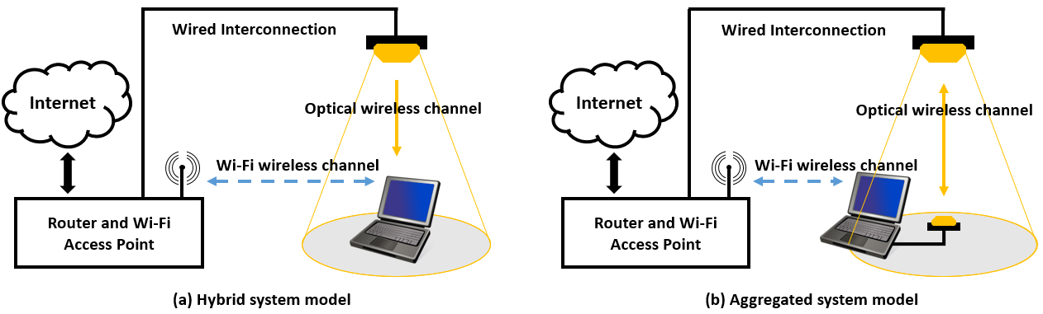
Use Case: Coexistence between OWC and Radio
Hybrid System: Unidirectional OWC downlink, Unidirectional radio uplink
  E.g. used together with low-power mobile devices
Aggregated System: Both systems are bidirectional and operated in parallel
  Radio has better coverage, optics has higher data rate
  Handover and link aggregation between both systems
What is the impact on IEEE 802.15.7r1 OWC standard?

Slide 4
Optical wireless is spatially selective
Sensitive against spatial displacement, rotation, obstructions
Signal strength is likely to change over time in mobile scenarios
Coexistence with radio can be helpful to maintain connectivity

Slide 5
Coexistence between OWC and Radio
Relevant for both, low- and high-speed detector schemes
Various schemes are useful
  Coexistence of unidirectional OWC and radio links
    Makes unidirectional links adaptive for mobile applications
    Enables user feedback on OWC at the application layer
  Coexistence of bidirectional OWC and radio links
    Vertical handover and link aggregation
Implementation is typically above both the MAC and thus outside scope
  But how low latency can be for applications in industrial control?
  Needs further investigation

Slide 6
Handover
Needs a clear understanding of what functionality is needed
  Response to network reconfiguration, resource availability and quality
Integration of both,
  Vertical handover (VHO) between OWC and radio
  Horizontal handover (HHO) between multiple co-located OWC links
Handover assessment
  Needs measurement reports
  Available from each PHY
  Using a central controller
Handover implementation
  Needs switching points
  In the network behind
System
Access
Perform VHO
RF Link
VLC Link
Hotspot
Discovery
Channel Monitoring
None
Assess
VHO
VHO
Perform HHO
Assess
Handover
VHO
HHO
Perform VHO
None

Slide 7
Link Aggregation
Aggregation of unidirectional OWC with unidirectional radio
  Combine up- and downstream into an asymmetric bidirectional link
Aggregation of bidirectional OWC and radio links
  Multiplies the data rate in case of double coverage
Multi-PHY design is very common within 802.15 community
  Reuse or adapt the existing framework if possible
  Research on low-latency is needed

Slide 8
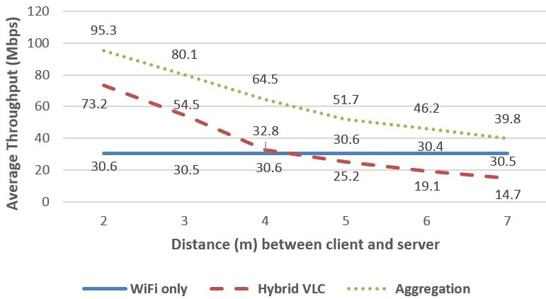
Preliminary experimental results
Combination of 802.11n WiFi and OWC frontends from Fraunhofer HHI
  Using a Linux computer on top of both PHYs
Both, hybrid unidirectional and aggregated bidirectional schemes are studied
Radio has constant coverage while OWC is spatially selective
Both combined schemes improve the performance near the OWC access point

Slide 9
Asking for in the standard …
Support for
  Measurement reports available above PHY and MAC
    Information about SINR
    Information about temporal characteristics
      Signal blocking conditions, frequency of signal losses
      Signal decay time
    Minimize overhead for low latency, high mobility
    Standard interface to higher layer

